Slide 1
Year 4 York Residential
Wednesday 30th April – Friday 2nd May 2025

Slide 2
Our aims:
To enthuse the children about our new topic, The Vikings.
To immerse the children in Vikings history
To encourage independence and self-resilience

Slide 3
Staff attending:
Miss Porteous
Mr Cotton
Miss Gadsby
Mrs Marshfield
Address
The Racecource Centre
York Racecourse Ltd
The Racecourse
York
YO23 1EX
Tel: 01904 620911

Slide 4
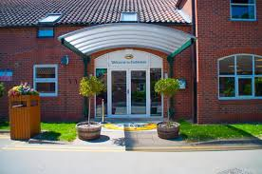

Where are we staying?
We have been allocated an annex building. All children will be in either a 6-bed dorm, a triple or double room. Each room has a wash basin. Toilets and showers are situated at each end of the corridor. Staff rooms are in the same vicinity as the children’s rooms. The children will be told which staff are where, should any of us be needed as any time.

Slide 5
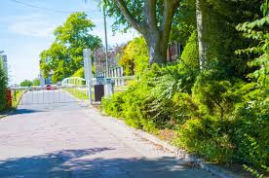
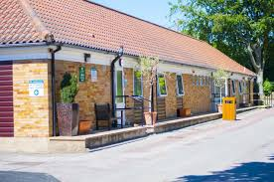
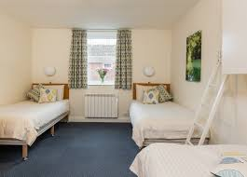
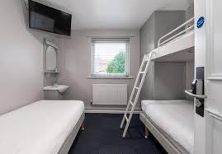

Slide 6
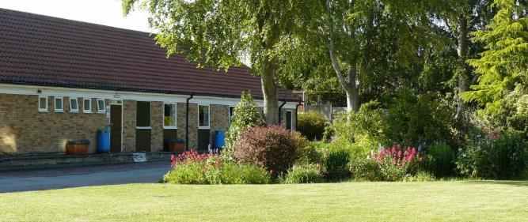
We also have access to a common room with a television so children can have some ‘down time’. There is also plenty of outdoor space for the children to play which we will make use of in the evenings. We will take games and activities like colouring. However, children can bring small non-digital games and a book/magazine to read if they wish.

Slide 7
Meals
Breakfast: Choice of cereals, toast and a hot option.
Lunch: Packed lunch provided by the centre.
Dinner: Hot meal such as roast dinner, with a dessert.
All dietary requirements will be forwarded to the centre and suitable alternatives are provided, on an individual basis if required.

Slide 8
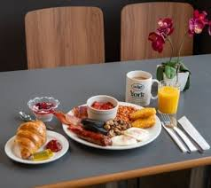
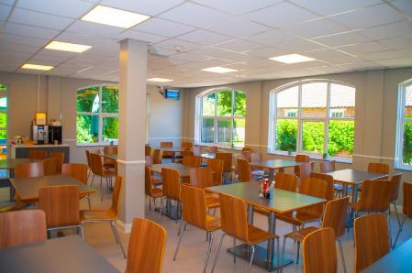
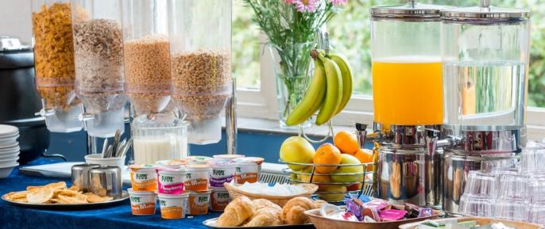

Slide 9
Itinerary
Wednesday
8:45 Arrive school
9.15 Leave
11:30 Arrive at York Racecourse Centre.
1pm York Minster- Creative Creation!
6pm Dinner

Slide 10
Thursday
8:15 Breakfast
10:00 Battle Tactics at DIG
11:00 DIG Tour
12:00 Lunch Room at DIG (packed lunch)
12:40 JORVIK Tour
5.15 Dinner

Slide 11
Friday
8:15 Breakfast
9:30am Leave in coach for Murton Park
10am Arrive Murton Park
3pm approx. Leave
5pm approx. Arrive at School

Slide 12
Kit List
Wash kit (toothbrush, toothpaste, soap, etc)
Pyjamas
3 changes of clothing
Underwear
Waterproof coat (with a hood)
Comfortable footwear
Indoor shoes/slippers
Towel
No valuables (ipads, e-books, mobile phones, ipods, etc)
Book
Small teddy
Small rucksack they are comfortable carrying.
Refillable drinks bottle.
Children may bring spending money between £5-10. This must be in a named purse/wallet and children are responsible for this.

Slide 13
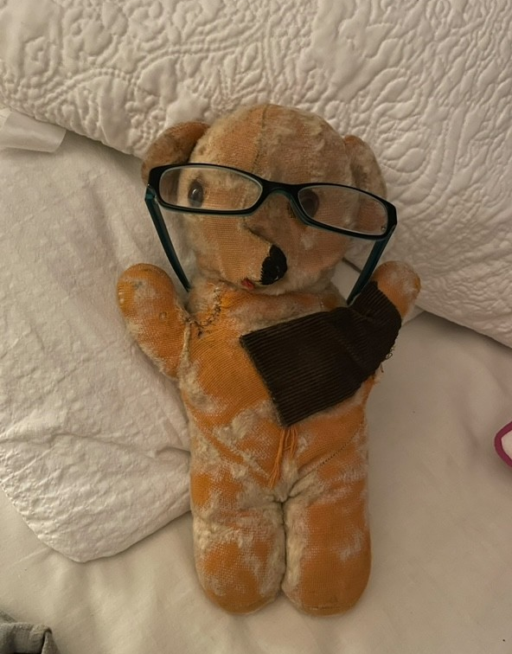

Slide 14
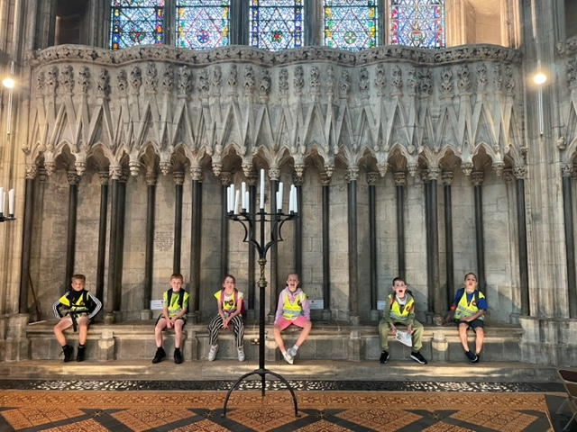
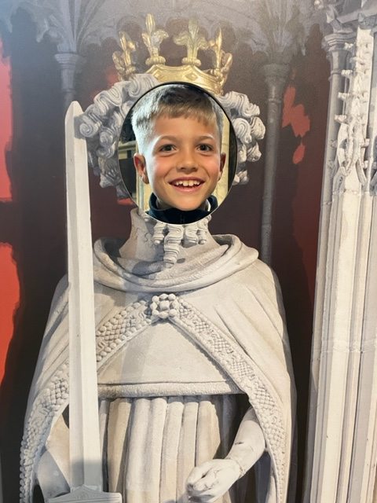
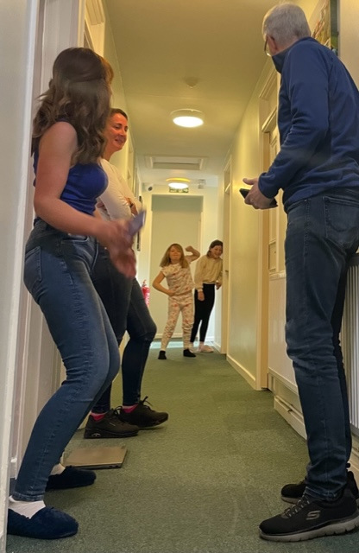
York Minster
The Stables

Slide 15
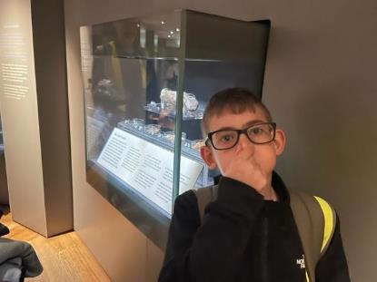
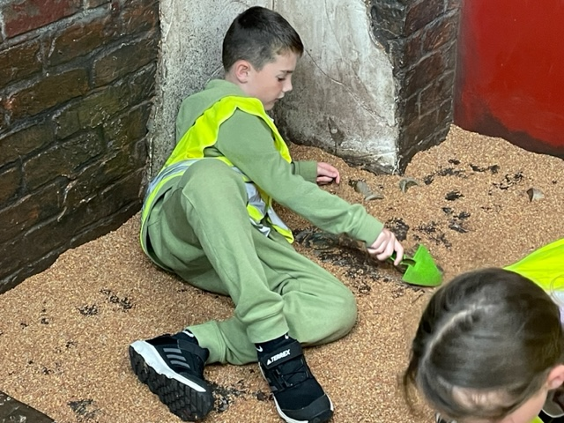
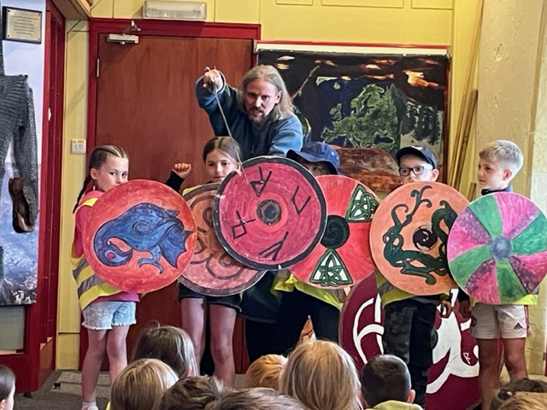
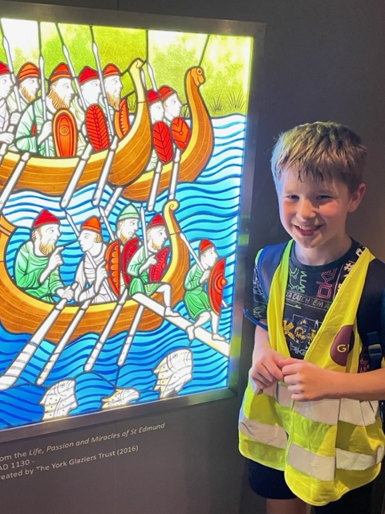
Yorvik Centre
DIG

Slide 16
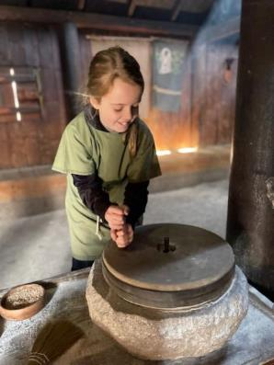
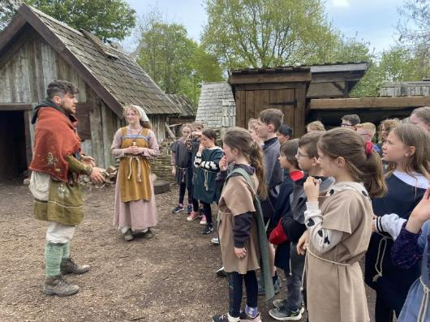
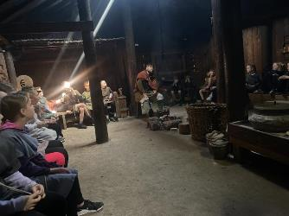
Murton Park

Slide 17
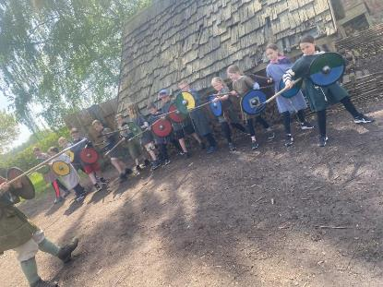
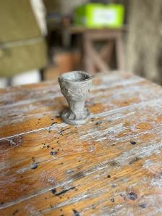
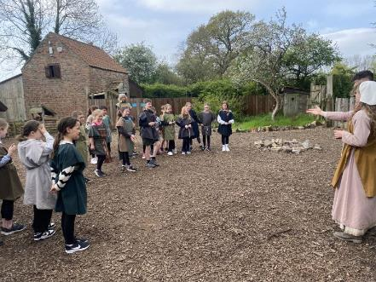

Slide 18
Behaviour
The children will be made aware before departure, that the expected standard of behaviour is the same as at school.
Any cases of inappropriate behaviour will be dealt with in accordance with our school behaviour policy.
In cases of extreme inappropriate behaviour, a member of staff may contact parents to assist with resolving the situation.

Slide 19
Health and Safety
Risk assessments have been prepared and all staff involved will receive a copy.
Children will be briefed on safety procedures on arrival at York Racecourse Centre.
The doors to our annex are locked at night. Only staff have access to the annex building.
The school has full travel insurance through RPA.

Slide 20
Medicines
All children taking any medicines, including travel sickness tablets, need to have this recorded on a school medical form.
All medical forms to be returned to the office.
Please ensure that your medical form is completed and handed in before departing.
Medicines should be handed to Miss Porteous on the morning of departure.
All medicines must be clearly labelled with the child’s name.

Slide 21
Communication
A member of staff will contact school once we arrive at York Racecourse Centre and also make contact each day to give regular updates.
A member of staff will also be in touch with school during the return journey to confirm arrival time.
We have access to all your emergency contact numbers via the medical forms you have filled in and via our contact with school.
We will endeavour to update the website regularly.

Slide 22
Children need to be in school at 8.45am so we can set off promptly at 9.15am.
Please bring a packed lunch in a disposable bag and a refillable drinks bottle.

