Slide 1

Welcome to our Phonics and Early Read Workshop
30.09.25
Alma Park Primary School

Slide 2
Aims of the presentation
to provide information on how we teach phonics and early reading at Alma Park
to build links between home and school and enable you to support your child’s learning

Slide 3

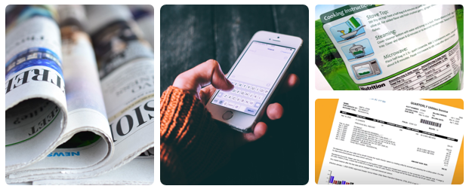
How many times have you
already read today?

Slide 4
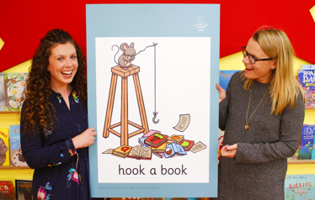
Little Wandle
Our school has chosen Little Wandle Letters and Sounds Revised as our phonics programme and we use this to teach early reading and spelling.
We use a consistent approach in Nursery, Reception and Year 1 and for any children further up the school who need support with the alphabetic code.

Slide 5
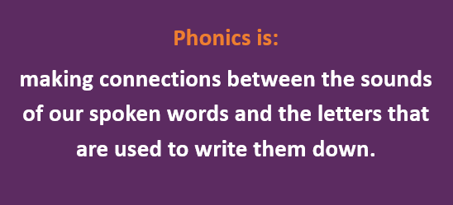

Slide 6
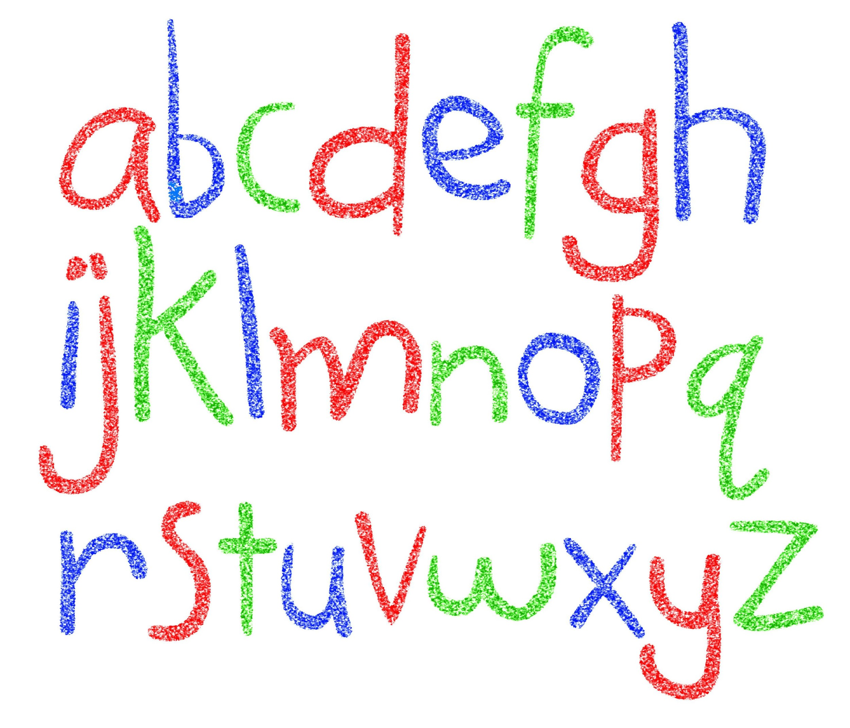
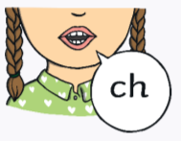
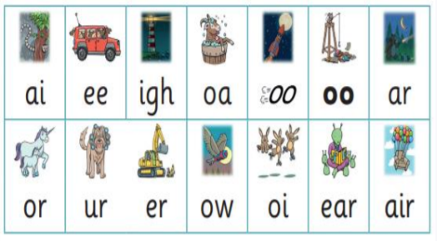
Did you know?
The English language has:-
26 letters
44 sounds
Over 100 different ways to spell
those sounds

Slide 7
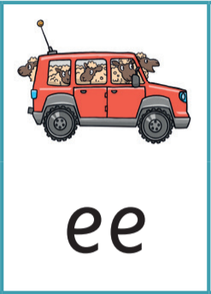


Terminology
You may hear your children say….
Phoneme – A unit of sound. That’s the sound that a letter may make , like a, b, c. It’s any one of the 44 sounds which make up words in the English language
Grapheme – How a phoneme is written down. There can be more than one way to spell a phoneme. E.g-the phoneme ‘ai’ is spelt differently in each of the words ‘rain’, ‘make’, ‘way’, ‘great’, ‘sleigh’ and ‘lady’
Digraph- two letters that represent one sound
Trigraph- three letters that represent one sound
Blending – it’s when we push the sounds in a word together in order to read it, e.g. ‘f – r – o – g, frog’
Segmenting – this is the opposite. It’s when we tune our ears in and listen, in order to break a word into it’s sounds so we can then spell it, e.g. ‘red, r – e – d ’’

Slide 8
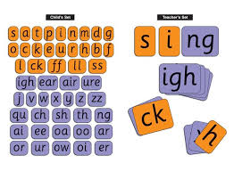
How do we teach phonics
The children have a daily phonics lesson
Children work as a whole class
  Letter and sound knowledge
  Blending sounds together
      oral blending
      blending phonemes using the
      graphemes

Slide 9
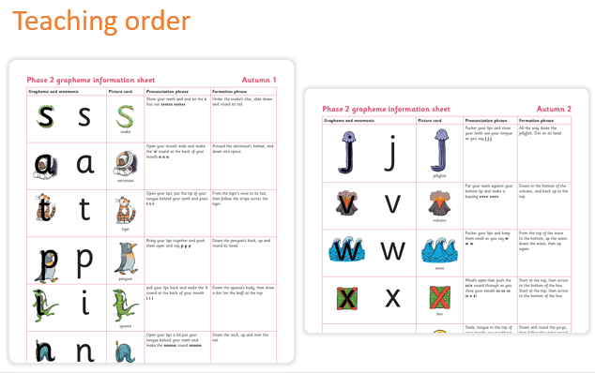
Each week 4 new sounds are taught and on Friday there is a review lesson covering all the sounds taught over the week.
In Reception and Year 1 a sheet informing you of the sounds taught will be sent home for you to continue practicing with your child.

Slide 10
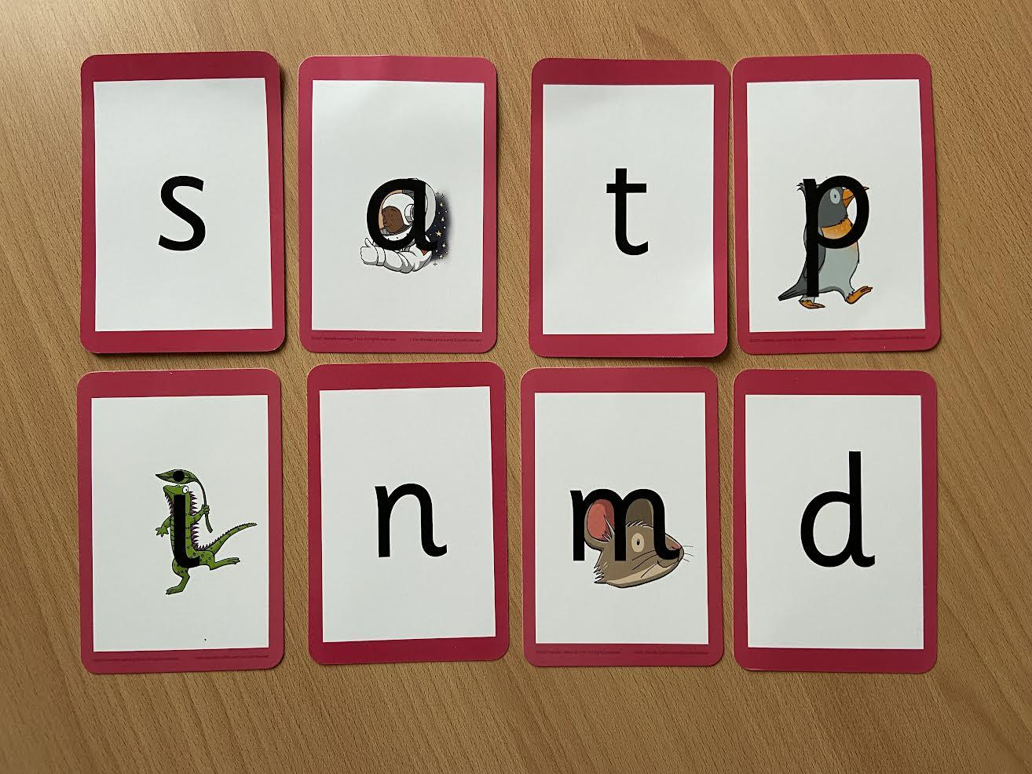
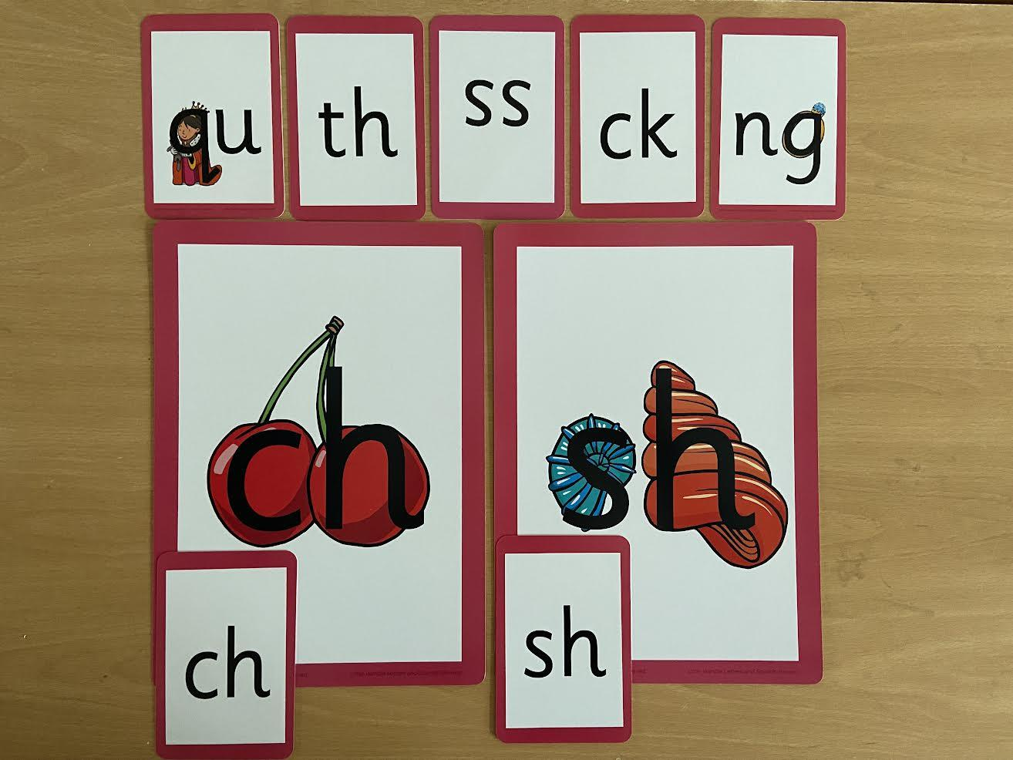
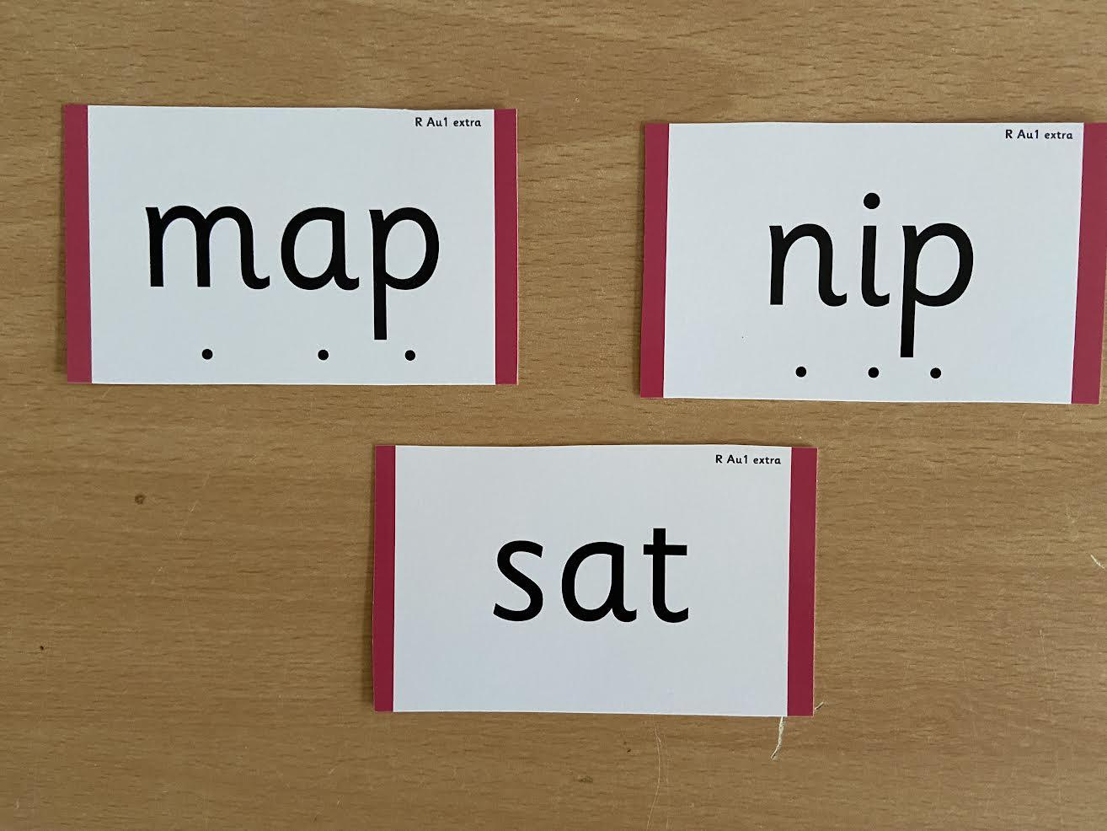
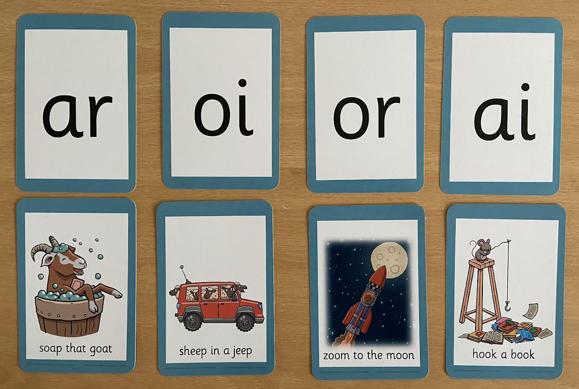
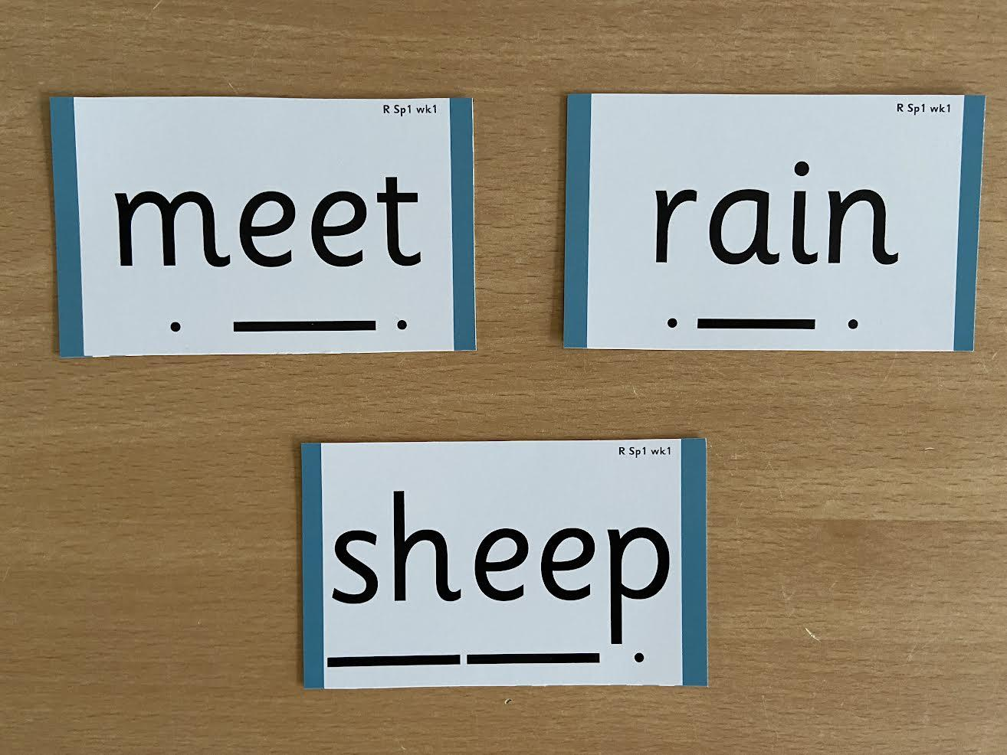
How we make learning stick
Notes:
Phonemes taught in order start to read words asap
LW has a picture pneumonic to help children remember the phoneme/grapheme

Slide 11
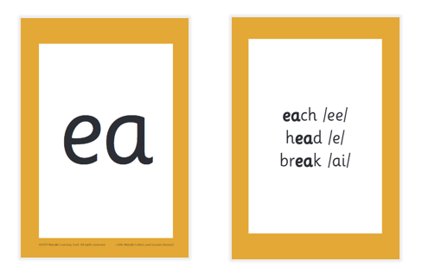

Year 1 - Reading and spelling
All the different sounds a phoneme can make when it is read in a word.
And all the different ways to write a phoneme- sh

Slide 12
Tricky Words
go
was
her
me
to

Slide 13

Spelling
say the word
segment the sounds
count the sounds
write them down

Slide 14

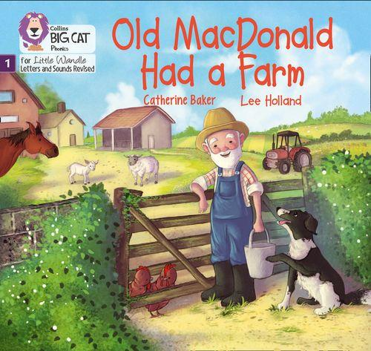
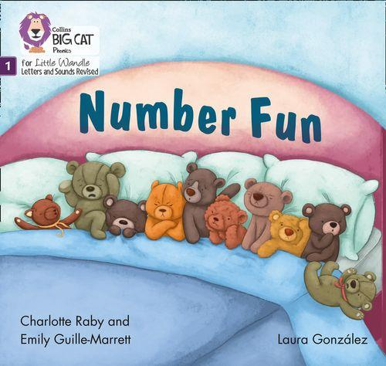
Reading
Once children have a secure knowledge of a number of
GPC’s (Grapheme Phoneme Correspondences)
and are confidently blending, they will be ready for
reading books with words.
Prior to this children have wordless books which develop
great language skills and teach children the layout of books
and how to handle books.

Slide 15
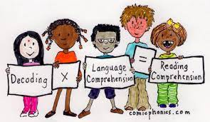
How do we teach reading in school?
There are three timetabled reading practice sessions a week – each one begins with some quick sounds and words practice. These are taught in small groups.
1. Decoding
2. Prosody
(intonation, expression)
3. Comprehension
Please do not worry that a book is too easy – your child needs to develop
fluency and confidence in reading. Re-reading a book they have had before
helps develop fluency – this is the goal.
Celebrate their success!!!

Slide 16
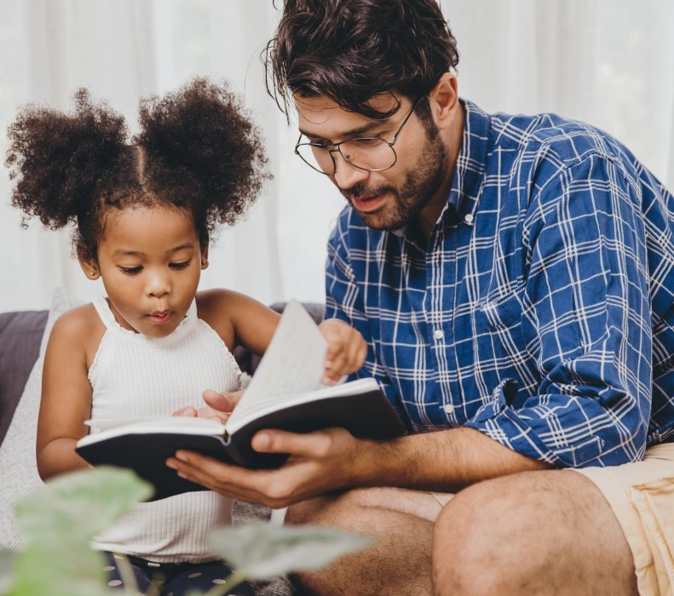
Reading at home
The most important thing you can do is read with your child
Reading a book and chatting had a positive impact a year later on children’s ability to…
understand words and sentences,
use a wide range of vocabulary
develop listening comprehension skills.
the amount of books children were exposed to by age 6 was a positive predictor of their reading ability two years later.

Slide 17
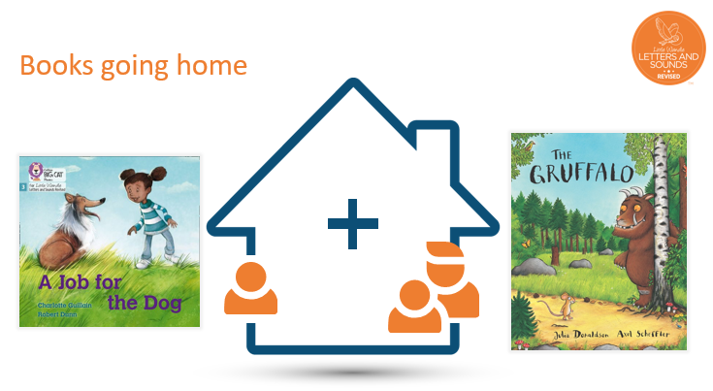
e books

Slide 18
Listening to your child read their phonic ebook
A new e book will be added to your child’s account each week.
Your child should be able to read their e book without a great deal of help.
If they can’t read a word, read it to them.
Talk about the book and celebrate their success.

Slide 19

Reading to your child
Children will also bring home a ‘reading for pleasure book’ from our class library each week.
To become lifelong readers, it is essential that they read for pleasure
The shared book is for YOU to read:
Make the story sound as exciting as you can by changing your voice.
Talk with your child as much as you can:
  Introduce new and exciting language
  Encourage your child to use new vocabulary
  Make up sentences together
  Find different words to use
  Describe things you see.

Slide 20
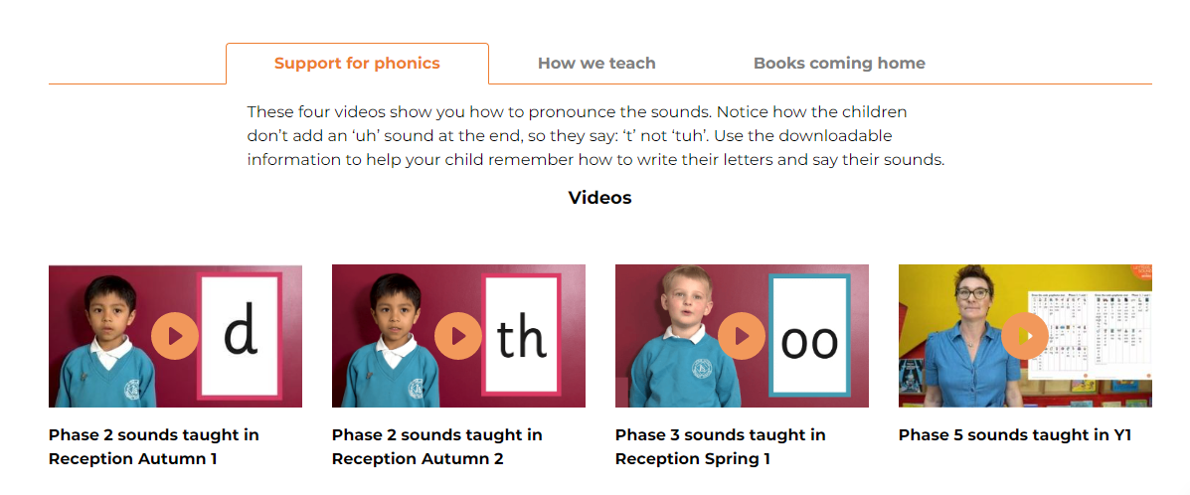
Little Wandle Website – For Parents
Click here for parent page

Slide 21
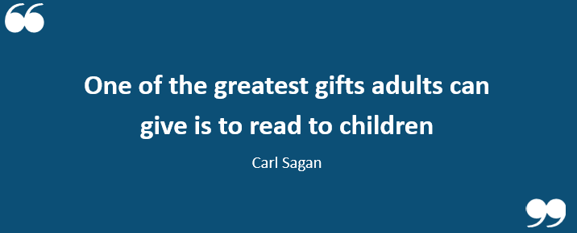

Slide 22

Many thanks for coming. Feel free to ask any questions you may have.

