Slide 1

EYFS at St. Bede’s Catholic Primary School
‘Inspiring Independent Learners with Jesus by our Side’

Slide 2
mission Statement
Our VISION
Achieving Excellence Together
Our MISSION
Inspiring independent learners with Jesus by our side
Our VALUES
Pride ~ Respect ~ Responsibility ~ Challenge ~ Curiosity

Slide 3
What is the Early Years Foundation Stage?
The Early Years Foundation Stage was created to ensure that a child’s first five years are enjoyable and fun as well as supporting their developmental needs. There are government guidelines for what each child should be able to do by the end of Reception.
All nurseries, pre-schools, reception classes and childminders deliver the EYFS, and it outlines what they must do to keep children safe and to flourish by offering a rich, stimulating experience to help them learn and develop.

Slide 4

Ofsted FRAMEWORK
“Every child deserves the best possible start in life and support to fulfil their potential. Children develop quickly in the early years and a child’s experience between birth and age 5 has a major impact on their future life chances. A secure, safe and happy childhood is important in it’s own right and it provides the foundation for children to make the most of their abilities and talents as they grow up.”
(Statutory Framework for EYFS 2021)

Slide 5
ST. BEDE’s Ofsted INSPECTION 2023
‘ Pupils delight in attending this warm, caring school. They said that they love their friends and teachers. Everyone is welcome at the school, regardless of their differences.’
‘ From the outset, children in the Reception class quickly learn the sounds that individual letters make. They experience success by reading books that contain the sounds that they have learned. Skilled staff use carefully crafted conversations to build on children’s communication and language skills.’
‘Children in the early years play happily together and welcome visitors to the classroom with polite conversation.’

Slide 6
ST. BEDE’s EYFS OUTCOMES
Good level of development 2024
School 87%
Local Authority 67%
National 68%

Slide 7
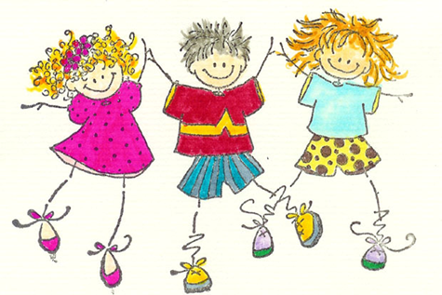
Why is EYFS important?
EYFS claims its name and importance from the fact it gives children secure foundations for later learning. Early experiences affect children’s attitude to learning so it is vitally important we get it right.
All the learning experiences we offer, are through play. It is through play that young children learn to make sense of the world around them, to formulate ideas and to build relationships with others. They are encouraged to choose their activities, both indoors and outdoors. Children are encouraged to ‘have a go’ at all activities and most importantly, to have fun! Staff plan focus activities for your children each day, which are supported by adults. We make regular observations of the children and use these to plan activities to develop their skills, based on what the children can and like to do. Taking all this into account, the children will be given the opportunity to learn through a carefully planned, well-balanced, topic-based curriculum.

Slide 8
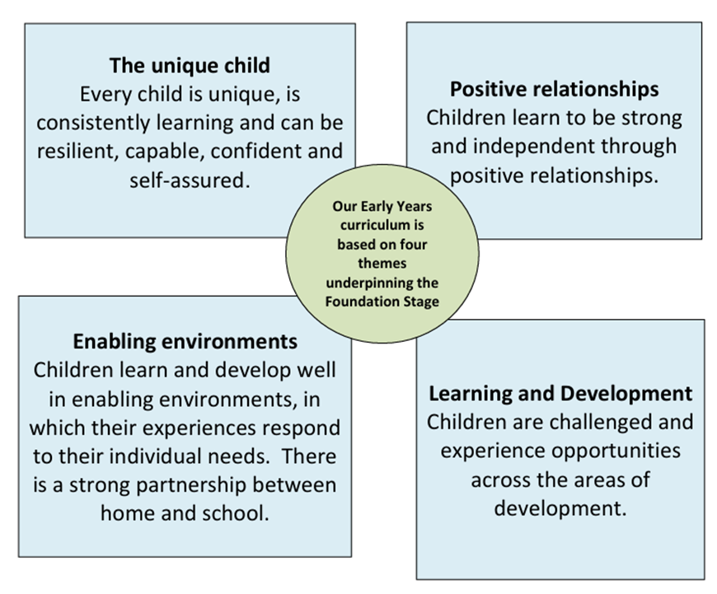
What does the EYFS involve?
The EYFS is based on 4 themes which underpin the EYFS curriculum -

Slide 9
Areas of Learning in EYFS
There are 7 areas of learning and development which shape the experiences that a child has in their early years setting. There are 3 areas which are particularly important in igniting children’s curiosity and enthusiasm for learning, and for building their capacity to learn, form relationships and thrive. These are known as the ‘Prime Areas’ which include Communication & Language, Physical Development & Personal, Social & Emotional Development.
The EYFS also has 4 ‘Specific Areas’ through which the 3 prime areas are strengthened and applied which include Literacy, Mathematics, Understanding the World & Expressive Arts & Design.

Slide 10
EYFS CURRICULUM at St. Bede’s
At St. Bede’s Catholic Primary School, our curriculum is sequenced across the year to enable children to build and develop their skills. We plan what the children learn in the classroom through adult led activities and through exploration and enhanced classroom environment, both indoors and outdoors. This allows the children to build curiosity and to give them time and space to further explore through their play. Our key knowledge and skills are planned and developed through our Curriculum Overview.

Slide 11
wHAT does THE EYFS LOOK LIKE
‘PLAY’
At St. Bede’s, play is an important part of our day where children are encouraged to explore independently or with their peers. Play is supported and extended by adults who carefully support children by giving suggestions and challenges, talking through their plans, scaffolding, modelling, adding vocabulary and adding teachable moments.

Slide 12
These play activities, allow the children to consolidate what they already know and enable them to become independent and resilient to be able to take their learning to the next level. The environment, both indoors and outdoors has a range of activities which the children have the freedom to explore and develop their characteristics of
effective learning such as; generating their own ideas, using the correct resources, sustaining their concentration and preserving when faced with a challenge.

Slide 13

Religious Education
At St. Bede’s we follow The Vine and The Branches syllabus for our Religious Education. A developing understanding of the love of the Lord Jesus Christ is central to the daily life of our children.
In Reception, your child will learn about how God created the world; God’s gift of Jesus; how to respond to the love of Jesus; the true meaning of forgiveness; new life through Jesus and the Church family of God.

Slide 14
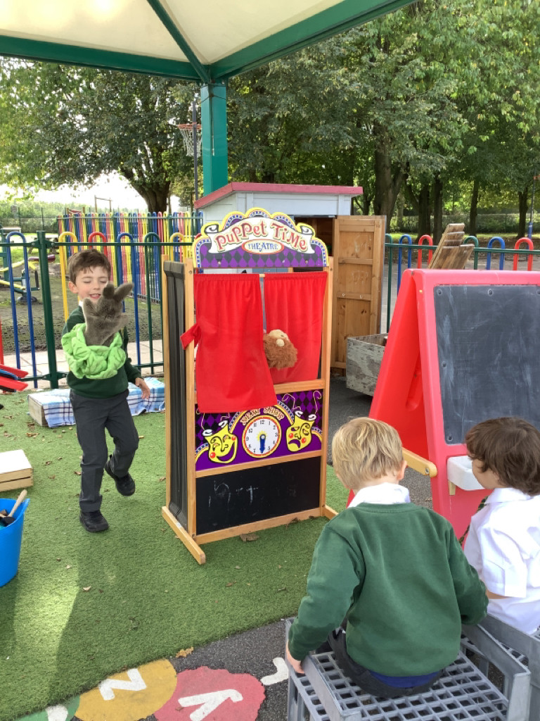
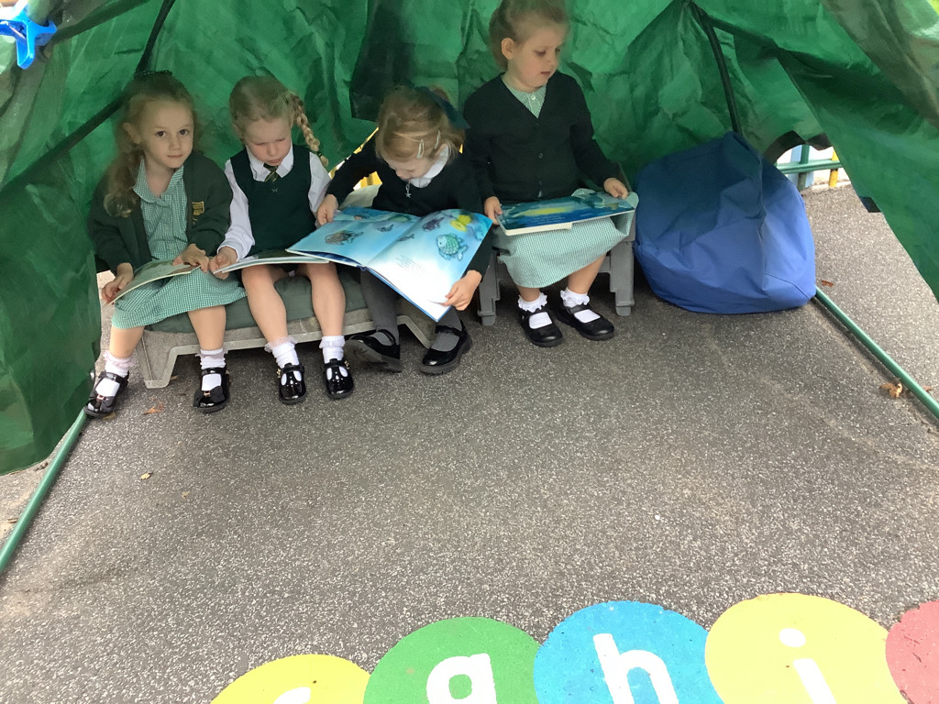
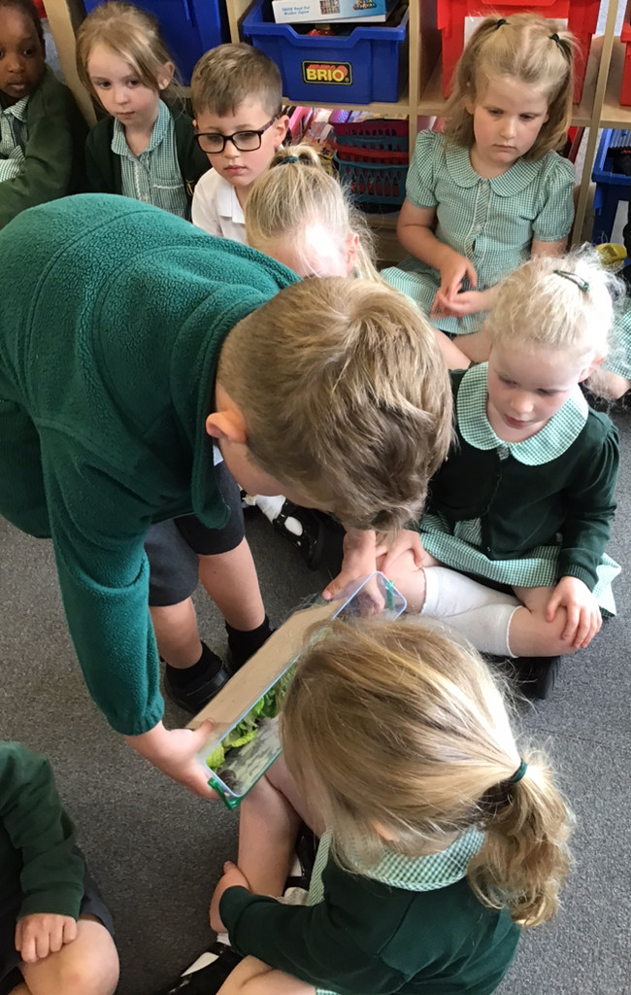
Communication & Language
Listening, Attention & Understanding – Sharing news from home and answering questions
Speaking - Sharing books and retelling using puppets

Slide 15
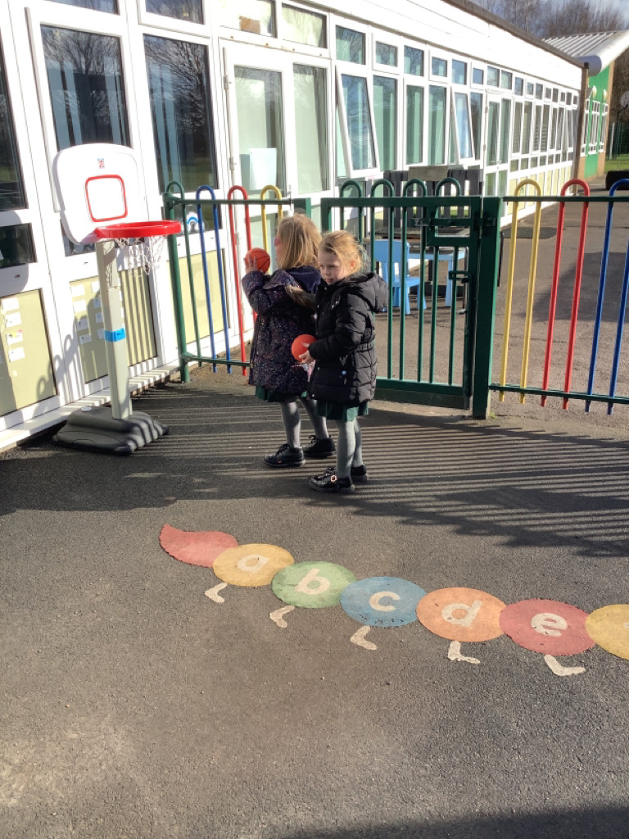
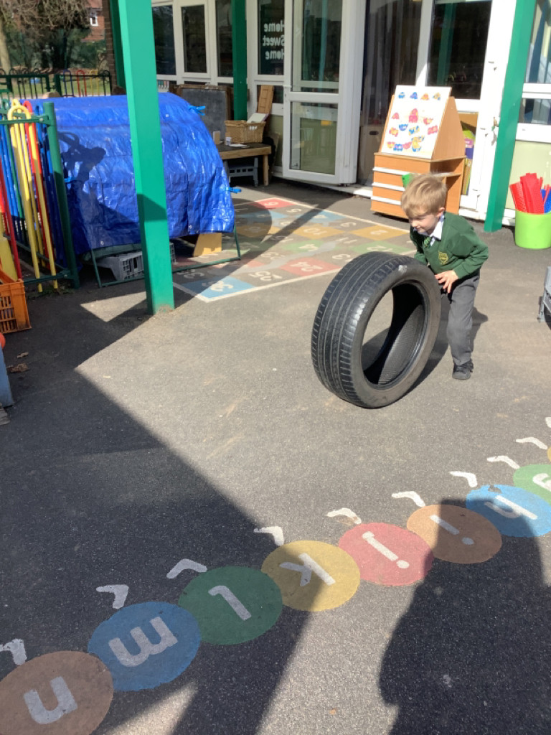
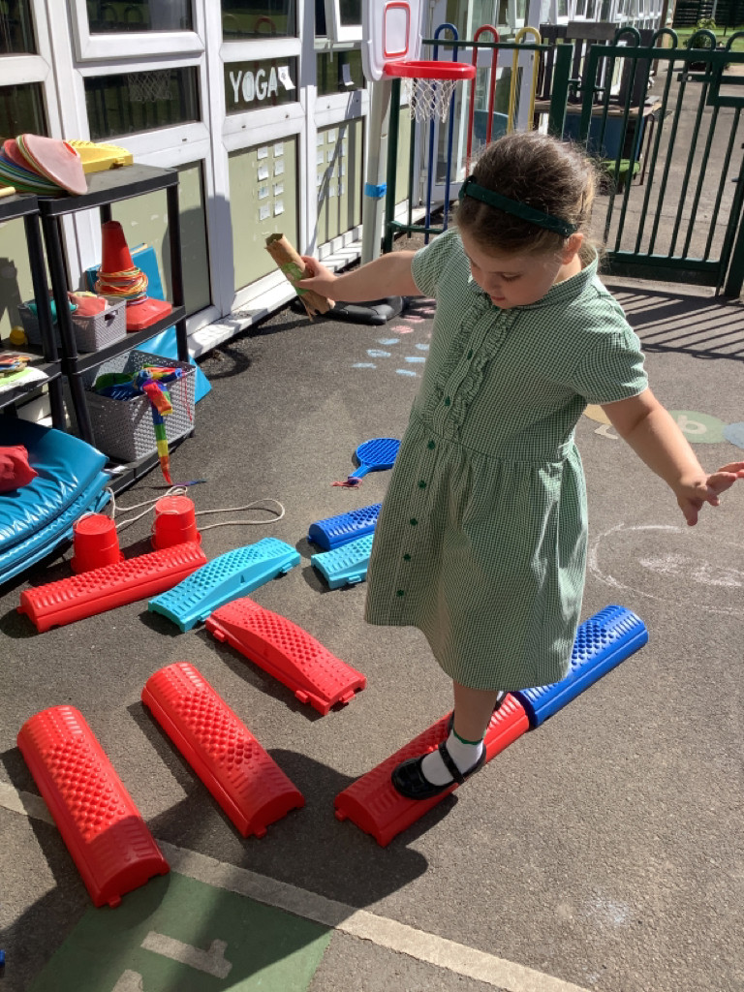
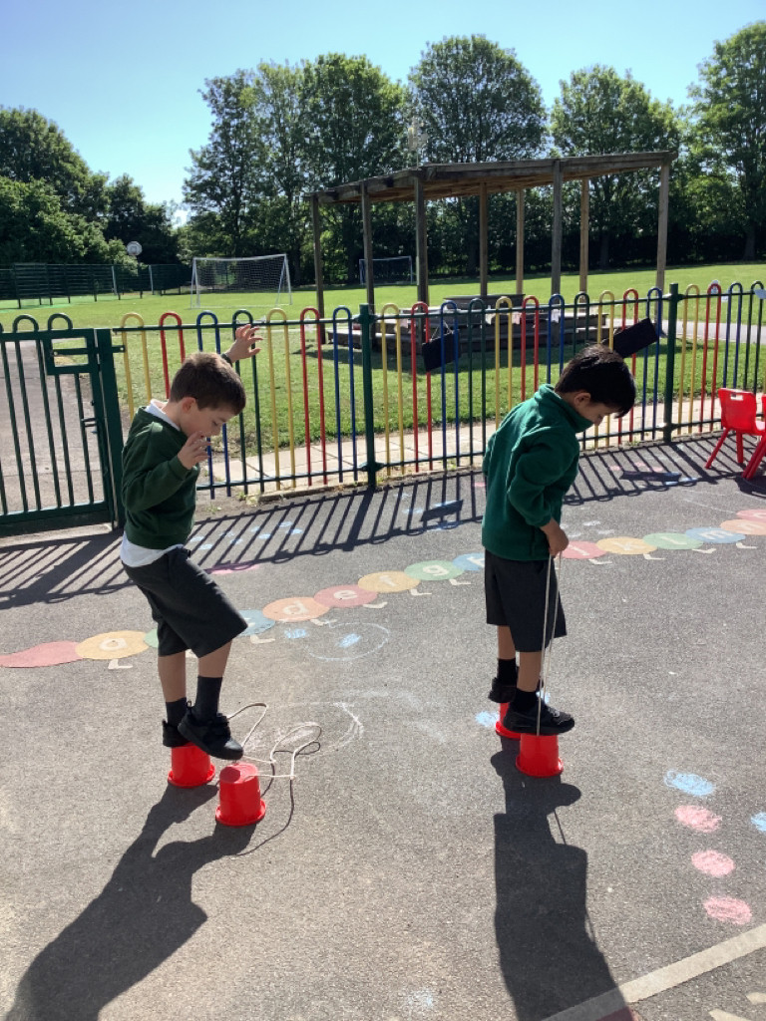
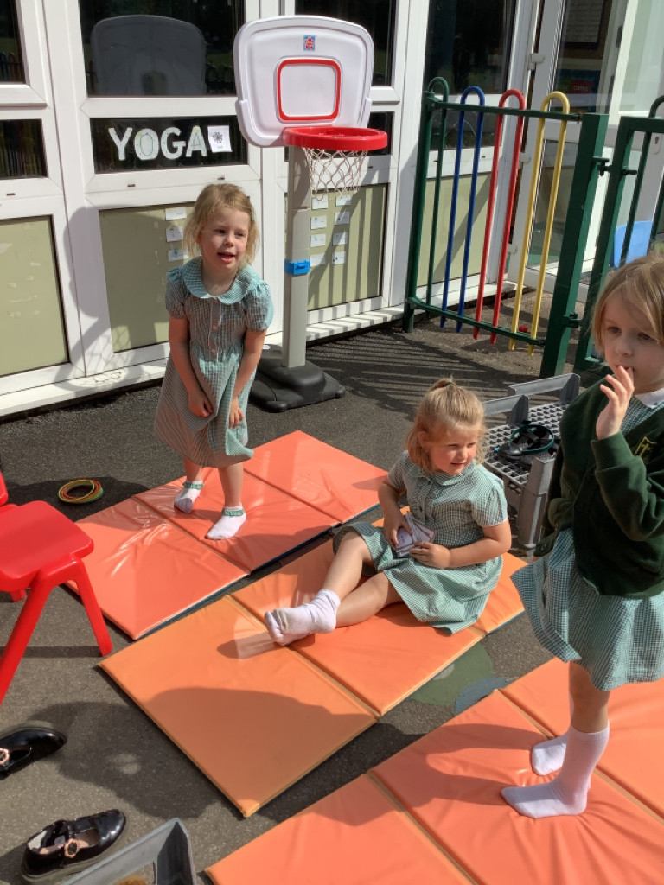
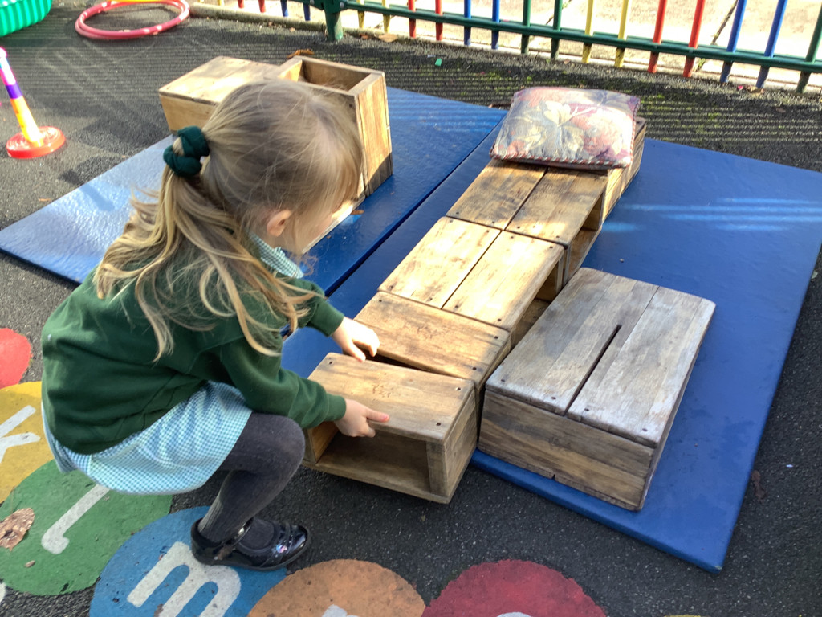
Physical Development
Gross Motor Skills - Negotiating space, demonstrating strength, balance & coordination, moving energetically.

Slide 16
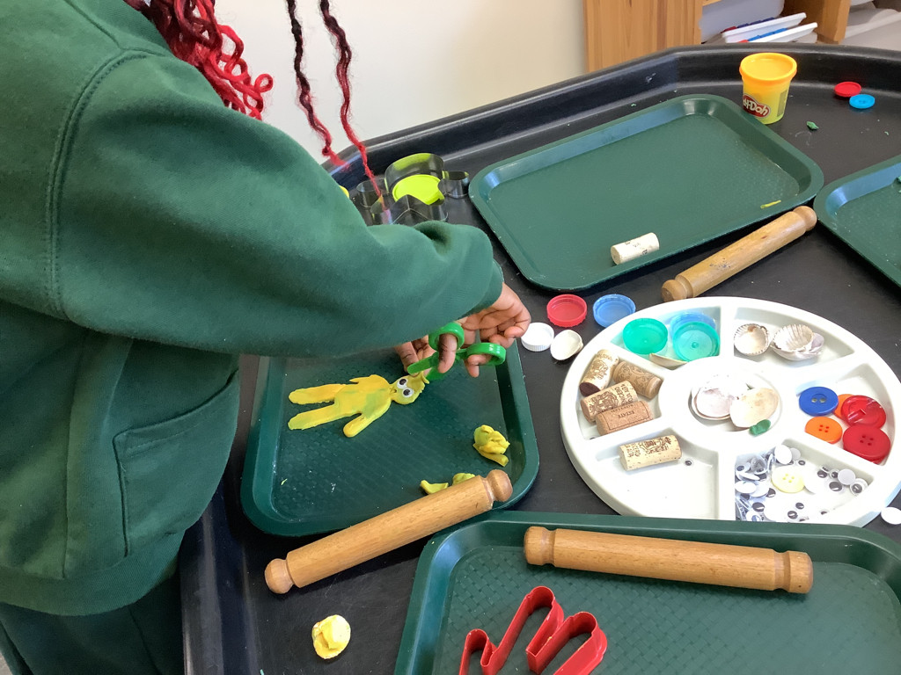
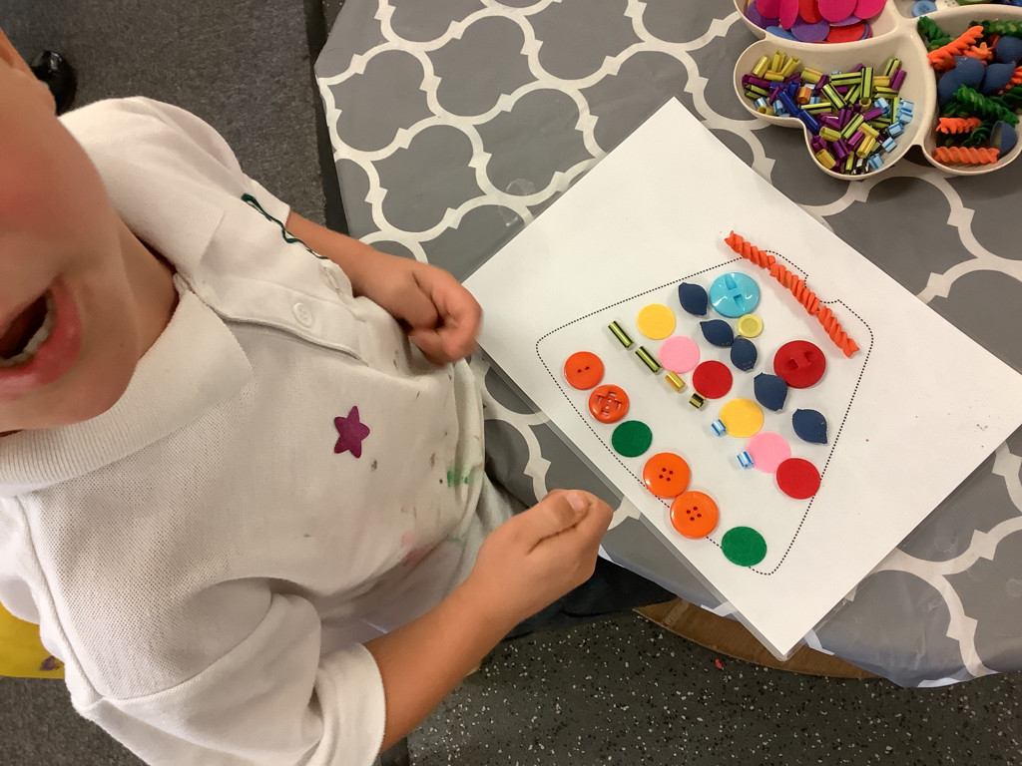
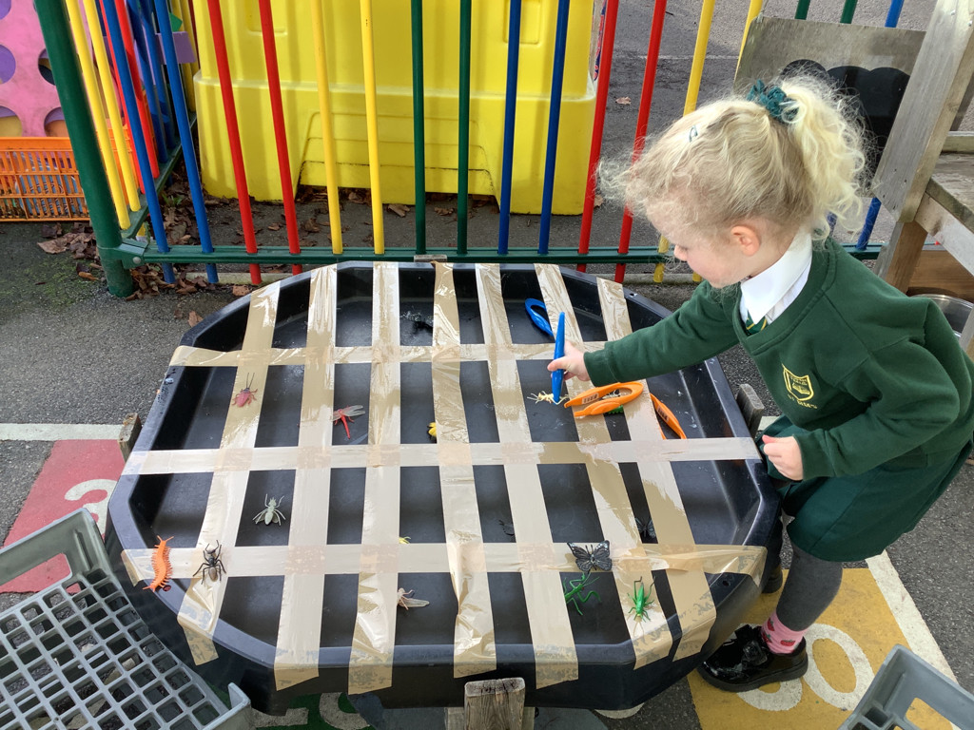
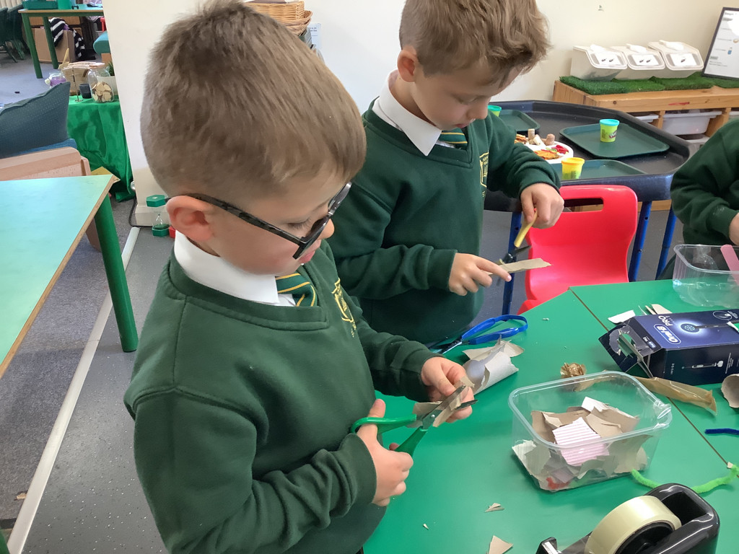
Physical Development
Fine Motor Skills - using pencils effectively & a range of small tools to show accuracy and care when drawing.

Slide 17
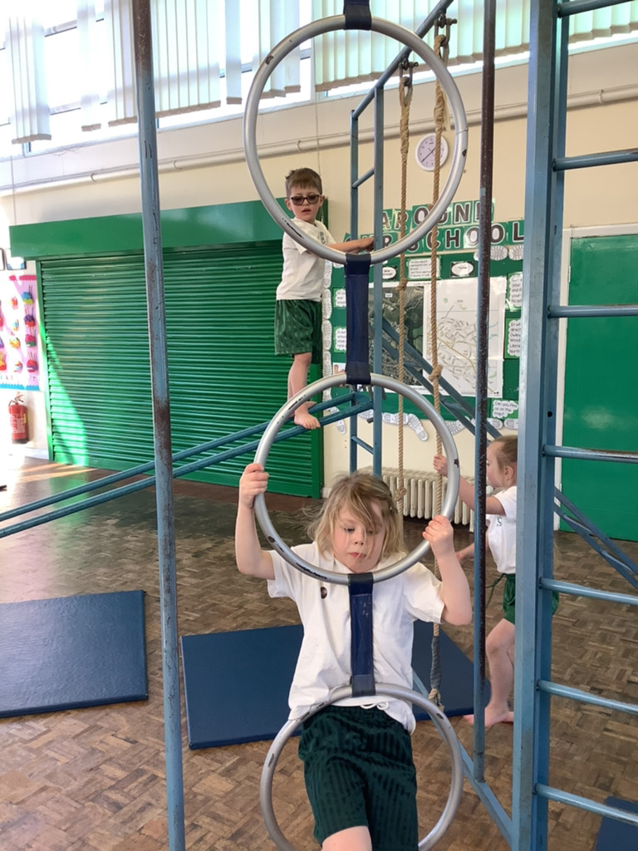
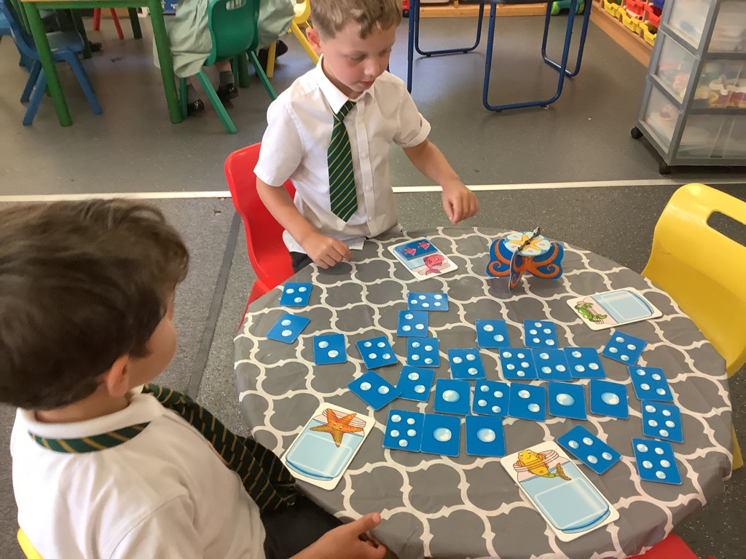
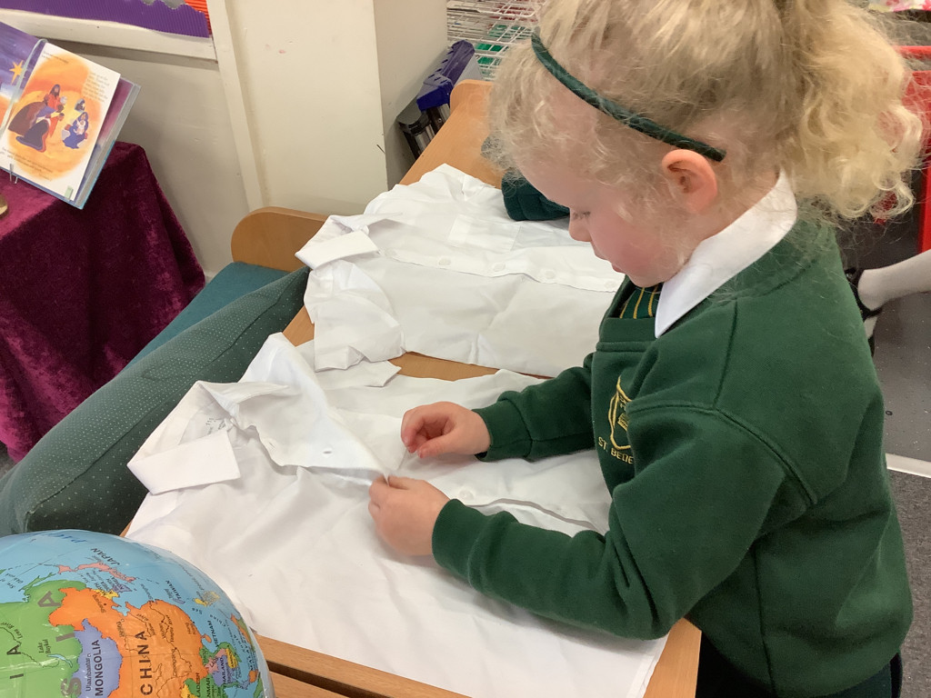
Personal, Social & Emotional Development
Managing Self - be confident to try new activities & show independence, resilience and perseverance, manage their own basic hygiene and personal needs.
Self-Regulation - understand their own feelings and those of others, give focused attention to what the teacher says, responding appropriately.
Building Relationships - work and play cooperatively & take turns, form positive attachments to adults and friendships with peers.

Slide 18
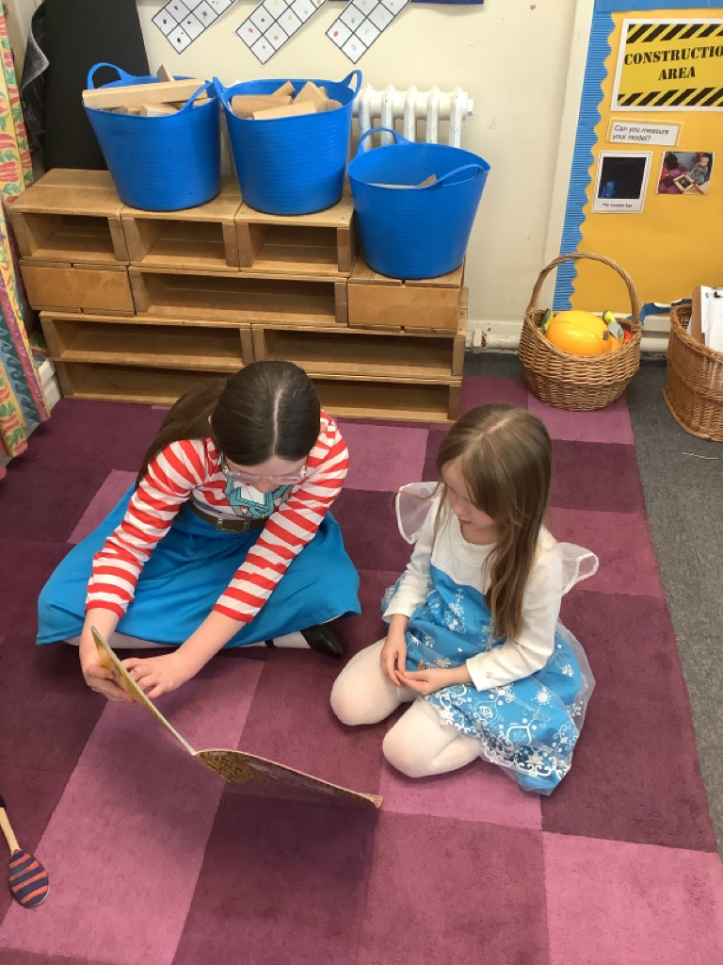
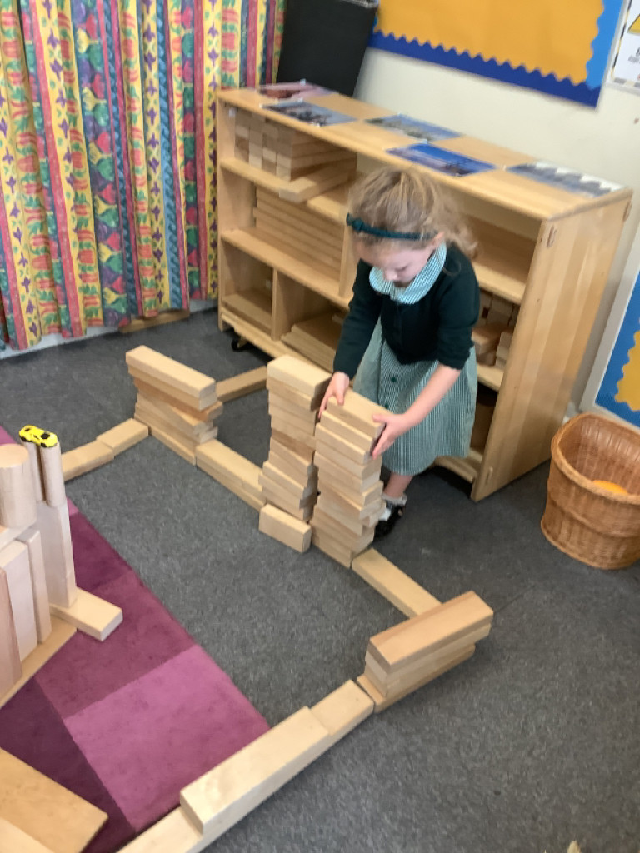
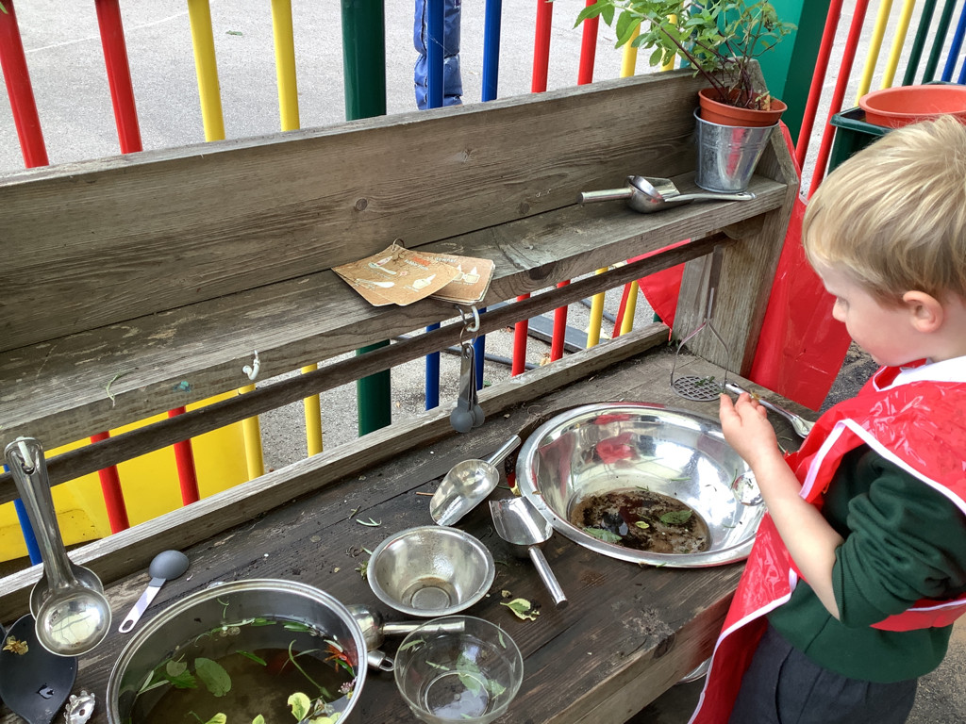
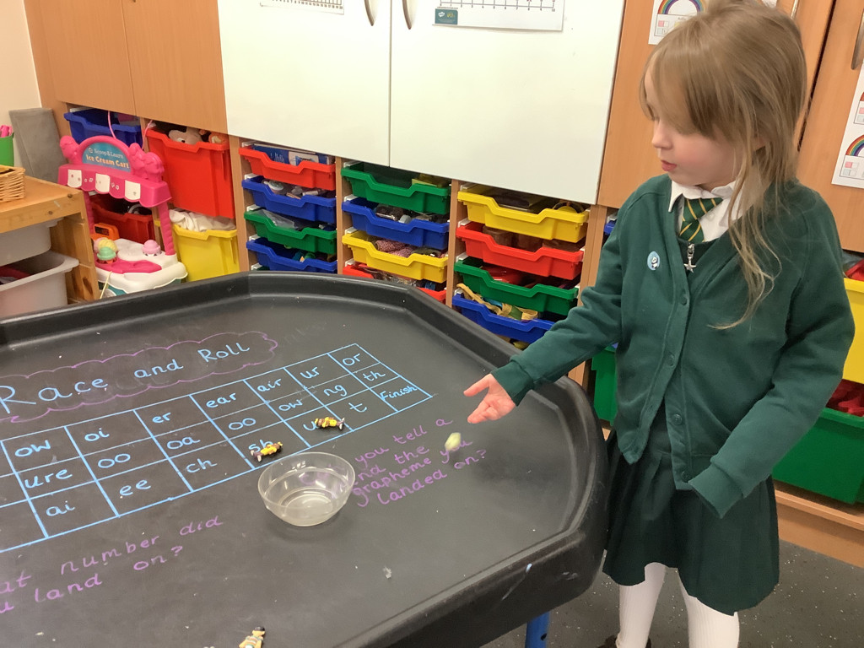
Literacy
Word Reading - read aloud simple sentences and books.
Comprehension – understand what has been read by retelling stories, use recently introduced
vocabulary during discussions.

Slide 19
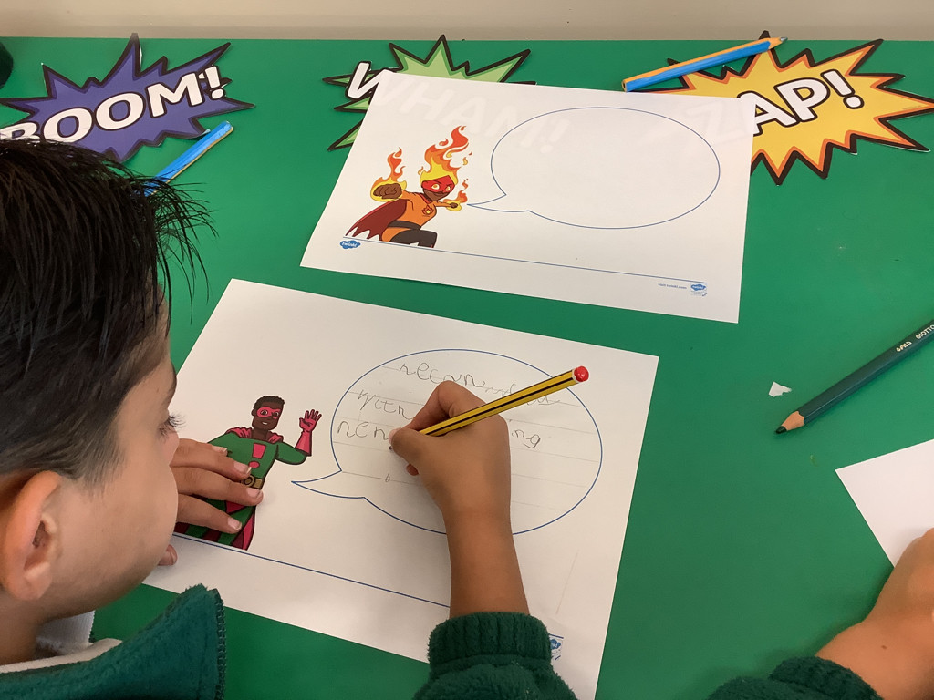

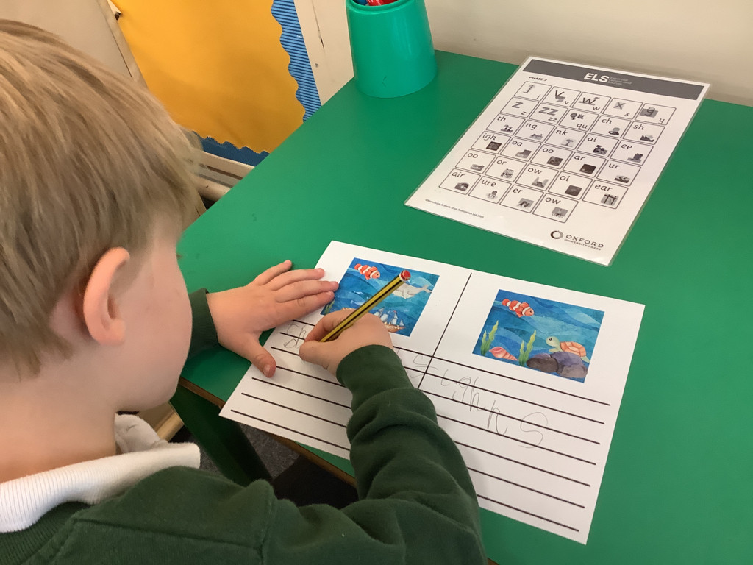
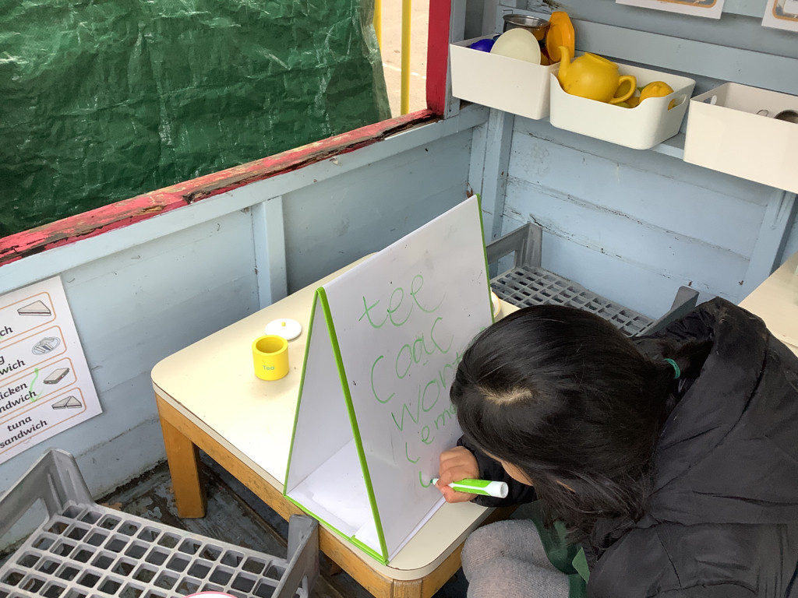
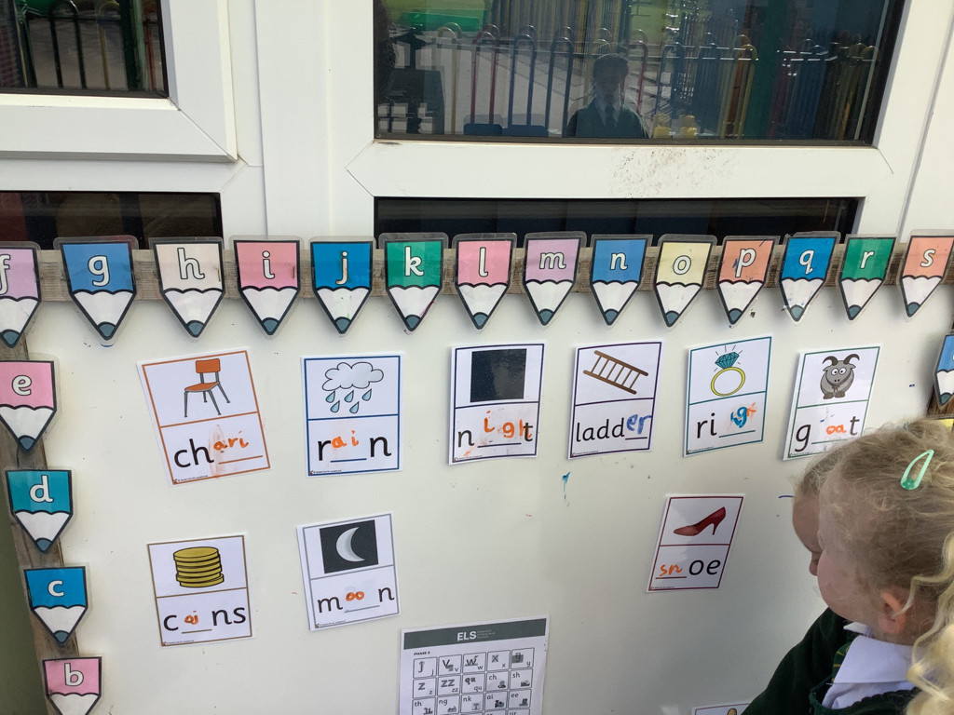
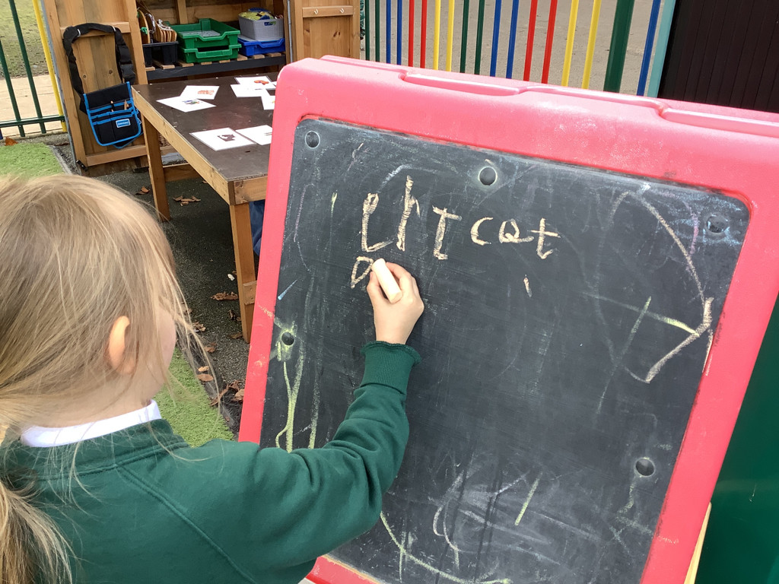
Literacy

Slide 20
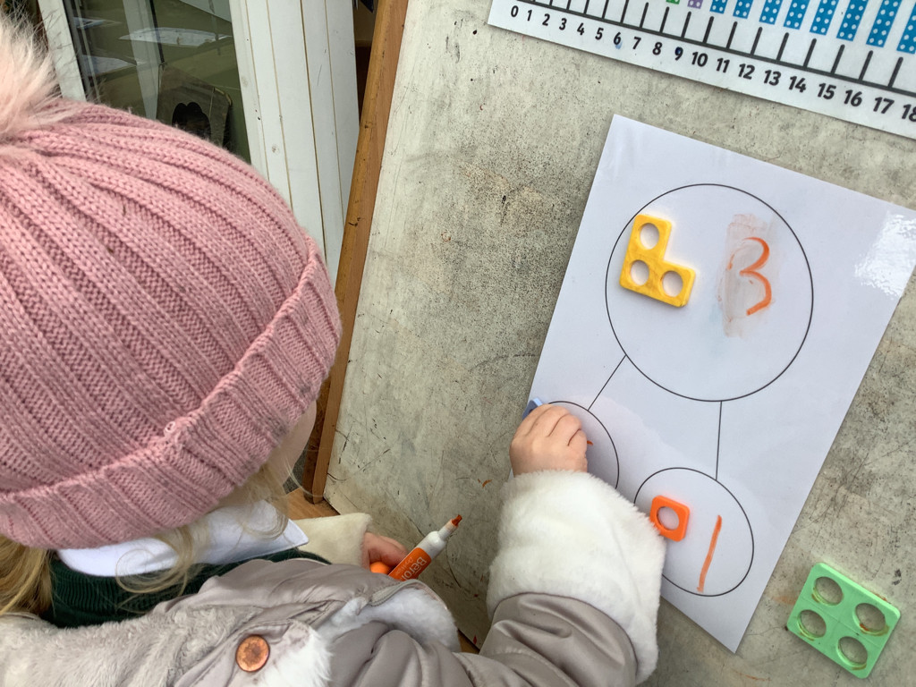
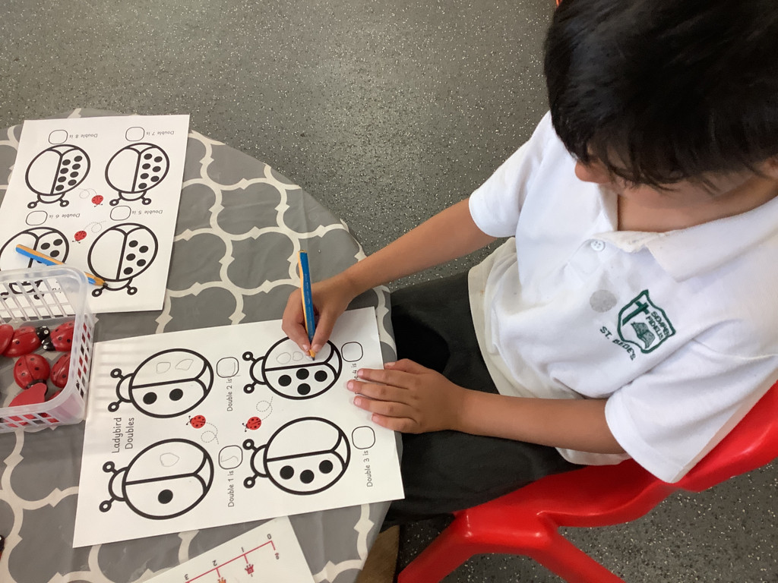
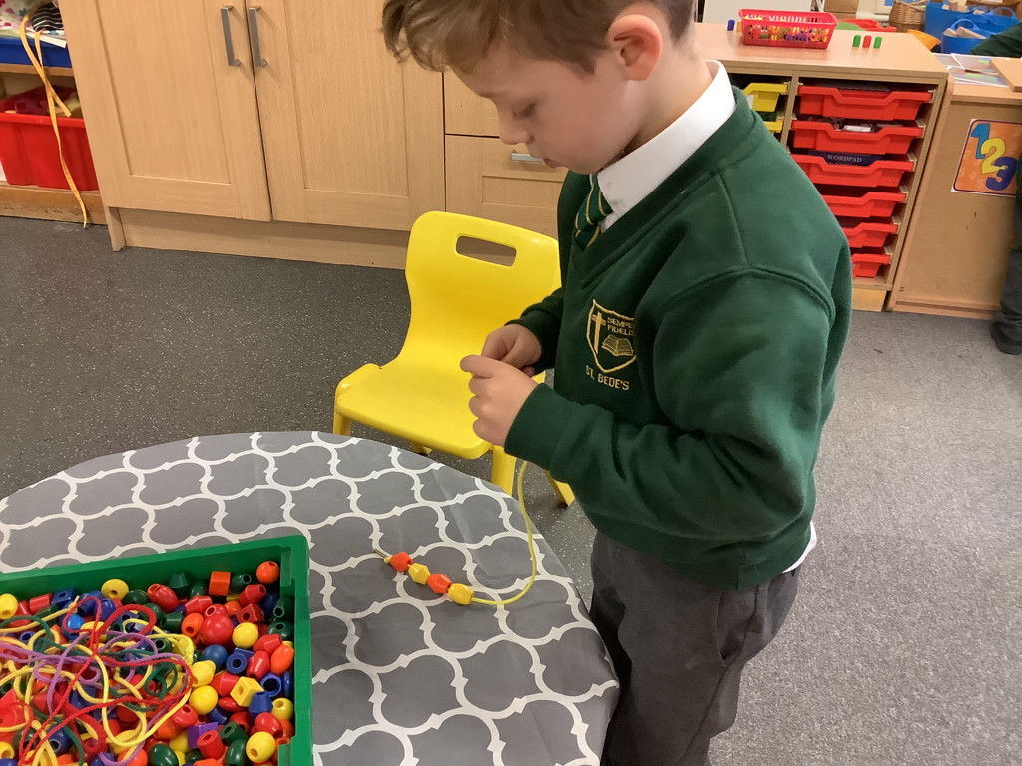
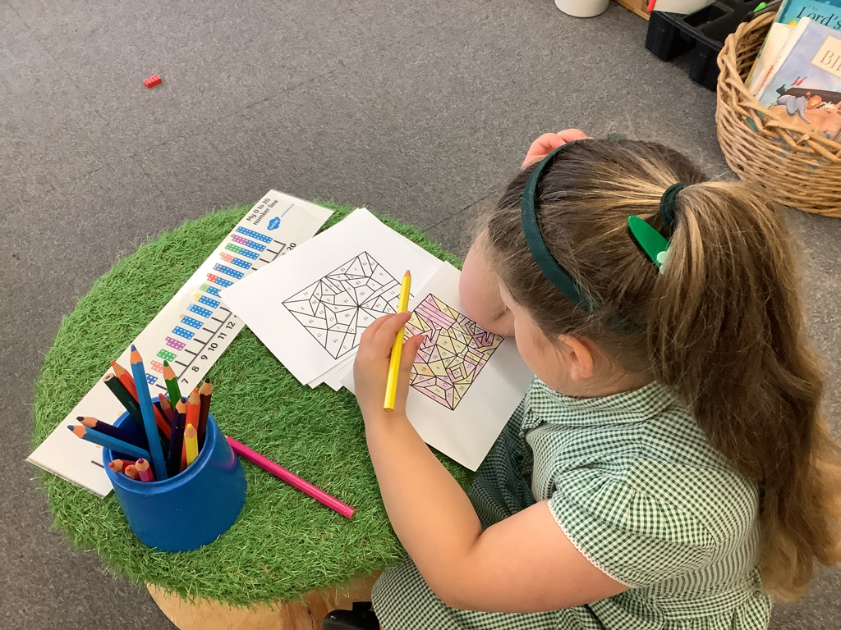
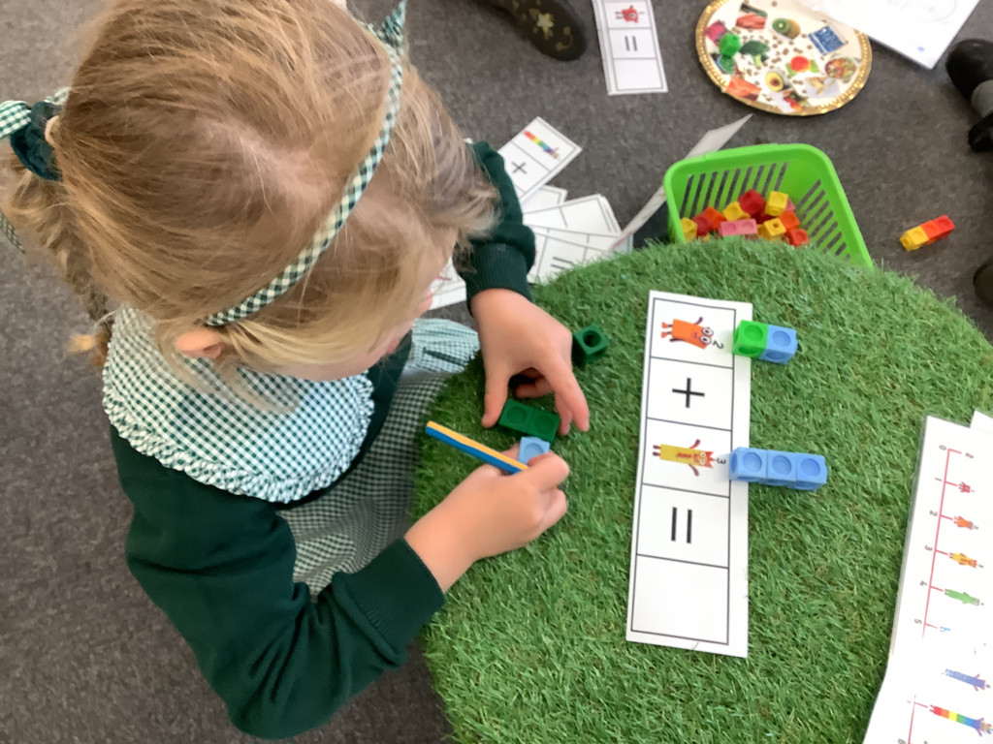
Mathematics
Number - We use different equipment to help us to count such as counters, cubes, Numicon, tens frames, number lines.

Slide 21
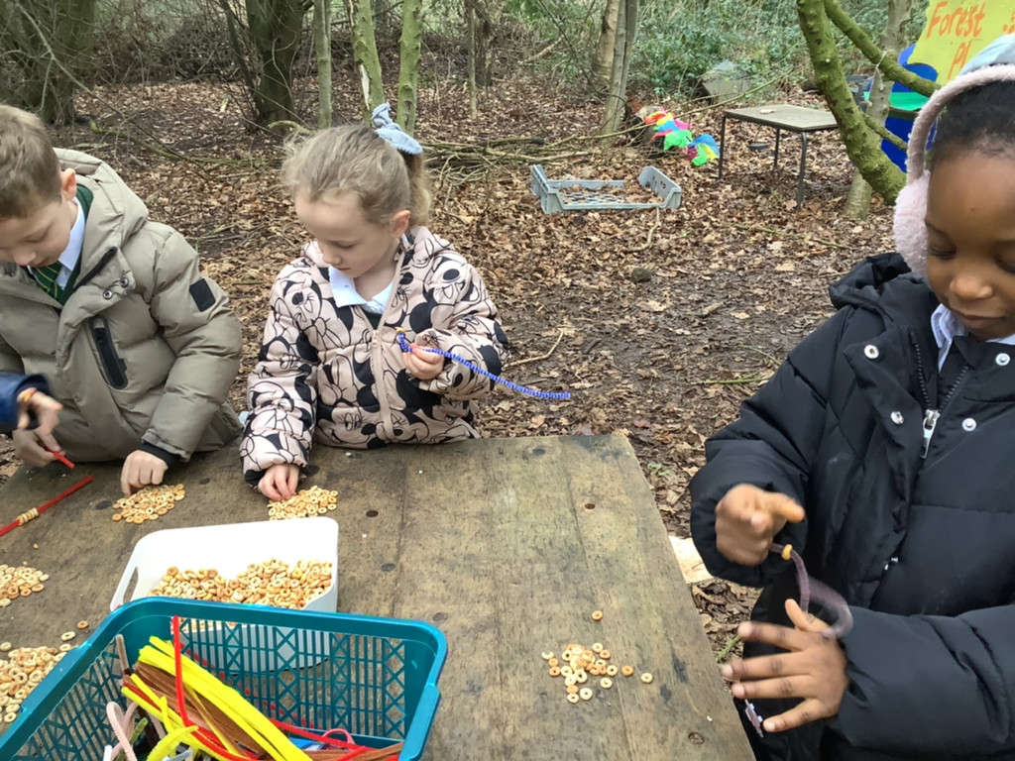
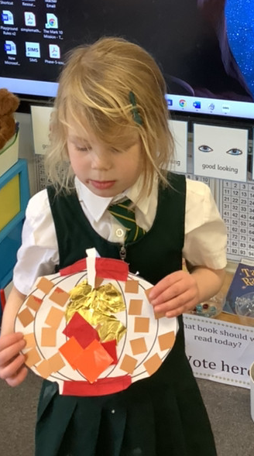
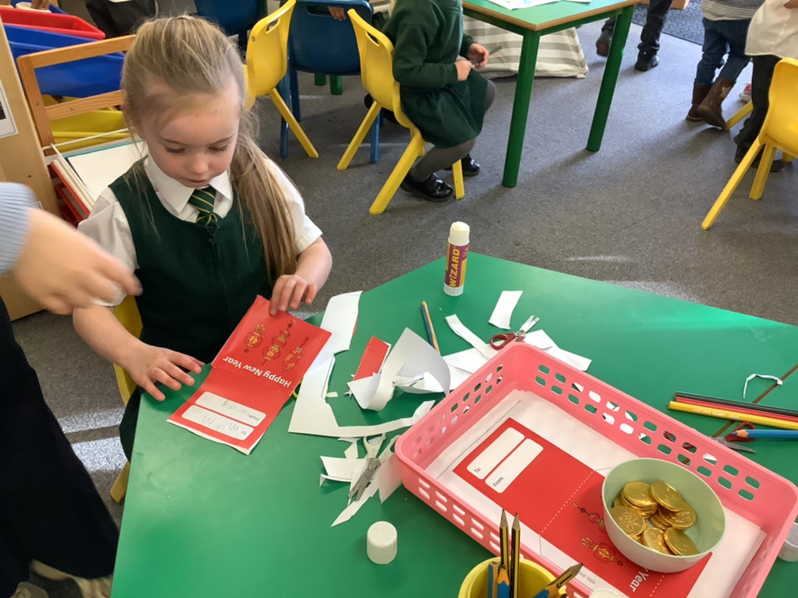
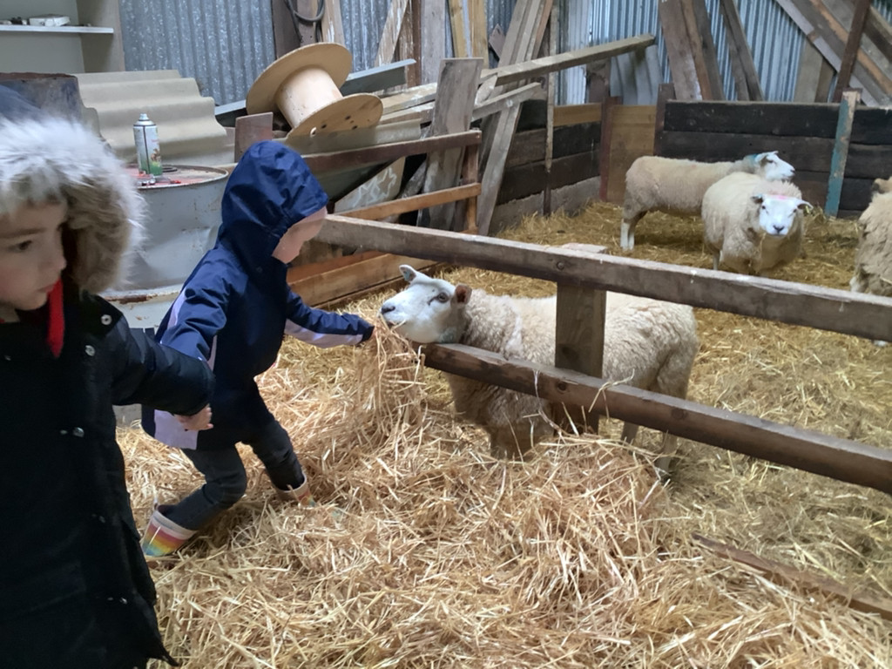
Understanding the world
The Natural World – exploring the world around them & making observing such as through the seasons.
Past & Present, People, Culture & Communities – Celebrating different religions and festivals such as Diwali, Lunar New Year.

Slide 22
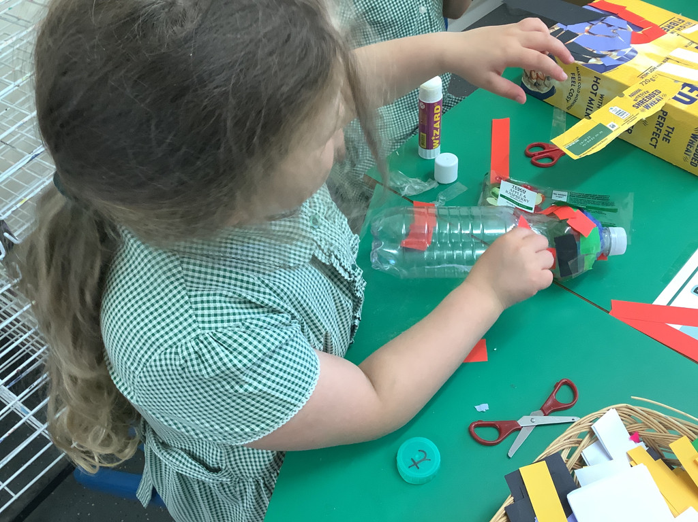
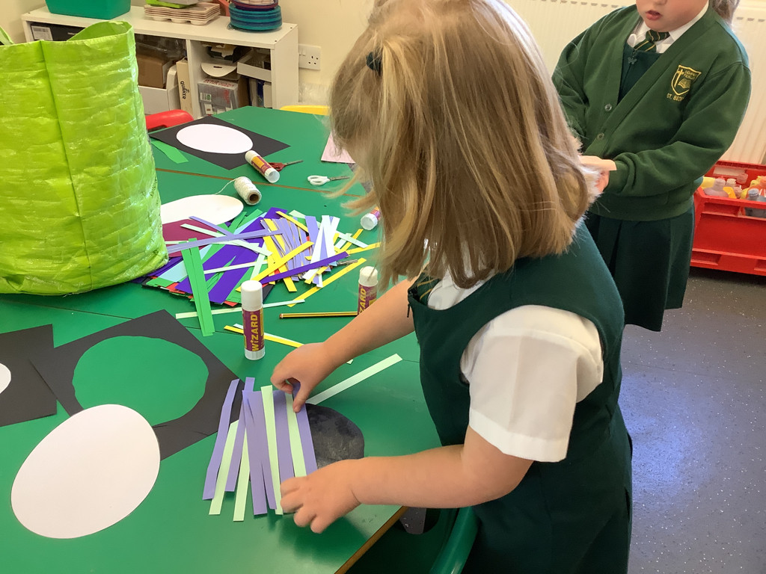
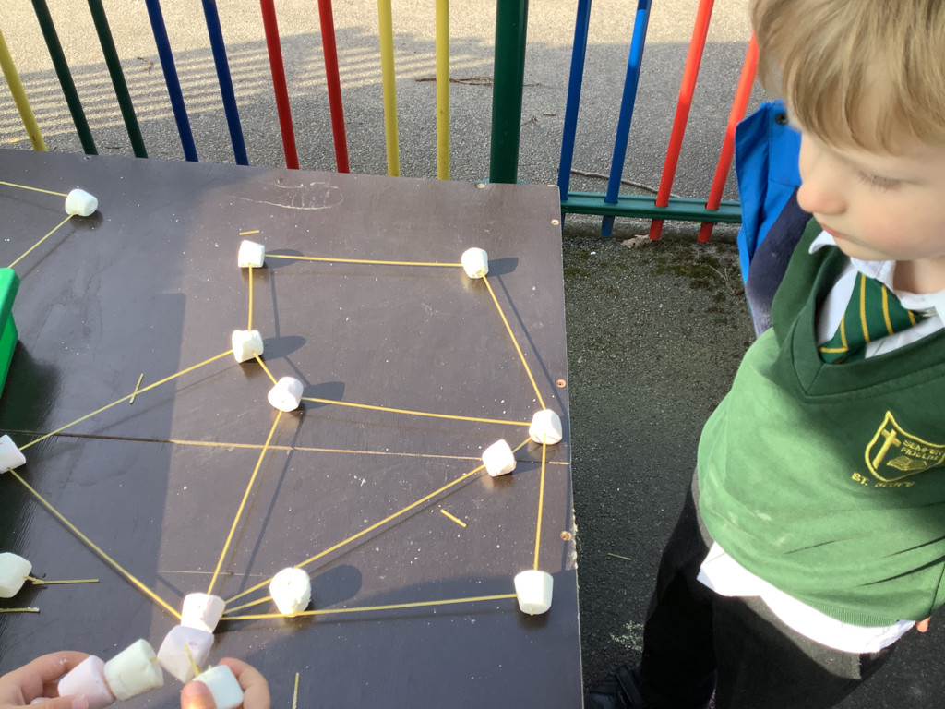
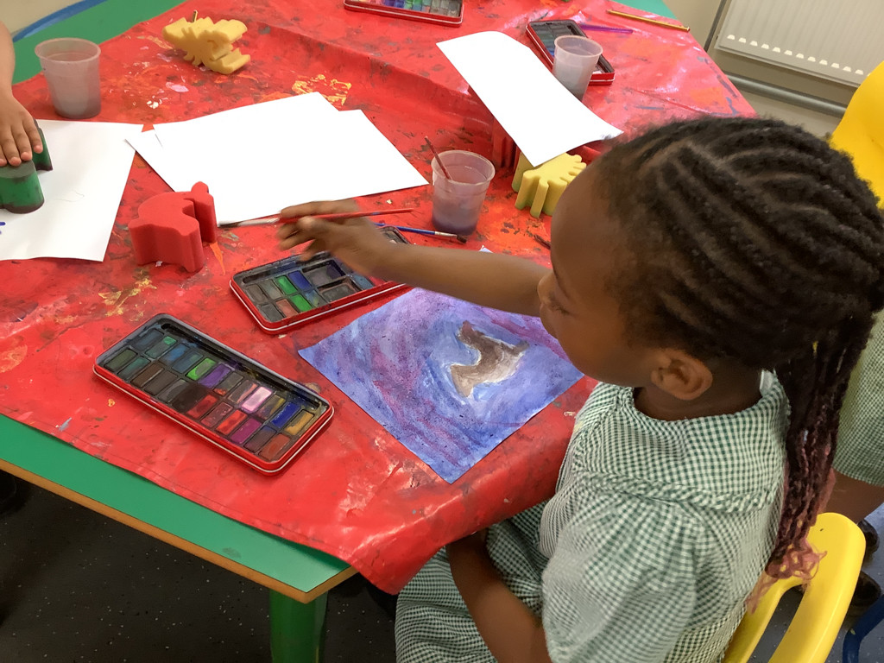
Expressive arts & design
Creating with Materials – using & exploring different materials, tools and techniques. Sharing creations and experimenting with colour, design, texture, form & function.
Being imaginative & expressive

Slide 23
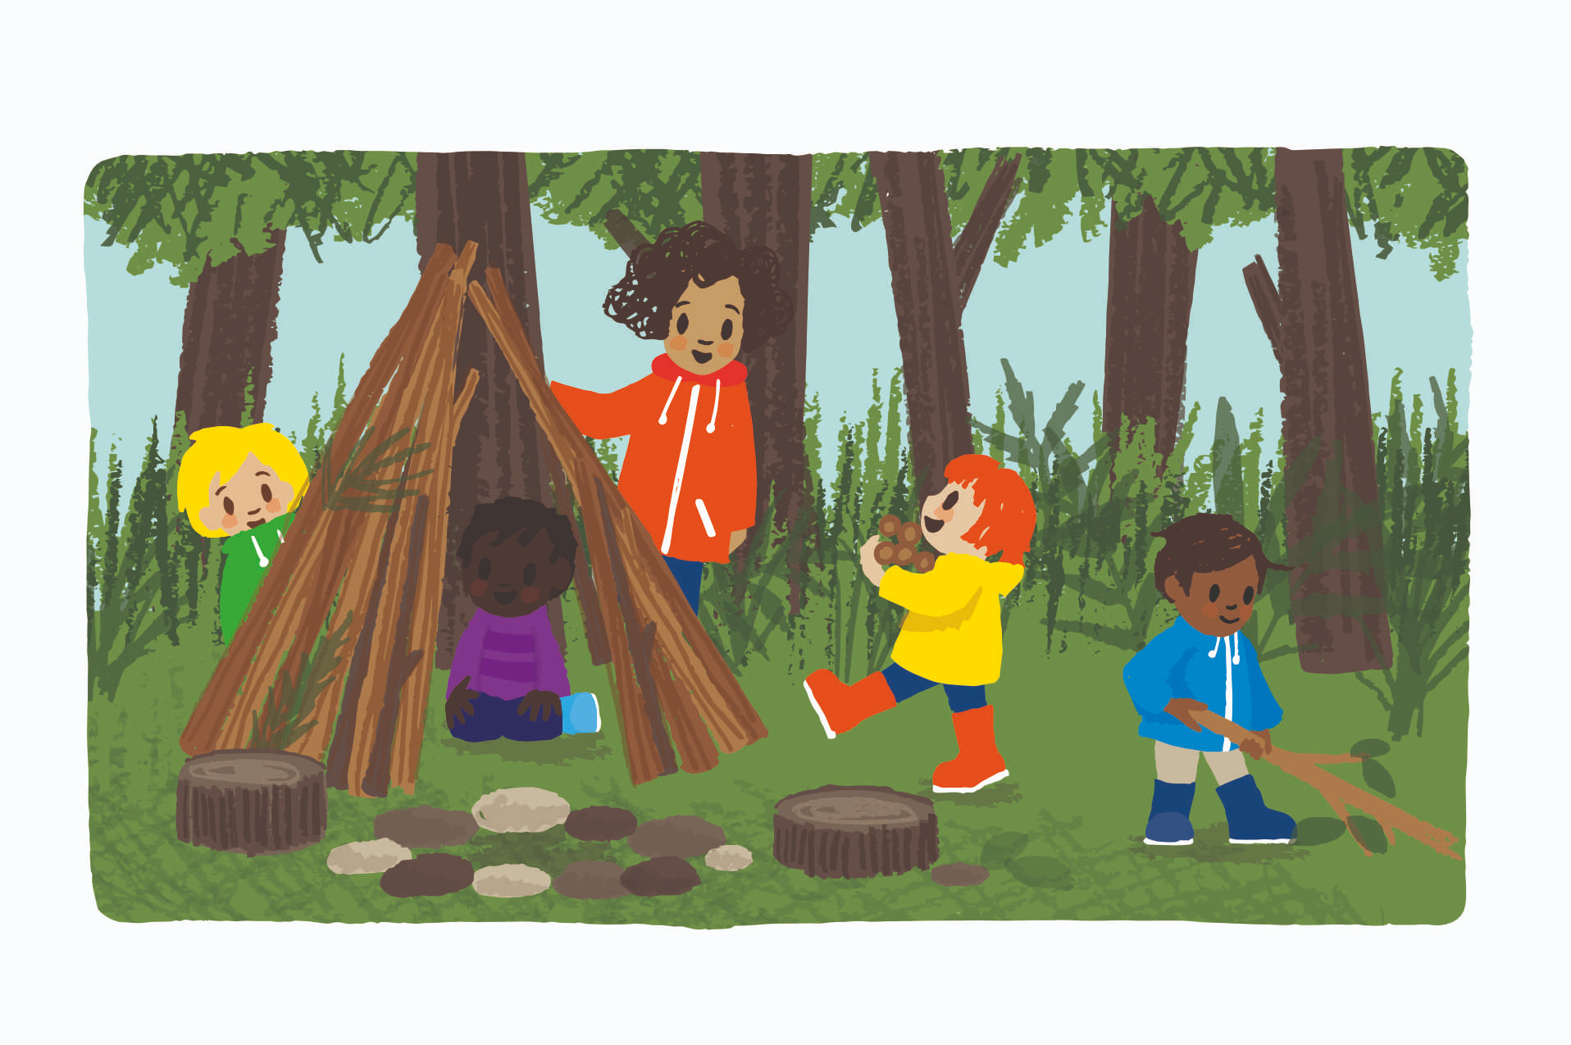
Forest PLAY
At St. Bede’s, we join with Woodlands Pre-School and take our learning outdoors. This experience allows the children to learn about our natural environment, develop confidence through hands-on learning, take risks, problem solve, play collaboratively and making links to their learning.

Slide 24
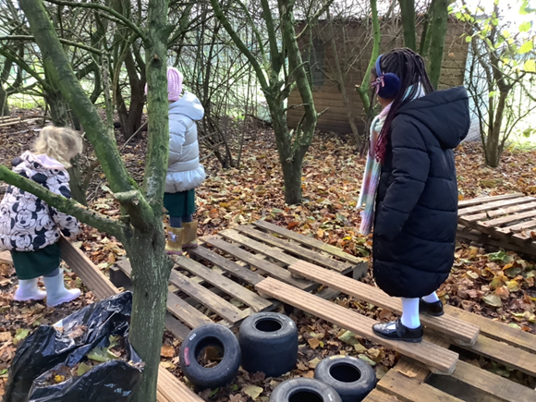
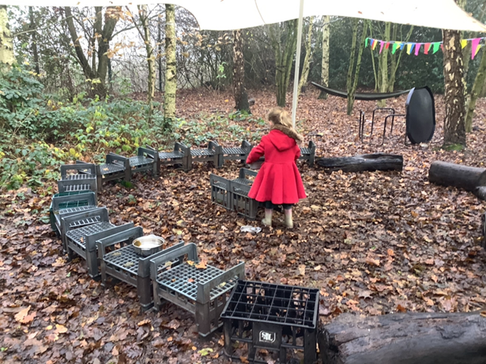
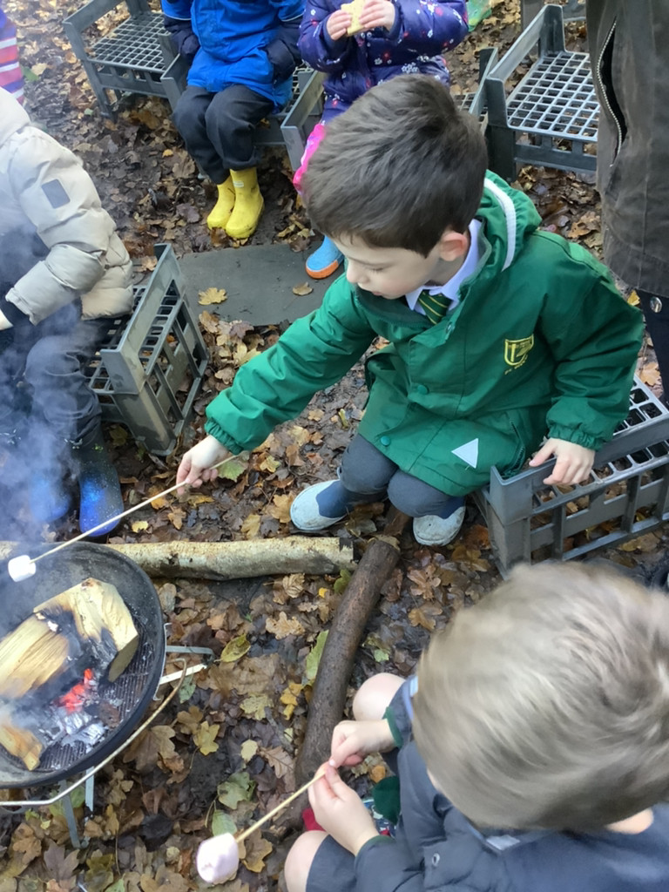
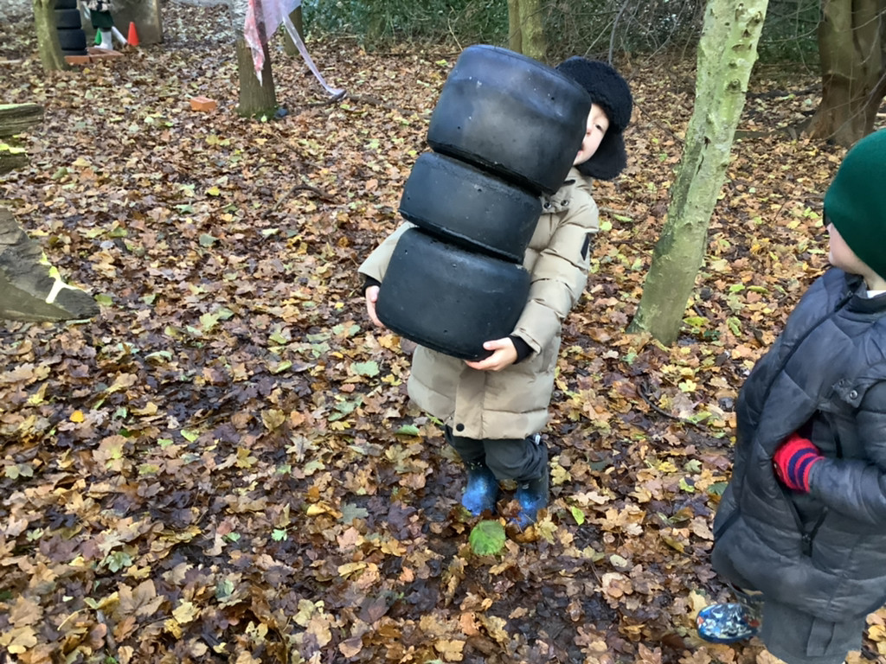
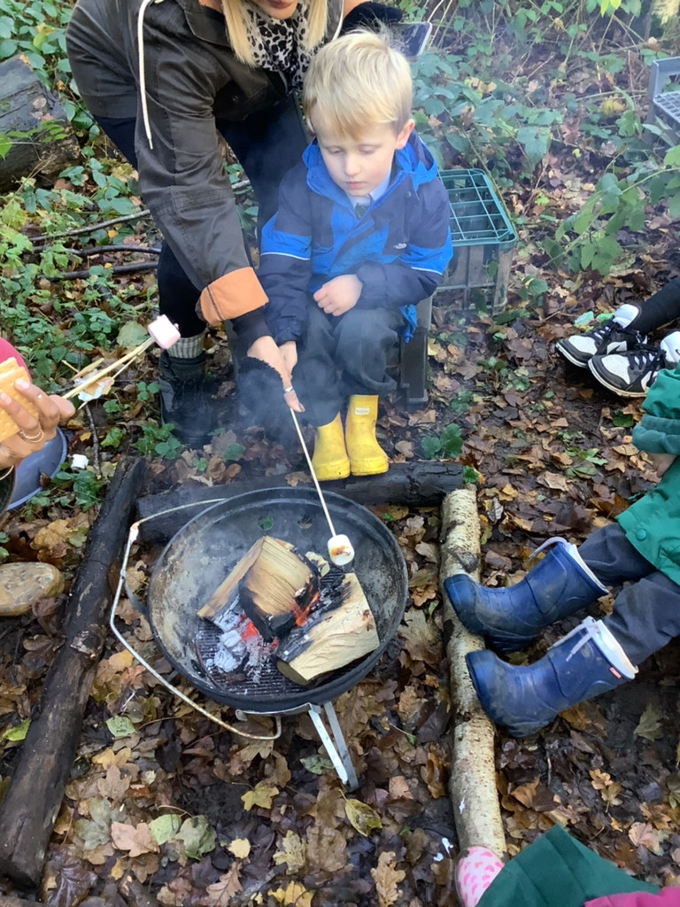
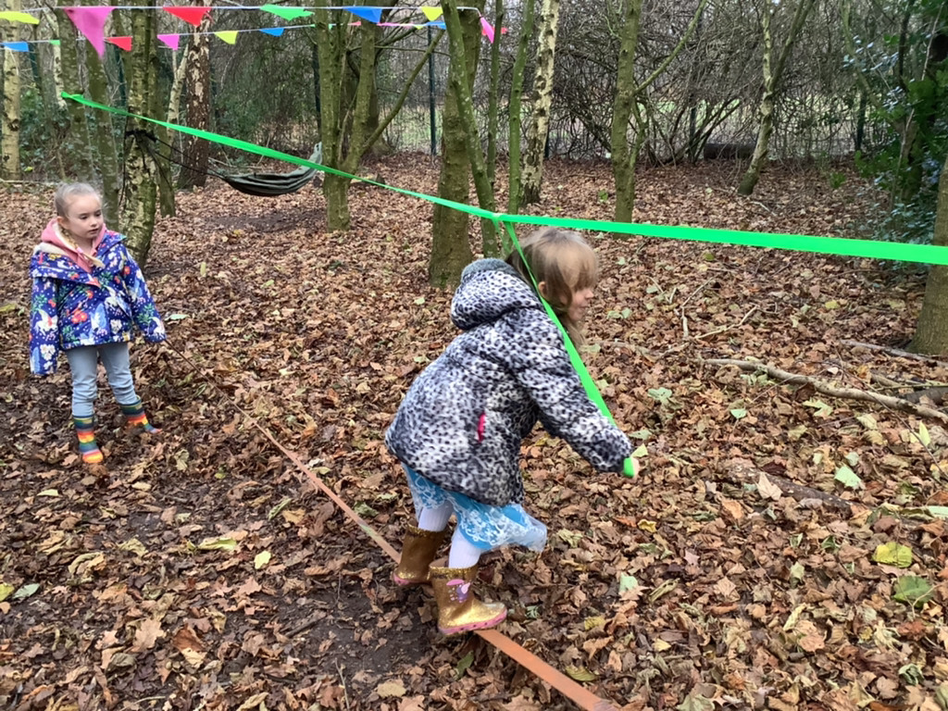

Slide 25


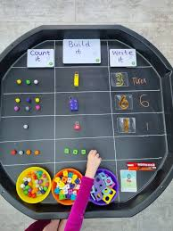
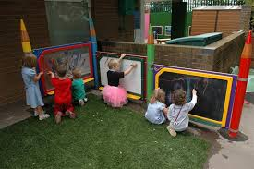
How to support at home
Speaking & Listening - Listen to your child and talk throughout the day together. Share nursery and nonsense rhymes. Play games such as ‘I Spy’.
Reading –
Read to and with your child everyday to promote a love of books. Re-tell the story together using role-play.
Writing –
Use different mark making tools such as pencils, chalk to do writing patterns such as circles, zigzags.
Maths –
Sing number songs & rhymes, sort objects into size, talk about shapes
in the environment.

Slide 26
Arrangements for Transition
Tuesday 24th June – 10:30 – 12:00
  Stay & Play with parents/carers (stay for lunch)
Tuesday 1st July – 9:15 – 10:45
  Stay & Play for all children
Thursday 10th July – 1:30 – 3:00
  Stay & Play for all children

Slide 27
Arrangements for September 2025
Our new reception children will be admitted to school gradually over the first few days, allowing staff time to settle the children into their new routine.
First Week:
2-3 Sept 25 8:55am – 12:30pm (stay for lunch)
4-5 Sept 25 Full Days*
If you have any further questions, concerns or queries please do not hesitate to ask. You are welcome to ask at the general office at any time or phone school on 01606 852149 for a chat with us after school.

Slide 28
General information
School Day
  Morning session - 8:55am – 12:00pm
  Afternoon session 1:00pm – 3:25pm
Always try to be on time for the beginning of the school day, the doors open at 8:45am ready for registration at 8:55am. If you are delayed, telephone the school office.
If your child is unable to attend school due to sickness, telephone the school office to let them know before 9.10am on the first day of absence.

Slide 29
MORNING SNACK
Free fruit is provided for all Reception and Key Stage 1 children and under 5’s also receive free milk. We have a rolling snack where children are encouraged to help themselves to which fruit they want, pour their own milk, all whilst chatting to their friends and sharing books/stories.
Please ensure that your child brings a named water bottle into school each day.
LUNCHTIME
School meals:
All children in Reception, Year 1 and Year 2 are entitled to a Universal Infant Free School Meal.
Packed lunches:
If you wish for your child to bring a packed lunch, we ask that it contains healthy choices, and their box is clearly labelled. For safety reasons do not send containers made of glass to school. Please teach your child how to open their lunchbox. We are a nut free school, so please do not include foods that contain nuts.

Slide 30
HOME TIME
The school day ends at 3:25pm. Children will be escorted out to the waiting parents via the gate at the outside area of the Reception classroom.
The children will not be allowed to go unless there is a known adult waiting for them.
Please inform the class teacher if a different adult will be collecting your child, you may tell the Reception staff in advance or you could give a message as you drop off in the morning, or email the school office at admin@stbedes.cheshire.sch.uk.
GET INVOLVED
Remember that the St. Bede’s community is for you as well as your child. Please contact your child’s teacher if you have any concerns, come and support all our activities whenever possible and join the ‘Friends of St. Bede’s (FOSB)’ parent teacher association. If you have any time to spare. You can also sign up and join our “Helpers” list.

Slide 31

We look forward to working in partnership with you to provide the best possible start for your child’s education.

Slide 32
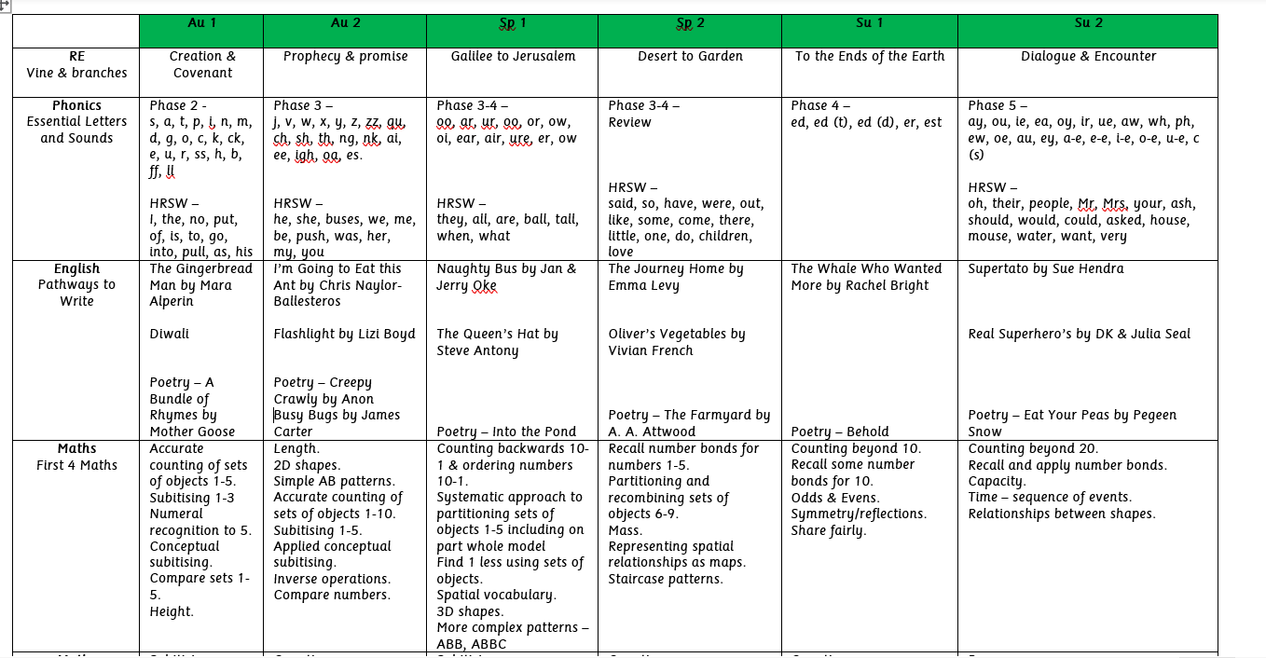
St. Bede’s Catholic Primary School EYFS Yearly Overview 2025/26

Slide 33


Slide 34


Slide 35


