Slide 1


Year 4!
ACHIEVING EXCELLENCE TOGETHER
Inspiring independent learners with Jesus by our side

Slide 2
Staff
Class Teacher: Mrs Dimbylow
TA support: Mrs Ogden:
Monday am
Wednesday am
Thursday 8:45-10:40
Friday 8:45-10:40
TA will support small group work in class and extra work during assemblies etc.
Swimming teacher: Mrs Axford

Slide 3
Y3 curriculum
Topics this term:
R.E – Creation and Covenant and Prophecy and Promises
Europe – focus on Greece
Ancient Greeks
Netball and dance in PE
Electricity and states of matter in Science
Monochromatic images in art
Chocolate in DT
Online safety and coding in Computing

Slide 4
PE – Mondays and Thursdays
Swimming – Mondays – PE kit
Autumn 1: Netball – outside
Autumn 2: Dance - inside
The school swimming gala, usually held in the Spring term, is the perfect opportunity for your child to celebrate their hard work and achievement in swimming. Details about the gala will follow nearer the time and we look forward to seeing your child there.

Slide 5
Reading
Encourage reading at home – it helps with decoding, blending and understanding which are the fundamental building blocks for reading. This will support them in the wider curriculum.
Not all will read 1:1 with an adult every day.
Children will all have a colour band book (even ‘free readers’ as there is a grey level for Year 4)
Children can also choose any book from our class library which may also be a topic book.

Slide 6

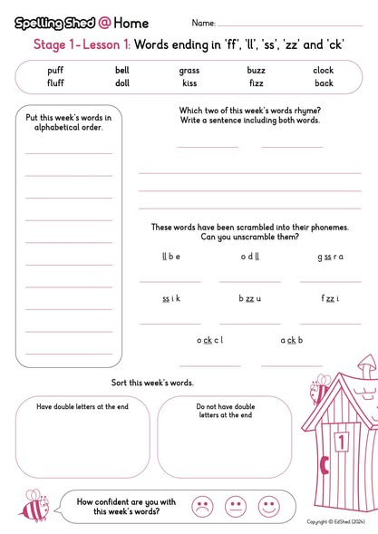

Homework and spellings
Homework – given out/set on a Monday, to be in by the following Monday.
Spellings
New words given and practiced Wednesday – Friday in school.
Homework sheet sent home Wednesday
- this does NOT get handed in.
Practice on app in school and at home.

Slide 7
Multiplication Tables Check
The ‘Multiplication Timetable Check’ is a statutory governmental requirement to be completed by pupils in Year 4 during the summer term. Twenty-five multiplication questions appear on the iPad screen and pupils have 6 seconds to answer and input their answer per question.
Instant recall of facts up to 12 x 12 is required.
We know how important knowledge and recall of multiplication facts are to support pupils in their mathematical development. Timetable knowledge is vital for quick mental maths calculations, fluency and problem solving, as well as for the many topics children learn in Years 5 and 6 (division, fractions, percentages). Having a secure knowledge of multiplication and recall of timetable facts is a great support to pupils as mathematical reasoning and problem-solving expectations increase.
Please note, the result of this assessment indicates how secure the knowledge and rapid recall of multiplication facts are for your child.

Slide 8
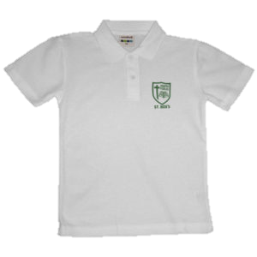
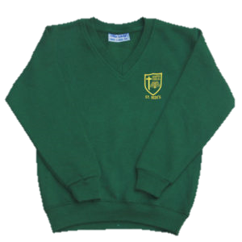
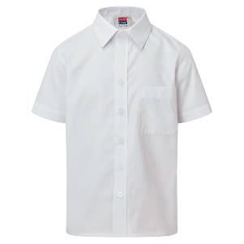
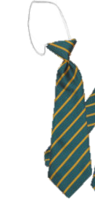
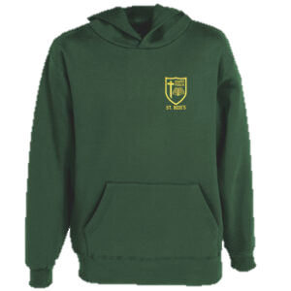
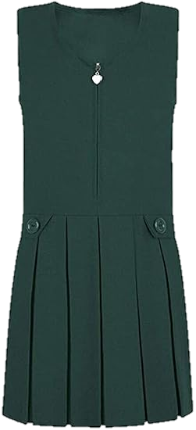
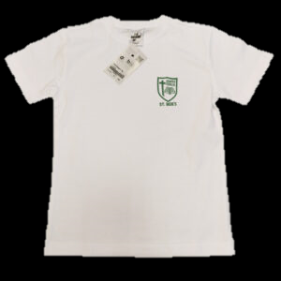
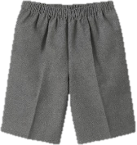
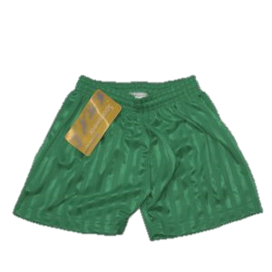
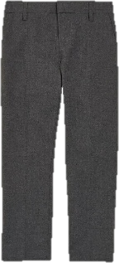
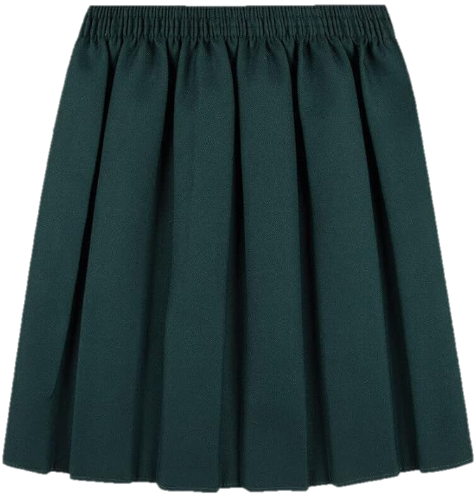
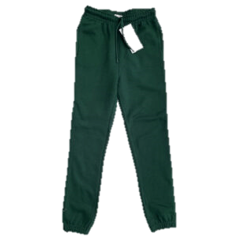
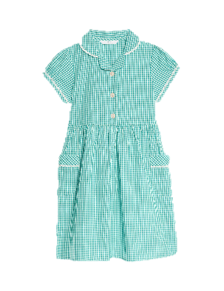
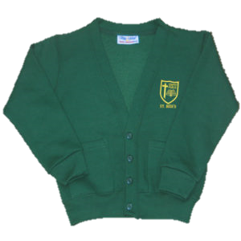
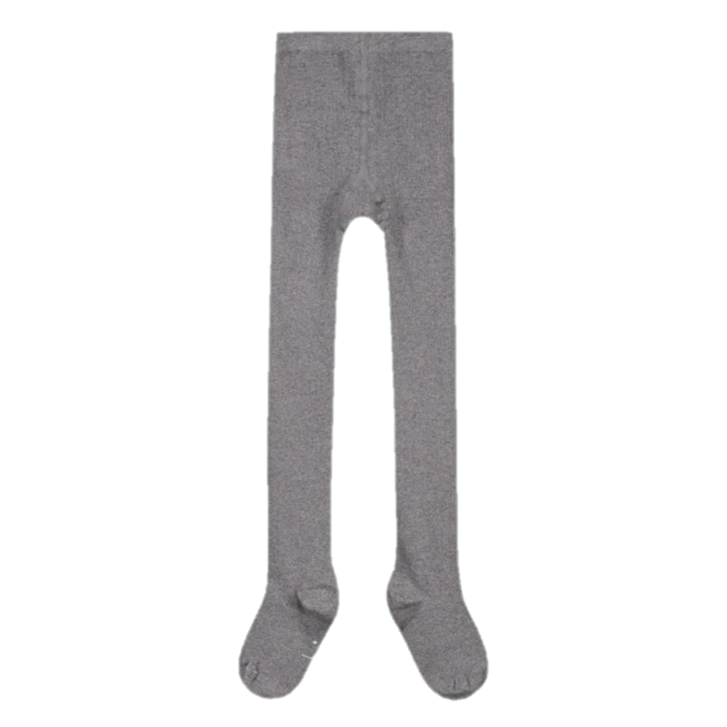
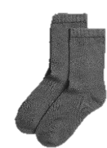
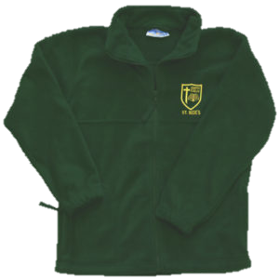
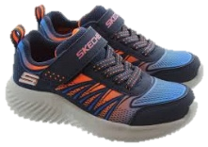
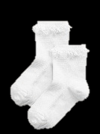
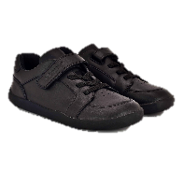
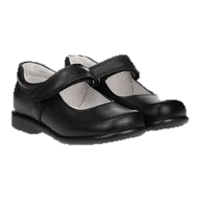
Uniform
Name all items
Summer Uniform
Winter Uniform
PE Kit
oes

Slide 9
Things to look forward to:
Robinwood residential – April 20th-22nd
This is the first 3 days back after the Easter holidays
Romans visit to Chester – Spring term
Lion Salt Works trip – Summer term

Slide 10
Communication
Emails: edimbylow@st-bedes.cheshire.sch.uk
Phone - message via office
If going home with someone else – must tell office or door in the morning – we cannot let them go without this.

Slide 11
Other:
Equipment needed:
School bag/book bag
Water bottle
Healthy snack
Children can bring in a pencil case but they do not need them. They will be kept in trays and got out if needed if they want to use their own colours or highlighters etc.

