Slide 1
Craft and making stuff.
By Lucy Charlotte Heald.

Slide 2
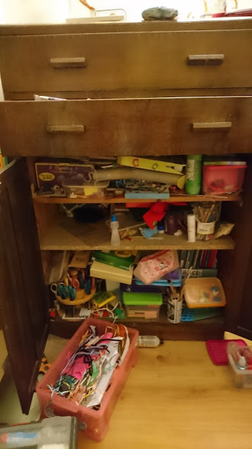
My art spase
The art cubd has a flouwerey pensil case and gloo and fansy sizuz and a big box of art too.

Slide 3
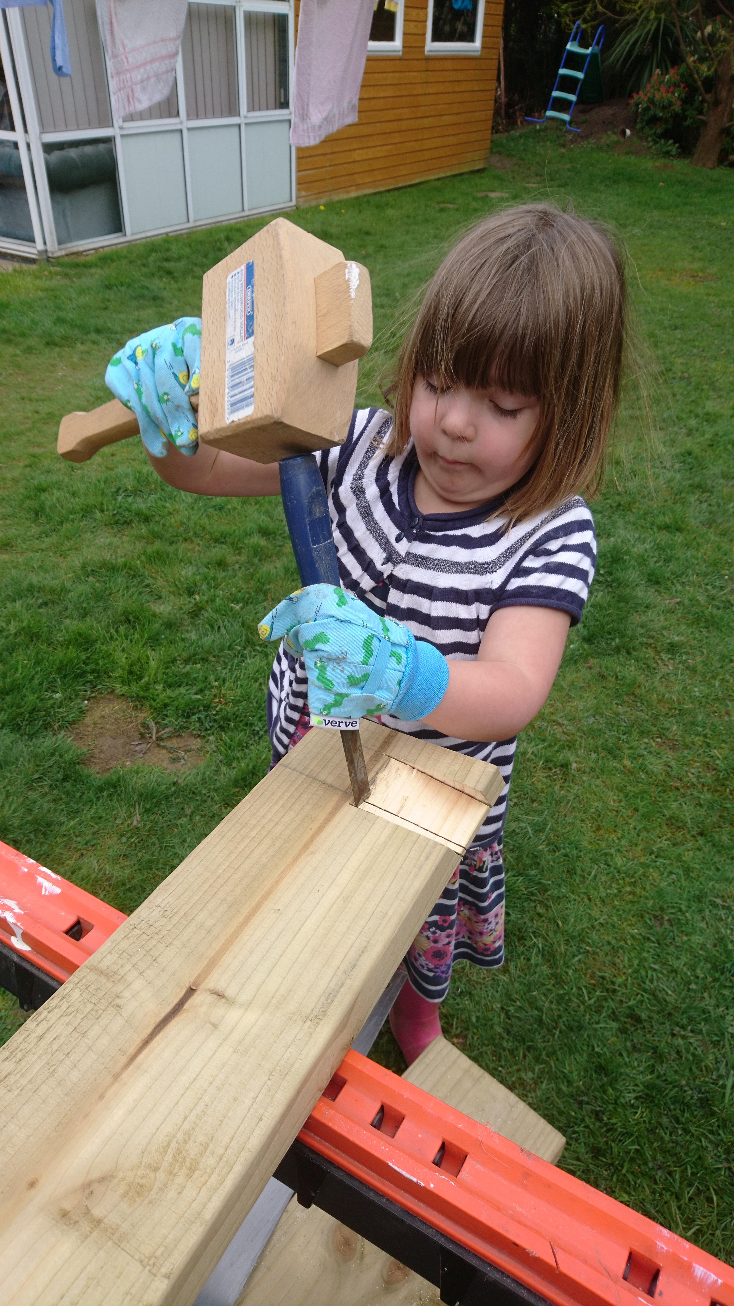
things I like.
This is a big foetoe of me making a vegetabl patch
I like doing picchus, models, gardening and I like bacing too.

Slide 4
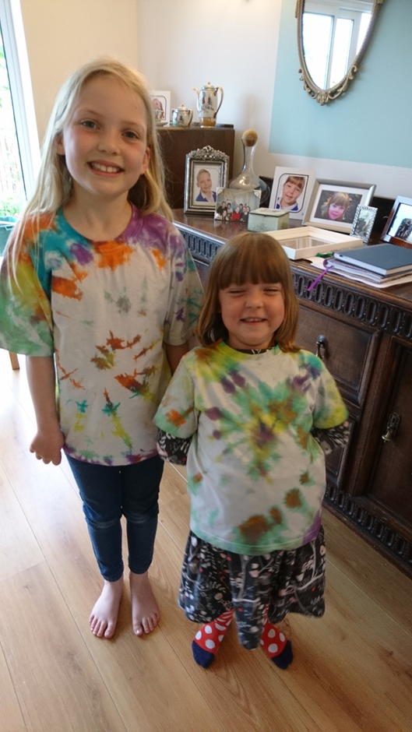
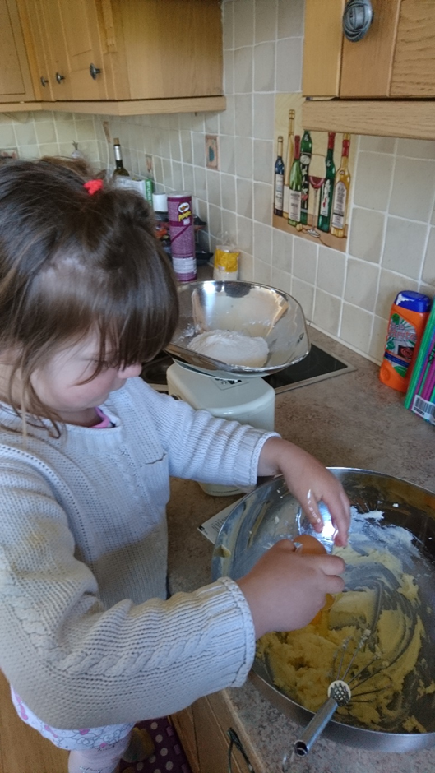
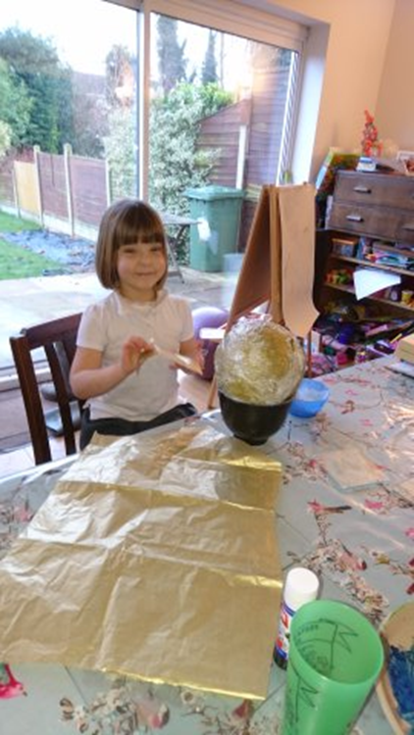
What I like doing
Tie dying
Making cakes
and making
anything

Slide 5
Its fun
I like getting messy.
I like giving people the things too.
You shud try it!

