Slide 1
Tinkerbell films
By Grace Baker

Slide 2
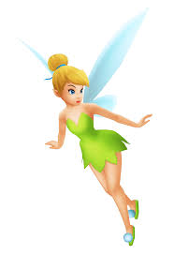
I love Tinkerbell

Slide 3
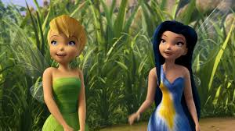
Fairies
I love to read about fairies in fairytales.
I like Tinkerbell’s friends.
Her friend Silvermist is a water fairy. She collects bubbles and puts them on spiderwebs.

Slide 4
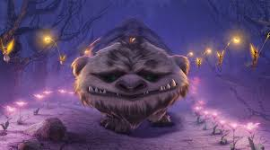
The Neverbeast!
Gruff is the Neverbeast and he saved Tinkerbell.
He was Fawn’s best friend.
At the end of the film he helps to save the fairies and then he goes to sleep for a thousand years.

Slide 5
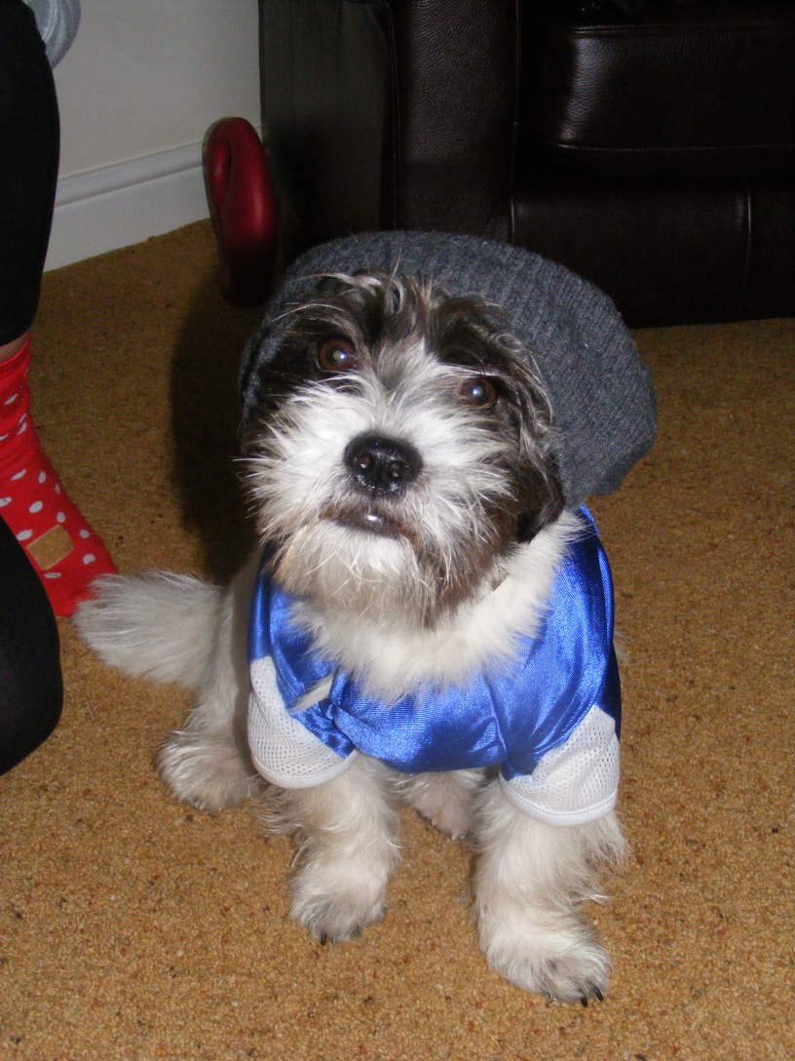
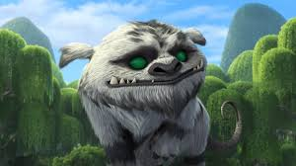
Is Bruno the Neverbeast?

Slide 6
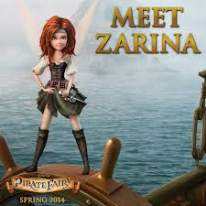
The Pirate Fairy
Zarina runs away and takes the fairy dust so the fairies don’t have enough pixie dust to last them forever.
Tinkerbell and her friends save her.

Slide 7
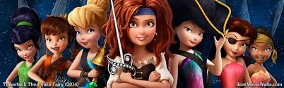
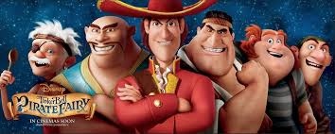
At the end the fairies beat the bad pirates.

Slide 8
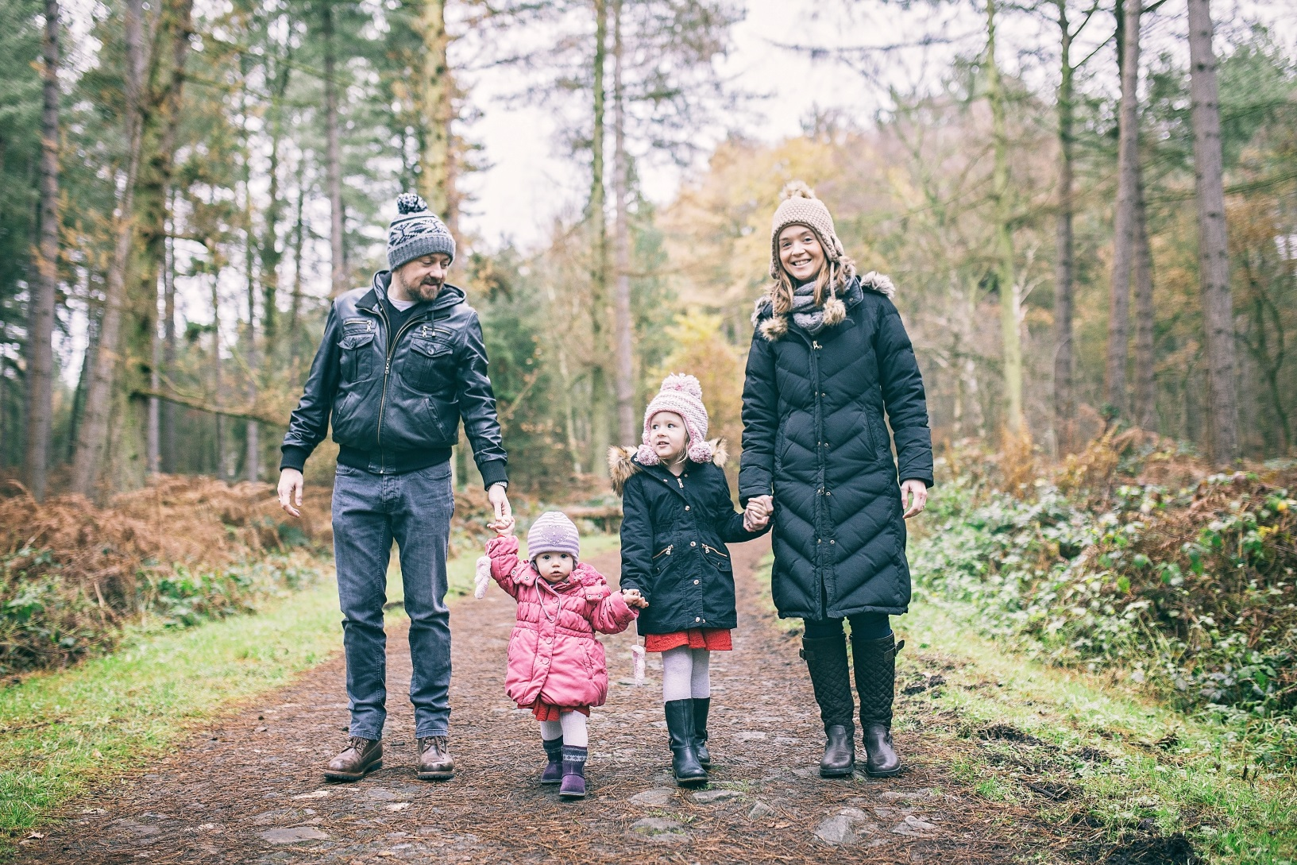
Thank you for listening to me

