Slide 1


Isobel Heald
Arrived at the start of Year 2
Year 6 leaver in July 2019

Slide 2
Year 2 Arrival
Isobel arrived at the start of Year 2. Immediately, her writing shone – handwriting was exceptional – a standard for others to reach and a standard that teachers could match their expectations to. The quality of her writing content was very high and she showed a wonderfully unique style of writing from the start.
Her work was a joy to read, but she had difficulties with accurate spelling and punctuation.
Also, her precision over her handwriting caused her speed of writing to be a significant area for development.
Reading was a real strength of Isobel’s. She had fluency, enjoyment and a clear understanding. She had developed a love of reading, that just thrived throughout KS2. Isobel found her favourite authors and absorbed herself in worlds of fiction.
Isobel was less secure in her maths. Initially, she lacked confidence, and held aspects with insecurity.

Slide 3
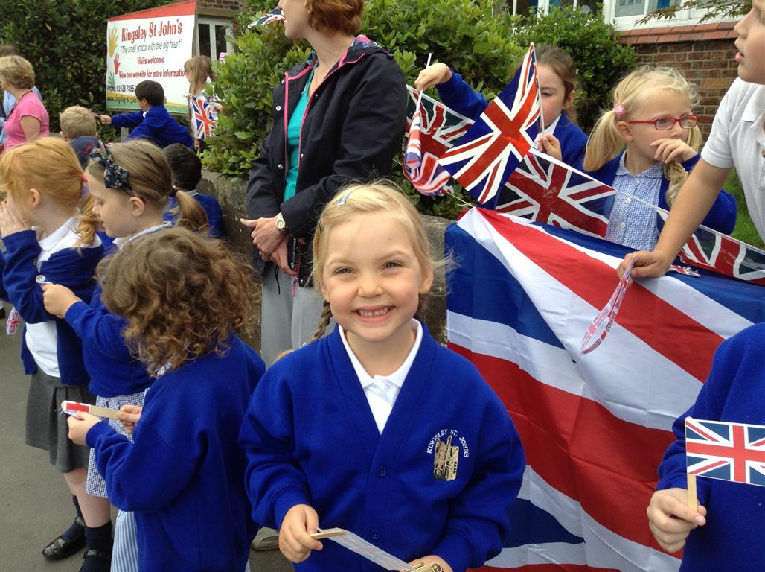

Slide 4
Year 6
By the end of primary school, Isobel was comfortably writing with greater speed, ensuring that she could complete a writing task in the time given.
Isobel kept hold of her unique and high quality writing style. The use of imagery and figurative language ensured a standard above expectations for the end of KS2.
Isobel showed greater control and success in her spelling of common exception words – year 3 and 4 words, most year 5 and 6 were secure in isolation. There continued to be spelling errors in her fluid writing, but these could be identified and corrected through editing.
Isobel finished KSJ with writing above expected.
Maths – working at the expected level
Reading – Above the expected level.

Slide 5
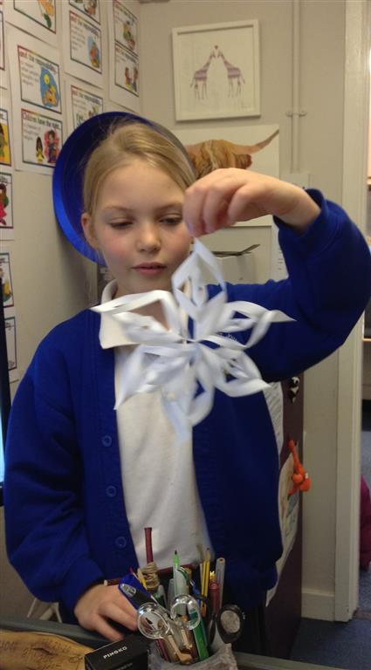
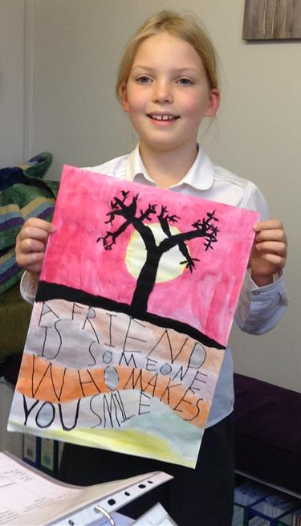
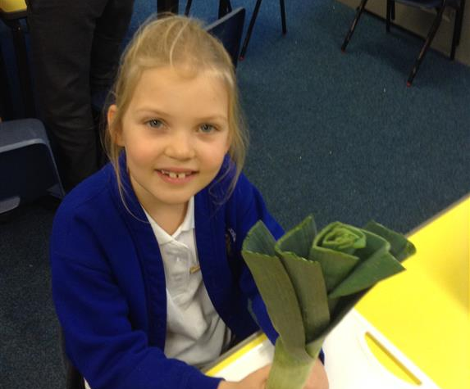
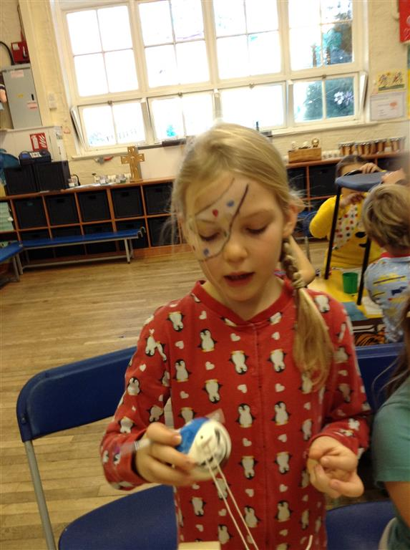
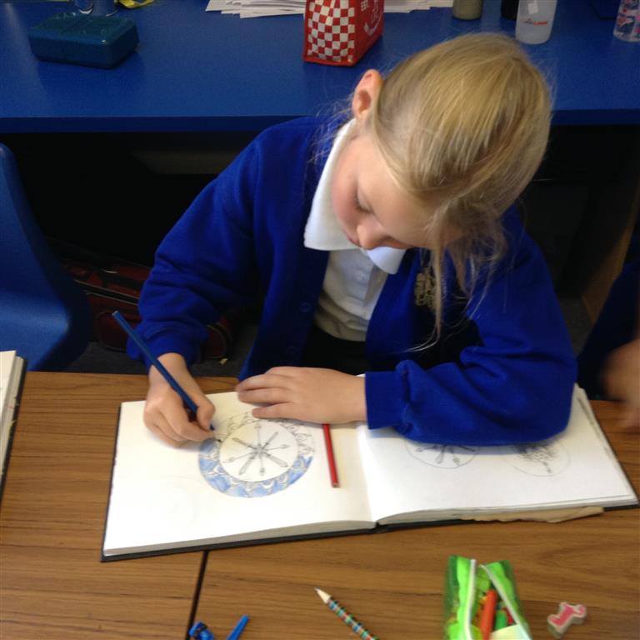

Slide 6
Key moments
In Year 5 Isobel wrote to Rolls Royce with her plan and invention to solve the problem of volcanic ash entering a plane’s engine. Her design was innovative, considered and unique.
So impressed were the managers and designers at RR, she was invited, with 3 friends and a teacher to visit the RR plant, take part in a working lunch conference and tour the facilities.
Isobel attended a number of science and art G+T sessions with NWGT signposted by school.

Slide 7
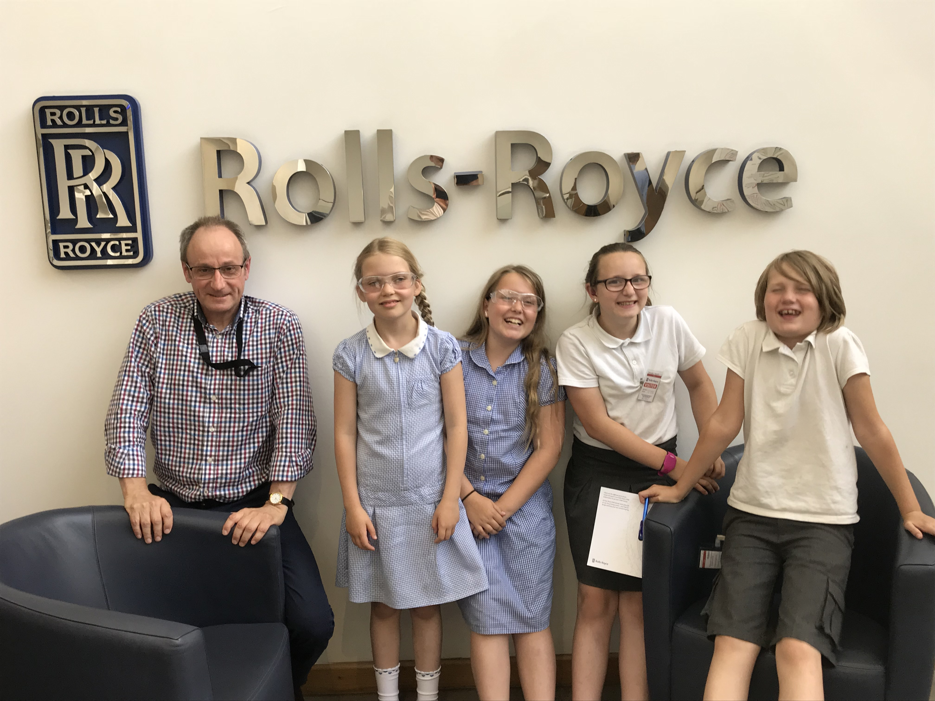
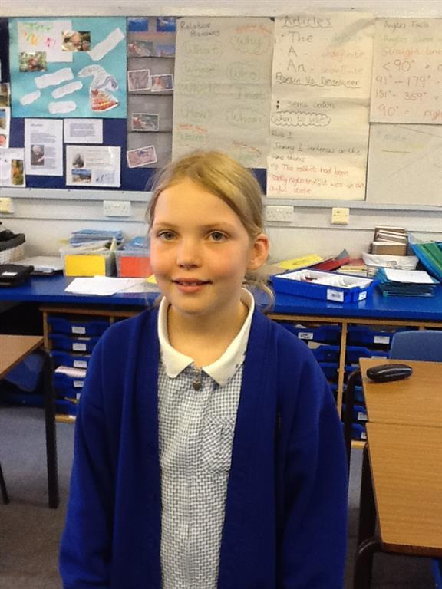
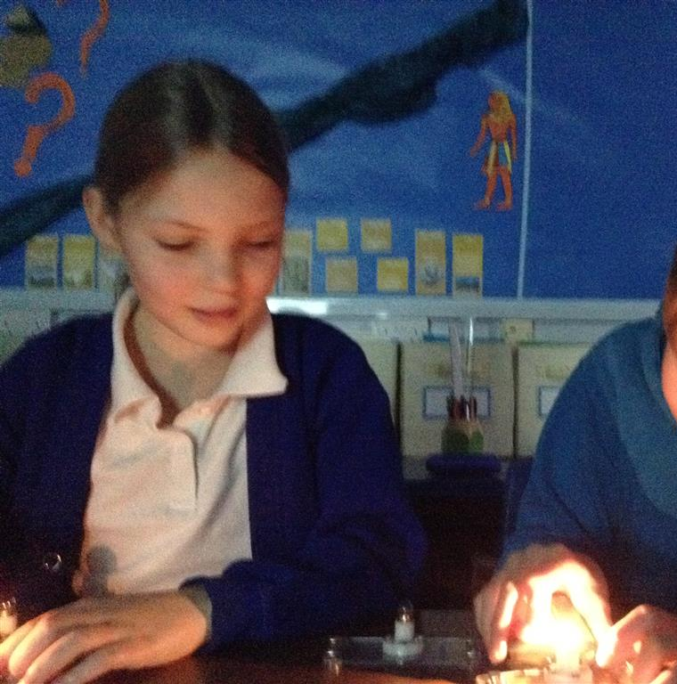

Slide 8
KS3
After a couple of nervous weeks in high school, Isobel has made special friendships. She is achieving highly in all of her subjects and has been awarded Star of the Week 4 times for English, Design & Technology and twice for French.
In a recent Year 8 English lesson, she described an old man’s face as having ‘blue eyes that twinkled out between laughter-crinkled lids like sapphires set in the folds of an ancient cliff face.’ In a gothic horror inspired story, she wrote of a castle, ‘It was a skeletal structure, tall, tapered towers tipped with superstitious spires, reaching with an absence of hope for the free atmosphere.’
She continues to hold strong to her talents in writing, reading, science and art.
It was our privilege to teach Isobel for her key stage 2 and we continue to watch her blossom and succeed as she thrives in secondary school.

Slide 9
