Slide 1
Kingsley St John’s Parent information session
Welcome Back Meeting

Slide 2
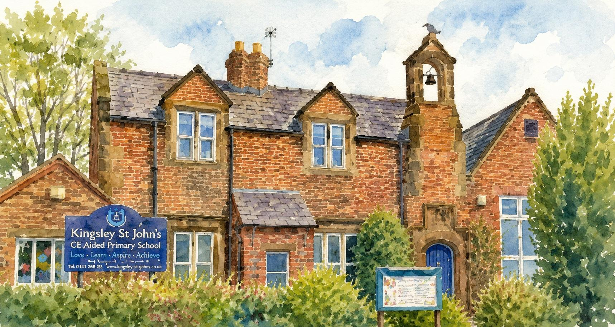
Welcome – Mrs Jones
‘Believe in the light, whilst you have the light so that you may become children of light’ (John 12:36) is our main aim for our children.
Love; Learn; Aspire Achieve
At the heart of everything is a personalised approach to each unique individual as part of our Christian Community. The strong family ethos ensures that all children feel valued and grow in self-confidence. Enthusiastic staff, with high expectations demonstrate care beyond the classroom. Through God’s guidance, we encourage his light in each and every child to discover their gifts and potential.

Slide 3
School Day Timings – Mrs Gibson
school gate opens and 1 member of staff will be outside – no playground equipment
teachers will be outside and available for quick messages – longer messgaes – please email
Bell rung
Register taken – after 9.00 is late after 9.15 is no mark for the whole morning session – unauthorized unless reason given or special circumstances agreed with the HT
Breaktime
lunch
learning time
Children are collected – let us know if you will be running late. Year 6 can leave independently – if permission from a parent obtained
8:30 AM
8:40 AM
8:45 AM
9:00 AM
10:30
12:00
1:00 PM
3:15 PM

Slide 4

Buddies – Mrs Jones
Before and After school care
7.30am – start of the school day £8.00 with breakfast
After school up to 5.30pm with snack
Special events will be advertised – up to 14 pupils – Buddies cost applies - ½ price for FSM
I can… with Buddies – baking, sport, music, dance, craft etc.

Slide 5
Contacting school staff – Mrs Jones
head@Kingsley-st-johns.cheshire.sch | Second stage when concerns have not been addressed, safeguarding, governors, concerns about staff
admin@Kingsley-st-johns.cheshire | school timings, attendance, medicine, forgotten items, running late, trips, Compass, Buddies, uniform, lunches
Byrne@kingsleystjohns.co.uk | Concerns about the school day, school work, behaviour, homework, PE, trips, friendships, reading, curriculum
Heald@kingsleystjohns.co.uk
Raynor@Kingsleystjohns.co.uk | Forest school, dyslexia sessions, DT, Music
Senco@Kingsley-st-johns.cheshire.sch.uk | SEND issues, Wrens class issues, PTA
sherlock@kingsleystjohns.co.uk | Buddies concerns or positive feedback

Slide 6
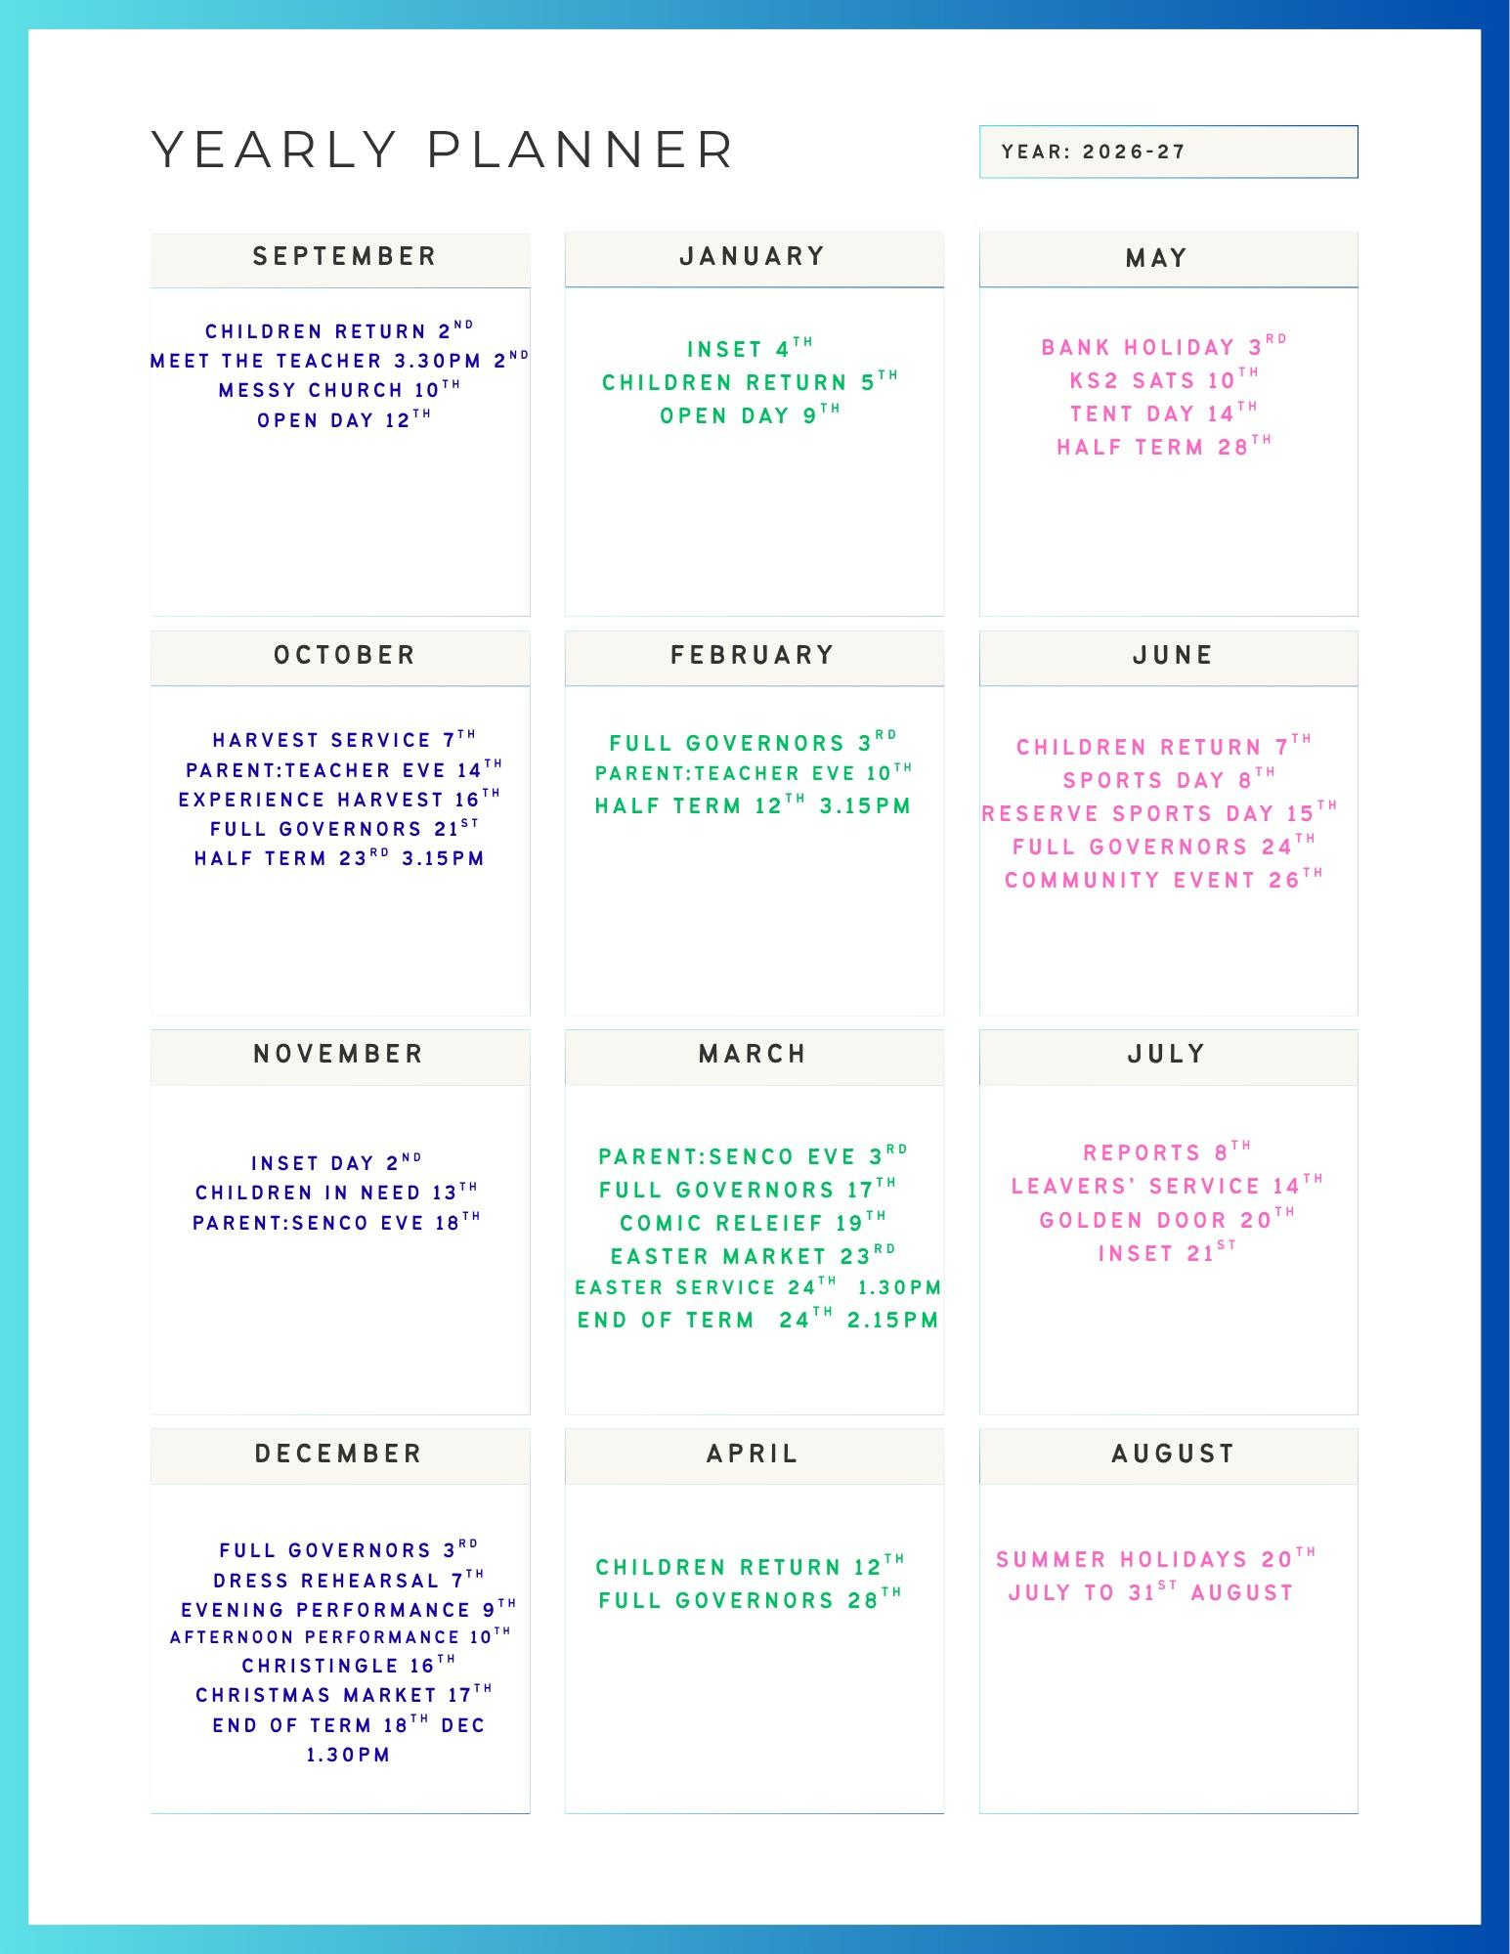
The Year ahead - Mrs Jones
The annual overview has been sent out
Paper copies available here

Slide 7

Uniform and PE – Miss Byrne
Grey trousers, shorts or skirt
White polo top
Blue jumper/cardigan
Black shoes
PE attire can be work on PE days for KS2
Falcons - Tuesday
Barn Owls – Thursday
Forest school clothing for forest school days

Slide 8

Forest School – Mrs Raynor
Long sleeves and long trousers must be worn and a waterproof coat. Sometimes activities involve water despite good weather,
Change of footwear is advisable
High winds and lightning will prevent it taking part, but alternative activities will be provided inside.
Friday afternoon – Wrens forest school each week and we invite children from our community to join us.

Slide 9
Compass – Mrs Bennett/Mrs Jones
Lunches can be ordered on the Compass APP - paid for at the time - prevents a build up
Snack can also be ordered on compass
Buddies can be booked on the Compass APP
Trips will be added throughout the year
Shop – buy your own Kingsley Bear or KSJ water bottle

Slide 10
Social Media – Mrs Gibson
If you don’t already – please follow us on Facebook – encourage your wider family members too as we strive to increase the number of followers and our reputation in the local area.
The school website has had an overhaul over the summer. There is lots of useful information on there including recent letters home and curriculum updates on the class pages.
PTA – please think about dedicating some time to support our FRIENDS PTA. The next meeting is -

Slide 11

Packed lunches – Mrs Heald
Please ensure packed lunches are healthy
No sweets, crisps or fizzy drinks.
We are a nut-free school. No peanut butter nor nut products please – help keep our children safe.

Slide 12

Fundraising – Mrs Gibson
Here is a link to the donation page https://www.fundingwall.org.uk/donation/outdoor-play-area-project-wa68ef

Slide 13

You are now invited to visit your child’s classroom
Class teachers will be available for any questions, queries or concerns.
Thank you for taking the time to stay and listen

