Slide 1
Phonics Workshop
8th November 2017

Slide 2
In school, we follow the Letters and Sounds programme. Letters and Sounds is a phonics resource published by the Department for Education and Skills which consists of six phases.

Slide 3
Terminology
Phoneme
Graphemes
Segmenting and blending
Digraph
Trigraph
Split digraph

Slide 4
Phase 1
There are 7 aspects with 3 strands.
A1 – Environmental
A2 – Instrumental sounds
A3 – Body Percussion
A4 – Rhythm and rhyme
A5 – Alliteration
A6 – Voice sounds
A7 – Oral blending and segmenting.

Slide 5
Phase 2
Set 1: s, a, t, p
Set 2: i, n, m, d
Set 3: g, o, c, k
Set 4: ck, e, u, r
Set 5: h, b, f, ff, l, ll, ss

Slide 6
Phase 3
Set 6: j, v, w, x
Set 7: y, z, zz, qu
Consonant digraphs: ch, sh, th, ng
Vowel digraphs: ai, ee, igh, oa, oo, ar, or, ur, ow, oi, ear, air, ure, er

Slide 7
Phase 4
This phase consolidates all the children have learnt in the previous phases.

Slide 8
Phase 5
Children will be taught new graphemes and alternative pronunciations for these graphemes.
Vowel digraphs: wh, ph, ay, ou, ie, ea, oy, ir, ue, aw, ew, oe, au
Split digraphs: a_e, e_e, i_e, o_e, u_e

Slide 9
Phase 6
The focus is on learning spelling rules for suffixes.
-s -es -ing -ed
-er -est -y -en
-ful -ly -ment -ness

Slide 10
Segmenting
Breaking down words for spelling.
cat
c a t

Slide 11
Segmenting
Queen
qu ee n

Slide 12
Blending
Building words from phonemes to read.
c a t
cat

Slide 13
Blending
Qu ee n
queen

Slide 14
What does a Phonics lesson look like?
Revisit/review | Flashcards to practise phonemes learnt so far.
Teach | Teach new phoneme air
Practice | Buried treasure Air, zair, fair, hair, lair, pair, vair, sair, thair
Apply | Read captions, opportunities for writing The knight had fair hair. The monster was in his lair.

Slide 15
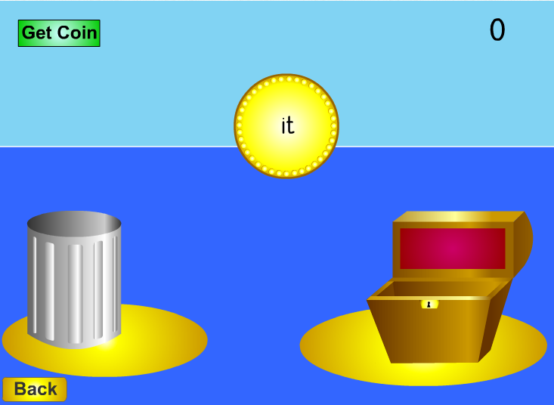
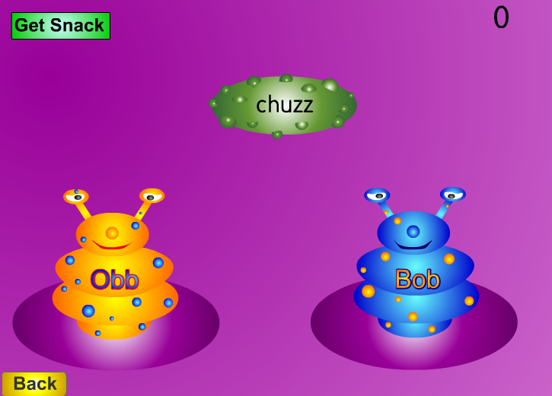
Resources
http://www.phonicsplay.co.uk

Slide 16
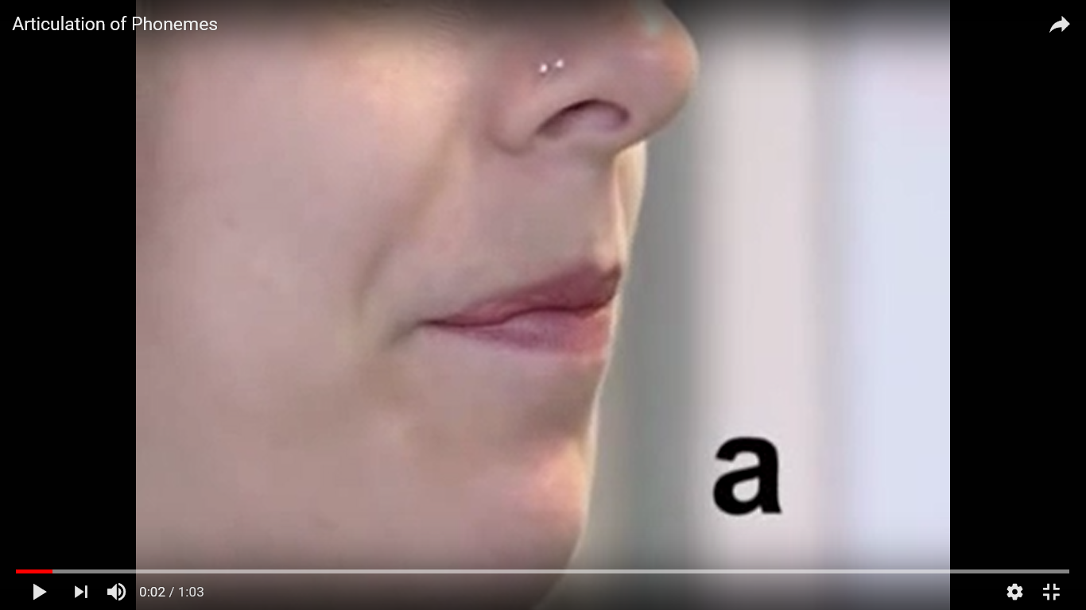
Resources

Slide 17
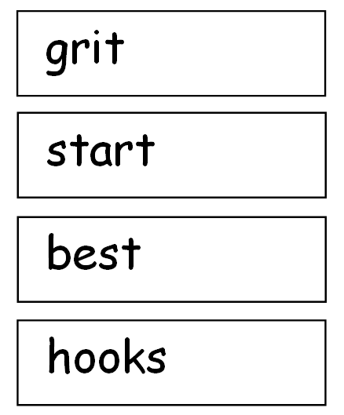
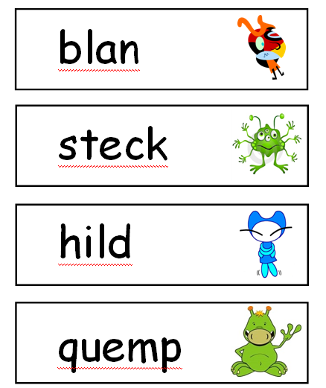
Year 1 Phonics Test

