Slide 1
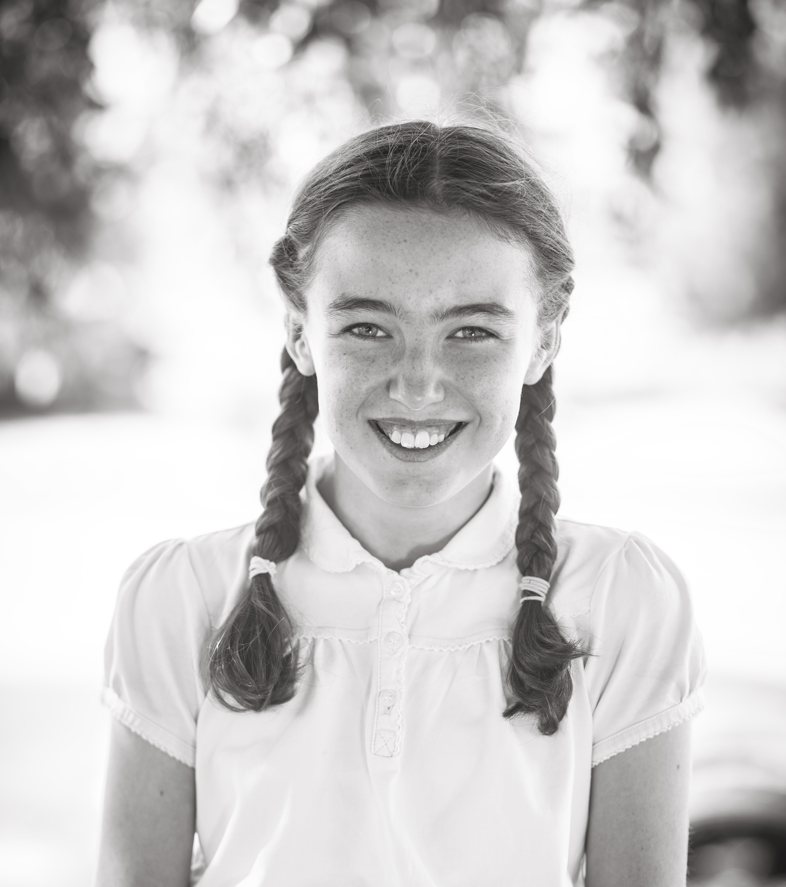

E Tierney
Reception 2013 – Year 6 2020

Slide 2
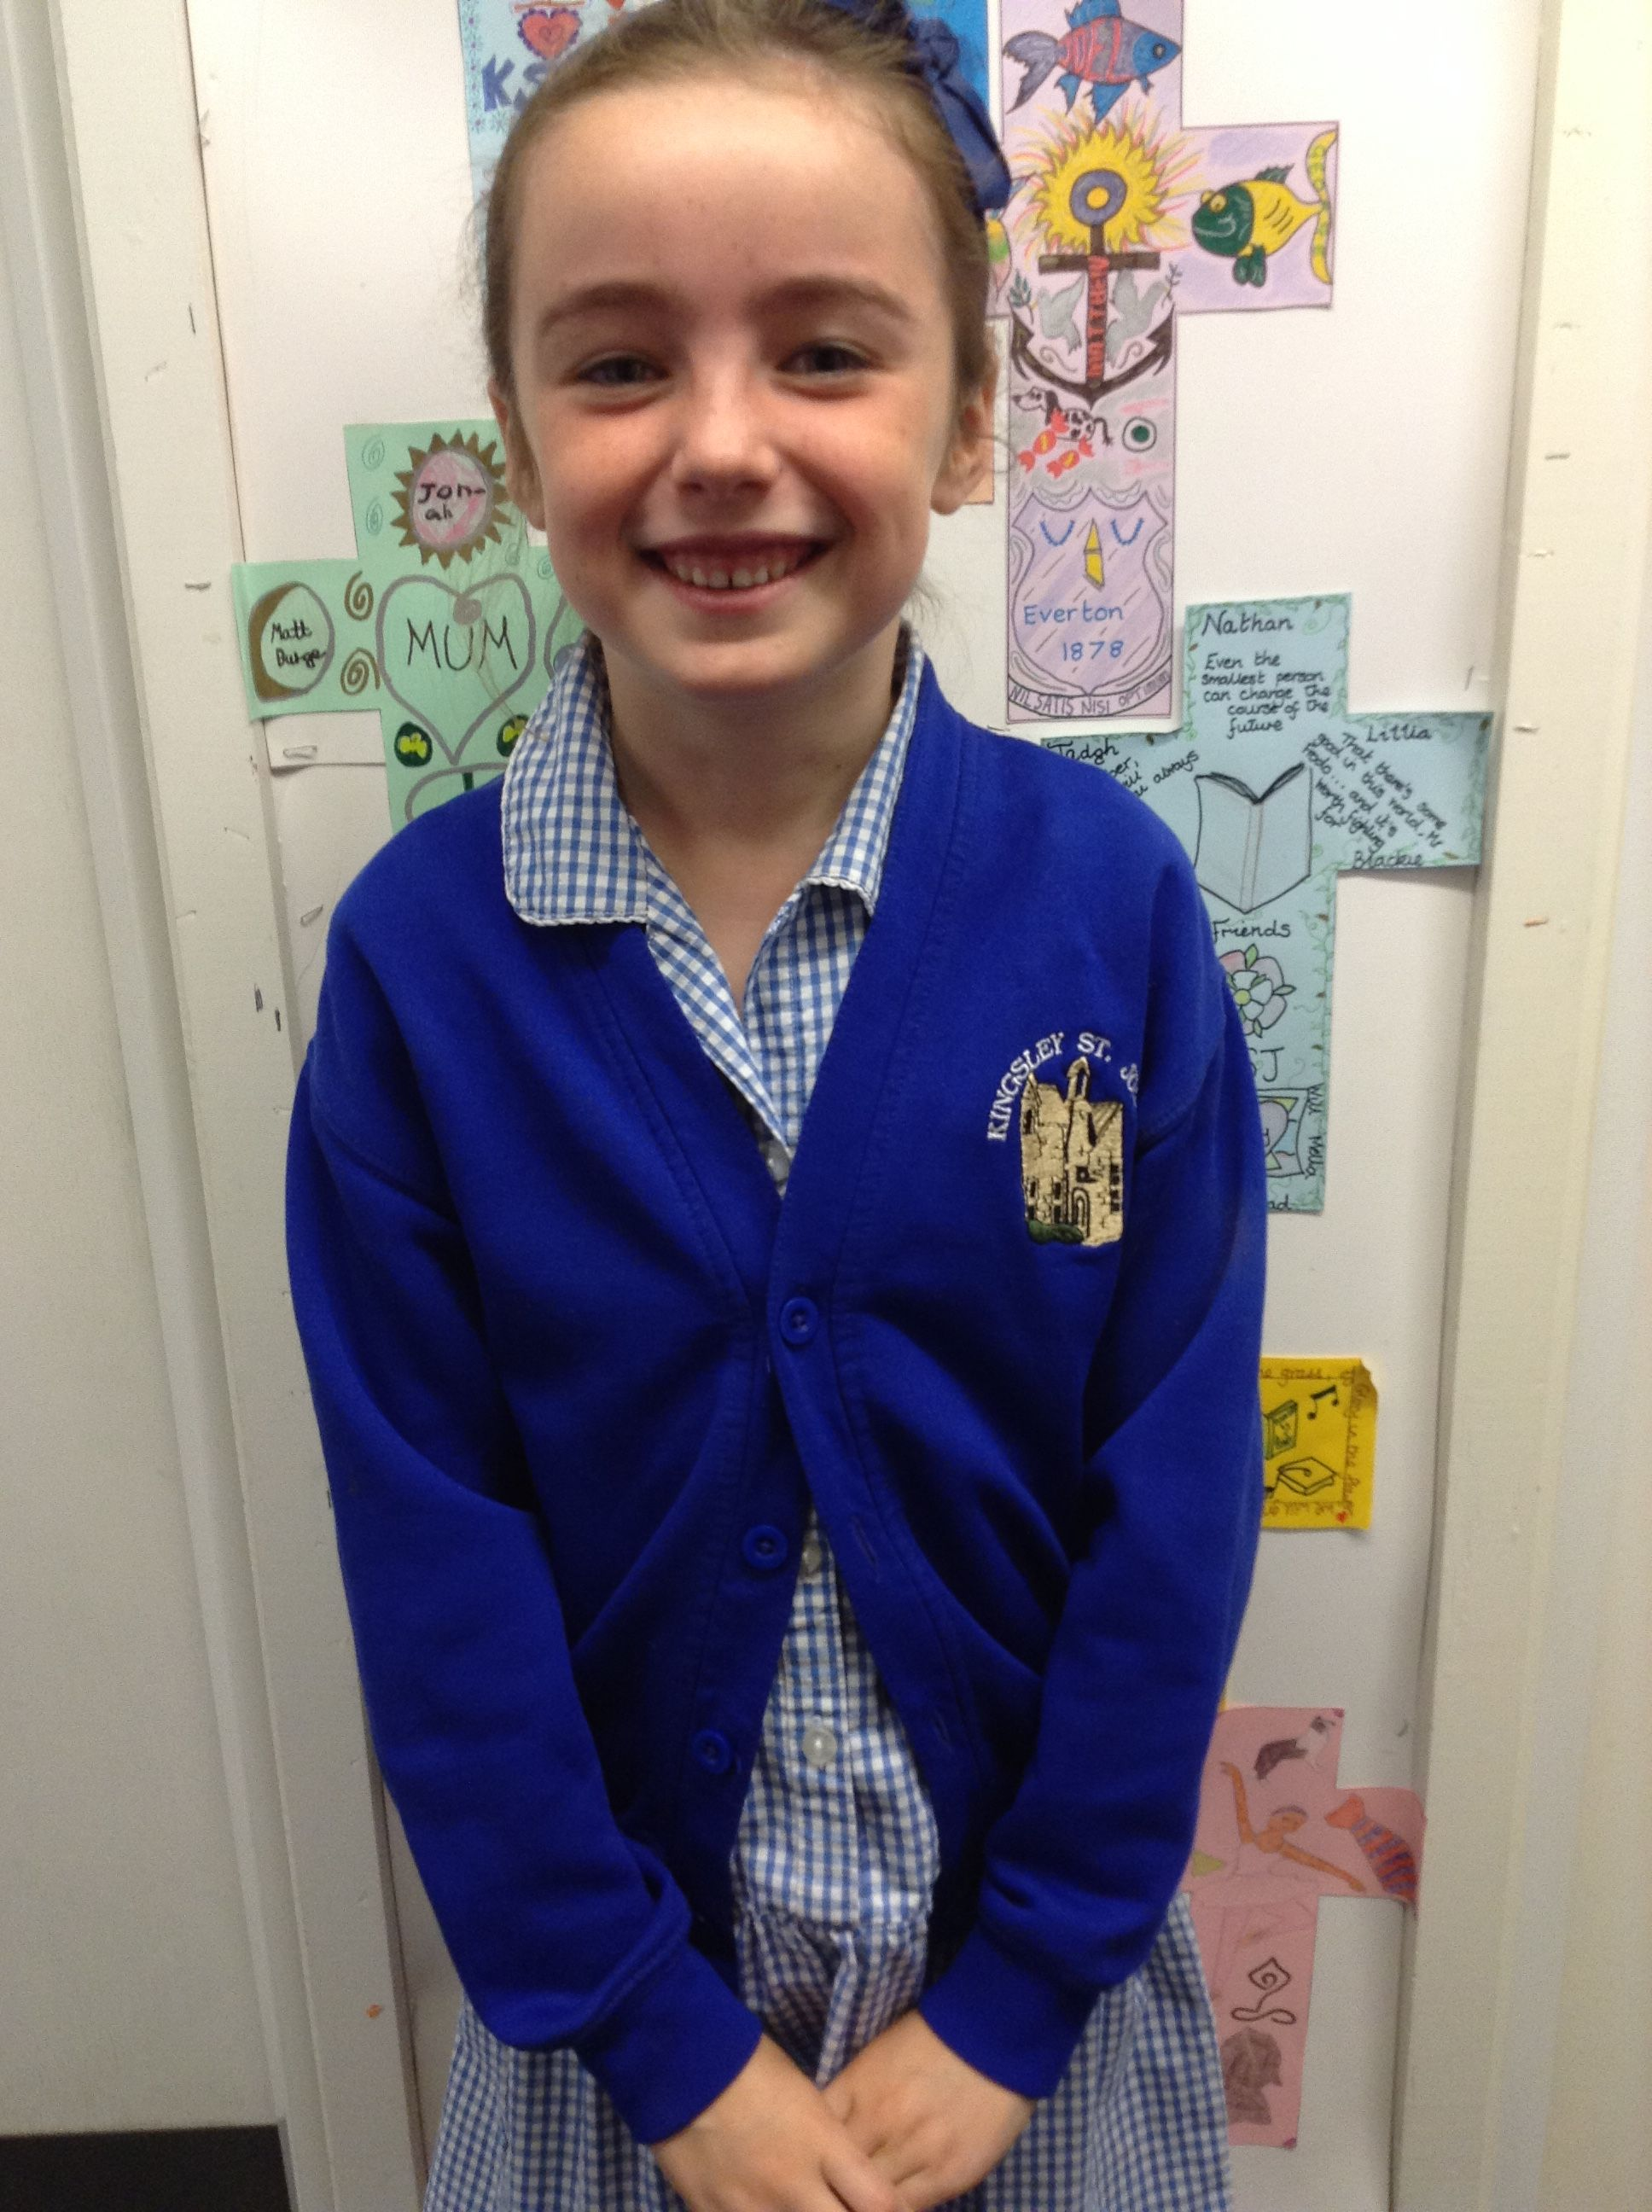
Early Years and KS1
E arrived at Kingsley St John’s from the nursery which was situated on site.
E was in line with age related expectations and ready for the learning in school.
E enjoyed a close friendship with EK too.
E made rapid progress in her reading, quickly reaching exceeding age-related expectations by the start of year 1.
Writing continued in line with expectations and, although maths concepts were developed with less confidence, E continued to make good progress, in line with expectations.

Slide 3
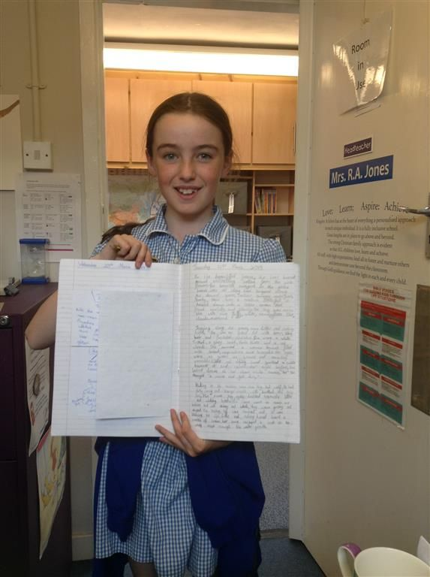
Friendships and interests
E LOVED horses. She was an accomplished horse rider, often bringing in her latest rosettes and trophies as she competed locally and nationally.
E worked alongside a settled year group – her core friendships with O, E, I and B were secured in key stage 1 and lasted throughout her time with us. She was as welcoming and friendly with new arrivals too and took L and W under her wing throughout key stage 2.
E was a marvellous runner too. Mr Davies quickly identified her talent in sports events and targeted her as a top ten finisher in the annual cross country event with local schools.
E gave her all – in whatever she was doing. Passionate, determined and enthusiastic

Slide 4
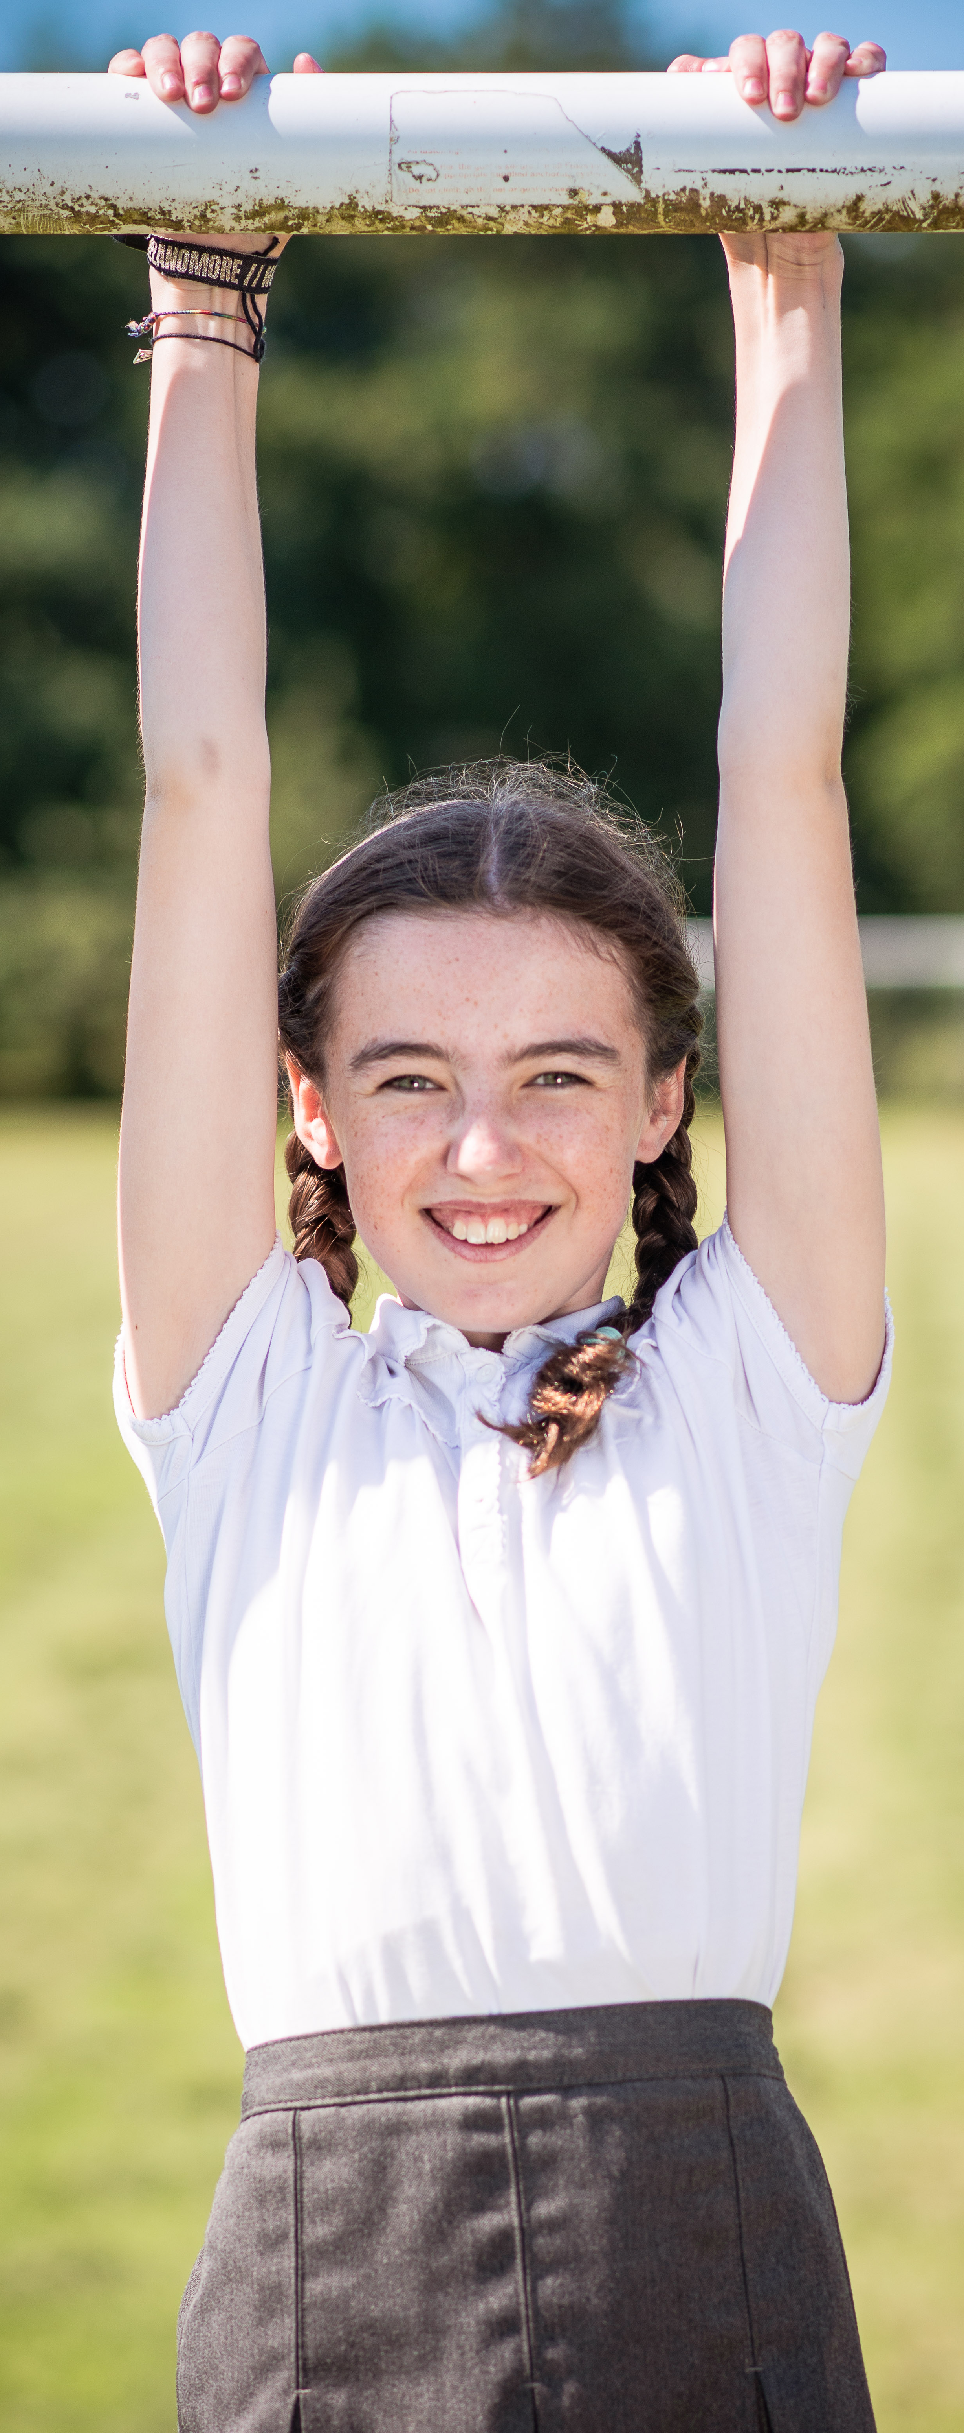
KS2 learning
It was through key stage 2 where E really excelled and the confidence blossomed. E was modesty personified. She had a shyness that could have proved to be a barrier to her progress. Her reading progress and the celebration of her reading progress spurred her to reach the same academic heights in writing. By the end of year 4, E was working above expected levels in reading and writing. Maths continued to be an area where she fought to gain the ascendency. The true battle was with her own self-belief. Eventually, that confidence ran through and ks2 maths was conquered.
It was E’s attitude to learning that propelled her from a young girl who reached the expected levels of development, to one who excelled in all areas.
And throughout it all, she held dear all of the KSJ values but the greatest of these - love, honesty, respect, resilience and kindness.

Slide 5
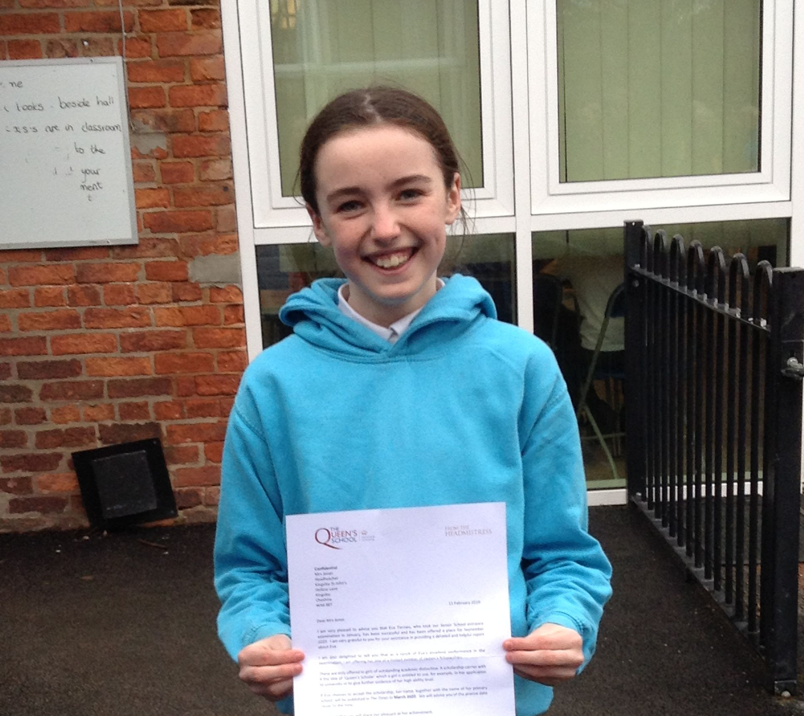
Key successes
E left KSJ to go to her high school. Such was her academic achievement, she won a prestigious Scholarship to accompany her on the next stage of her educational journey.
E completed the annual crosscountry race in the top 5 for 3 years on the run.
E was a fantastic house captain for our school in her Year 6. She was also a wonderful peer mentor.
E took part in some of the NWGT subject days – leading to further academic success.
By the end of Year 6, E had a reading age above 15 years .
It was an absolute pleasure to watch E love; learn; aspire and achieve.

Slide 6
Year 7 Parents’ Evening
Just a little note to let you know about E’s first parents evening last night with her new teachers.
K and I were completely blown away with the comments from ALL of her teachers.
They consistently praised her for her organisation , positive attitude and hard work in all subjects , and told us that she will achieve great things if she continues in this way (we have both always told her this too!!).
They also made a special point of saying how caring and compassionate she is towards the other girls and this is something they just don’t see on a regular basis from year 7 girls (I think this says a lot about what you have taught her at KSJ and the strong ethos you have towards always looking after each other and being 100% inclusive to everybody no matter what!).
Just thought this little message would make you smile and let you know that we really appreciate the great start you have helped give to E’s life adventure.

Slide 7
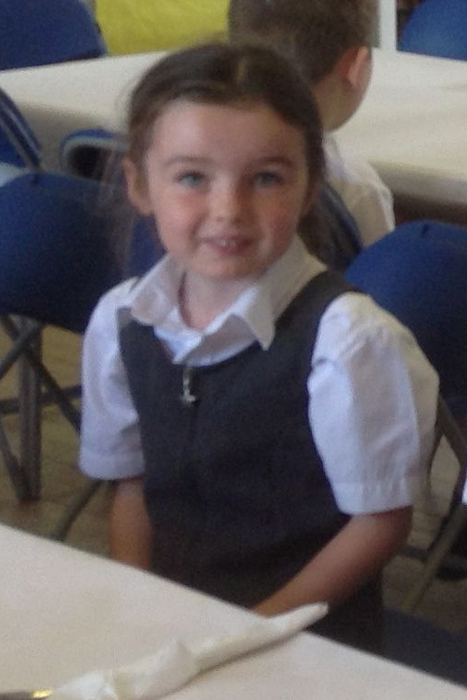
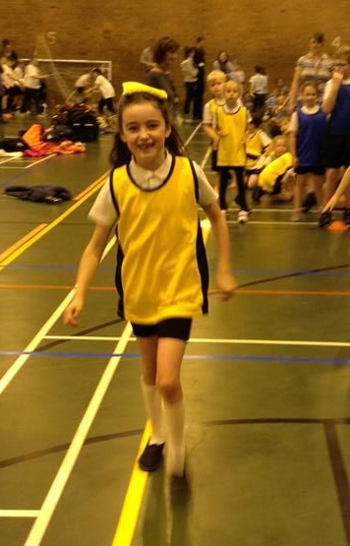

Slide 8
LOVE; LEARN; ASPIRE; ACHIEVE
Another
KSJ
Superstar

