Slide 1
Meet the teacher
Wrens R/Y1
2025-2026

Slide 2
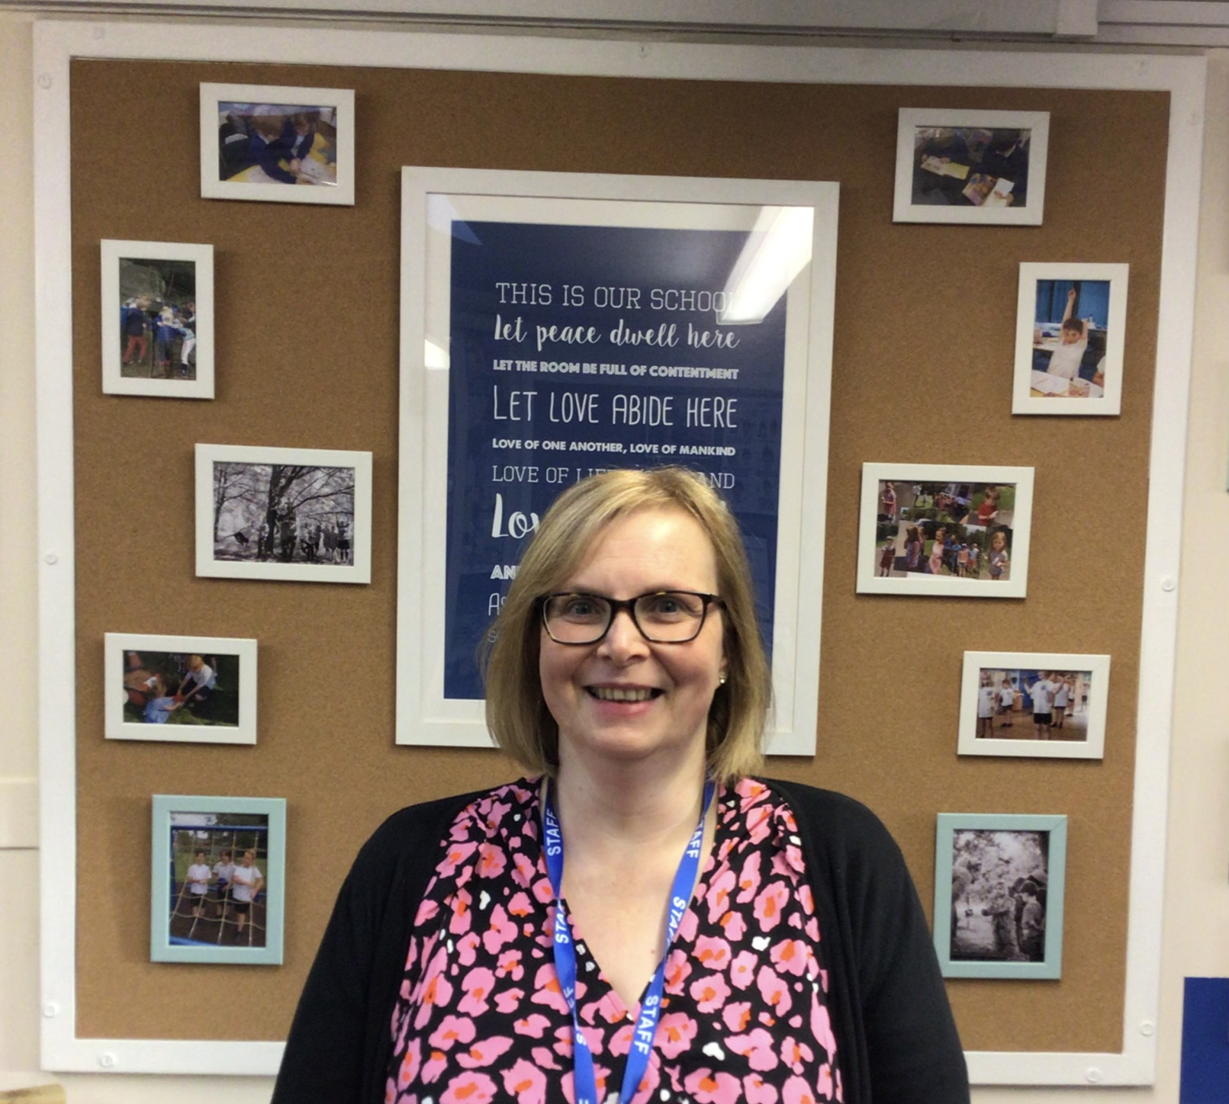
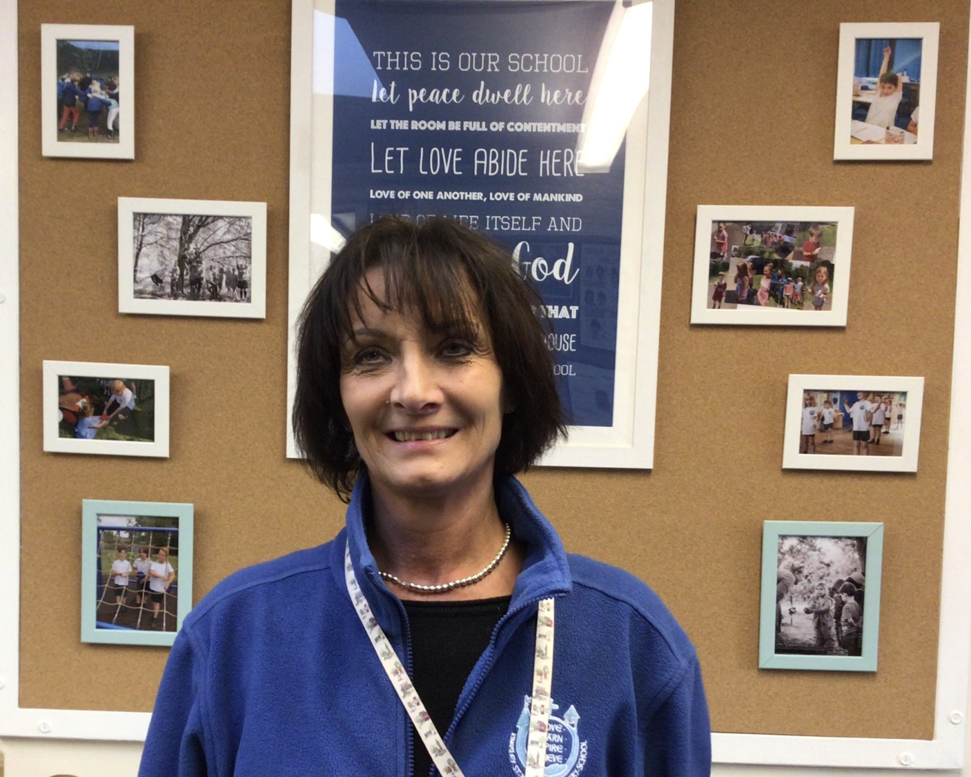
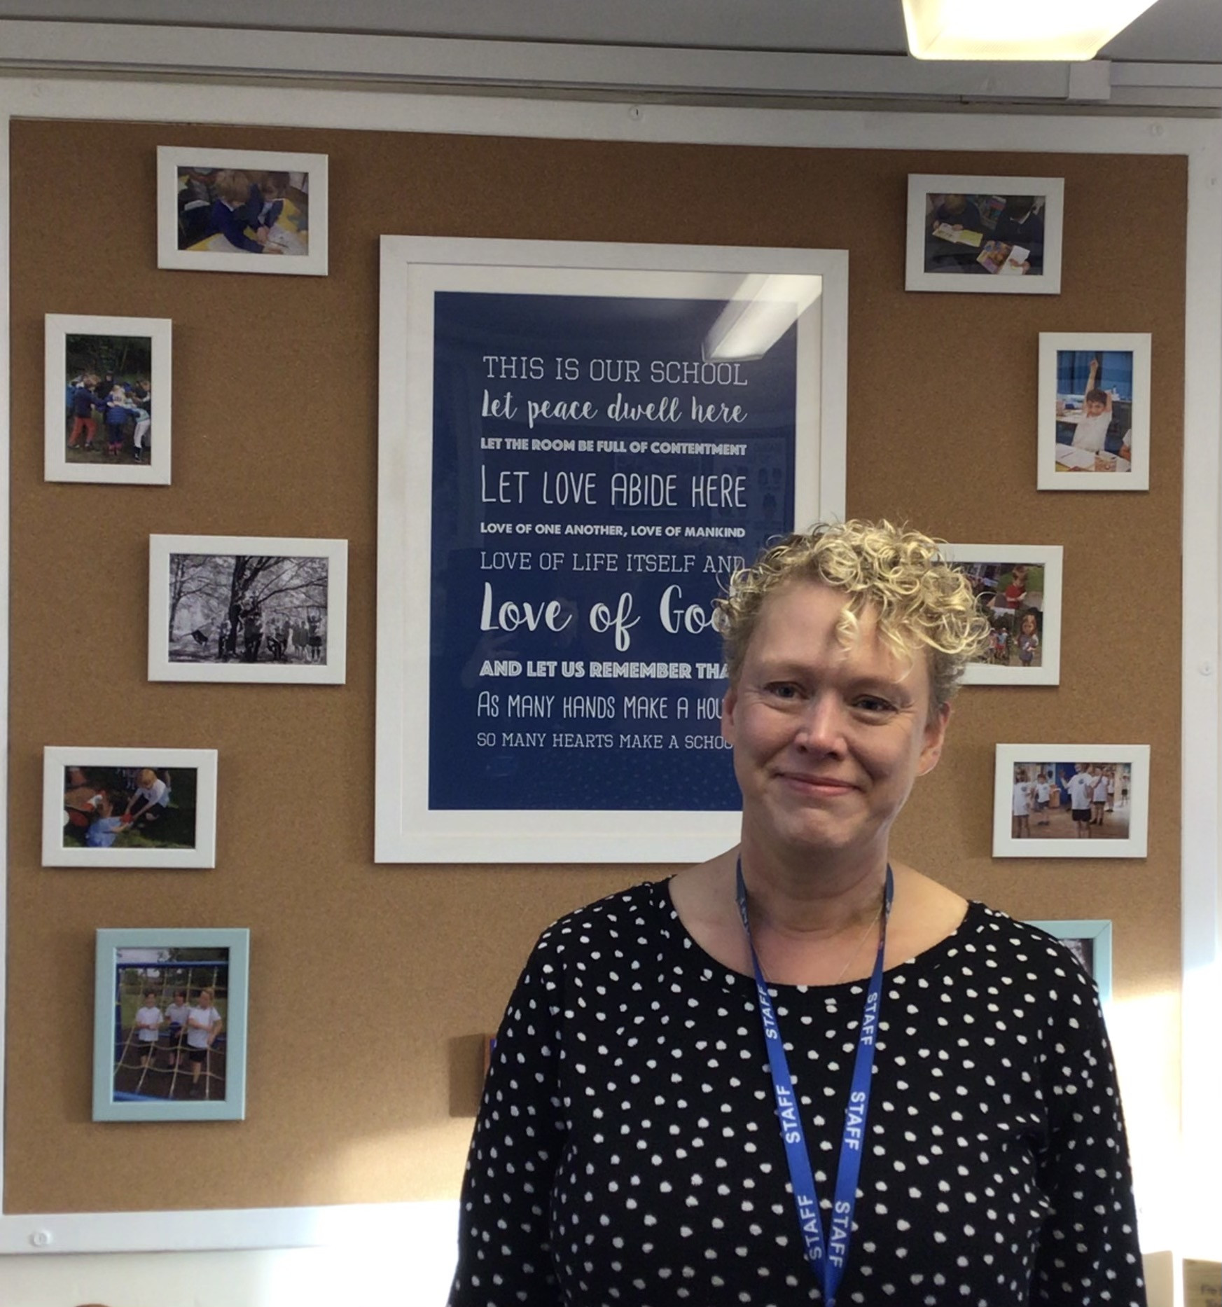
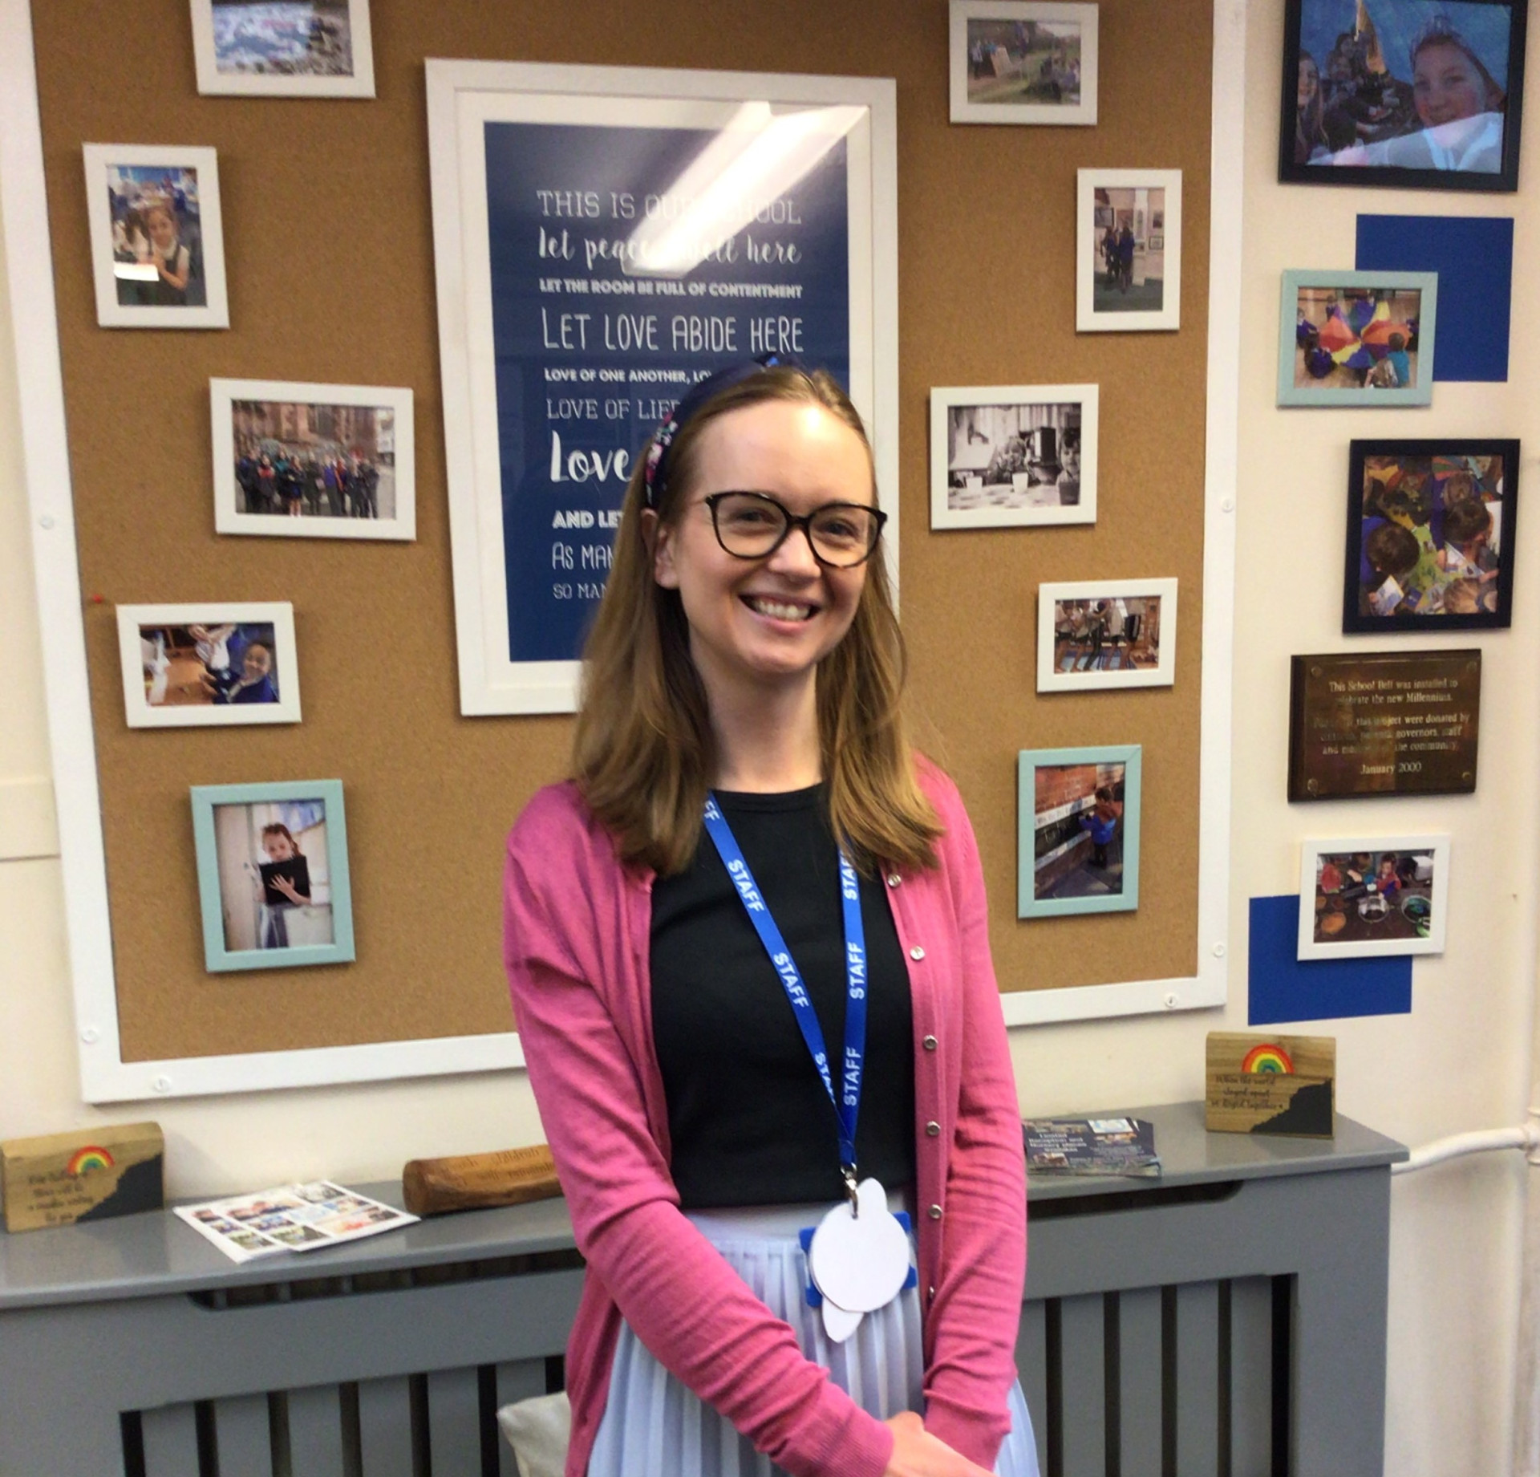
Meet the team
Mrs Gibson Mrs Hudson Mrs Worthington Mrs Baker

Slide 3
Daily routine
8:35 Gate opens
8:40 Staff on playground
8:45 Bell rings and children line-up
9:00 Morning session
10:30 Break time for KS1
12:15 Lunchtime- Wrens
1:00 Afternoon session
2:00 Break
3:15 End of school day
Wrens will leave by the hall door with staff

Slide 4
What to expect in Reception
In Reception, your child will follow the Early Years Foundation Stage (EYFS) curriculum. This sets the standards for the learning, development, and care of your child.
The things your child will learn in Reception have been organised into three prime areas of learning:
Communication and Language
Physical Development
Personal and Social Development
And four specific areas of learning:
Literacy
Mathematics
Understanding the World
Expressive Arts and Design
What will my child do in Reception?
In the EYFS, play is a very important part of your child’s development and most learning will be introduced through a mixture of carefully planned play and some adult-led focused activities. Don’t be too concerned if your child says that they have been playing all day!

Slide 5
Phonics
As Wrens, we are starting to learn the different phonemes and graphemes we use to read and spell words. We will have discrete phonics sessions at least once a day for all children. We follow Twinkl Phonics which include interactive whiteboard work, tasks, letter formation, games and reading books. We use actions to aid recall of these phonemes so a prompt sheet for each letter will be sent home weekly so they can be reinforced as part of our homework
Our Y1 Wrens will sit the phonics screening check in June 2025

Slide 6
Reading
To be ready to start reading, children need to have a variety of skills in place. These early reading skills include matching, rhyming, awareness of phonics and the skills associated with language development such as listening, attention, alliteration and sound discrimination
We provide daily opportunities to look at books and listen to stories with EYFS accessing story and rhyme time before lunch. Picture books and story sacks will be sent home within the first few weeks until the children are able to begin to segment and blend and access books linked to their phonics level.
Daily reading at home continues to be essential at KS1 and we would ask that you read regularly at home with your child to develop a love of reading. Set aside a specific time for reading every day and make reading a priority. Try not to do the reading when you are both tired! Walk through the book first and discuss the pictures and the important words. Always remember to keep reading aloud to your child even when they can read independently

Slide 7
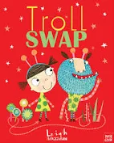



English
We follow the Literacy Company planning which uses a focus text to lead our learning.
Reception are looking at ‘The Three Little Pigs’ by Mara Alpern and 'Peace at Last' by Jill Tomlinson
KS1 we will use The Troll Swop to write an adventure story.For Autumn 2 we will write a report based on The Owl Who was Afraid of the Dark by Jill Tomlinson

Slide 8
Maths
The first few years of a child’s life are especially important for mathematics development, as practitioners we need to ensure that all children develop firm mathematical foundations in a way that is engaging, and appropriate for their age.
There are six key areas of early mathematics learning, which collectively provide a platform for everything children will encounter as they progress through their maths learning at primary school, and beyond:
cardinality and counting, comparison ,composition, pattern, shape and space and measures.
At Kingsley St John's we use NCTEM and White Rose materials to support our maths work in EYFS
Our KS1 Wrens also access White Rose maths and follow a
concrete, pictorial and abstract approach.

Slide 9
How can you help?
Get them used to instructions
From helping to lay the table to family games night, getting them used to simple instructions will help to make your child feel comfortable following their teacher’s requests.
Social skills and self-confidence
Practice sharing, taking turns and spending time away from the family home. Playing family games and visiting different places, the park, the library.
Bedtime stories
A story before bed is a wonderful way to boost their literacy and reading skills and provides a calming routine to continue as school gets started and life gets busier.
Read, read,read
Literacy and maths skills
Use games to make learning part of everyday life. From counting apples during the weekly shop to word games in the car – practising simple literacy and maths skills ahead of school can help them feel more confident in the classroom.
Looking at clocks and counting in 2s 5s 10s for KS1
Independence skills
Getting dressed/undressed , shoelaces ,putting on coats, being responsible for carrying school bag, etc,

Slide 10
General information
Please ensure PE kits are in school each day. They can be kept in school and will be sent home at the end of each half term.
Please ensure earrings and removed or covered for PE.
A change of clothes, in case of accidents or messy play, can be left in school.
Please bring drinks bottles daily for water. These must be labelled and not single use bottles.
Please clearly label all you child's belongings
Please ensure any hair longer that shoulder length is tied back.
A waterproof coat is essential as a large proportion of your child's day may be outside
Forest School - arms and legs need to be covered, waterproof coat and wellies/walking boots/old trainers- every Friday

Slide 11
Contact us on:
Mrs Gibson- senco@kingsley-st-johns.cheshire.sch.uk
https://www.kingsley-st-johns.cheshire.sch.uk/classes
@ksjceaided
https://www.facebook.com/Kingsleystjohns.

