Slide 1
A fun and engaging Christmas and winter-themed science quiz! Complete with 10-minute science activities for each day of advent, plus ideas and resources for diving deeper.

Slide 2


Before you start…
Make sure you are viewing this PowerPoint in
‘Slide Show’ mode.
Click on this icon in the bottom-right of your screen.
This will allow you to see the full resource and to use
any interactivity.

Slide 3


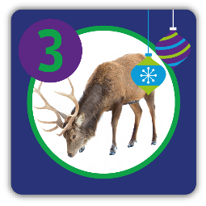
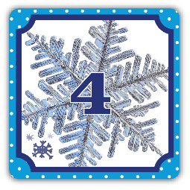
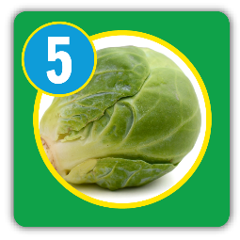
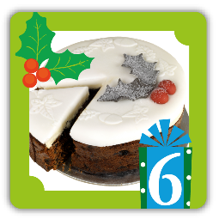

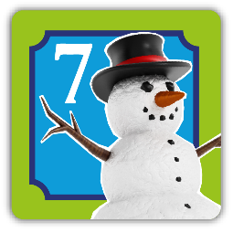
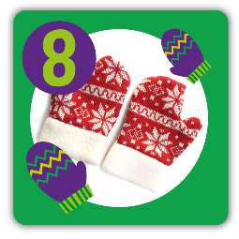


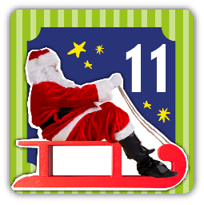






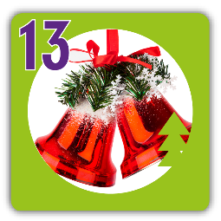
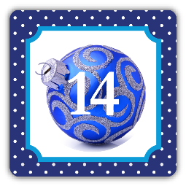
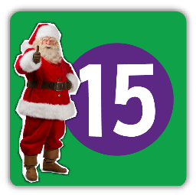
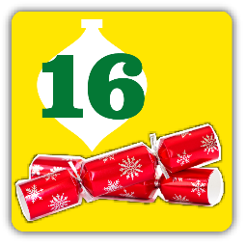
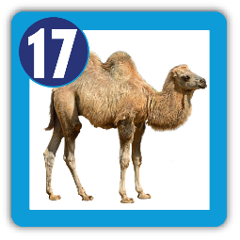

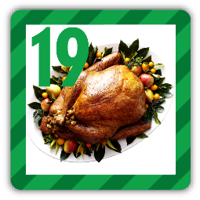


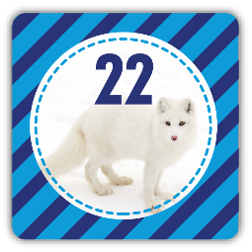
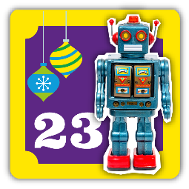
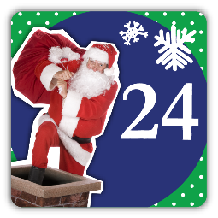
Click on today’s picture

Slide 4





1st December
24
Days to go
Is a Christmas tree
an evergreen or a deciduous tree?

Slide 5


1st December
24
Days to go
Is a Christmas tree
an evergreen or a deciduous tree?
Deciduous trees don’t have leaves all year round. They lose their leaves in Autumn.
Evergreen trees have leaves all year round.

Slide 6




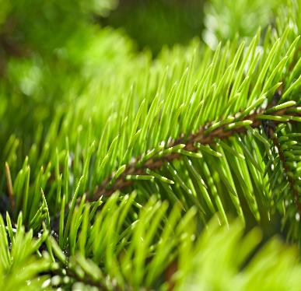
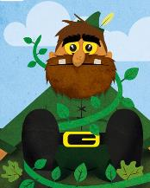
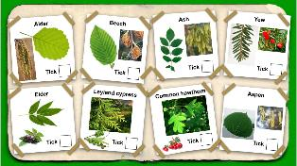

10-minute science
Do a survey to find out what type of Christmas tree people normally have in their homes? Do they have cut trees, trees in pots or trees made from plastic? What are the advantages and disadvantages of each?
1st December
24
Days to go
Christmas trees are evergreens.
Spruce, pine and fir trees are used as Christmas trees. Their leaves have waxy, waterproof coats so they can cope with the cold and not lose too much water.
Dive deeper
Use this Jack and the Beanstalk presentation to find out more about identifying common trees.

Slide 7

2nd December
23
Days to go
In the Christmas story, the Kings followed a star to find Jesus in the stable. What is a star?

Slide 8
2nd December
23
Days to go
In the Christmas story, the Kings followed a star, to find Jesus in the stable. What is a star?
A star is something that gives out light. Our Sun is a star.

Slide 9
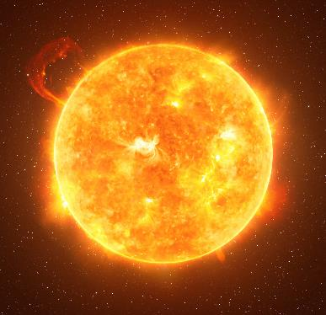
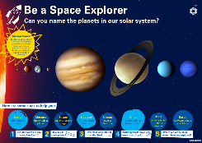
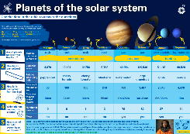
10-minute science
Earth is one of the eight planets that orbit the Sun in our solar system. Can you name the others? What do you know about each of the planets?
2nd December
23
Days to go
A star is a huge, hot, ball of glowing gases that produces heat and light. Our closest star is the Sun. Even though it is millions of miles from Earth, we can still feel its heat.
Dive deeper
Use this Planets of the Solar System poster to help you name the planets and to find out how huge the Sun is.

Slide 10

3rd December
22
Days to go
Is a reindeer a carnivore, herbivore or omnivore?

Slide 11
3rd December
22
Days to go
Is a reindeer a carnivore, herbivore or omnivore?
A herbivore eats plants, a carnivore eats other animals and an omnivore eats plants and other animals.

Slide 12
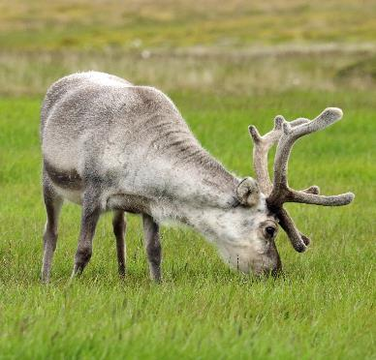
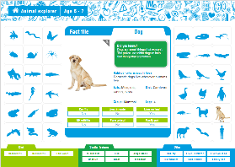
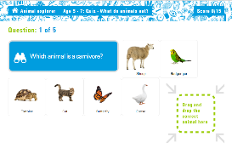
10-minute science
Make a list of five animals that are carnivores, five that are herbivores, and five that are omnivores.
3rd December
22
Days to go
A reindeer is a herbivore. It eats grass, moss, herbs and ferns as well as the shoots and leaves of shrubs and trees.
Dive deeper
Use this Animal explorer interactive to find out about more than 100 animals.

Slide 13
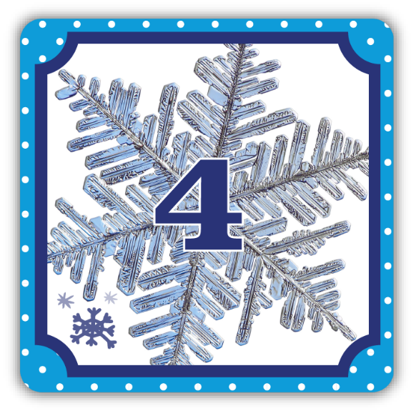
4th December
21
Days to go
Why does a snowflake fall much more slowly than a raindrop?

Slide 14
4th December
21
Days to go
Why does a snowflake fall much more slowly than a raindrop?
Think about the shape of the raindrop compared to the snowflake.

Slide 15
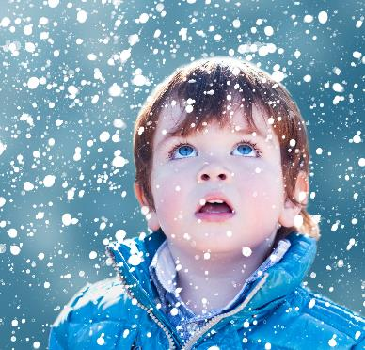
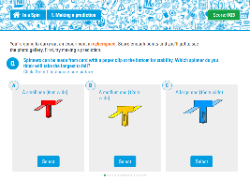
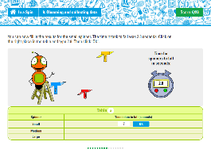
10-minute science
Follow these simple instructions and make a snowflake from a folded square of paper. Make small and large snowflakes with the same patterns. Which one reaches the ground first when dropped from a height?
4th December
21
Days to go
The snowflake has a bigger surface area than the raindrop. Air pushes against this larger area and slows the snowflake down, just like a parachute! This force is called air resistance.
Dive deeper
Investigate how surface area is linked to speed with this air resistance interactive game.

Slide 16
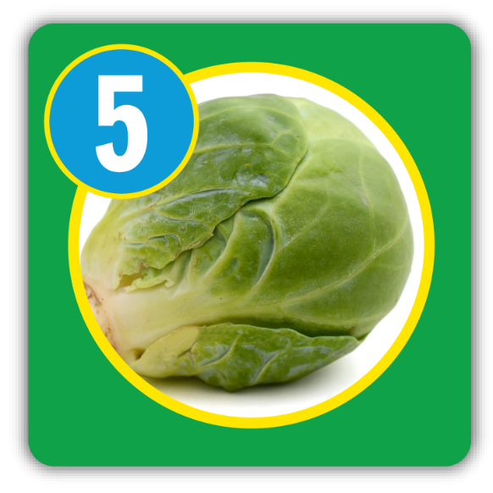
5th December
20
Days to go
What part of the plant is a brussel sprout?

Slide 17
5th December
20
Days to go
What part of the plant is a brussel sprout?
Here are some plant parts to choose from: leaf, root, stem, bud, leaf, flower.

Slide 18
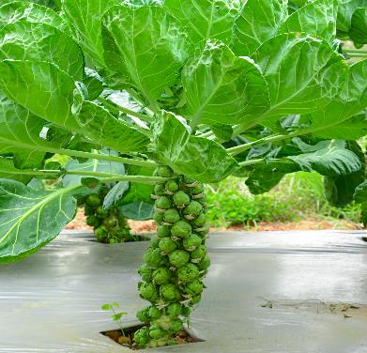
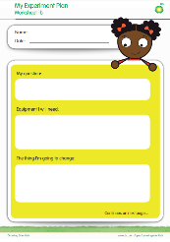
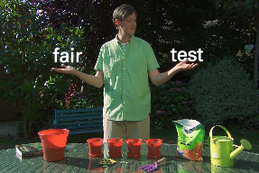
10-minute science
Do a survey to find out how many of your friends and family like brussel sprouts. Scientists have found that some people have a gene that means sprouts taste very bitter to them! What other plant parts do we eat? Make a list.
5th December
20
Days to go
A brussel sprout is a bud. Look closely at the photo and you can see the stems of old leaves sticking out between the buds.
Dive deeper
How much water do plants need to grow? Investigate with this sunflower experiment.

Slide 19
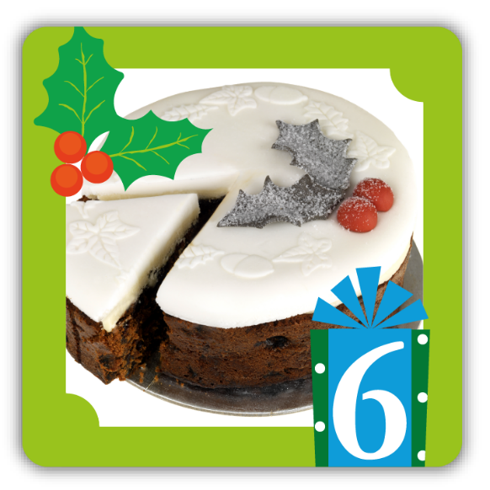
6th December
19
Days to go
Currants, raisins and sultanas are dried fruits often found in Christmas cakes and puddings. What fruit were they before they were dried?

Slide 20
6th December
19
Days to go
Currants, raisins and sultanas are dried fruits often found in Christmas cakes and puddings. What fruit were they before they were dried?
This fruit comes in many colours including red, green, purple and black.

Slide 21

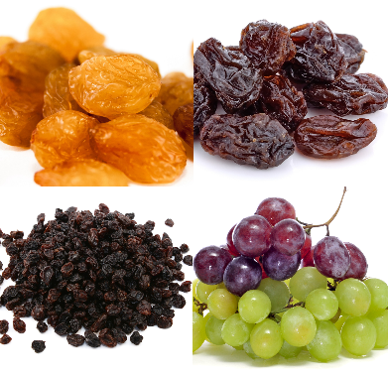




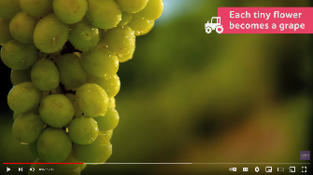
10-minute science
Grapes lose water when they dry out. Do you think a currant or raisin will turn back into a grape if it's left in water overnight? Make your prediction and then design an investigation to find out. How will you make sure that you set up a fair test?
6th December
19
Days to go
sultanas
raisins
They were all grapes! Currants are made from small varieties of red grapes while raisins are from larger, green grapes. They are dried out in the sun for three weeks. Sultanas are made from green grapes. They're treated with a chemical before they're dried, to speed up the drying process.
grapes
currants
Dive deeper
Watch this video clip and see how grapes are turned into raisins.

Slide 22

7th December
18
Days to go
What is snow made from and how is it made?

Slide 23
7th December
18
Days to go
What is snow made from and how is it made?
Snow is made from a liquid that you need to drink to stay alive!

Slide 24
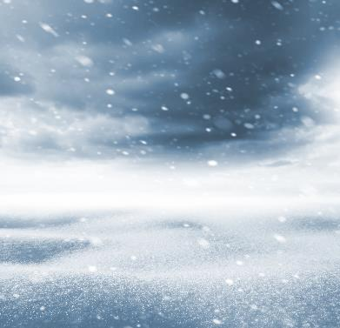
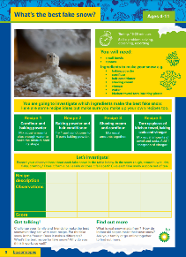
10-minute science
Draw a labelled diagram explaining how snow is made. Then, write a list of adjectives describing snow. Think about how it feels, looks and sounds.
7th December
18
Days to go
Snow is made from water vapour which is water in the form of a gas. Water vapour freezes in cold clouds and forms ice crystals. Ice crystals clump together to form snowflakes.
Dive deeper
What ingredients make the best fake snow? Follow this Ready. Steady. Science! investigation to find out.

Slide 25

8th December
17
Days to go
Some materials like wool and fleece, keep us warm in winter. Are they good heat conductors or insulators?

Slide 26
8th December
17
Days to go
Some materials like wool and fleece, keep us warm in winter. Are they good heat conductors or insulators?
A conductor allows heat to pass through it easily. An insulator does not.

Slide 27
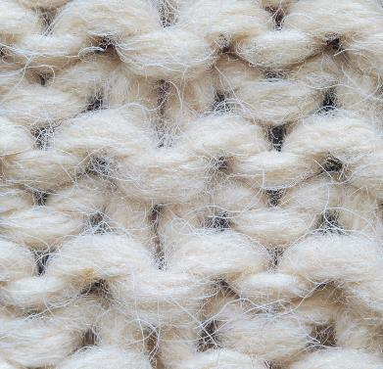
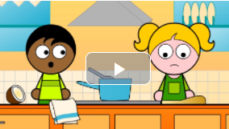
10-minute science
Make a list of all of the things you like to do in the snow. Draw or list the clothes you wear in the snow and explain what materials they are made from. Why are they good materials to wear in the snow?
8th December
17
Days to go
They are good heat insulators. Wool and fleece are both made from lots of tiny fibres that trap air and keep our bodies warm.
Dive deeper
Take a closer look at conductors and insulators and test how much you know with this video and worksheets.

Slide 28

9th December
16
Days to go
In the Christmas story, what special gifts did the Kings bring to Jesus?

Slide 29
9th December
16
Days to go
In the Christmas story, what special gifts did the Kings bring to Jesus?
One of the gifts was gold. What were the other two gifts?

Slide 30
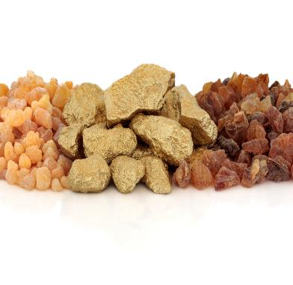



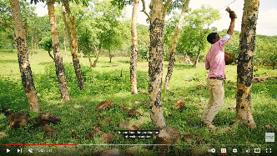
10-minute science
Gold is a metal. How many other metals can you name? Think about metals that are used to make jewellery and for objects in your kitchen. What properties do metals have?
9th December
16
Days to go
gold
The Kings brought gold, frankincense and myrrh. Gold is a precious metal. Frankincense and myrrh are expensive substances that produce a pleasant smell. They both come from the sticky liquid (sap) that runs through the trunks and branches of trees.
frankincense
myrrh
Dive deeper
Watch this video to see how frankincense and myrrh are collected from trees in Africa.

Slide 31


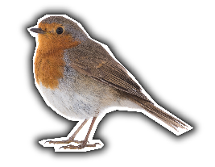

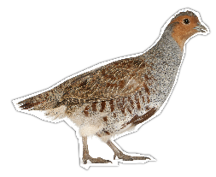
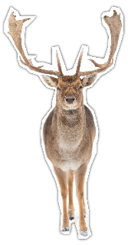
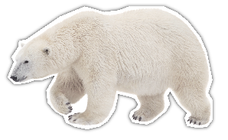
10th December
15
Days to go
These animals are often found on cards at Christmas time. What vertebrate animal groups do they belong to?

Slide 32
10th December
15
Days to go
These animals are often found on cards at Christmas time. What vertebrate animal groups do they belong to?
Vertebrates are animals with backbones. Birds, amphibians, reptiles, fish and mammals are vertebrates.

Slide 33


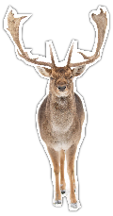




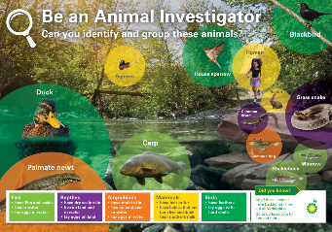
10-minute science
Here are some other animals you might see on Christmas cards: camel, owl, goose, fox, swan, squirrel, penguin, badger. Which are birds and which are mammals?
10th December
15
Days to go
The robin and the partridge are birds. The reindeer and the polar bear are mammals.
birds
mammals
Dive deeper
Use this poster to find out how to tell the difference between birds, amphibians, reptiles, fish and mammals.

Slide 34

11th December
14
Days to go
Some people say that Santa’s sleigh travels at the speed of light. How fast is that?

Slide 35
11th December
14
Days to go
Some people say that Santa’s sleigh travels at the speed of light. How fast is that?
Light travels much faster than the speed of sound. Sound travels at 343 metres per second.

Slide 36

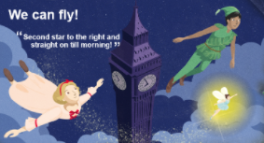
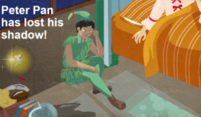
10-minute science
Make a list of all the things you can think of that give out light. Which ones use main electricity, and which use batteries?
11th December
14
Days to go
Light travels at 300,000 kilometres per second! That means it takes about 8 minutes 17 seconds for light from the Sun to reach Earth's surface. That's fast!
Dive deeper
Investigate light and shadows with these Peter Pan: Science in Stories resources.

Slide 37

12th December
13
Days to go
What is this Christmas plant called and where does it grow?

Slide 38
12th December
13
Days to go
What is this Christmas plant called and where does it grow?
People hang this plant up in their houses and kiss under it at Christmas time!

Slide 39



10-minute science
Draw a plant (any plant) and label its parts: leaf, root, flower, stem. What job does each part of the plant do?
Does it provide support, nutrition, water, or does it help the plant to produce seeds (reproduction)?
12th December
13
Days to go
It's called mistletoe. Mistletoe is a plant that grows on the branches of trees and gets its nutrients and water from that tree. It weakens the tree but doesn't kill it. It's called a parasite. The tree is called the host.
Dive deeper
What is biodiversity and how can you increase the number of plant and animal species in your local area? Find out with this Biodiversity Challenge.

Slide 40

13th December
12
Days to go
Click on each number to hear a sound. What sounds can you hear?
2
1
3
4

Slide 41
13th December
12
Days to go
Click on each number to hear a sound. What sounds can you hear?
2
1
Listen carefully and have a guess. They are all sounds you might hear at Christmas time.
3
4

Slide 42



10-minute science
Make a list of other sounds you might hear at Christmas. Sort them into quiet and loud sounds.
13th December
12
Days to go
2
1. Unwrapping a gift
2. Sleigh bells
3. Walking in snow
4. Crackling fire
1
4
3
Dive deeper
Read The Jungle Book and discover how sounds are made with this Science in stories presentation.

Slide 43

14th December
11
Days to go
Why are baubles, glitter and tinsel so shiny?

Slide 44
14th December
11
Days to go
Why are baubles, glitter and tinsel so shiny?
Think about the materials they are made of and what happens when light hits these materials.

Slide 45


10-minute science
Look around you. What objects reflect light? Try turning all of the lights off and use a phone torch to find out which materials reflect the most light. Design a winter jacket that uses reflective materials that can be seen by motorists.
14th December
11
Days to go
They are made from materials that reflect light. Light travels from a light source such as a bulb or flame, and when it reaches a smooth, shiny material it bounces off the surface. Dark and dull materials don't reflect light well.
Dive deeper
Can you make light bend so that it goes round a corner? Watch this video and take up the challenge!

Slide 46

15th December
10
Days to go
Some people say that Santa lives at the North Pole. Where is the North Pole and what is it like there?

Slide 47
15th December
10
Days to go
Some people say that Santa lives at the North Pole. Where is the North Pole and what is it like there?
You need to work out where North is. If you start at the top and go clockwise, the points of the compass are: North, East, South, West. This mnemonic will help you to remember: Never Enter Santa's Workshop

Slide 48




10-minute science
Global warming is causing the ice the polar bears and walruses live on, to melt. Design a poster that tells people where the North Pole is, what is happening to the ice and how this is affecting the animals that live there.
15th December
10
Days to go
The North Pole is the northernmost point on Earth. It's not on land but is in the Arctic Ocean. It's so cold there that the ocean is covered in sea ice. Animals including polar bears and walruses live on the ice.
North Pole
Dive deeper
Have fun while you go fishing for ice with this easy-to-do Ready. Steady. Science! winter investigation.

Slide 49

16th December
9
Days to go
What makes Christmas crackers go BANG?

Slide 50
16th December
9
Days to go
What makes Christmas crackers go BANG?
Think about what makes a gun go bang too!

Slide 51



10-minute science
Friction is a force between two things that are sliding across each other. A rough surface increases friction. Look closely at the soles of your shoes and your friends' shoes. Are they rough or smooth? Whose shoes would be safer on a slippery surface?
16th December
9
Days to go
Christmas crackers go BANG
because they contain two overlapping cardboard strips that are treated with gunpowder. When the cracker is pulled, friction between the two strips causes enough heat to set the gunpowder off.
You need all these parts to make a cracker. Can you work out what each part is?
Dive deeper
Use this interactive game to investigate shoes and friction.

Slide 52

17th December
8
Days to go
In the Christmas story, the Three Kings rode on camels. What do camels store in their humps?

Slide 53
17th December
8
Days to go
In the Christmas story, the Three Kings rode on camels. What do camels store in their humps?
Camels store something in their humps that helps them survive - but it's not water!

Slide 54



10-minute science
Humans use water very day but what do we use it for? Make a mind-map showing all of the things you use water for each day. Think about keeping healthy and clean, for growing food, cooking and for cleaning the objects we use every day.
17th December
8
Days to go
Many people think that camels store water in their humps when they actually store fat. They can break down this fat into water and energy when food and water are in short supply.
Dive deeper
How much do you know about the water cycle? Check your understanding with these worksheets.

Slide 55

18th December
7
Days to go
We all create waste. Do you think we create more or less waste at Christmas time, compared with other times of the year?

Slide 56
18th December
7
Days to go
We all create waste. Do you think we create more or less waste at Christmas time, compared with other times of the year?
Think about waste from food, wrapping, unwanted gifts and Christmas trees.

Slide 57



10-minute science
Make a list of things you can do to reduce waste over Christmas. Think about recycling, reducing the amount you throw away and reusing things you already have. You could even wrap presents in reusable cloth materials!
18th December
7
Days to go
We produce about a third more waste over Christmas. In the UK that can include 83 square kilometres of wrapping paper, 40 million rolls of sticky tape and 8 million Christmas trees!
Dive deeper
Find out how Jamie Garcia discovered a fully recyclable plastic and write about a world without plastic with this Super Scientist resource.

Slide 58

19th December
6
Days to go
How many turkeys do you think are eaten every Christmas in the UK?

Slide 59
19th December
6
Days to go
How many turkeys do you think are eaten every Christmas in the UK?
It is more than 5 million!

Slide 60



10-minute science
What will you eat on Christmas day? Or what is a meal you really enjoy having? Draw your plate of food and label each part. Which foods are from plants, and which are from animals?
19th December
6
Days to go
Around 9 million turkeys are eaten in the UK every Christmas. Although turkey is popular, lots of other foods are eaten too including chicken, ham, duck and goose, and plant-based foods including nut roasts and vegetable pies.
Dive deeper
The life cycle of a turkey starts with an egg. Use this presentation to investigate the strength of eggs and discover what other animals lay eggs.

Slide 61

20th December
5
Days to go
Holly is often used to decorate our homes at Christmas. It is an evergreen plant with red berries. But what is a berry?

Slide 62
20th December
5
Days to go
Holly is often used to decorate our homes at Christmas. It is an evergreen plant with red berries. But what is a berry?
Is a berry a leaf, seed, fruit or bud?

Slide 63



10-minute science
Holly, ivy, fir, and mistletoe are all plants we use to decorate our homes at Christmas. Design a decoration using these plants. You could design a wreath, a table decoration or something for a mantlepiece.
20th December
5
Days to go
A berry is a fruit with seeds inside it. Holly berries are an important winter food for birds and mammals. When they eat the berries, the seeds travel straight through their digestive systems and are dropped away from the plant, to grow into new plants. Holly berries are poisonous to humans and pets!
Dive deeper
Seeds are dispersed in many ways. Find out more with this video and challenge.

Slide 64

21th December
4
Days to go
What are candles made from and what happens to this material when it is heated?

Slide 65
21th December
4
Days to go
What are candles made from and what happens to this material when it is heated?
The material turns from a solid into a liquid when it is heated.

Slide 66


10-minute science
Wax is used in wax crayons. It has special properties. Try this and discover how it resists water: Use wax crayons to draw a Christmas or winter scene onto white paper. Then, paint over the whole page with a dark, water colour paint. What do you notice?
21st December
4
Days to go
Candles are made from wax. Wax melts when it is heated and turns from a solid into a liquid. The liquid wax is drawn up by the wick into the flame. When it is hot enough, the liquid wax turns from a liquid into a gas. The hot gas then reacts with the oxygen in the air and burns, making a flame.
Dive deeper
Discover more about the science of candles with this great video from the Royal Institution.

Slide 67

22nd December
3
Days to go
This fox lives in the cold Arctic. How is it suited to where it lives?

Slide 68
22nd December
3
Days to go
This fox lives in the cold Arctic. How is it suited to where it lives?
Look at its fur!

Slide 69



10-minute science
Draw a picture of an Arctic fox and label the parts of its body. Explain how it has adapted to its environment.
22nd December
3
Days to go
The Arctic fox has thick, white fur to keep it warm in the cold winter. By summer it has shed its long, white coat and has grown short, grey fur. It has short legs, small ears and a short nose. This helps it to lose less heat and to stay warm in the freezing temperatures.
Dive deeper
Learn more about how adaptations can lead to changes in living things, over time, with these Super Scientist: Charles Darwin resources.

Slide 70

23rd December
2
Days to go
This robot toy needs energy to make it move and light up. Where does that energy come from?

Slide 71
23rd December
2
Days to go
This robot toy needs energy to make it move and light up. Where does that energy come from?
What do you have to put inside a toy like this to make it work?

Slide 72



10-minute science
Do a survey to find out what gifts your friends would love to receive. Which ones need batteries? Which ones need to be plugged into the mains? Which ones don't need electricity?
23rd December
2
Days to go
This robot gets its energy from batteries. A battery is an energy store. It changes chemical energy into electrical energy by a chemical reaction.
Dive deeper
Investigate simple circuits with this online experiment.

Slide 73

24th December
1
Days to go
What force pulls Santa down the chimney on Christmas Eve?

Slide 74
24th December
1
Days to go
What force pulls Santa down the chimney on Christmas Eve?
Is it air resistance, friction, water resistance or gravity?

Slide 75



10-minute science
Does a heavier object fall more quickly than a lighter object? Discuss your prediction with a friend. Plan an experiment together to investigate. Make sure your test is fair.
24th December
1
Days to go
Gravity pulls Santa down the chimney. It is the force that acts between Earth and a falling object and pulls that object to the ground. Without gravity everything would float in the air!
Dive deeper
Use these Super Scientist resources to find out about Isaac Newton, the scientist who discovered gravity.

