Slide 1


All About My New School
St Julie Catholic Primary School

Slide 2

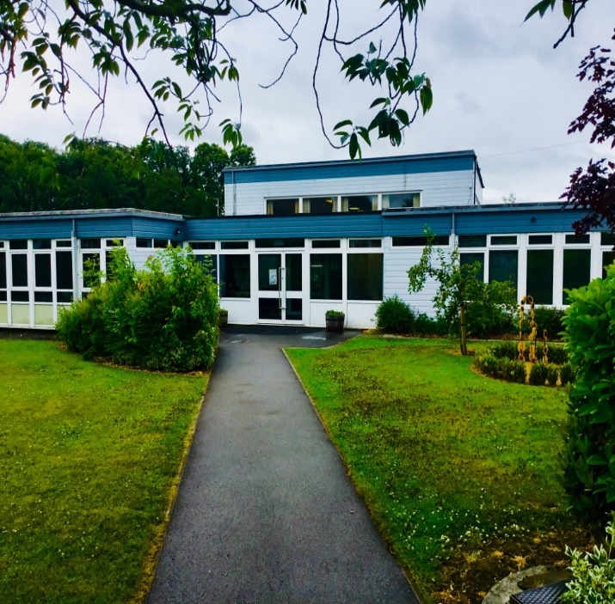
Your New School
This is your new school. It is called St Julie Catholic Primary School. We are really pleased that you are going to join us.

Slide 3
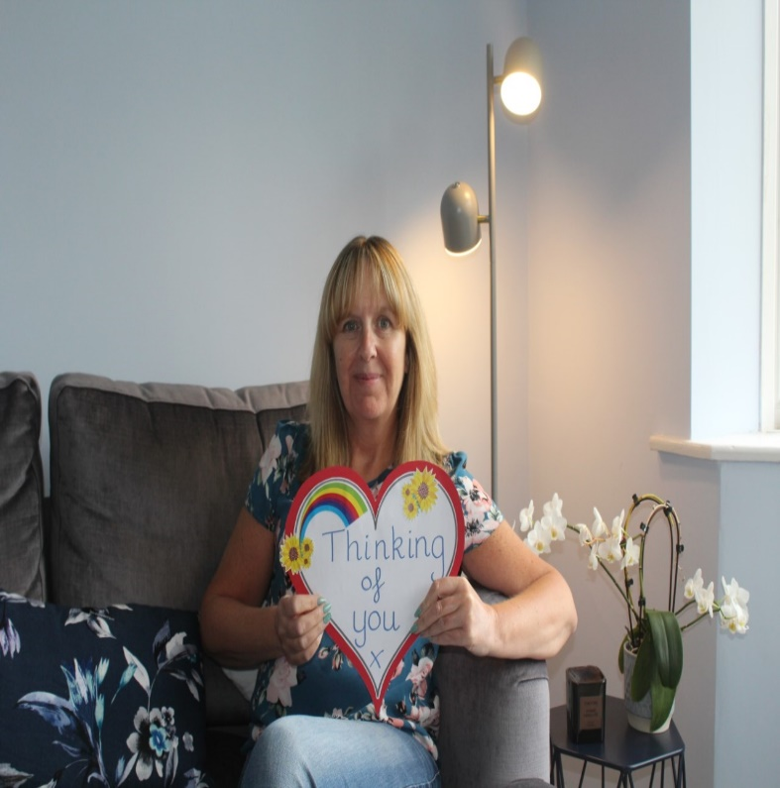
Meet Your Headteacher
Add a photograph of your headteacher here.
My name is Mrs Hodgson and I will be your headteacher. When you start school, I will come and say hello and look at the lovely work and playing you are doing.

Slide 4
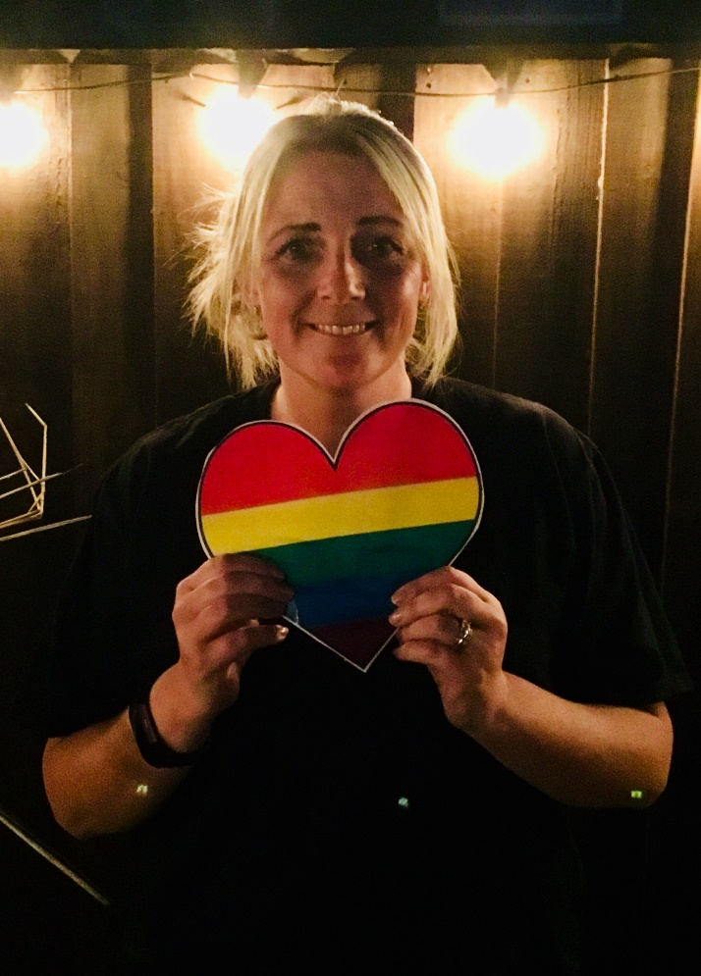
Meet Your Teacher
Add photograph of
teacher/s here.
Hello. I will be your new teacher. My name is
Mrs Ashcroft.
Our class is called
Reception.
We are going to have lots of fun at school and make lots of new friends.

Slide 5
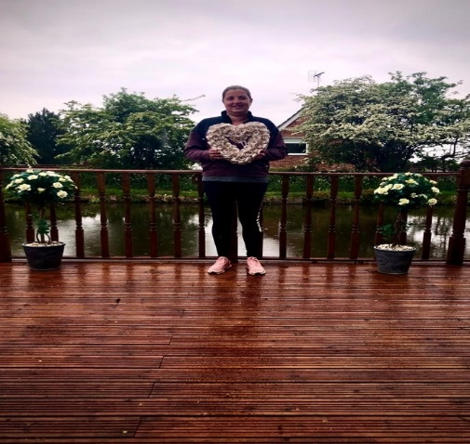
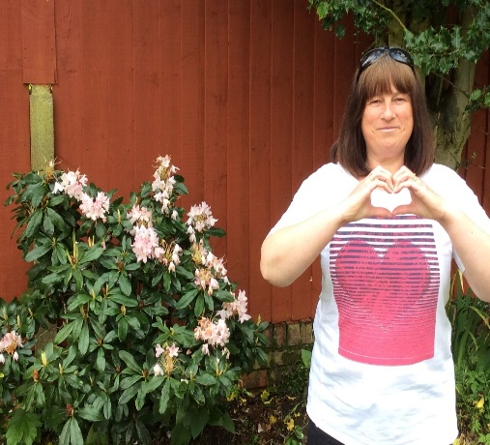
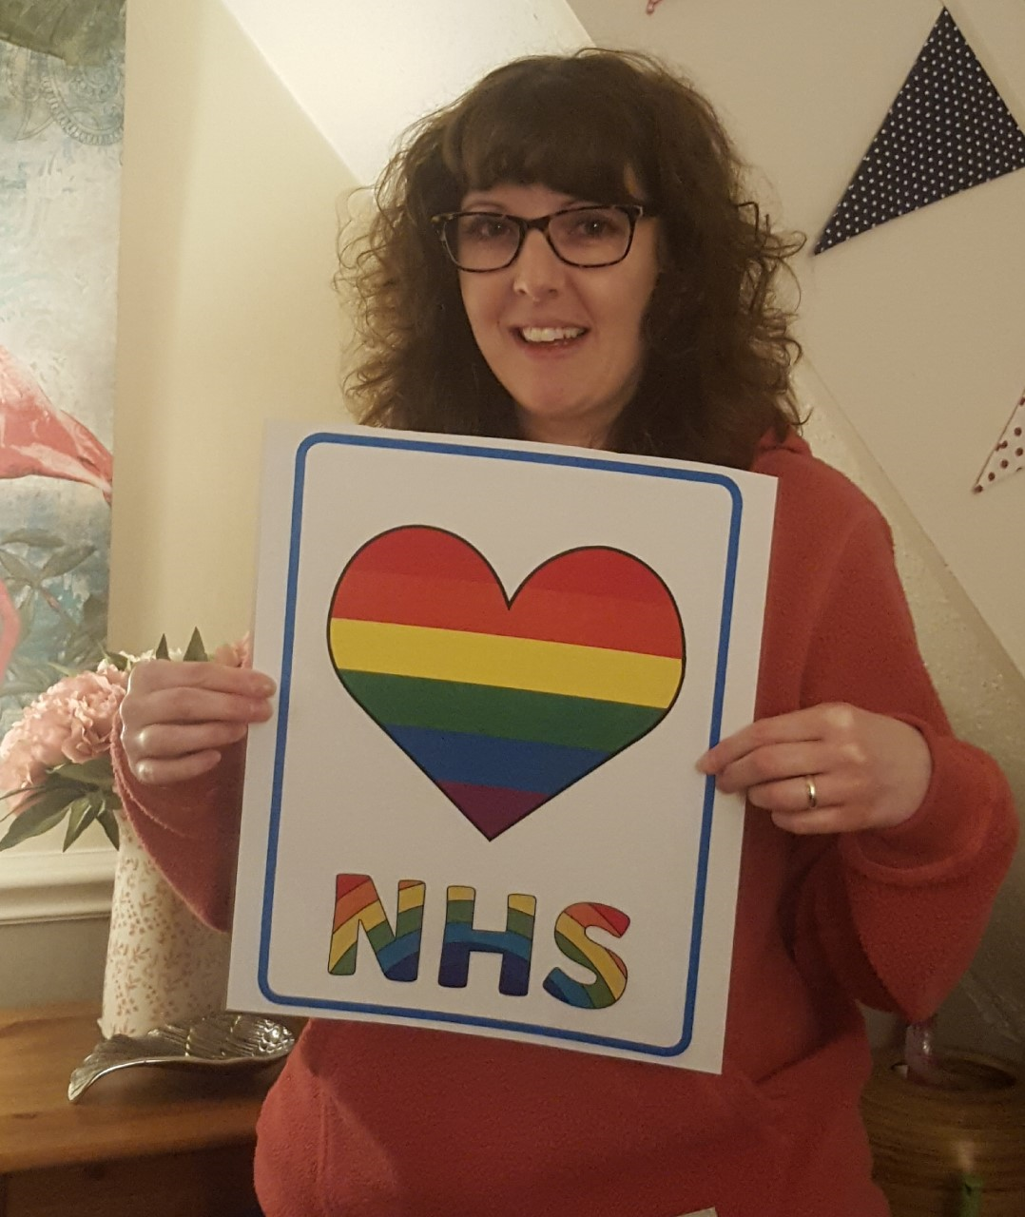
Meet the Reception Team
There are lots of other people in school that can’t wait to meet you.
Here are a few people you will meet at school.
Add photograph
Add photograph
Mrs Smith
Teaching Assistant
Mrs Slocombe class teacher and Deputy Head teacher
Add photograph
Mrs Pincock
Teaching Assistant

Slide 6
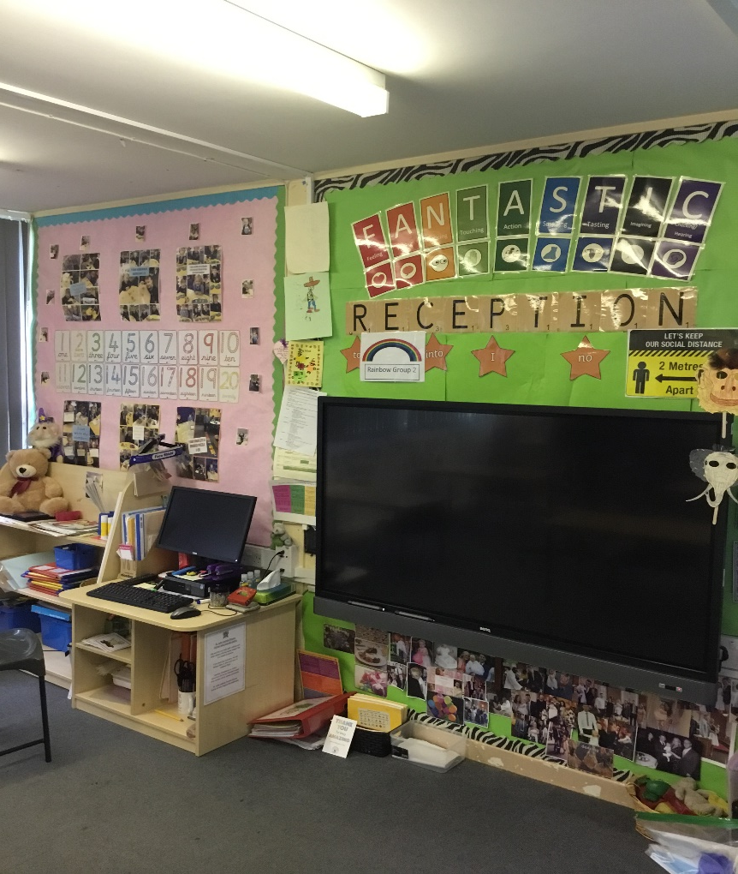
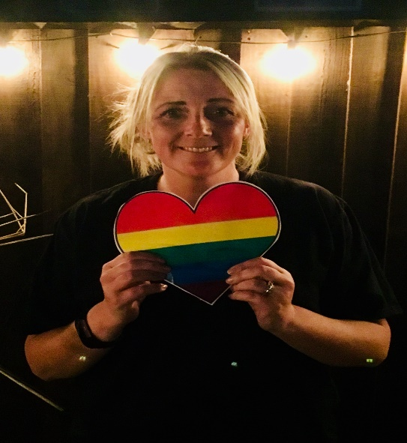
Your New Classroom
This is Reception classroom. There are lots of lovely things to do. You might like to play with the toys, read a book and draw a picture.
Add photograph of the classroom.
Add photograph of class teacher.

Slide 7
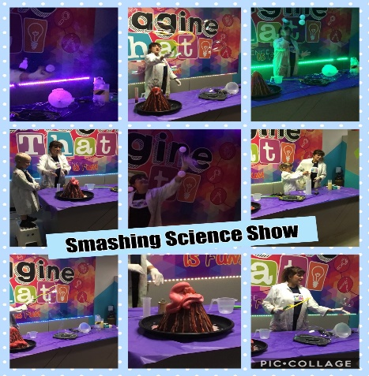
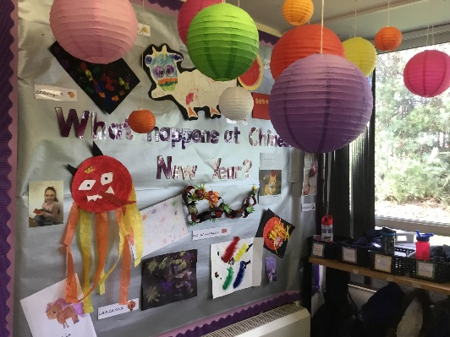
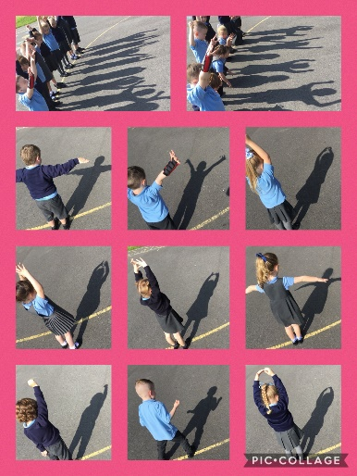
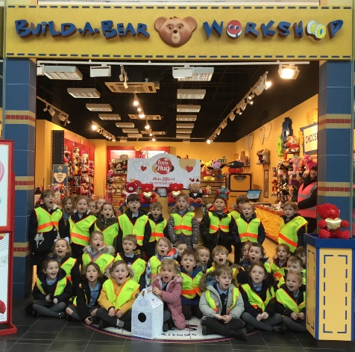
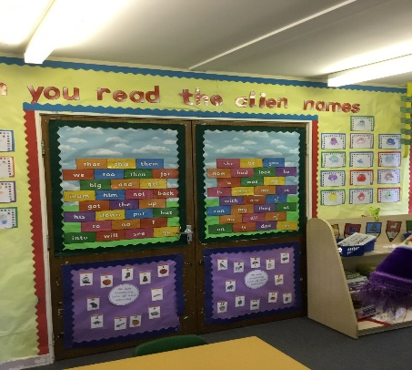
Some Lovely Activities We Do in Our Class and Exciting Places we visit
There are lots of things to play with and trips to go on. What do you think you will do first?
Add photograph of an area in the classroom or activity.
Add photograph of an area in the classroom or activity.
Add photograph of class teacher.
Add photograph of an area in the classroom or activity.
Add photograph of an area in the classroom or activity.

Slide 8
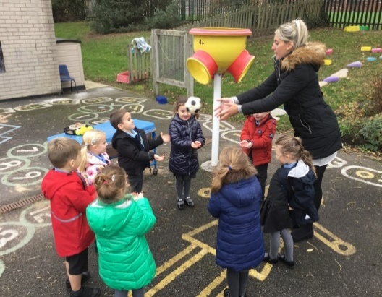
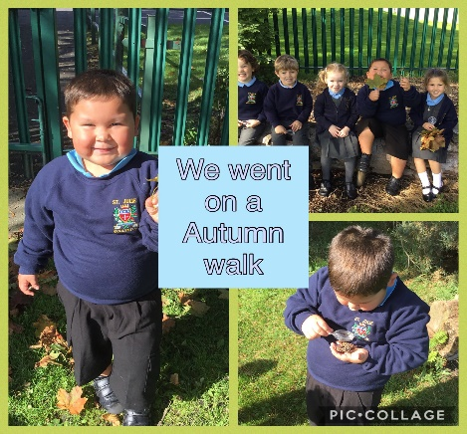
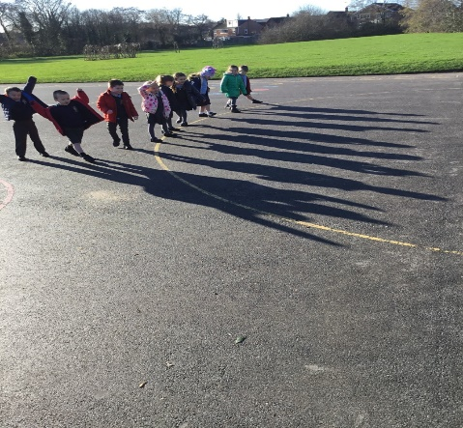
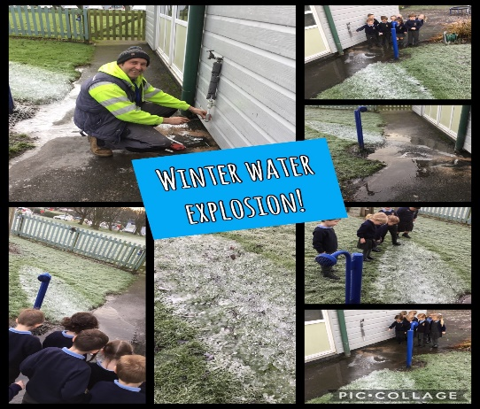
The Outside Area
We also have a lovely outside area for you to play in.
Look at all the wonderful things to do.
Add photograph of an area in the outside area.

Slide 9
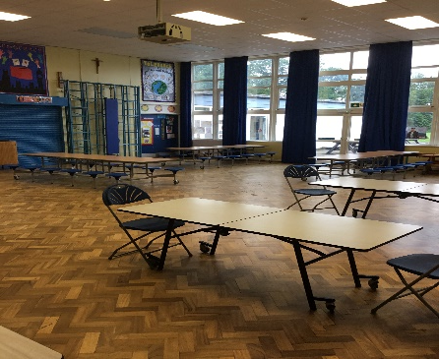
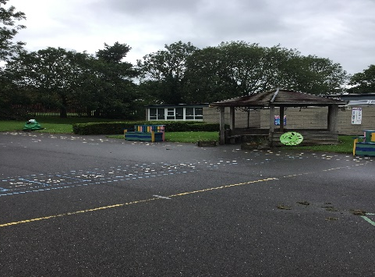
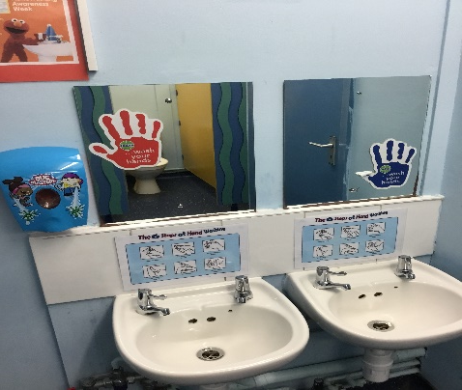
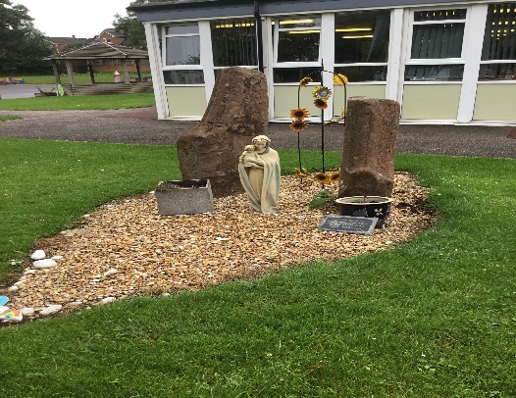
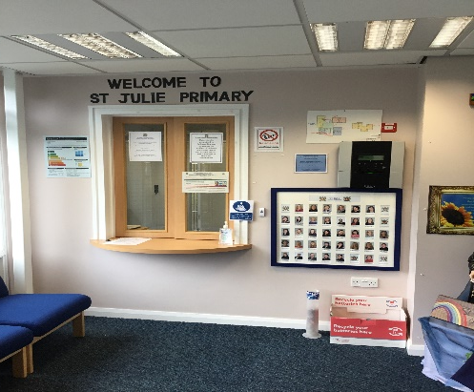
Let’s Have a Look Around School
There are lots of other places in school that we can explore together.
Here are a few that we will visit and use.
Add a photograph of the hall.
Add a photograph of the playground.
Add a photograph of the toilets.
the hall
the playground
the toilet
Add a photograph of the library.
Add a photograph of the office.
the prayer garden
the office

Slide 10

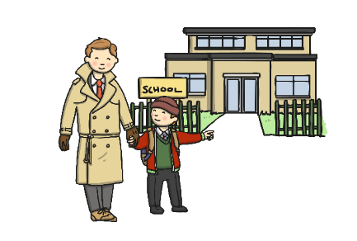








We can’t wait to meet you. Have a lovely summer and stay safe!

