Slide 1

MARY
MOTHER
OF GOD
May 2020

Slide 2
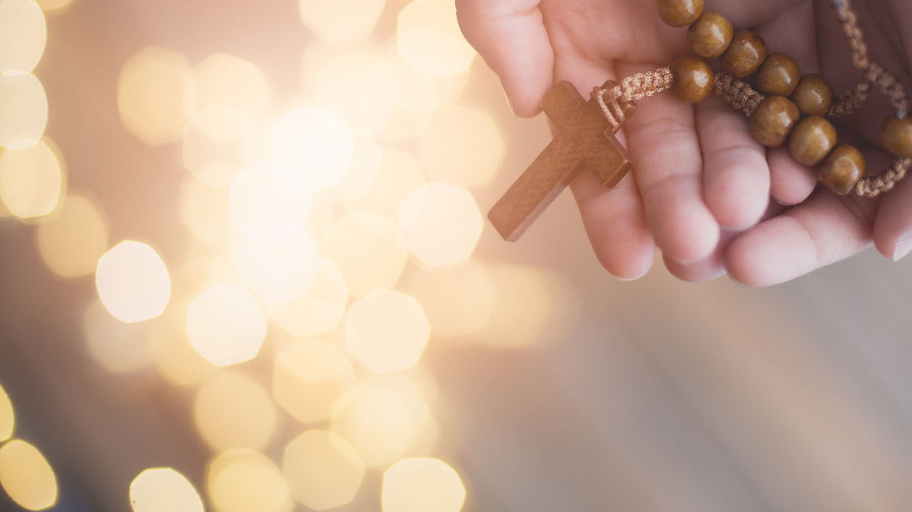
The month of May is dedicated to Mary our mother.
We are also encouraged to pray the Rosary with the people in our household.

Slide 3
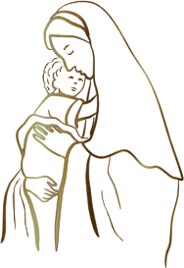
MARY
As we all know, Mary is the mother of Jesus, commonly referred to as the mother of God
and she is one of the most admired people within the Bible.
Mary was of no great background or upbringing, she had no money or possessions,
however when God called upon her to be the mother of Jesus, she did not hesitate.
Mary simply said YES.
Mary was willing to trust God with her whole heart.
We know that being Jesus’ mother was not an easy role to fulfil.
Mary found joy in motherhood but also felt great pain and suffering
when she had to see Jesus tortured and crucified.
Mary was a witness to us of unlimited strength, courage and faith.

Slide 4
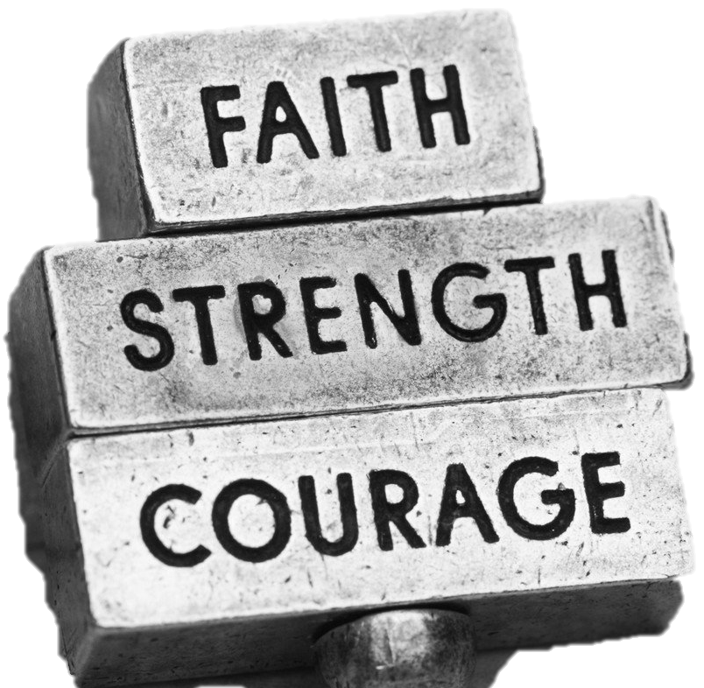
HOW ABOUT YOU?
Think about in your own life…
When have you shown moments of strength?
When have you acted with courage?
When have you decided to trust your faith?

Slide 5

STRENGTH, COURAGE & FAITH

Slide 6
PRAYING THE ROSARY
Praying the rosary is something that has brought great comfort to people during times of prayer.
The reason the rosary became so well used was because it allowed people to recite prayers that were known off by heart and use them in a way that was meditative and repetitive.
It was a way of praying that everyone could do no matter their education or status.
During the month of May, Pope Francis has encouraged us to pray the rosary with those in our household.
The rosary is a collection of beads/knots, representing the prayers that are said:
Sign of the Cross
Apostles Creed
Our Father
Hail Mary
Glory Be

Slide 7
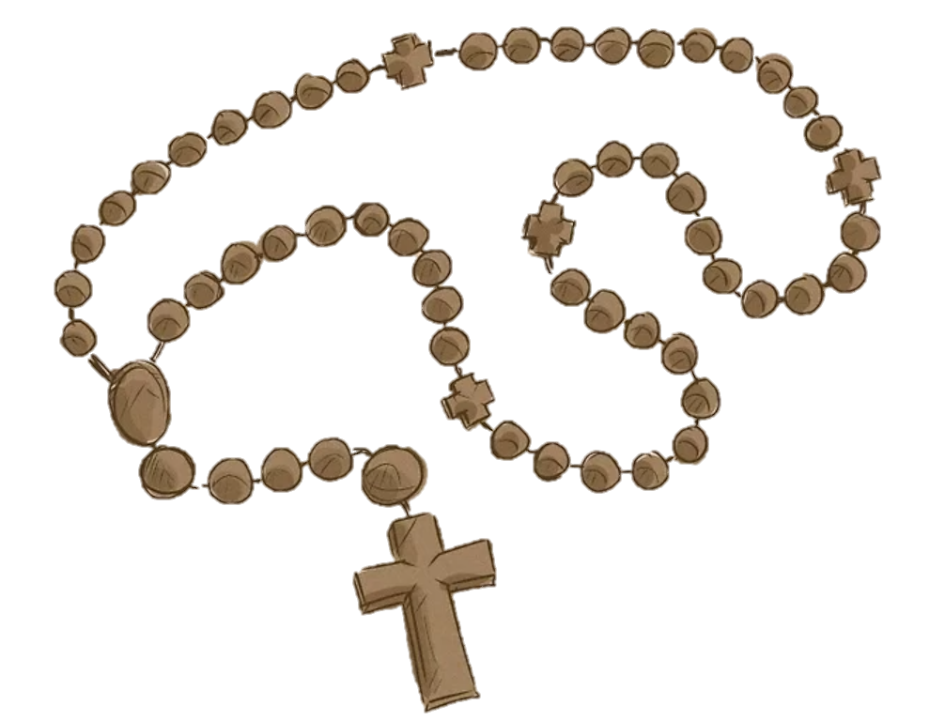
FIND OR CREATE
To begin we need a rosary…
If you have one in the house – go and find it ☺
If you don’t let’s create one! (copy the image)
E.g. beads and elastic, knots in string,
draw it on a piece of paper or print a picture)

Slide 8
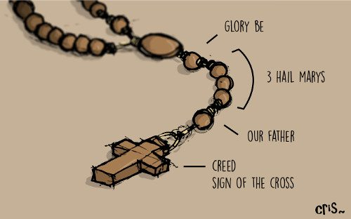
Sign of the cross:
In the name of the Father and of the Son and of the Holy Spirit. Amen.
The Creed:
I believe in God, the Father Almighty, Creator of heaven and earth; and in Jesus Christ, His only Son, our Lord: Who was conceived by the Holy Spirit, born of the Virgin Mary; suffered under Pontius Pilate, was crucified, died and was buried. He descended into hell; the third day He rose again from the dead; He ascended into heaven, is seated at the right hand of God the Father Almighty; from thence He shall come to judge the living and the dead. I believe in the Holy Spirit, the Holy Catholic Church, the communion of Saints, the forgiveness of sins, the resurrection of the body, and life everlasting. Amen.
Our Father:
Our Father, Who art in heaven, Hallowed be Thy Name. Thy Kingdom come. Thy Will be done, on earth as it is in Heaven. Give us this day our daily bread. And forgive us our trespasses, as we forgive those who trespass against us. And lead us not into temptation, but deliver us from evil. Amen.
Hail Mary:
Hail Mary, full of grace, the Lord is with thee; Blessed art thou among women, and blessed is the fruit of thy womb, Jesus. Holy Mary, Mother of God, pray for us sinners, now and at the hour of death. Amen.
Glory Be:
Glory be to the Father, and to the Son, and to the Holy Spirit. As it was in the beginning, is now, and ever shall be, world without end. Amen.
THE BEGINNING

Slide 9
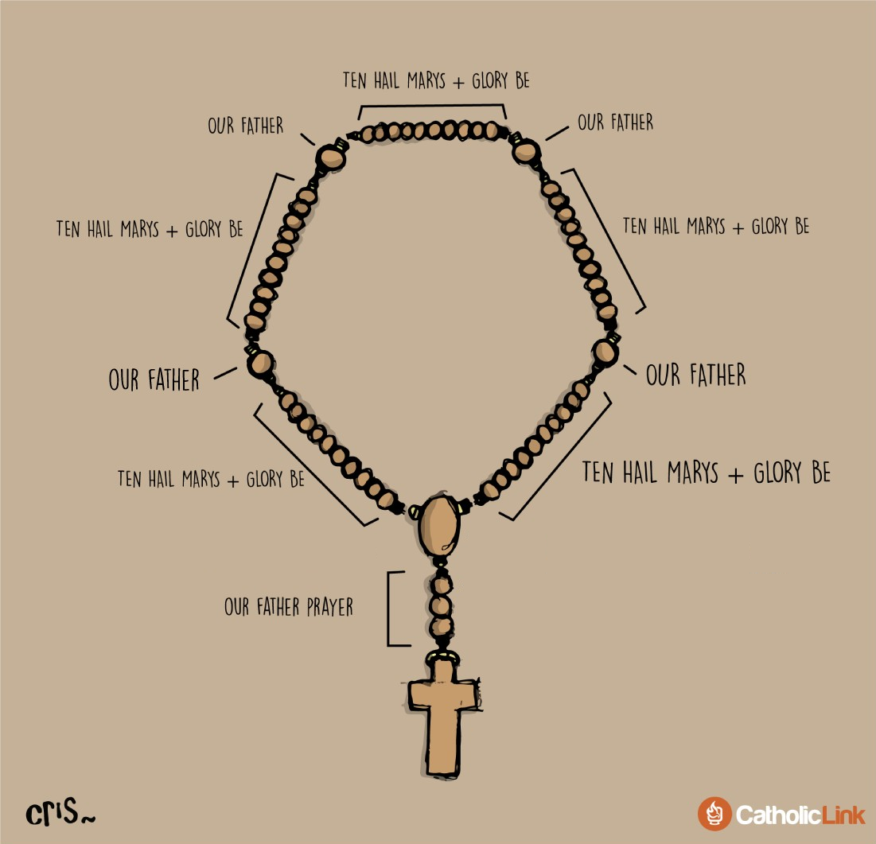
MEDITATIVE PRAYER
Each section now has 10 beads for you to pray
the Hail Mary and the Glory Be.
The sections are then separated by a bead to pray
the Our Father.
Hail Mary:
Hail Mary, full of grace, the Lord is with thee; Blessed art thou among women, and blessed is the fruit of thy womb, Jesus. Holy Mary, Mother of God, pray for us sinners, now and at the hour of death. Amen.
Glory Be:
Glory be to the Father, and to the Son, and to the Holy Spirit. As it was in the beginning, is now, and ever shall be, world without end. Amen.
Our Father:
Our Father, Who art in heaven, Hallowed be Thy Name. Thy Kingdom come. Thy Will be done, on earth as it is in Heaven. Give us this day our daily bread. And forgive us our trespasses, as we forgive those who trespass against us. And lead us not into temptation, but deliver us from evil. Amen.

Slide 10
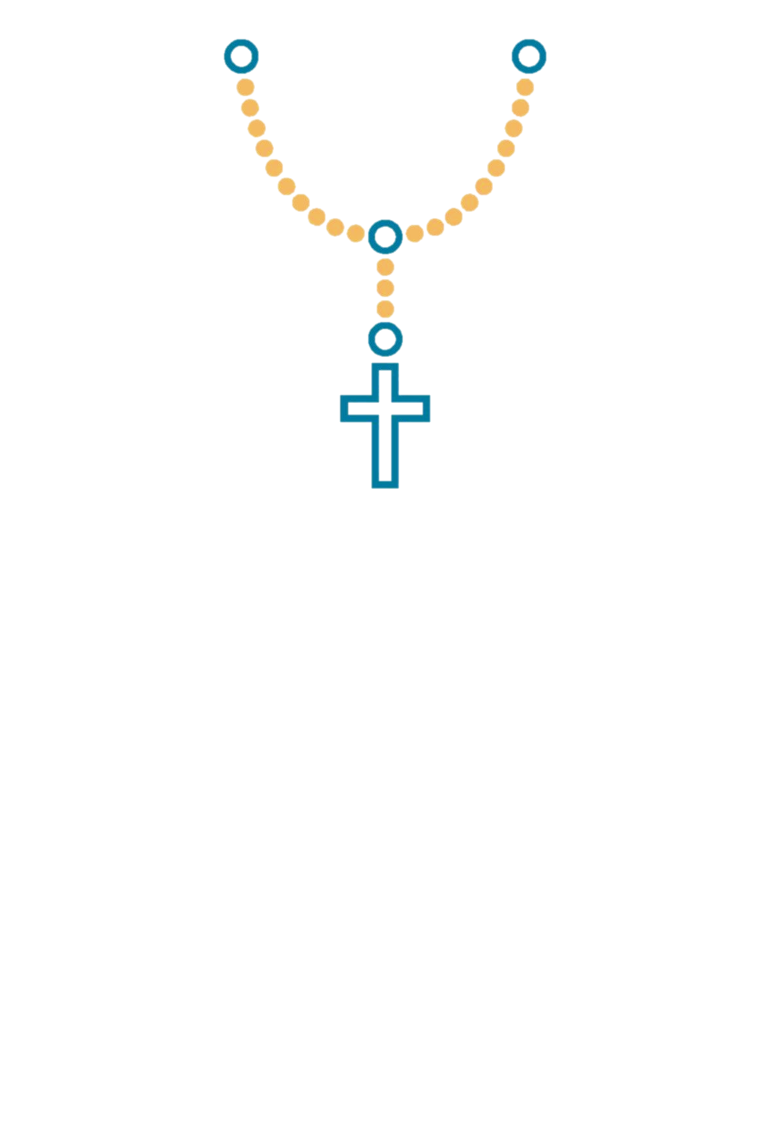
The rosary journey’s through the main life events of Jesus and Mary by recalling the mysteries.
The mystery you pray depends on the day of the week.
The Joyful Mysteries (Monday & Saturday)
The Annunciation
The Visitation
The Nativity
The Presentation
The Finding of Jesus in the Temple
The Sorrowful Mysteries (Tuesday & Friday)
The Agony in the Garden
The Scourging at the Pillar
The Crowning with Thorns
The Carrying of the Cross
The Crucifixion
The Glorious Mysteries (Wednesday & Sunday)
The Resurrection
The Ascension
The Descent of the Holy Spirit
The Assumption of Mary
The Coronation of Mary
The Luminous Mysteries (Thursday)
The Baptism in the Jordan
The Wedding at Cana
Proclamation of the Kingdom
The Transfiguration
Institution of the Eucharist
THE MYSTERIES

Slide 11
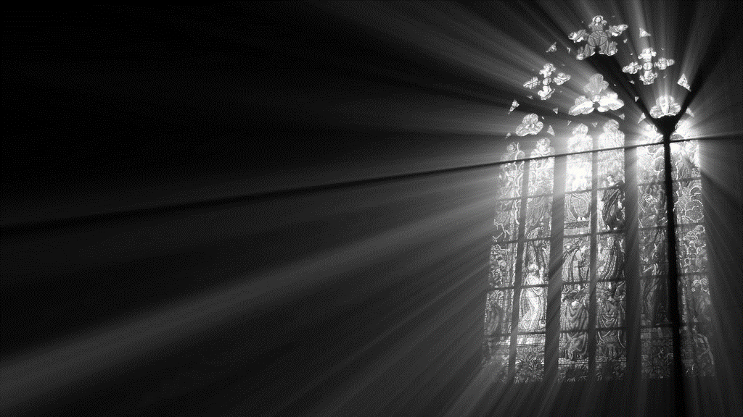

MARY, YOU ARE A SIGN OF SALVATION AND HOPE TO US ALL
May hope and peace be a part of our daily lives, as we welcome you once again into our hearts. Amen.

Slide 12
MARY
MOTHER
OF GOD
Pray for us!

