Slide 2
Trading
Trading is when goods are bought and sold. They are often moved from one place to another.
Talk About It
  What kinds of things do you think are traded to and from the UK? How do you think they are transported?
Oil, cars, food and medicines are some of the things that are traded to and from the UK each year. These goods are transported by air or on massive shipping containers.

Slide 3
Trading
Talk About It
  In the days before modern transport, how do you think goods were transported?
In the past, goods had to be moved over land using pack animals, such as camels, horses and mules. Because of this, it was important that the routes were as direct and safe as possible.

Slide 4
The Han Dynasty
Ancient Chinese ruling families were known as dynasties. The Han dynasty was from 206 BC to AD 220.
The Han dynasty was a time of scientific and technological advances.
For thousands of years, silk had been used in China but how it was made was kept a secret from outsiders. Chinese silk was very valuable. During the Han dynasty, a trading route was established where silk could be transported and sold across Asia and into Europe.

Slide 5
The Han Dynasty
The trading route would one day be known as the ‘Silk Road’. As well as silk, the Chinese also traded spices, glass beads, animal furs and pottery along the Silk Road.
It wasn’t only goods being transported; ideas were also shared as people travelled along the Silk Road. Some historians believe that ideas from Buddhism, Christianity and other ideologies were spread along the
Silk Road.
Did You Know?
The Ancient Greeks called China ‘Seres’ which means ‘the land of silk’.

Slide 6
The Golden Age
A caliphate is the name given to the Muslim government which ruled the Islamic Empire during the Middle Ages.
The Umayyad Caliphate started in AD 661. The Islamic Empire grew during this time and the period is known as the Golden Age of Islam. The Golden Age of Islam continued under the Abbasid Caliphate and lasted until AD 1258.
During this time, trade and industry across nations flourished.

Slide 7
The Golden Age
During the Abbasid Caliphate, the capital of the Islamic Empire became Baghdad in what is now Iraq.
Baghdad’s position between Europe, Africa and Asia made it ideal for a centre of trade. Many people travelled there because it became a centre of knowledge and culture.

Slide 8
The Silk Road
The Silk Road was once again used as a trading route. It was around 6400km in length.

Slide 9
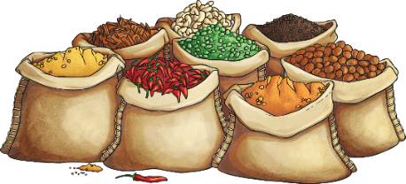
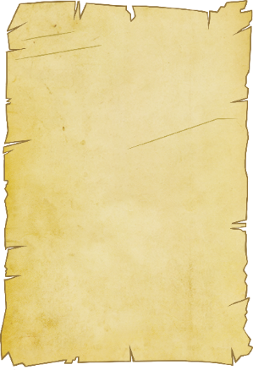
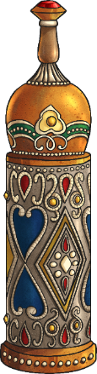
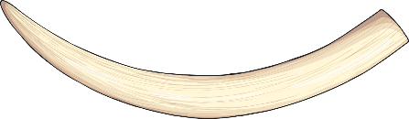
What Was Traded?
Many goods were traded along the Silk Road. They included spices, perfumes, silk, ivory, gold and paper.

Slide 10
Travels on the Silk Road
Marco Polo was an explorer from Venice. He travelled to China along the Silk Road. His book ‘The Travels of Marco Polo’ inspired many other explorers, such as Christopher Columbus.
Although the Silk Road hasn’t been used as a trading route for hundreds of years, tourists still travel along some of the Silk Road today.

