Slide 1
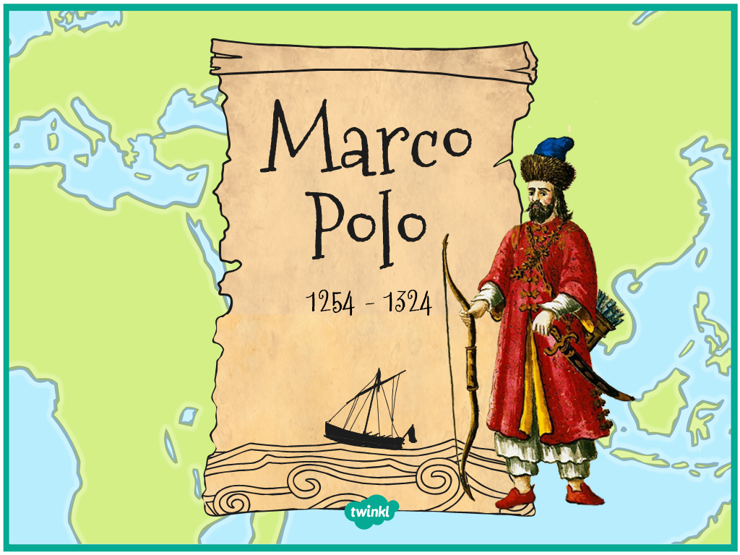

Slide 2
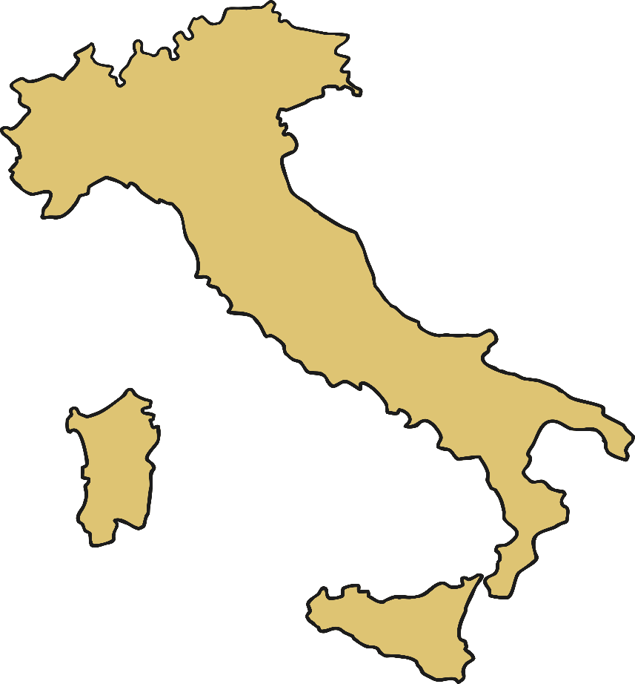
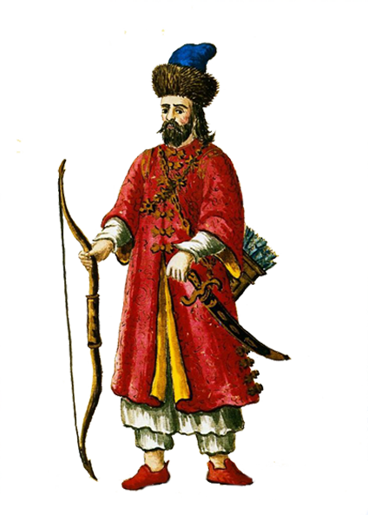
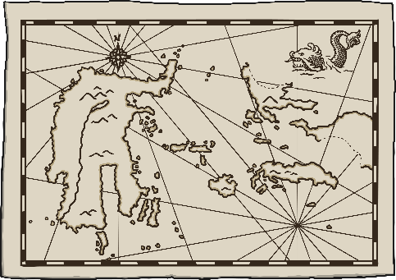
Who Was Marco Polo?
Marco Polo was born in 1254 and died in 1324.
He was a Venetian trader and an explorer.
He was an Italian explorer from Venice who travelled through Central Asia and China.
His travels were recorded in a book called “The Travels Of Marco Polo”.

Slide 3
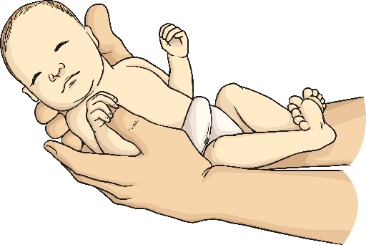
Marco Polo – Early Life
Marco Polo’s mother died after giving birth to him so he was raised by his aunt and uncle.
His father and his uncle were both merchants.
After Marco Polo’s father (Niccolo) and uncle (Maffeo) returned home to Venice after travelling as merchants, Niccolo discovered that his wife had died, leaving fifteen-year-old Marco in his care.
Instead of leaving Marco at home in Venice, the two men decided that it would be better to take Marco to China with them. In 1271 they left for their journey.

Slide 4
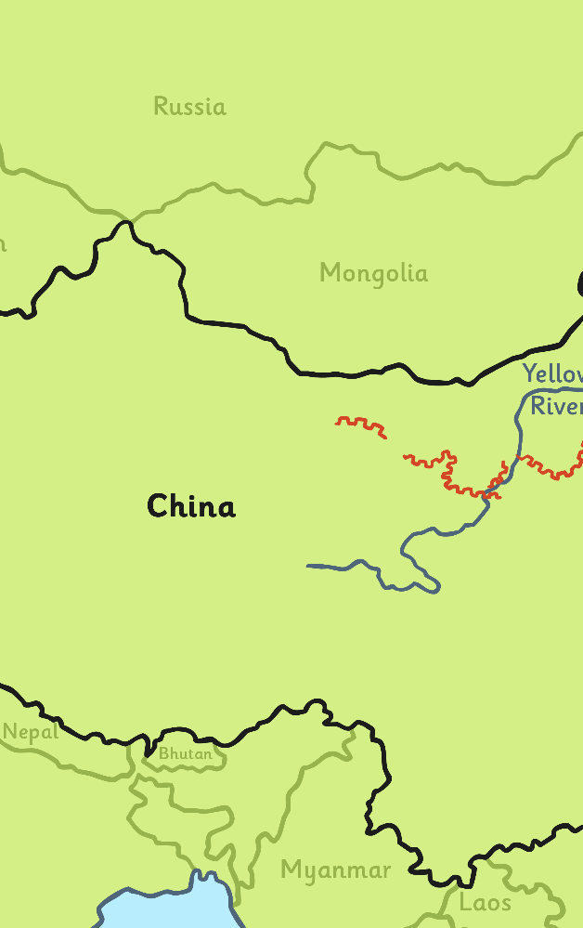
Marco Polo’s Travels
Marco left his home in Venice, Italy in 1271 with his father Niccolo and his uncle Maffeo.
They were traders who were interested in the riches of the East.
Four years after beginning their journey, the Polos reached China.
The Polos also visited India, Persia and Afghanistan and crossed the Gobi desert on their journey.

Slide 5
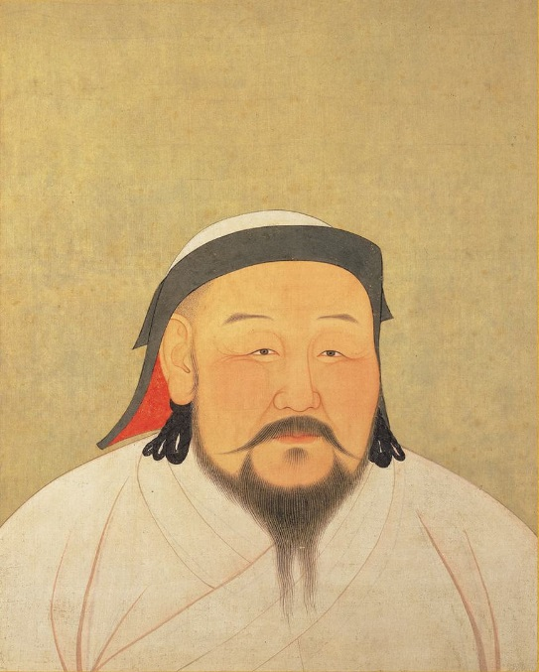
Marco Polo – The Envoy
Marco’s father introduced his son to China’s ruler, Kublai Khan.
Kublai Khan asked Marco to explore his kingdom and then to report back to him with what he had observed.
Marco spent twenty-four years working for the Khan, travelling to places which Europeans had never visited before, such as Vietnam, Burma, Tibet and Sumatra.
Marco Polo returned with his pockets full of jewels and riches.
Photo courtesy of Anige (Araniko) of Nepal, an astronomer, engineer, painter, and confidant of Kublai Khan (Artdaily.org) and Wikimedia Commons, granted under creative commons licence – attribution.

Slide 6
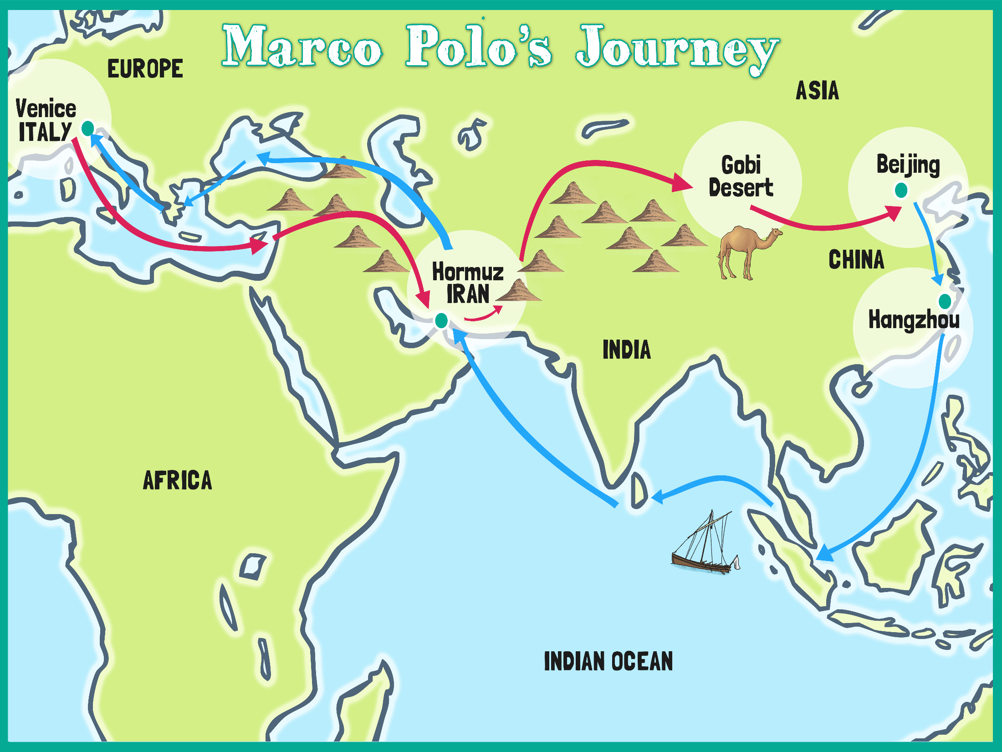

Slide 7
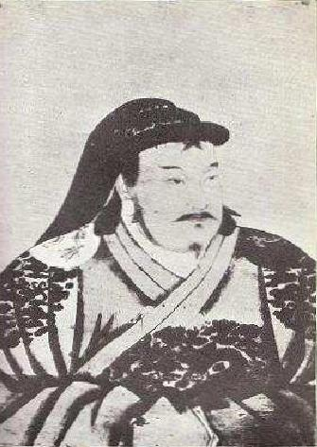
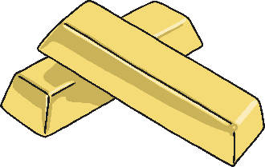
Kublai Khan
The Polos arrived in China in 1275 when Kublai Khan was China’s ruler.
Marco described his palace as having walls covered with gold and silver.
One hall was so big that a meal might be served for more than 6000 men!
Photo courtesy of Anige (Araniko) of Nepal, an astronomer, engineer, painter, and confidant of Kublai Khan (Artdaily.org) and Wikimedia Commons, granted under creative commons licence – attribution.

Slide 8
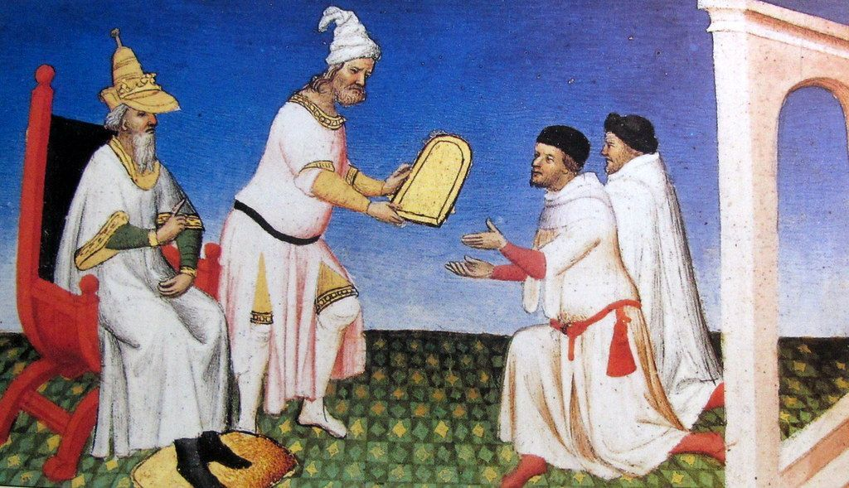
Kublai Khan
Khan liked Marco a lot, and conscripted him into service for the empire.
Marco Polo served in many government positions (including as an ambassador of the city of Yangzhou).
After several years, Khan finally said that the Polos could leave the empire.
In order to leave they were told to escort the princess, who was to marry a Persian king.
Photo courtesy of Pilar Rubio Remiro (@flickr.com) - granted under creative commons licence - attribution

Slide 9
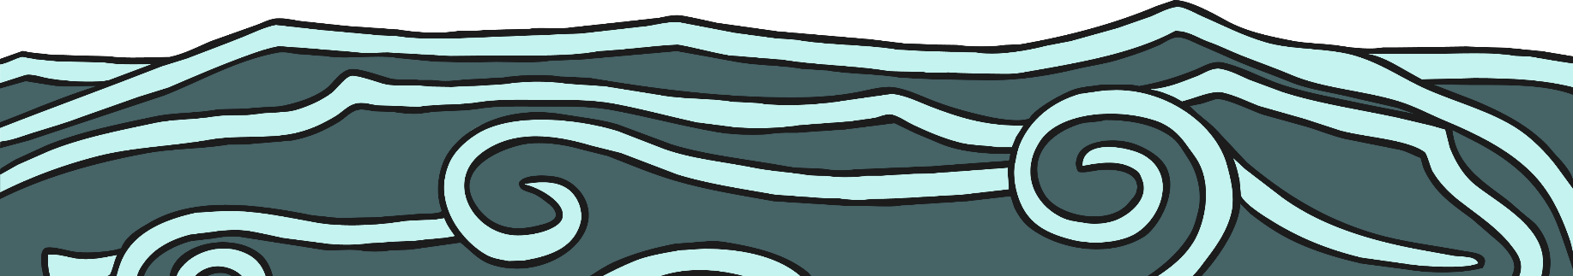
The Journey Home
The princess and the Polos headed southward on the China Sea.
It was a long, torturous voyage.
Stops were made along the way at Borneo, Sumatra, Ceylon and other places, until the ships reached the Persian Gulf.
After leaving the princess in Persia, Marco, his father, and his uncle finally went to the Black Sea and headed for home.

Slide 10
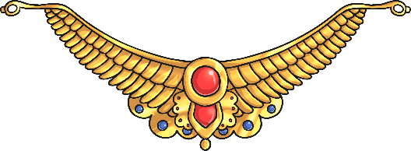

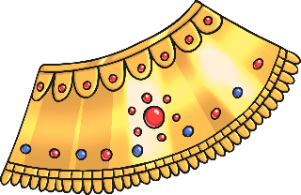

Returning Home
After being gone so long, the Polos’ appearance had changed drastically and even their closest friends didn't recognize them.
The Polos held a dinner to persuade their old friends who they were and still people could hardly believe it was really them.
During the dinner, Marco opened the coats they were wearing and out spilled rubies, emeralds and diamonds.
After seeing the most amazing jewellery collection ever known in Venice, the guests decided to believe that the hosts were who they said they were.

Slide 11
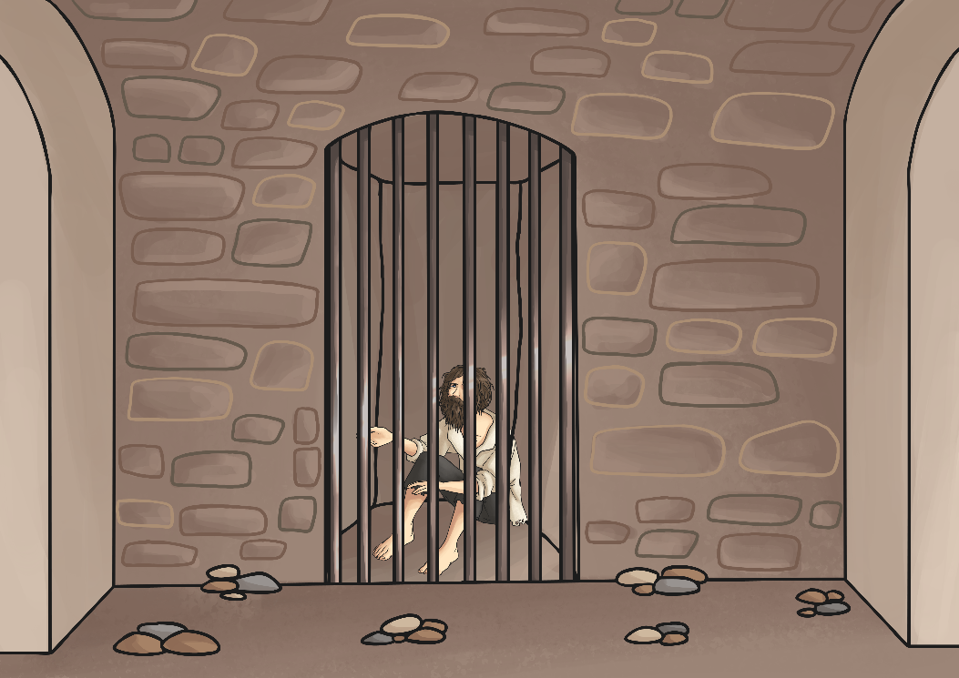

War at Home
Marco Polo, his father, and uncle returned to Venice where Marco joined the army to fight against the state of Genoa.
Marco Polo was captured in 1298 and held in Genoa.
While in prison he dictated his travels to another prisoner, and “The Travels of Marco Polo” was published in French.

Slide 12
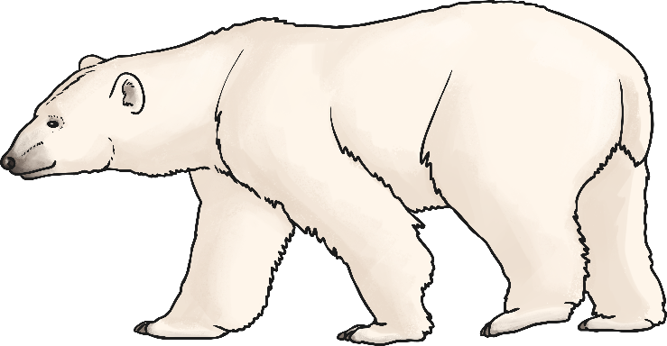
Marco Polo – The Storyteller
He often told of adventures to faraway places such as Cathay.
Marco had traveled to Cathay (China) and the Indies, the islands off of the China coast.
He told stories about meeting Kublai Khan, China’s ruler, and seeing amazing things – white bears, black stones that burned, and a place where night lasted all winter and day lasted all summer.

Slide 13
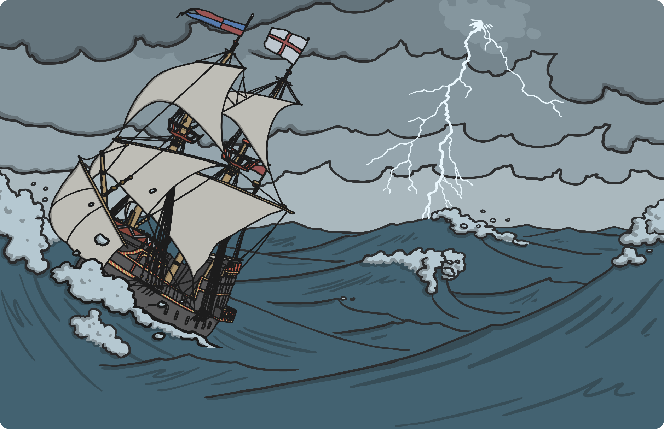
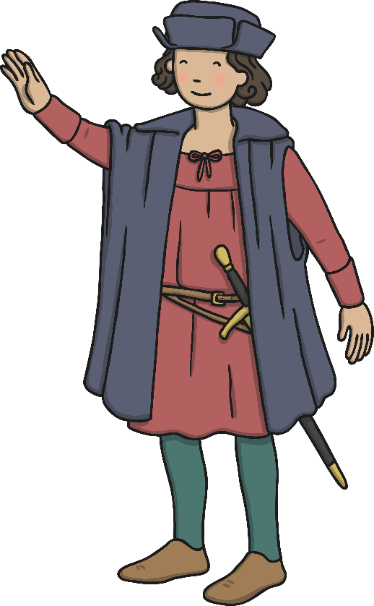
The Influence of Marco Polo
Marco Polo’s book influenced much of later Europe.
It influenced other explorers.
It even influenced Christopher Columbus.

Slide 14
