Slide 1

St Helens School Health and Wellbeing Newsletter
Spring Term 2020
Welcome to the 2020 Spring Term St Helens School Health and Wellbeing Newsletter
This newsletter has been designed to inform schools about the health and wellbeing services and support available for young people and their families, as well as school specific programmes, campaigns, service news, updates and developments.
We hope you find this useful. If you would like to contribute to the next edition, please email Julie Dunning at juliedunning@sthelens.gov.uk
Big 6 Advice Pathways Launched
St Helens CCG has worked with GPs, Children’s Community Nurses, Paediatricians and Pharmacists to develop the ‘Big 6’ pathways for conditions that children and young people most commonly attend A&E and the Urgent Treatment Centre with.
The Big 6 conditions are sepsis; fever; respiratory: bronchiolitis, croup and asthma; gastroenteritis; head injury; and abdominal pain.
All GPs in St Helens will have access to the Big 6 pathways which
include parent information leaflets giving a red, amber and green guide to managing the above illnesses safely at home.
All information, including the parent leaflets, is available on the St Helens CCG website
Coronavirus
For the latest information and advice about coronavirus, please visit the GOV.UK website
You can also visit the NHS website www.nhs.uk/coronavirus for information
Public Health England have issued guidance for educational settings:
COVID-19: guidance for educational settings
e-Bug has a range of fun lesson plans on hand washing and respiratory hygiene. Visit the e-Bug website for resources and information.

Slide 2

St Helens OK To ASK – Covid-19 Advice
Support for those who are struggling with their mental health during this difficult timehttp://www.oktoaskcampaign.co.uk/covid-19/
A list of fantastic resources, which includes boredom busting activities for those who are self isolating or feel isolated. Chatter Box includes things such as museum and aquarium virtual tours, online concerts, online learning and more.
http://www.oktoaskcampaign.co.uk/covid-19-digital-resources/
Supporting Young People’s Mental Health During Periods of Disruption
There is much that each one of us can do to support the wellbeing of those in our lives.
We don't know whether the coronavirus situation will impact on children and young people's mental health, but we think that it may.
We want to do all we can to prevent this from happening, or to minimise it. That's why we are giving this clear, simple advice to all those who are supporting children and young people - including to young people themselves.
There is much that each one of us can do to support the wellbeing of those in our lives, including children and young people who may already be vulnerable or suffering from mental health difficulties. Schools can encourage young people and parents/carers to access information, advice and guidance using the following link.
https://www.annafreud.org/what-we-do/anna-freud-learning-network/coronavirus/
Safe2Speak Domestic Abuse Service
Due to the current situation, Safe2Speak Domestic Abuse Services have moved away from face to face support with clients and will be providing all support via telephone/email and any other safe method of communication. Torus receptions have been closed to the public and IDVA/DA Outreach staff are working from home, however all are still contactable via the same methods. For more information please go to the website www.safe2speak.co.uk
The team are still accepting new referrals and service will continue as normal, except face to face support and group work. If you identify domestic abuse, please complete the MERIT which can be found on our website with all relevant referrals forms. Refuge is staffed and operating. If you are aware of anyone seeking support call our domestic abuse services (IDVA & Outreach) on 01744 743200
If you are aware of anyone seeking emergency accommodation in relation to domestic abuse they can contact our 24 hour helpline 01925 220541. Email safe2speak@torus.co.uk
Please share with your colleagues and partner agencies.

Slide 3




Information for Parents and Carers
Please feel free to share with others
Change for Life
Fun ideas to help your kids stay healthy
https://www.nhs.uk/change4life
Childline
It can be difficult to cope when there’s so much changing around us. You might be worried about schools closing, friends or relatives getting ill or what'll happen in the future.
https://www.childline.org.uk
Stay safe online
https://www.childline.org.uk/info-advice/bullying-abuse-safety/online-mobile-safety/staying-safe-online/
Education ideas for parents
https://www.bbc.co.uk/bitesize/learn
https://youngminds.org.uk/
Pete's home learning kit
https://www.dropbox.com/sh/y3ni3ymgtlbrndd/AABDqPQS9fopyDllT9VnFlnWa?dl=0&fbclid=IwAR1y_qXgQoSlG3gn3493UujII0KRN-_12R-QByln7opkvJoPac-QQixKAtc
Home learning packs from Ashfield school
https://www.ashfield.leicester.sch.uk/blue-pathway/?fbclid=IwAR1B_MRLWSjB_kwtyHOeLBZnG2kHwynPs1R_YCyoUn9mB5fU_q2S21Hs6Pg
Soundabout is offering live online inclusive music sessions
https://www.facebook.com/SoundaboutUK/
Ways to learn through play
https://www.youtube.com/channel/UCpkztoFHIgP4jpJDKWNWaHA

Slide 4
Ted Ed – Stay Curious
https://ed.ted.com/
Twinkl - free home learning booklets from EYFS through to GCSE, you can download them here:
https://www.twinkl.co.uk/resources/extra-subjects-parents/school-closures-category-free-resources-parents/school-closures-free-resources-parents
Oxford Owl - free e-books for ages 3-11, and range of how-to videos for maths. They also have a parents’ page which explains how spelling and grammar are taught in schools. If you ever wondered what a 'fronted adverbial' was, here's your chance to find out!
https://www.oxfordowl.co.uk/for-home/
Discovery Education - English, Maths & Science activities for KS1 & KS2 and also a section on coding
https://www.discoveryeducation.co.uk/free-resources
Topmarks - a collection of educational games covering all topics
https://www.topmarks.co.uk/
Have fun at home!
GoNoodle - videos designed to get kids moving.
https://www.gonoodle.com/
Seusville - a lot of activities, crafts and games based on the world of Dr Seuss
Children: https://www.seussville.com/
Parents: https://www.seussville.com/parents/
Thinking games - this website has links to a whole host of games designed to improve logical thinking skills
https://allinonehomeschool.com/thinking/
Highlights Kids - a popular US magazine for children, this site has lots of ideas for craft activities, recipes and an 'explore' section covering science questions and experiments
https://www.highlightskids.com/
Art for Kids Hub - this Youtube channel shows you how to draw a variety of things from animals to cartoon characters and even cars
https://www.youtube.com/channel/UC5XMF3Inoi8R9nSI8ChOsdQ
The Imagination Tree
Creative art and craft activities for the very youngest.
https://theimaginationtree.com/
The MET Office
https://www.metoffice.gov.uk/weather/learn-about/met-office-for-schools
RSPB - activities
https://www.rspb.org.uk/fun-and-learning/for-kids/games-and-activities/activities/
Paw Print Badges – Free challenge packs and other downloads. Indoor and outdoor.
https://www.pawprintbadges.co.uk/

Slide 5


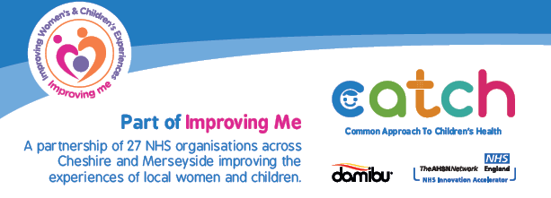
Kooth
Kooth has now launched in St Helens and is available for all 11-25 year olds. Kooth is a free online mental health and wellbeing support service for children and young people. Established in 2004, the service is accredited by the British Association for Counselling and Psychotherapy (BACP). Kooth has no waiting lists or thresholds. It is anonymous and
open 24/7, with counsellors available for one to one ‘chat’ sessions from mid-day to 10pm on weekdays and from 6pm until 10pm at weekends. Children and young people can access online tools such as a goal tracker, as well as self-help articles and live moderated discussion forums. There will be an introductory letter distributed to all schools and GP practices in St Helens initially, with promotional materials made available across the borough. St Helens will also have a designated promotional officer, who will be engaging with various organisations to attend school assemblies, presentations and various other forums to explain what Kooth brings and how it can be used. The service is commissioned by the NHS and available in more than 130 clinical commissioning group areas. Kooth has strict safeguarding procedures, robust clinical oversight and is fully moderated. For more information, visit the website www.kooth.com
CATCH App
The CATCH (Common Approach to Children’s Health) App is a FREE app providing local NHS-approved support and information to parents and carers of children aged 0-5. With the app you can:
Create profiles for your children to view health articles most relevant to your child’s age
Have timely reminders to alert you to key health dates, such as childhood immunisations
Browse and search local support, health articles and videos regularly reviewed by NHS clinicians
Find healthcare services in your area, such as pharmacies or dentists
You can download the app for FREE from the Apple and Google Play stores. Just search for ‘catch app’. You can also visit the CATCH App website for more information.

Slide 6


Public Health England School Zone
Public Health England’s School Zone website provides curriculum-linked materials, exciting lesson ideas, homework tasks and whole school activities for teachers to use with KS1, KS2 and secondary school pupils.
The resources include Change4Life (encouraging healthy eating and physical activity) and Rise Above, which includes topics such as social media, sleep, transition to secondary school, exam stress, bullying and more.
Visit the Public Health England School Zone website to download the resources. You can also sign up to the School Zone newsletter for updates and to keep informed when new resources become available.
Schools in Mind
Schools in Mind is a FREE network for school staff and allied professionals which shares practical, academic and clinical expertise regarding the wellbeing and mental health issues that affect schools. The network provides a trusted source of up-to-date and accessible information and resources that school leaders, teachers and support staff can use to support the mental health and wellbeing of the children and young people in their care. To sign up to the network, visit the Schools in Mind website
St Helens Wellbeing Service
Introducing the St Helens Wellbeing Service, which combines the Healthy Living Team, Smokefree St Helens and Specialist Weight Management services. The new service makes it easier for people to access all healthy living and wellbeing services through a ‘one stop shop’. The service offers a number of programmes/interventions including healthy eating, social wellbeing, mental health, oral health, getting active, stopping smoking, volunteering, weight management, health checks and infant feeding.
The service would like to find out from schools what programmes/interventions you have received previously from them (when known as Healthy Living) and if you would be interested in the service delivering any particular programmes/interventions in the future. Please complete the proforma which will be sent alongside this newsletter and email to chcp.sthelens@nhs.net For more information about the service call 01744 371111

Slide 7

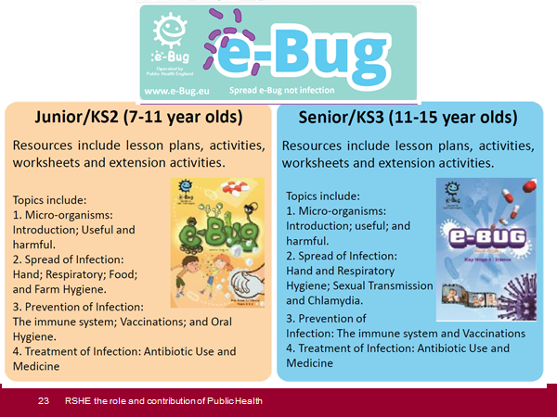
Good Childhood Inquiry
St Helens Good Childhood Inquiry moved into its second phase recently with team members from The Children’s Society doing face to face consultations with young people across the borough to find out more about their well-being and life in St Helens.
In total the team have met with over 600 young people in the borough including seven primary and secondary schools and 11 different smaller groups including 2 special schools, an LGBTQ group, refugee and migrant young people, young people with learning difficulties, young carers and many more.
In these face to face sessions young people shared their thoughts on safety in the local area, their aspirations for the future, mental health, and who supports them in their lives. The conversations were fantastic and gave the team a really rich picture of what it’s like to grow up in St Helens.
Young people’s views from the consultation will be added to the survey findings. Over 3,000 young people took the survey representing 70% of primary schools and two thirds of secondary schools in the Borough. In the coming weeks we’ll begin the process of reporting back all our findings across the borough and more information about what we have found, how you can learn more, and get involved in the next steps will be in the next edition of this newsletter.
E-Bug
To visit the website click on the link here: https://e-bug.eu/

Slide 8
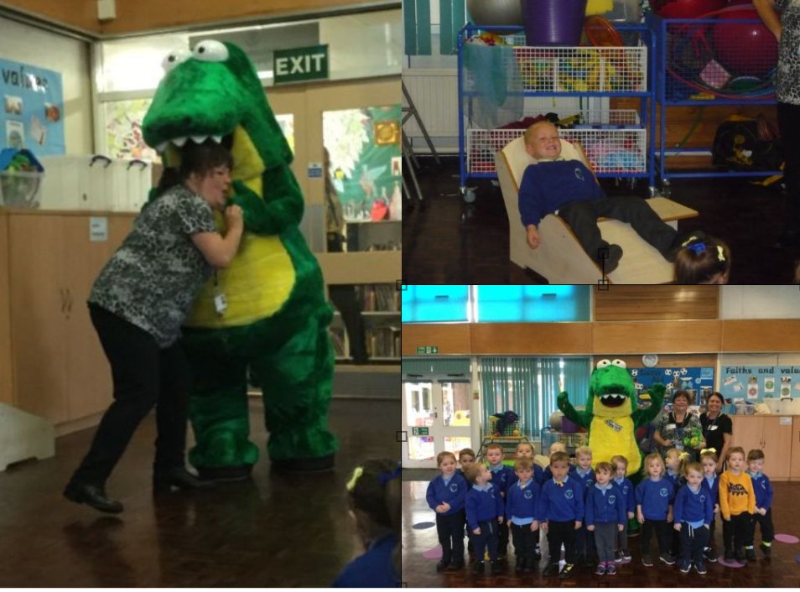
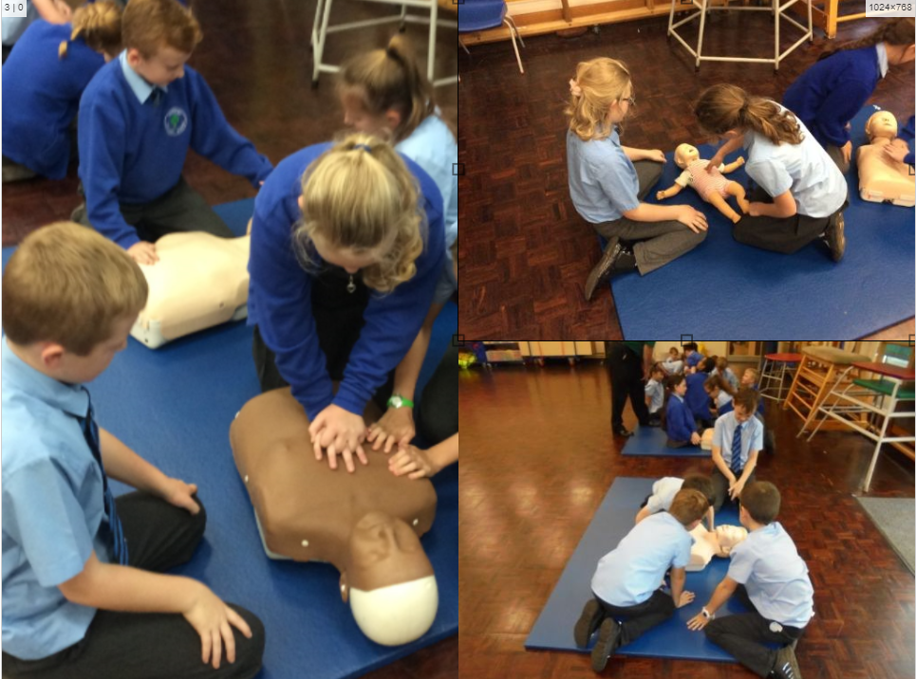
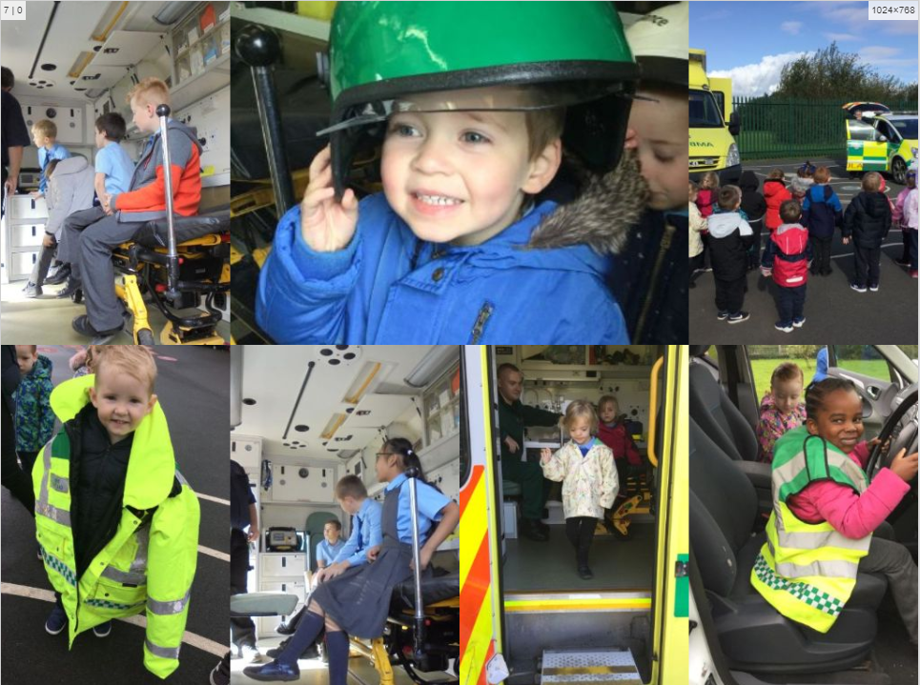
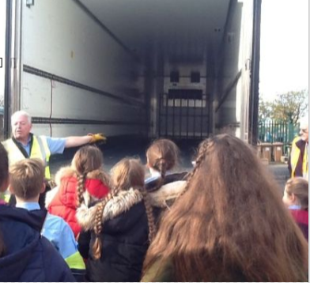
SCHOOL SPOTLIGHT
Sherdley Primary Wellbeing Week
Sherdley Primary School hosted their annual wellbeing week last term with lots of different activities:
The St Helens Wellbeing Service Oral Health Team, along with their mascot Croc-O-Smile, brought along a dental chair and a message for all Pre-School, Reception, Year 1 and 2 children about the importance of cleaning our teeth.
The Ambulance Service attended for 3 days, delivering CPR workshops to Year 2 – 6, and invited all children from Pre-School to Year 6 to visit, climb aboard and understand the role of the ambulances and paramedics.
The Road Safety Team brought a 16m DHL lorry to school to teach Year 3 - 6 about the importance of road safety and allowed the children to see how difficult it is for HGV drivers to hear noises/pedestrians around the vehicle when it’s running.
The Smokefree St Helens Service delivered some workshops with Year 4 around the impact of smoking on our lungs and lifestyles.
The Young People’s Drugs and Alcohol Team worked with Year 6 over 2 afternoons to find out what they already know or think they know about drugs and alcohol, then addressed misconceptions.
The Festival of Vision Tablet Academy from Telford attended; they worked primarily with Year 5, covering the functions and features of the eye and how to keep your eyes healthy. They also trained several staff members in how to test children's eyesight. This was also rolled out to the whole school in an afterschool session, where over 50 parents and children from other year groups came to have their eyes tested on site.
The St Helens Wellbeing Service worked with the EYFS (Early Years Foundation Stage) teaching them about healthy food choices, as well as the importance of physical activity. They also worked with several parents in Cook and Taste workshops.
Year 2 worked alongside the school’s cook Mel, to prepare the table lunch pots. Last year the children were asked why they didn't access the school salad bar. Feedback included being too high, not being able to reach and looking messy by the time it was their turn. Following this feedback, the school have introduced small table pots - these include fruit and vegetables that the children have requested e.g. strawberries, blueberries, watermelon, apples, raisins, cucumber, cherry tomatoes - the impact of listening to the children is that the school has significantly reduced their waste. A new set of fresh, replenished pots are put out when KS2 arrive for their lunch.

Slide 9

SCHOOL SPOTLIGHT
Promoting positive mental health and wellbeing at De La Salle
At De La Salle we ensure that our young people flourish, learn and succeed by providing opportunities for them, and the adults around them, to develop the strengths and coping skills that underpin resilience. We believe that supporting and promoting positive mental health and wellbeing is fundamental to our values, mission and culture.
The whole-school approach, directed by the student Wellbeing Ambassadors, is about developing a positive ethos and culture – where everyone feels that they belong. It involves working with families and making sure that the whole school community is welcoming, inclusive and respectful. It means maximising the students’ learning through promoting good mental health and wellbeing across the school through a meaningful curriculum, extra-curricular opportunities, early support for students, staff-student relationships, strong student and staff leadership and a commitment from all who are part of the school community.
All staff (teaching and non-teaching) receive regular training about recognising and responding to mental health issues as part of their regular child protection training, enabling them to keep students safe. Nominated members of staff have engaged with professional Mental Health First Aid training. Opportunities for staff who require more in depth knowledge is considered as part of the performance management process, and additional CPD is supported throughout the year where appropriate.
The trained team of student Wellbeing Ambassadors, supported by a member of the Senior Leadership Team and the School Chaplain, have led from creation to implementation to ensure opportunities to understand and maintain wellbeing reverberate through the culture and daily life of the school community. Their initiatives and voice have promoted the introduction of:
A wellbeing noticeboard to signpost students to school, local and national services
A wellbeing policy and website page
Mental Health Week – this includes assemblies, form activities, therapy dogs, yoga, art therapy, baking therapy, bake off, mindfulness, Glowfit
Wellbeing Wednesdays – offering weekly sessions in yoga, mindfulness, cooking, sport, Nintendo Wii Fit, weekly walk, Tackling The Blues, Mixed Martial Arts and creative activities
BOSS champions (students trained to promote the Barnardo’s service)
Wellbeing space (safe, calm and supportive environment)
Exam stress-busting workshops
De La Salle mental health and wellbeing leaflets for parents and pupils
Wellbeing plans to support students in need

Slide 10
SCHOOL SPOTLIGHT continued…
Promoting positive mental health and wellbeing at De La Salle
Here are some of the other activities/sessions which have been delivered at the school as part of promoting positive mental health and wellbeing:
The school has worked with the St Helens Wellbeing Service to create exciting and engaging opportunities for students, families and staff to support and maintain positive mental health and wellbeing:
  Oversubscribed with 150 students, and some very enthusiastic staff, the school participated in the Fit4All programme. These one hour sessions, delivered by two personal trainers from the St Helens Wellbeing Service, combined a range of exercise routines and nutritional information to equip the students to make healthy and informed lifestyle choices. To complement these sessions, the school is also running the Food4Life and the Cook and Taste programmes which help the students in menu planning, costing and cooking a range of nutritious, economical family meals.
  The St Helens Wellbeing Service have also delivered training to staff and students, which includes whole staff mental health awareness training, student sessions to manage stress and anxiety, ASK training for key staff and Youth Connect 5 sessions for parents and carers. In addition, a cross-curricular team of staff have participated in a three phase training programme from the Education Psychology service. This training has enhanced skills and understanding of pertinent educational psychology theories and research to support colleagues in the development of attachment aware and asset based approaches to teaching.
The Teenage Advice Zone (TAZ) delivers Healthy Bodies, Healthy Minds group work, which aims to enhance life skills and self-esteem by expanding the knowledge base of young people to make healthier lifestyle choices.
The Young People’s Drug and Alcohol Team (YPDAAT) delivers Life Matters group work to improve awareness and management of risk taking behaviours and environments, empowering them to maintain healthy relationships and choices.
The school now has an ADHD Ambassador who has promoted an understanding of what ADHD is, and isn’t, by meeting with staff, students and parents. This has subsequently led to a neurodiversity working party who have created an exciting display in the heart of the school to further support a truly inclusive community.
If you would like your school to be included in the next School Spotlight feature, please email melissahalligan@sthelens.gov.uk

