Slide 1

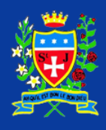
Class Collective Worship
Summer 2025

Slide 2

Helping Children to plan:
READINGS MUST BE FROM THE ‘GOOD NEWS’ BIBLE.
The following link includes responses for psalms (select the Sunday date for the readings):
https://www.catholicgallery.org/mass-reading/daily-mass-readings-2024
What will you put on the focus table?
Gather
What music might you play?
How will you arrange the children?
Will you light the candle(s)?
Can you find an appropriate picture / poster / artefact? – explain it.
Respond
How will you help your friends to reflect on what they have read?
Will you say prayers that need a response?
Who will lead the prayers?
Listen
Who will read?
What Scripture will you read?
Will you act out the reading?
Will you use a Power Point presentation?
Go Forth
What do you want your friends to
take away from this Act of
Worship to remember its
message?

Slide 3
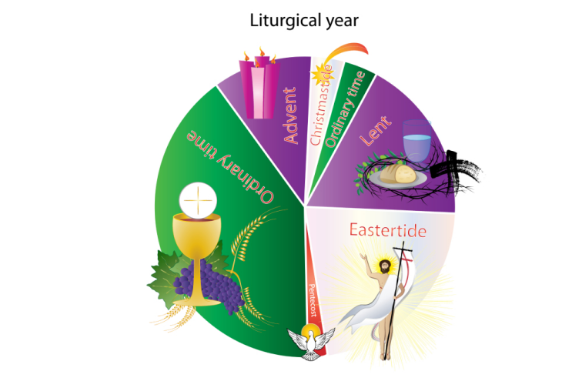
Collective Worship prayer themes overview Summer1 2025
Wk Liturgical colour | Date | Reading | Theme
1 | 21.4.25 | Easter Day: Acts 10.34-43; Psalm 118.1-2,14-24; 1 Corinthians 15.19-26; John 20.1-18; Luke 24.1-12 | 20 - 26 April 2025 Do you see what I see?
2 | 28.4.25 | Easter 2: Acts 5.27-32; Psalm 150; Revelation 1.4-8; John 20.19-31 | Locking and unlocking
3 | 5.5.25 | Easter 3: Acts 9.1-6,(7-20); Psalm 30; Revelation 5.11-14; John 21.1-19 | A change of perspective
4 | 12.5.25 | Easter 4: Acts 9.36-43; Psalm 23; Revelation 7.9-17; John 10.22-30 | Called to live Easter 4: Acts 9.36-43; Psalm 23; Revelation 7.9-17; John 10.22-30
5 | 19.5.25 | Easter 5: Acts 11.1-18; Psalm 148; Revelation 21.1-6; John 13.31-35

Slide 4
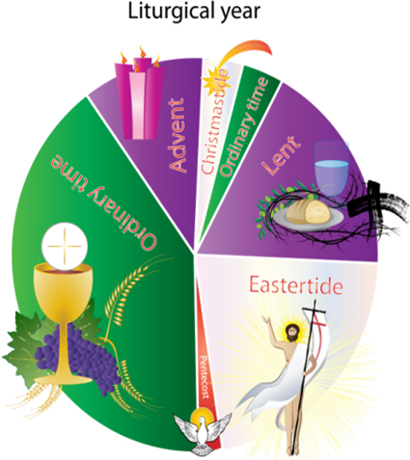
Collective Worship prayer themes overview Summer 2 2025
Wk Liturgical colour | Date | Reading | Theme
 | 26.5.25 | HALF TERM
6 | 2.6.25 | Easter 7: Acts 16.16-34; Psalm 97; Revelation 22.12-14,16-17,20-21; John 17.20-26 | Freeing captives
7 | 9.6.25 | Pentecost: Acts 2.1-21; Genesis 11.1-9; Psalm 104.24-34,35b; John 14.8-17,(25-27) | Unity in diversity
8 | 16.6.25 | Trinity Sunday: Proverbs 8.1-4,22-31; Psalm 8; Romans 5.1-5; John 16.12-15 | God invites us in
9 | 23.6.25 | Proper 7: Isaiah 65.1-9; Psalm 22.19-28; Galatians 3.23-29; Luke 8.26-39 | Change for the better
10 | 30.6.25 | Proper 8: 1 Kings 19.15-16,19-21; Psalm 16; Galatians 5.1,13-25; Luke 9.51-62 | Free to be kind
11
12

Slide 5
Summer Wk: 1 Date: 21.4.25
Theme / Readings for this week: Do you see what I see?
Easter Day: Acts 10.34-43; Psalm 118.1-2,14-24; 1 Corinthians 15.19-26; John 20.1-18; Luke 24.1-12
 | Mon KS2 CW | Tues KS1 CW | Weds KS2 CW | Thurs KS2 CW | Fri Whole School
Resources
Gather
Word
Respond
Going Forth

Slide 6
Summer Wk: 2 Date: 28.4.25
Theme / Readings for this week: Locking and unlocking
Easter 2: Acts 5.27-32; Psalm 150; Revelation 1.4-8; John 20.19-31
 | Mon KS2 CW | Tues KS1 CW | Weds KS2 CW | Thurs KS2 CW | Fri Whole School
Resources
Gather
Word
Respond
Going Forth

Slide 7
Summer Wk:3 Date: 5.5.25
Theme / Readings for this week:A change of perspective
Easter 3: Acts 9.1-6,(7-20); Psalm 30; Revelation 5.11-14; John 21.1-19
 | Mon KS2 CW | Tues KS1 CW | Weds KS2 CW | Thurs KS2 CW | Fri Whole School
Resources
Gather
Word
Respond
Going Forth

Slide 8
Summer Wk: 4 Date: 12.5.25
Theme / Readings for this week:Called to live
Easter 4: Acts 9.36-43; Psalm 23; Revelation 7.9-17; John 10.22-30
 | Mon KS2 CW | Tues KS1 CW | Weds KS2 CW | Thurs KS2 CW | Fri Whole School
Resources
Gather
Word
Respond
Going Forth

Slide 9
Summer Wk: 5 Date: 30.9.24
Theme / Readings for this week: Easter 5: Acts 11.1-18; Psalm 148; Revelation 21.1-6; John 13.31-35
 | Mon KS2 CW | Tues KS1 CW | Weds KS2 CW | Thurs KS2 CW | Fri Whole School
Resources
Gather
Word
Respond
Going Forth

Slide 10
Summer Wk:6 Date:2.6.25
Theme / Readings for this week:Freeing captives
Easter 7: Acts 16.16-34; Psalm 97; Revelation 22.12-14,16-17,20-21; John 17.20-26
 | Mon KS2 CW | Tues KS1 CW | Weds KS2 CW | Thurs KS2 CW | Fri Whole School
Resources
Gather
Word
Respond
Going Forth

Slide 11
Summer Wk: 7 Date: 9.6.25
Theme / Readings for this week: Unity in diversity
Pentecost: Acts 2.1-21; Genesis 11.1-9; Psalm 104.24-34,35b; John 14.8-17,(25-27)
 | Mon KS2 CW | Tues KS1 CW | Weds KS2 CW | Thurs KS2 CW | Fri Whole School
Resources
Gather
Word
Respond
Going Forth

Slide 12
Summer Wk: 8 Date: 16.6.25
Theme / Readings for this week: God invites us in
Trinity Sunday: Proverbs 8.1-4,22-31; Psalm 8; Romans 5.1-5; John 16.12-15
 | Mon KS2 CW | Tues KS1 CW | Weds KS2 CW | Thurs KS2 CW | Fri Whole School
Resources
Gather
Word
Respond
Going Forth

Slide 13
Summer Wk: 9 Date:23.6.25
Theme / Readings for this week:
Change for the better
Proper 7: Isaiah 65.1-9; Psalm 22.19-28; Galatians 3.23-29; Luke 8.26-39
 | Mon KS2 CW | Tues KS1 CW | Weds KS2 CW | Thurs KS2 CW | Fri Whole School
Resources
Gather
Word
Respond
Going Forth

Slide 14
Summer Wk: 10 Date:30.6.25
Theme / Readings for this week:
Free to be kind
Proper 8: 1 Kings 19.15-16,19-21; Psalm 16; Galatians 5.1,13-25; Luke 9.51-62
 | Mon KS2 CW | Tues KS1 CW | Weds KS2 CW | Thurs KS2 CW | Fri Whole School
Resources
Gather
Word
Respond
Going Forth

Slide 15
Summer Wk:11 Date:
Theme / Readings for this week:
 | Mon KS2 CW | Tues KS1 CW | Weds KS2 CW | Thurs KS2 CW | Fri Whole School
Resources
Gather
Word
Respond
Going Forth

Slide 16
Summer Wk:12 Date:
Theme / Readings for this week:
 | Mon KS2 CW | Tues KS1 CW | Weds KS2 CW | Thurs KS2 CW | Fri Whole School
Resources
Gather
Word
Respond
Going Forth

Slide 17
Summer Wk:13 Date:
Theme / Readings for this week:
 | Mon KS2 CW | Tues KS1 CW | Weds KS2 CW | Thurs KS2 CW | Fri Whole School
Resources
Gather
Word
Respond
Going Forth

Slide 18
Summer Wk: Date:
Theme / Readings for this week:
 | Mon KS2 CW | Tues KS1 CW | Weds KS2 CW | Thurs KS2 CW | Fri Whole School
Resources
Gather
Word
Respond
Going Forth

