Slide 1

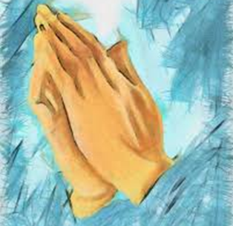
Prayer and liturgy
St Julie Primary School
Our School Prayers

Slide 2

Prayer contents(Click to link to prayer)
Hail Mary
Grace Before Meals KS1
The Lords Prayer
Grace Before Meals KS2 Meals KS2
Act of Sorrow
Grace After meals
Act of Faith, Hope and love
Eternal Rest
Glory Be
Mini Vinnies
The Memorare

Slide 3
Hail Mary
Hail Mary, full of grace,
the Lord is with thee:
blessed art thou among women,
and blessed is the fruit of thy womb, Jesus.
Holy Mary, Mother of God,
pray for us sinners,
now and at the hour of our death.
Amen.

Slide 4
The LorD’s Prayer
Our Father who art in heaven,
hallowed be thy name.
Thy kingdom come,
Thy will be done
on earth, as it is in heaven.
Give us this day our daily bread,
and forgive us our trespasses,
as we forgive those who trespass against us,
and lead us not into temptation,
but deliver us from evil.
Amen.

Slide 5
Grace Before Meals KS1
Bless us, O God, as we sit together.
Bless the food we eat today.
Bless the hands that made the food.
Bless us, O God.
Amen.

Slide 6
Grace Before Meals KS2
Bless us O’ Lord, and these, your gifts,
Which we are about to receive from your bounty,
Through Christ, Our Lord,
Amen

Slide 7
Grace after meals
Thank you, God, for the food we have eaten.
Thank you, God, for all our friends.
Thank you, God, for everything,
Thank you God.
Amen.

Slide 8
Act of Sorrow
O my God,
Because you are so good,
I am very sorry that I have sinned against you,
And with the help of your grace,
I will not sin again.
Amen

Slide 9
Act of Faith,HOPE AND LOVE
Jesus I believe in you
Jesus I hope in you
Jesus I love you

Slide 10
Glory Be
Glory be to the Father,
And to the Son,
And to the Holy Spirit,
As it was in the beginning,
Is now, and ever shall be,
World without end,
Amen

Slide 11
ETERNAL REST
Eternal rest grant to them O Lord,
And let perpetual light shine upon them,
May they rest in peace,
Amen

Slide 12
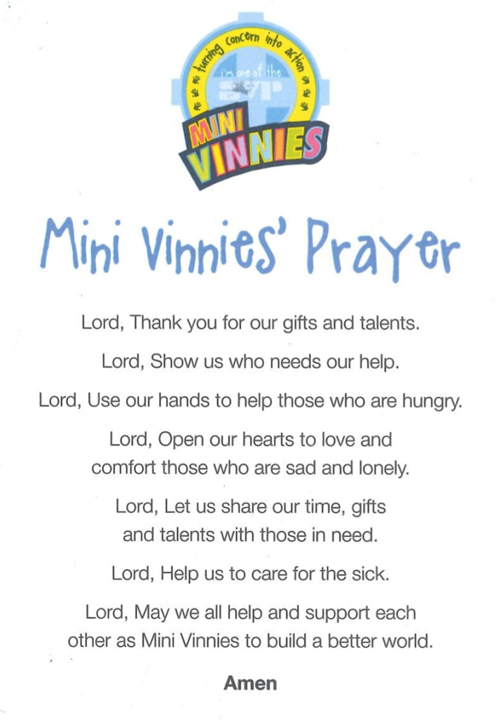

Slide 13
The Memorare
Remember, O most gracious Virgin Mary, that never was it known that anyone who fled to thy protection, implored thy help, or sought thine intercession was left unaided.
Inspired by this confidence, I fly unto thee, O Virgin of virgins, my mother; to thee do I come, before thee I stand, sinful and sorrowful. O Mother of the Word Incarnate, despise not my petitions, but in thy mercy hear and answer me.
Amen.

