Slide 1



Holocaust Remembrance 2019
St Helens Town Hall

Slide 2
Each year the school councillors from Y5 and Y6 honour the memory of those who died in the holocaust.
We pray for people around the world today who live in oppression and fear.

Slide 3
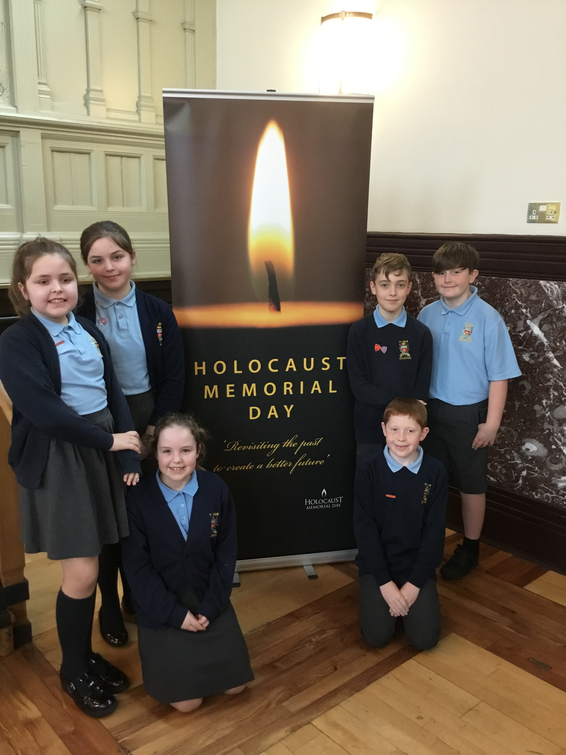

Slide 4
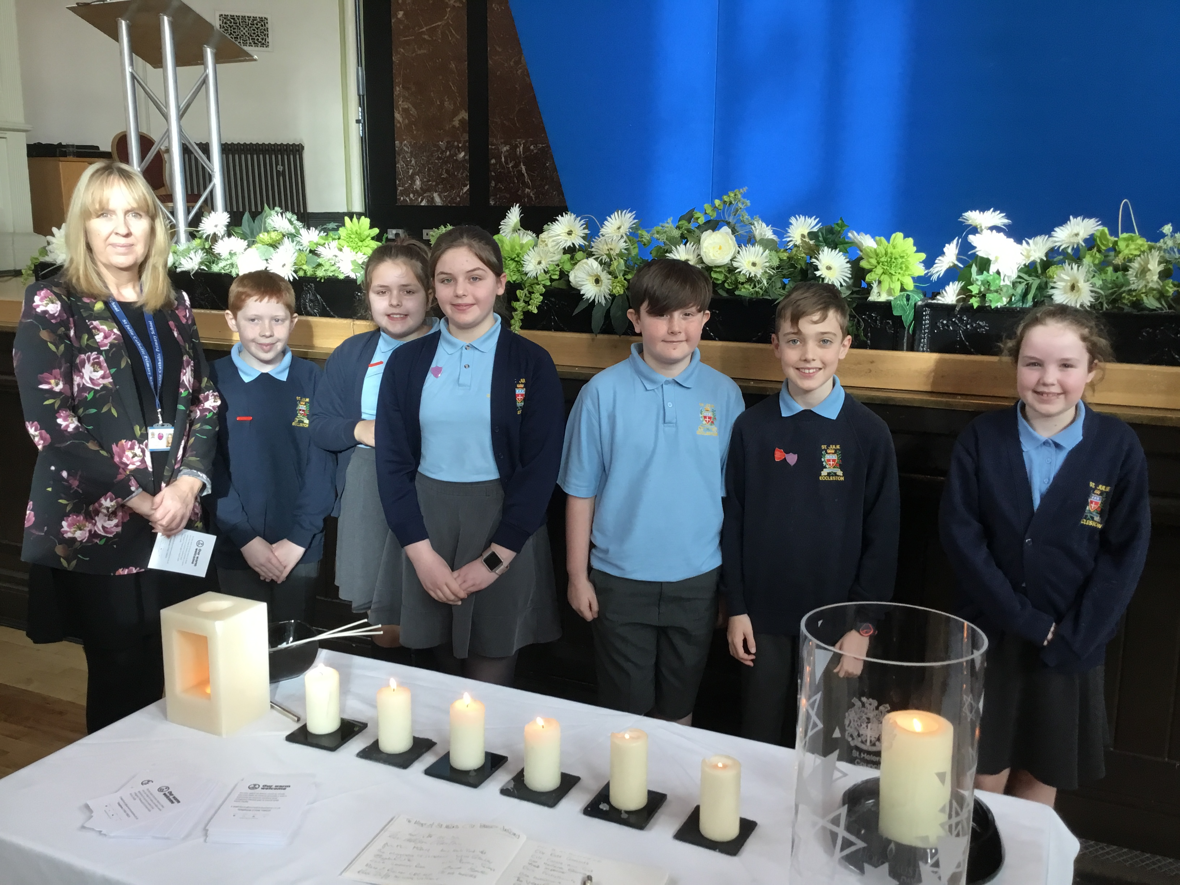

Slide 5
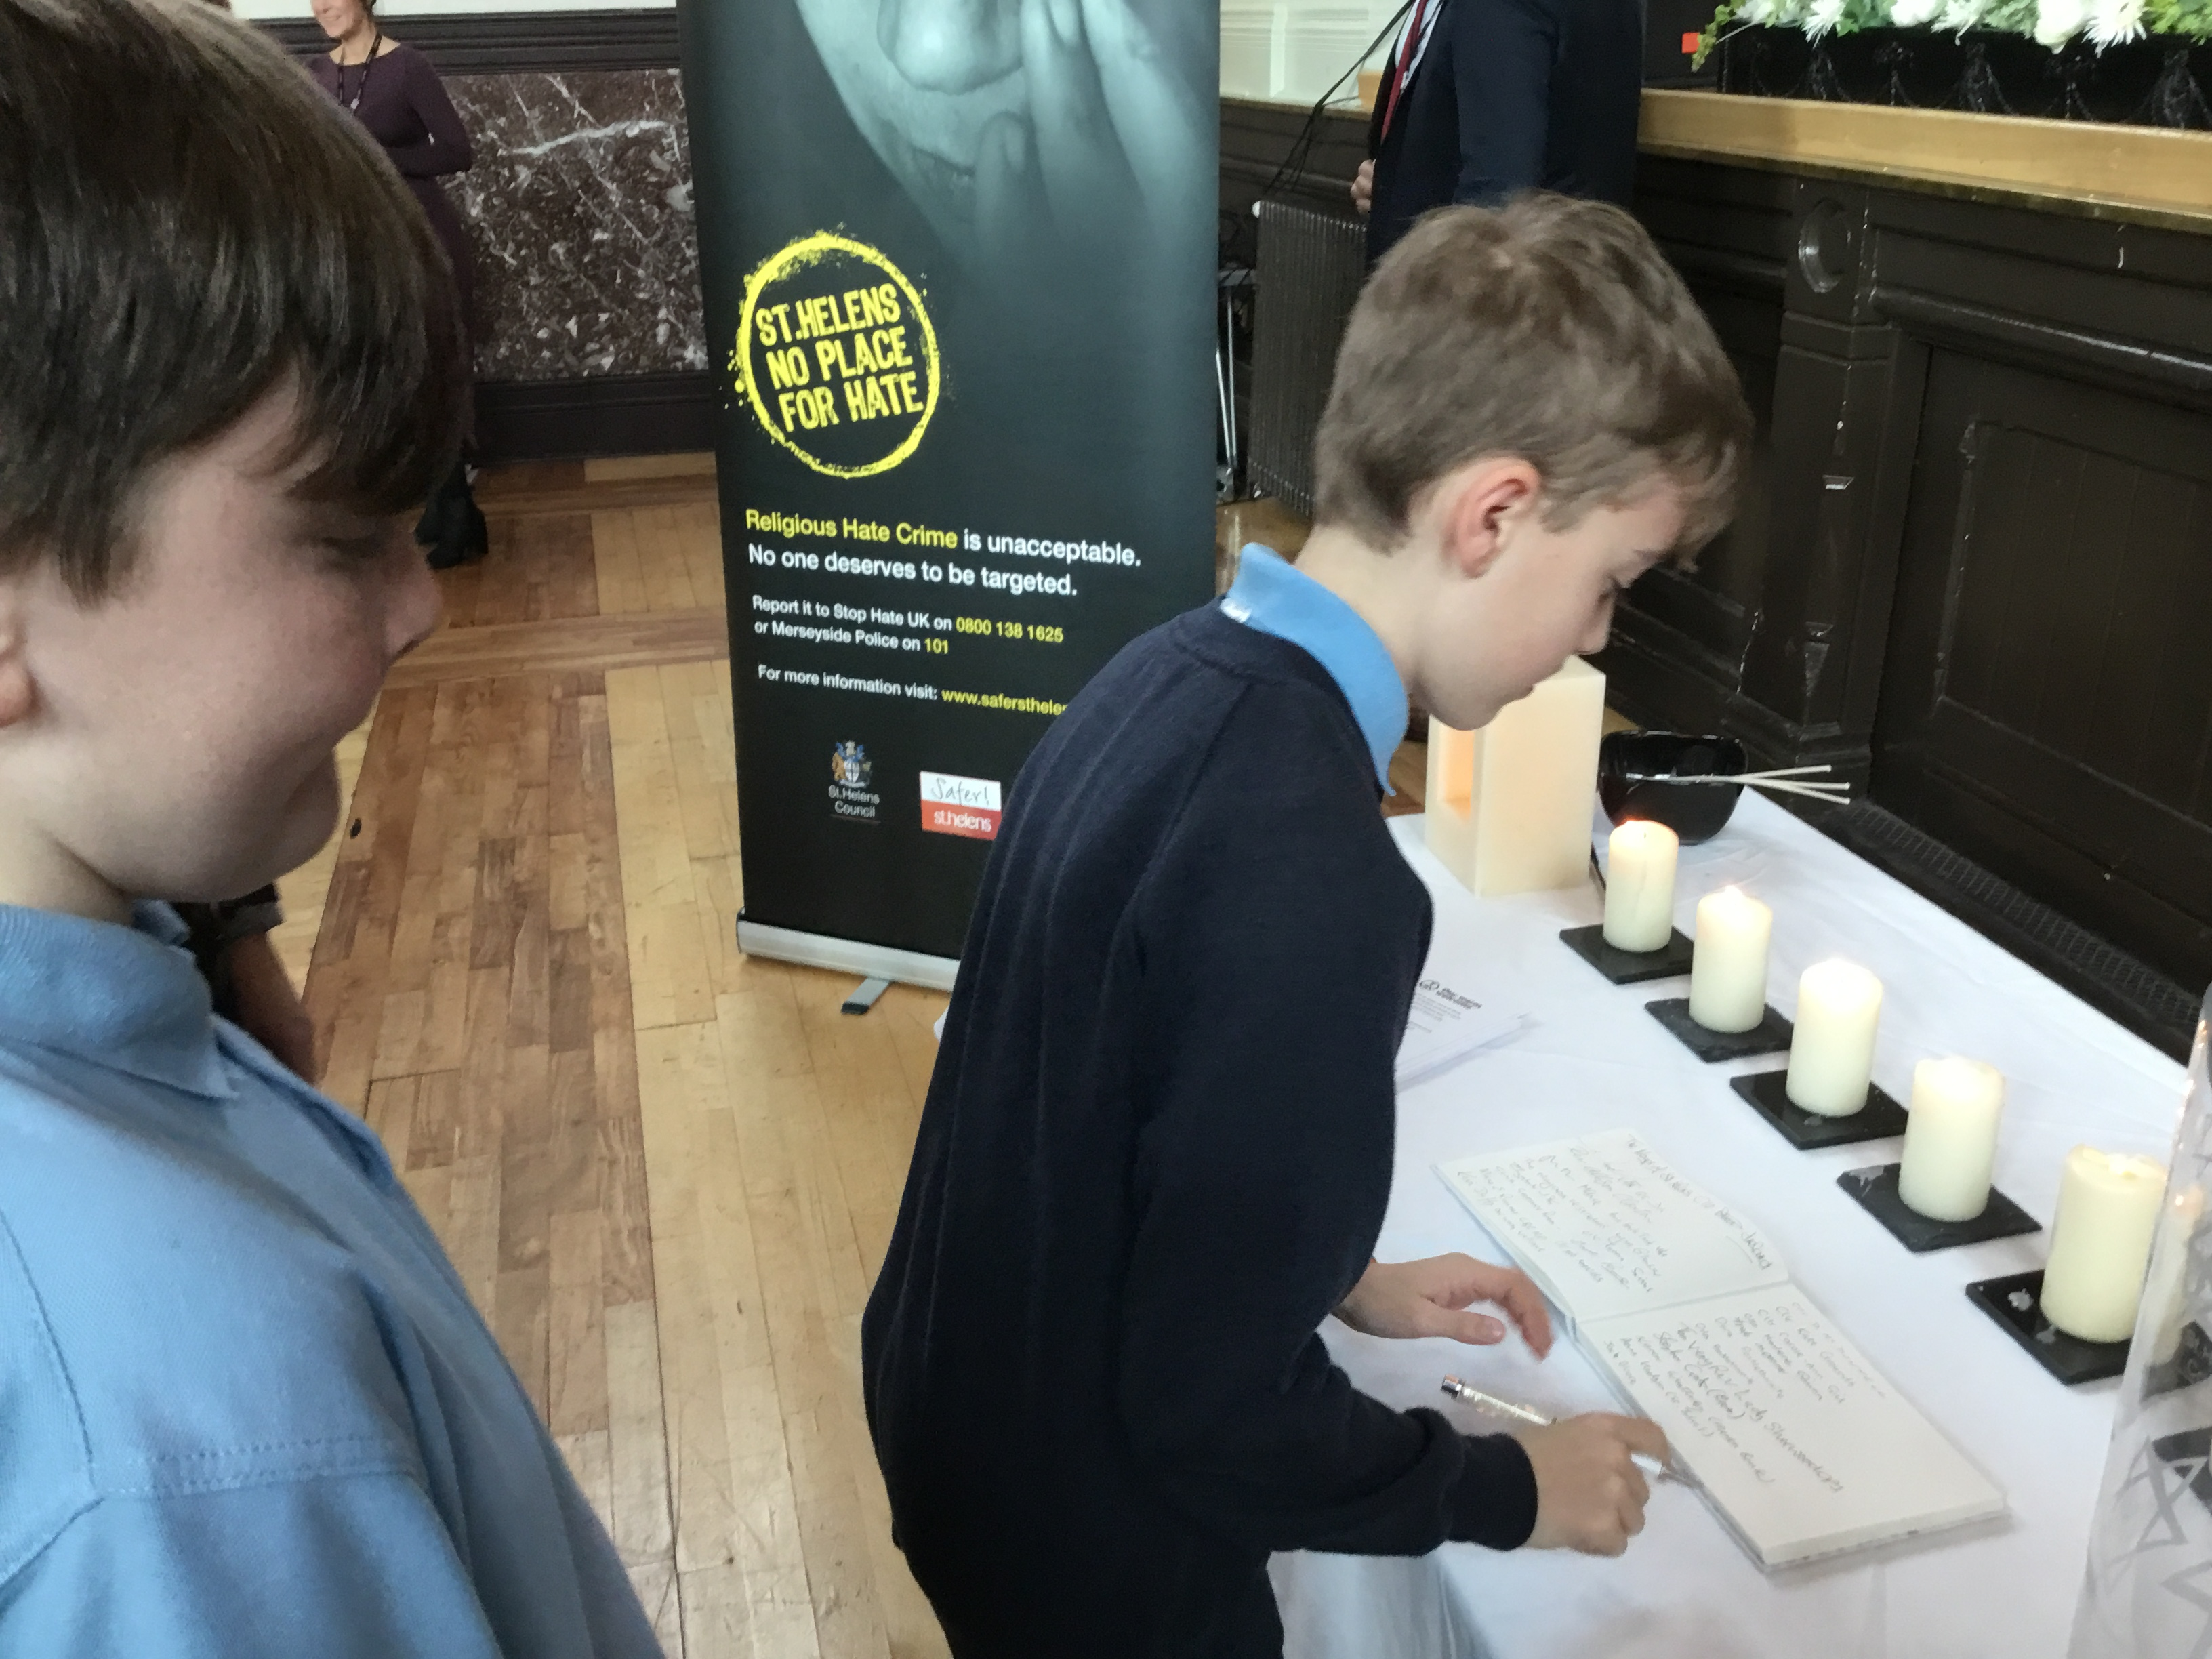

Slide 6
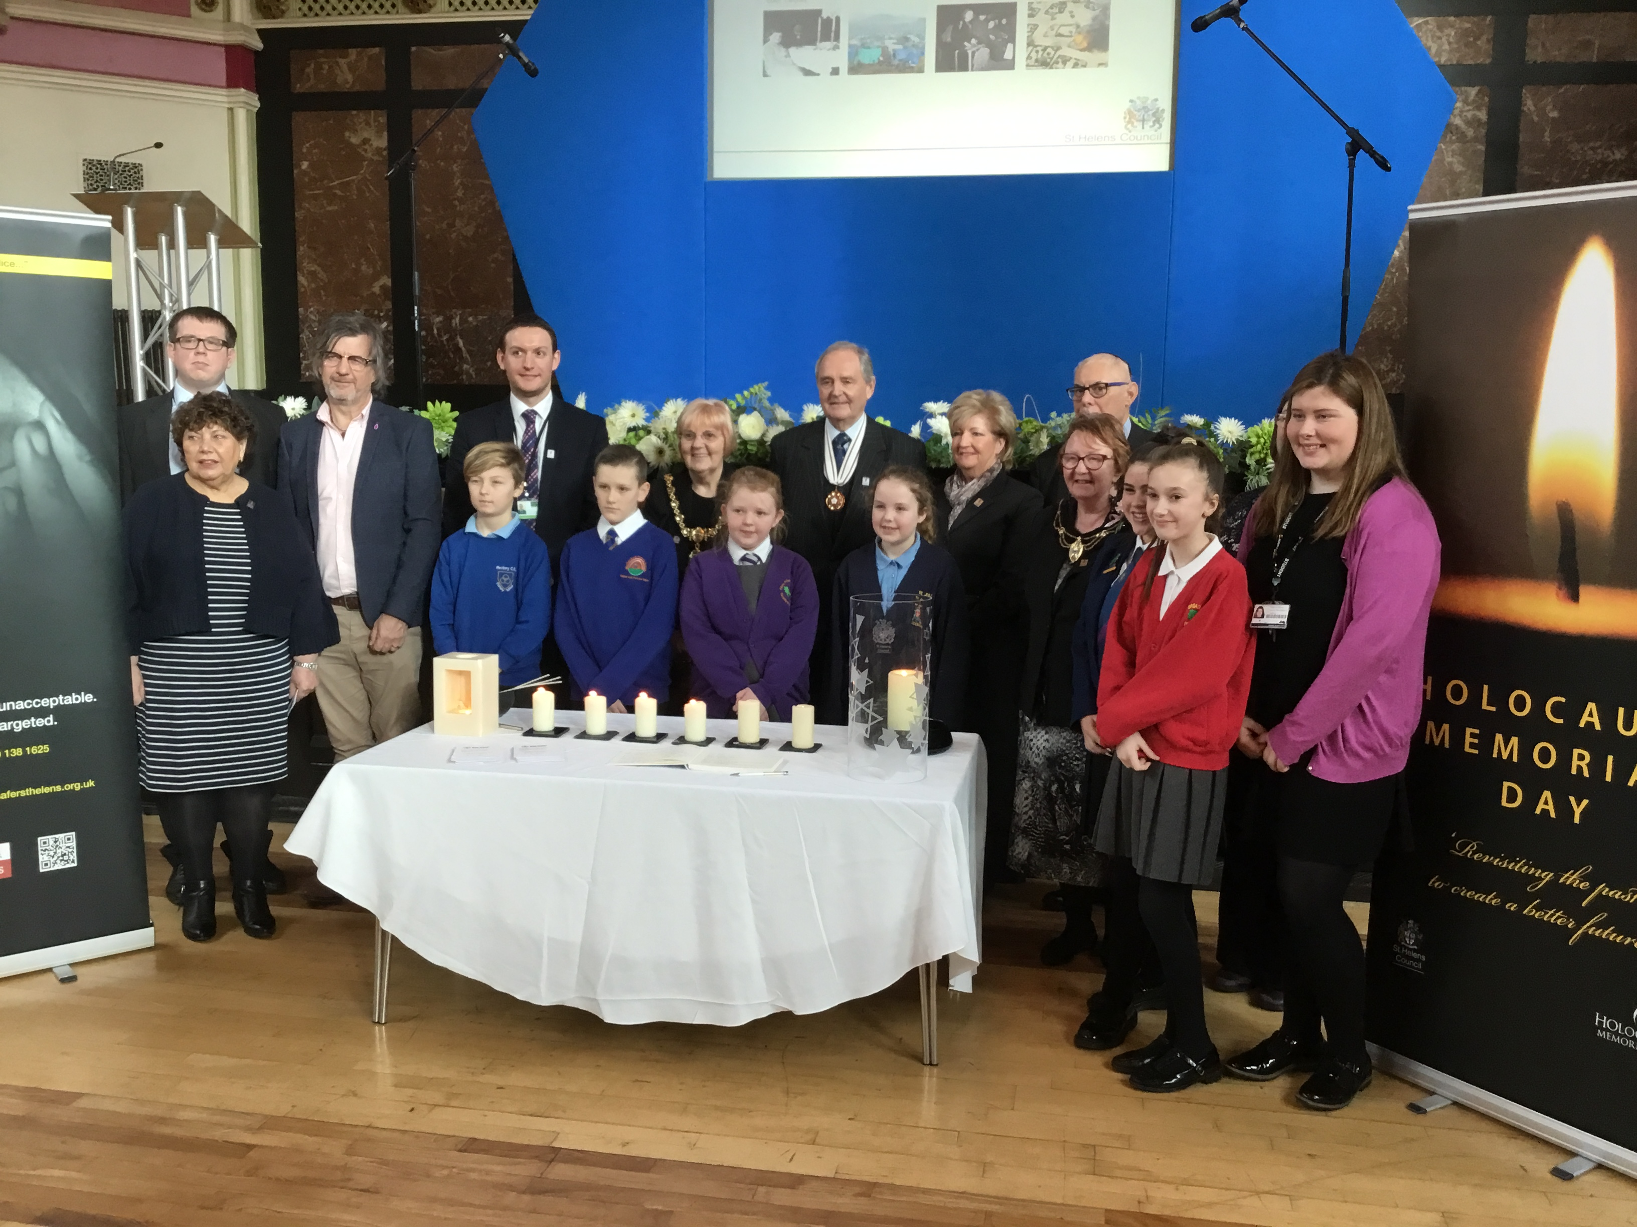

Slide 7
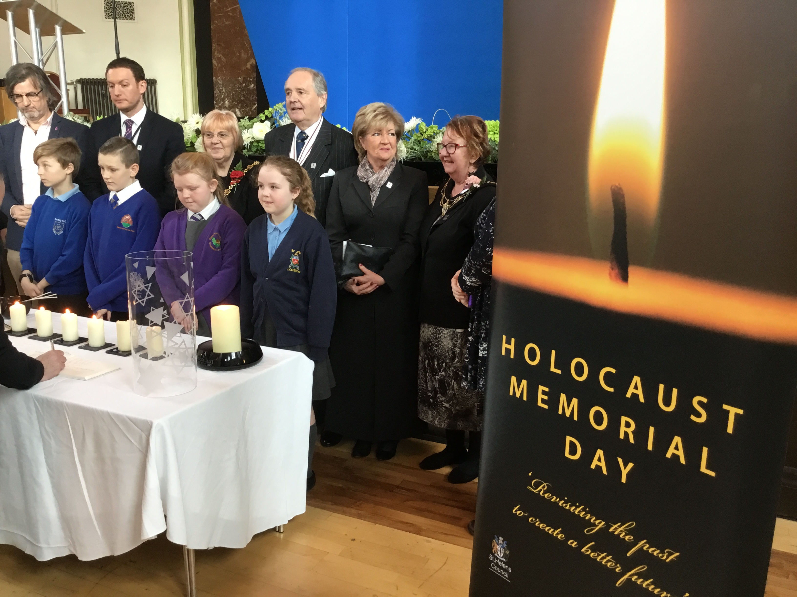

Slide 8
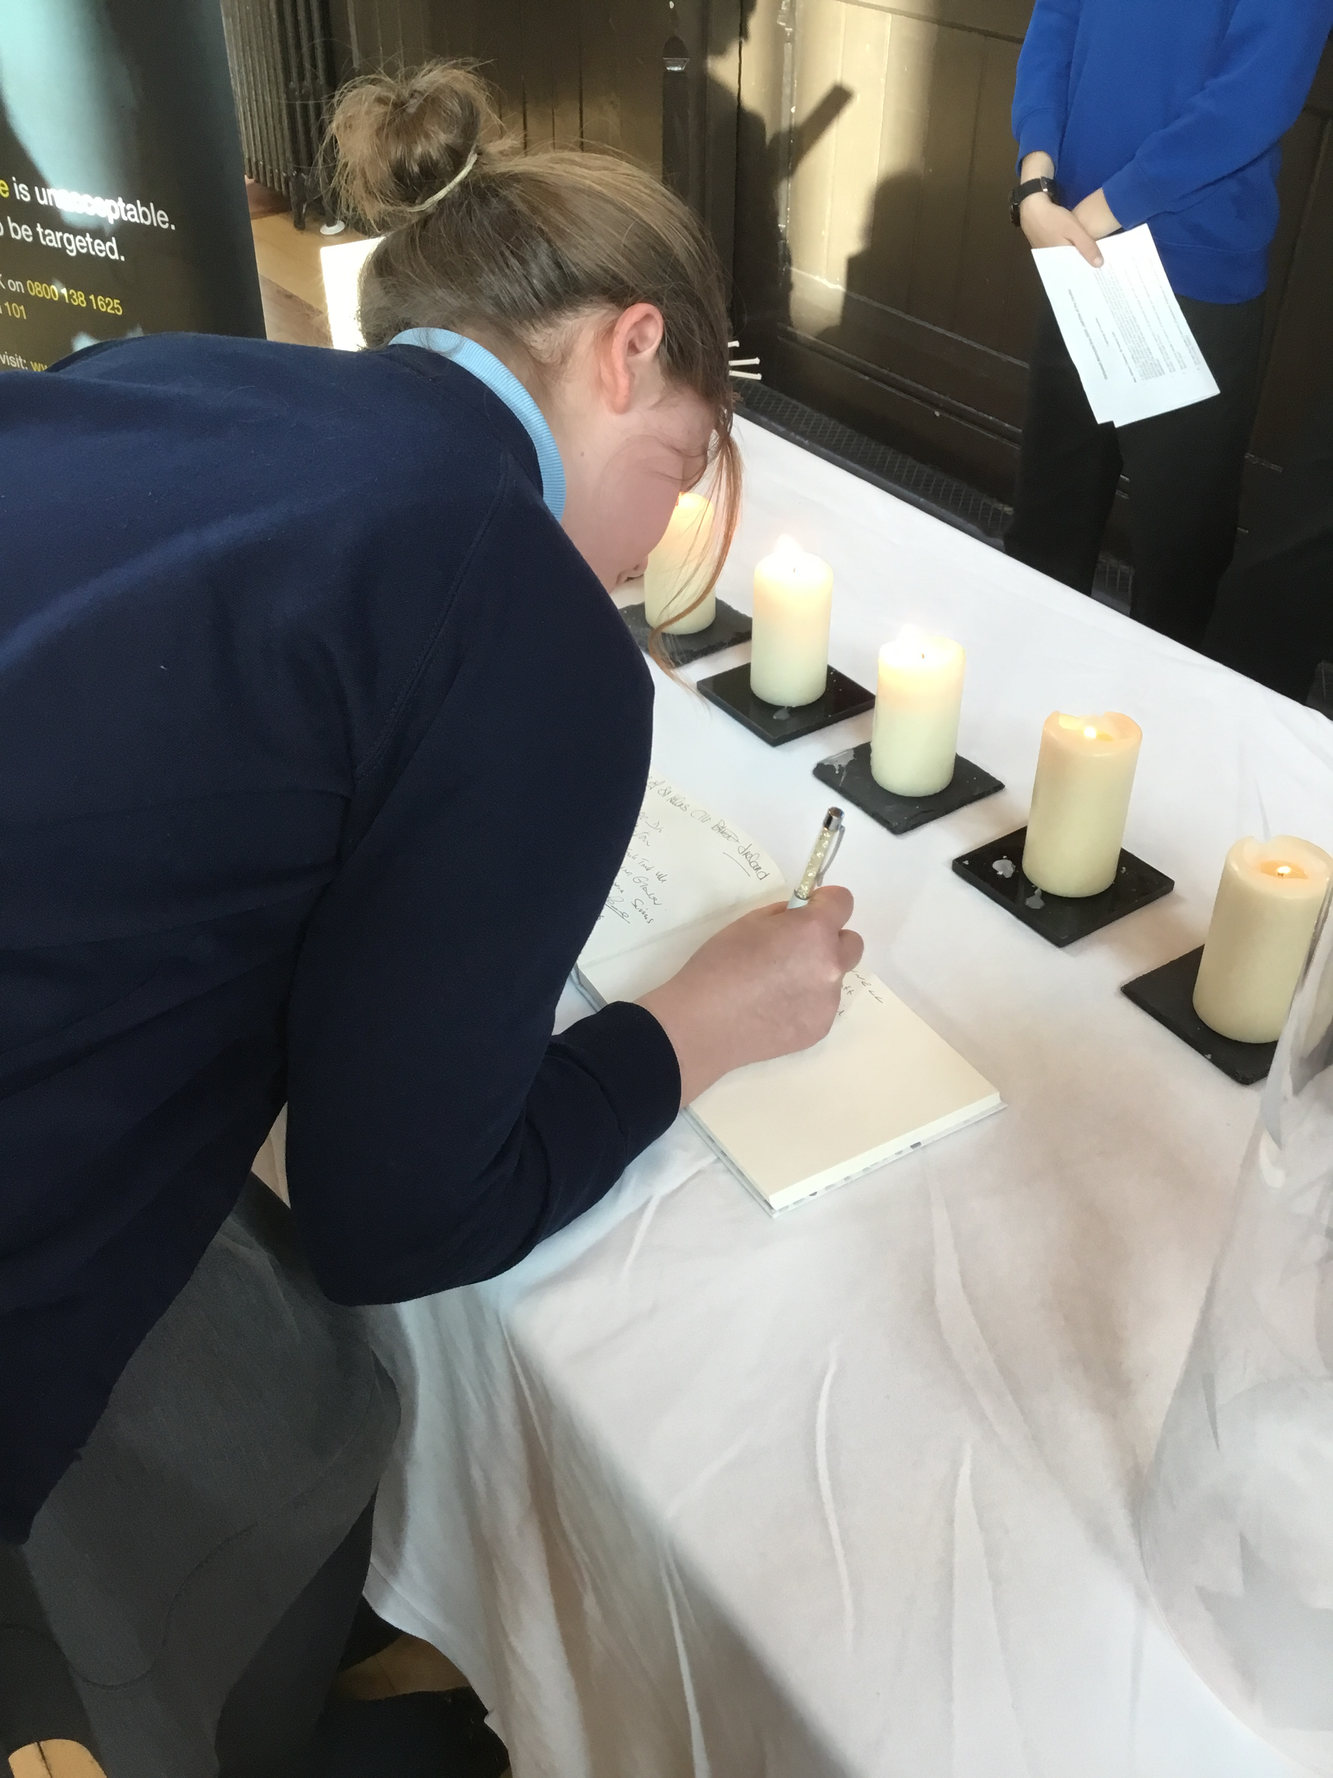

Slide 9
