Slide 1

Grandparents’ Afternoon
December 2018

Slide 2
Faith in Action
In St Julie’s, we believe that we should “walk in the footsteps of Jesus”. Therefore, we do not just read about what Jesus did – we also try to do what he preached.
On Monday, 10th December, we planned and carried out a Grandparents’ Afternoon. During the afternoon we………

Slide 3
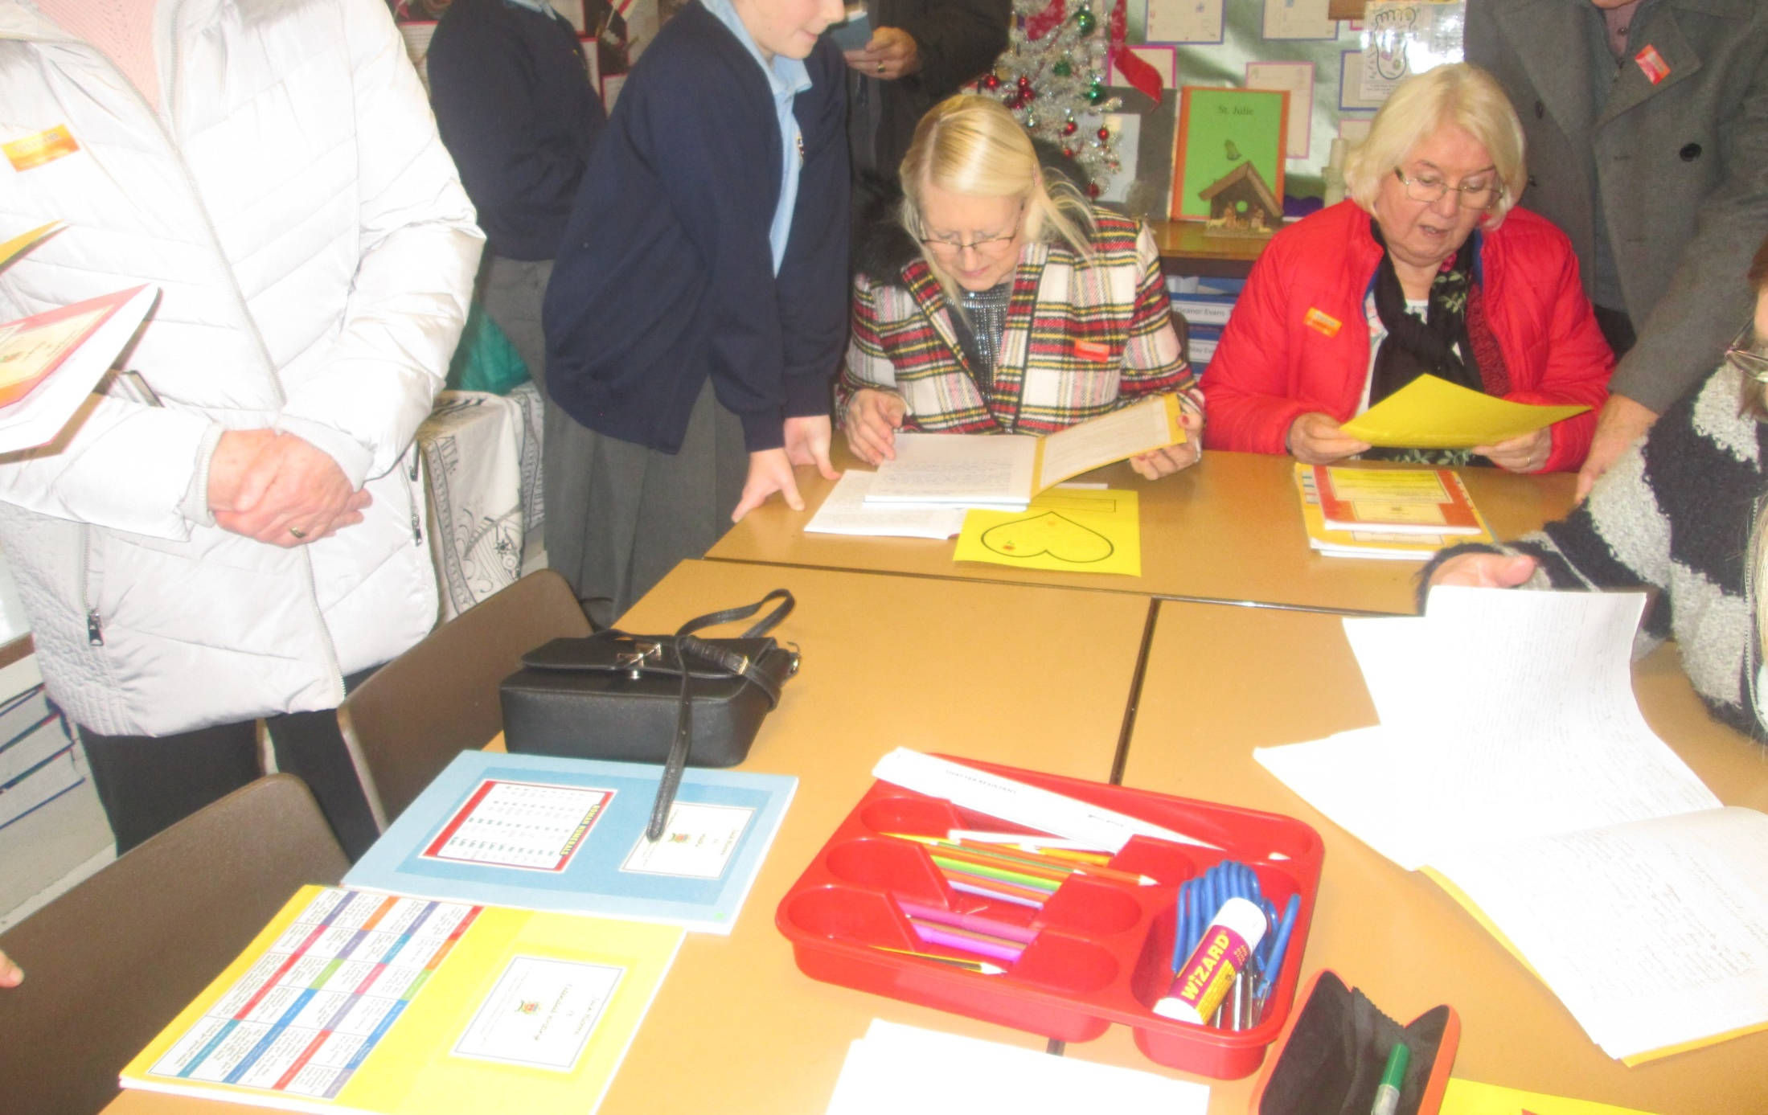
We shared our work with our grandparents

Slide 4
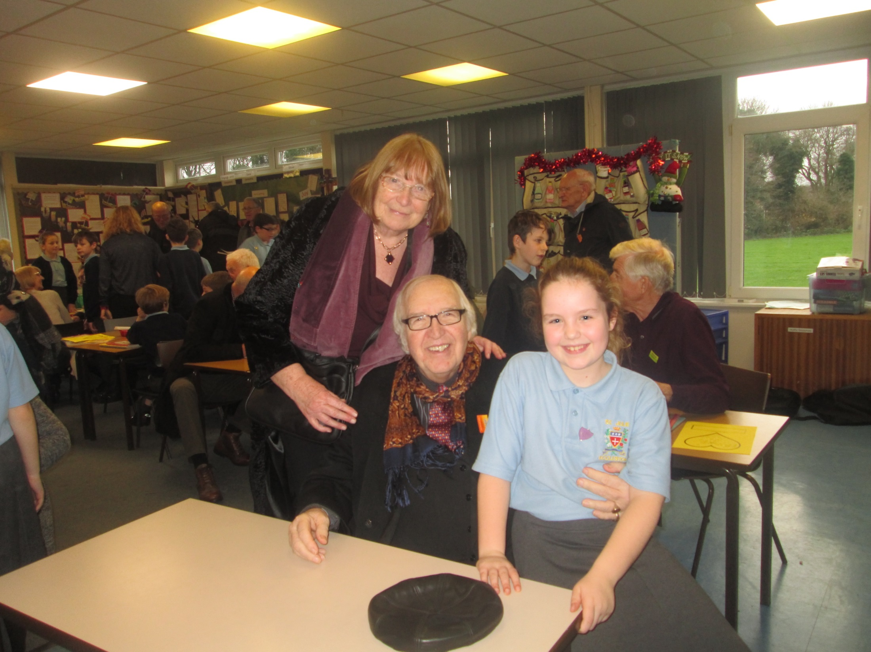

Slide 5
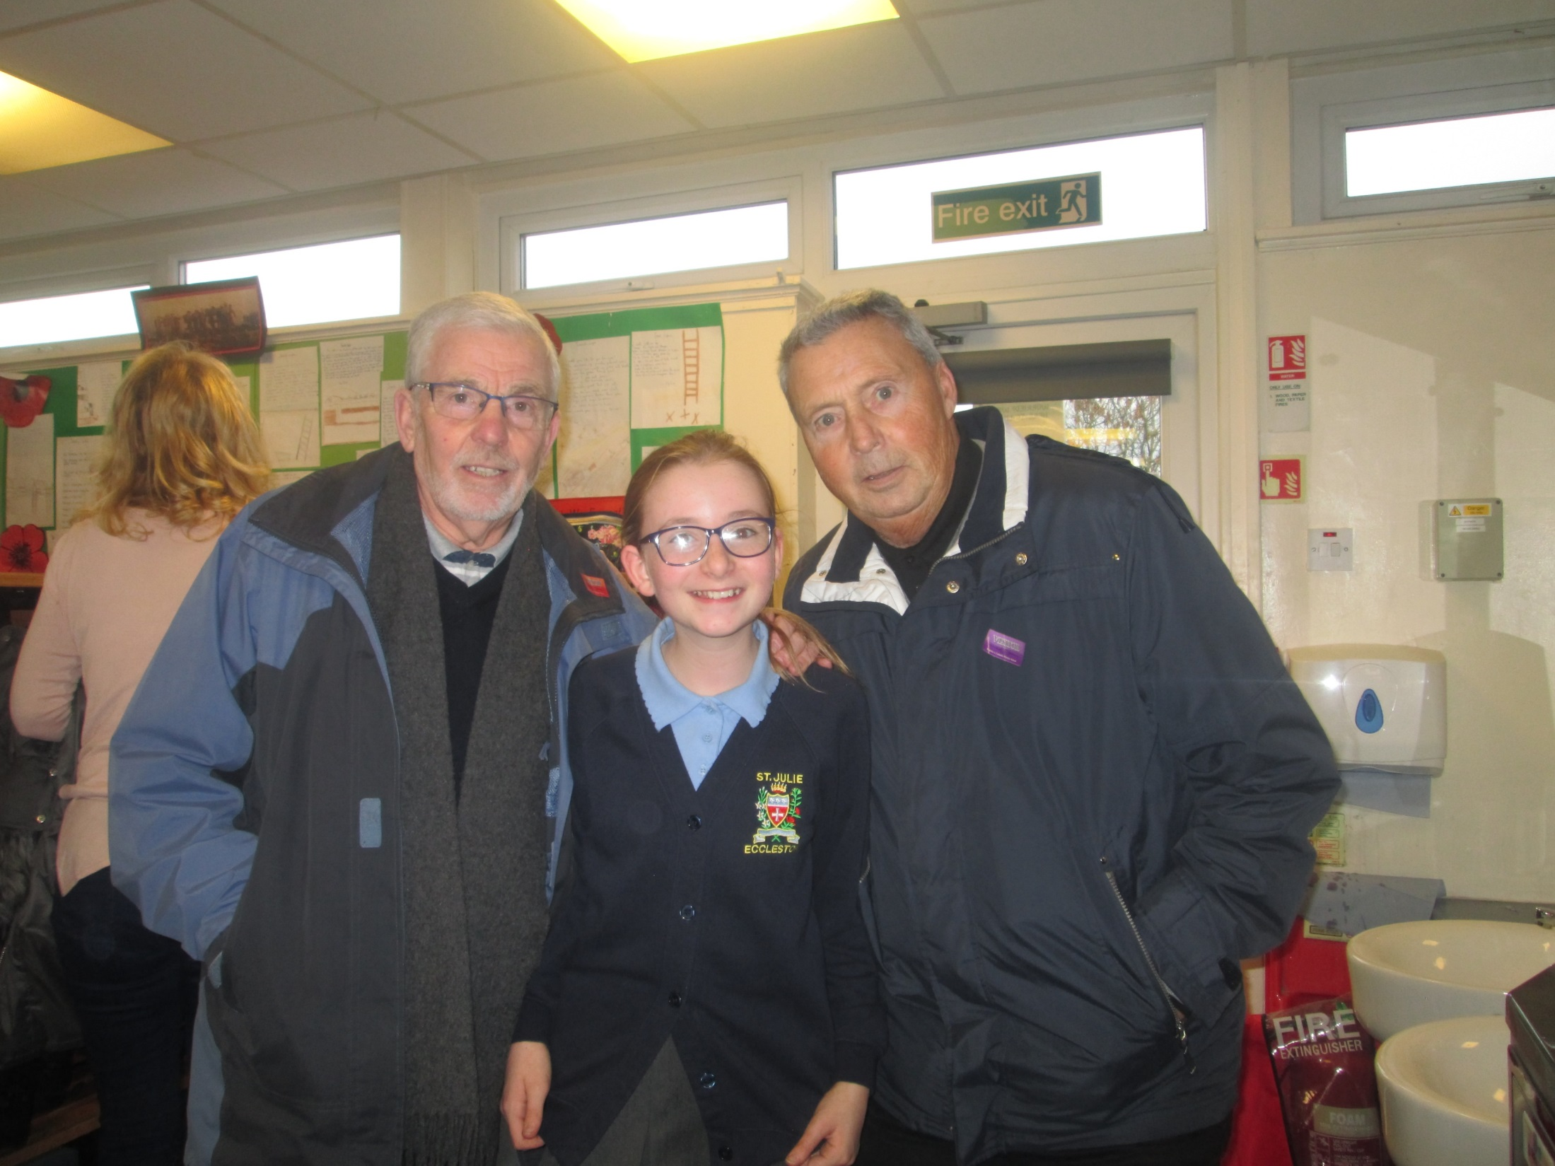

Slide 6
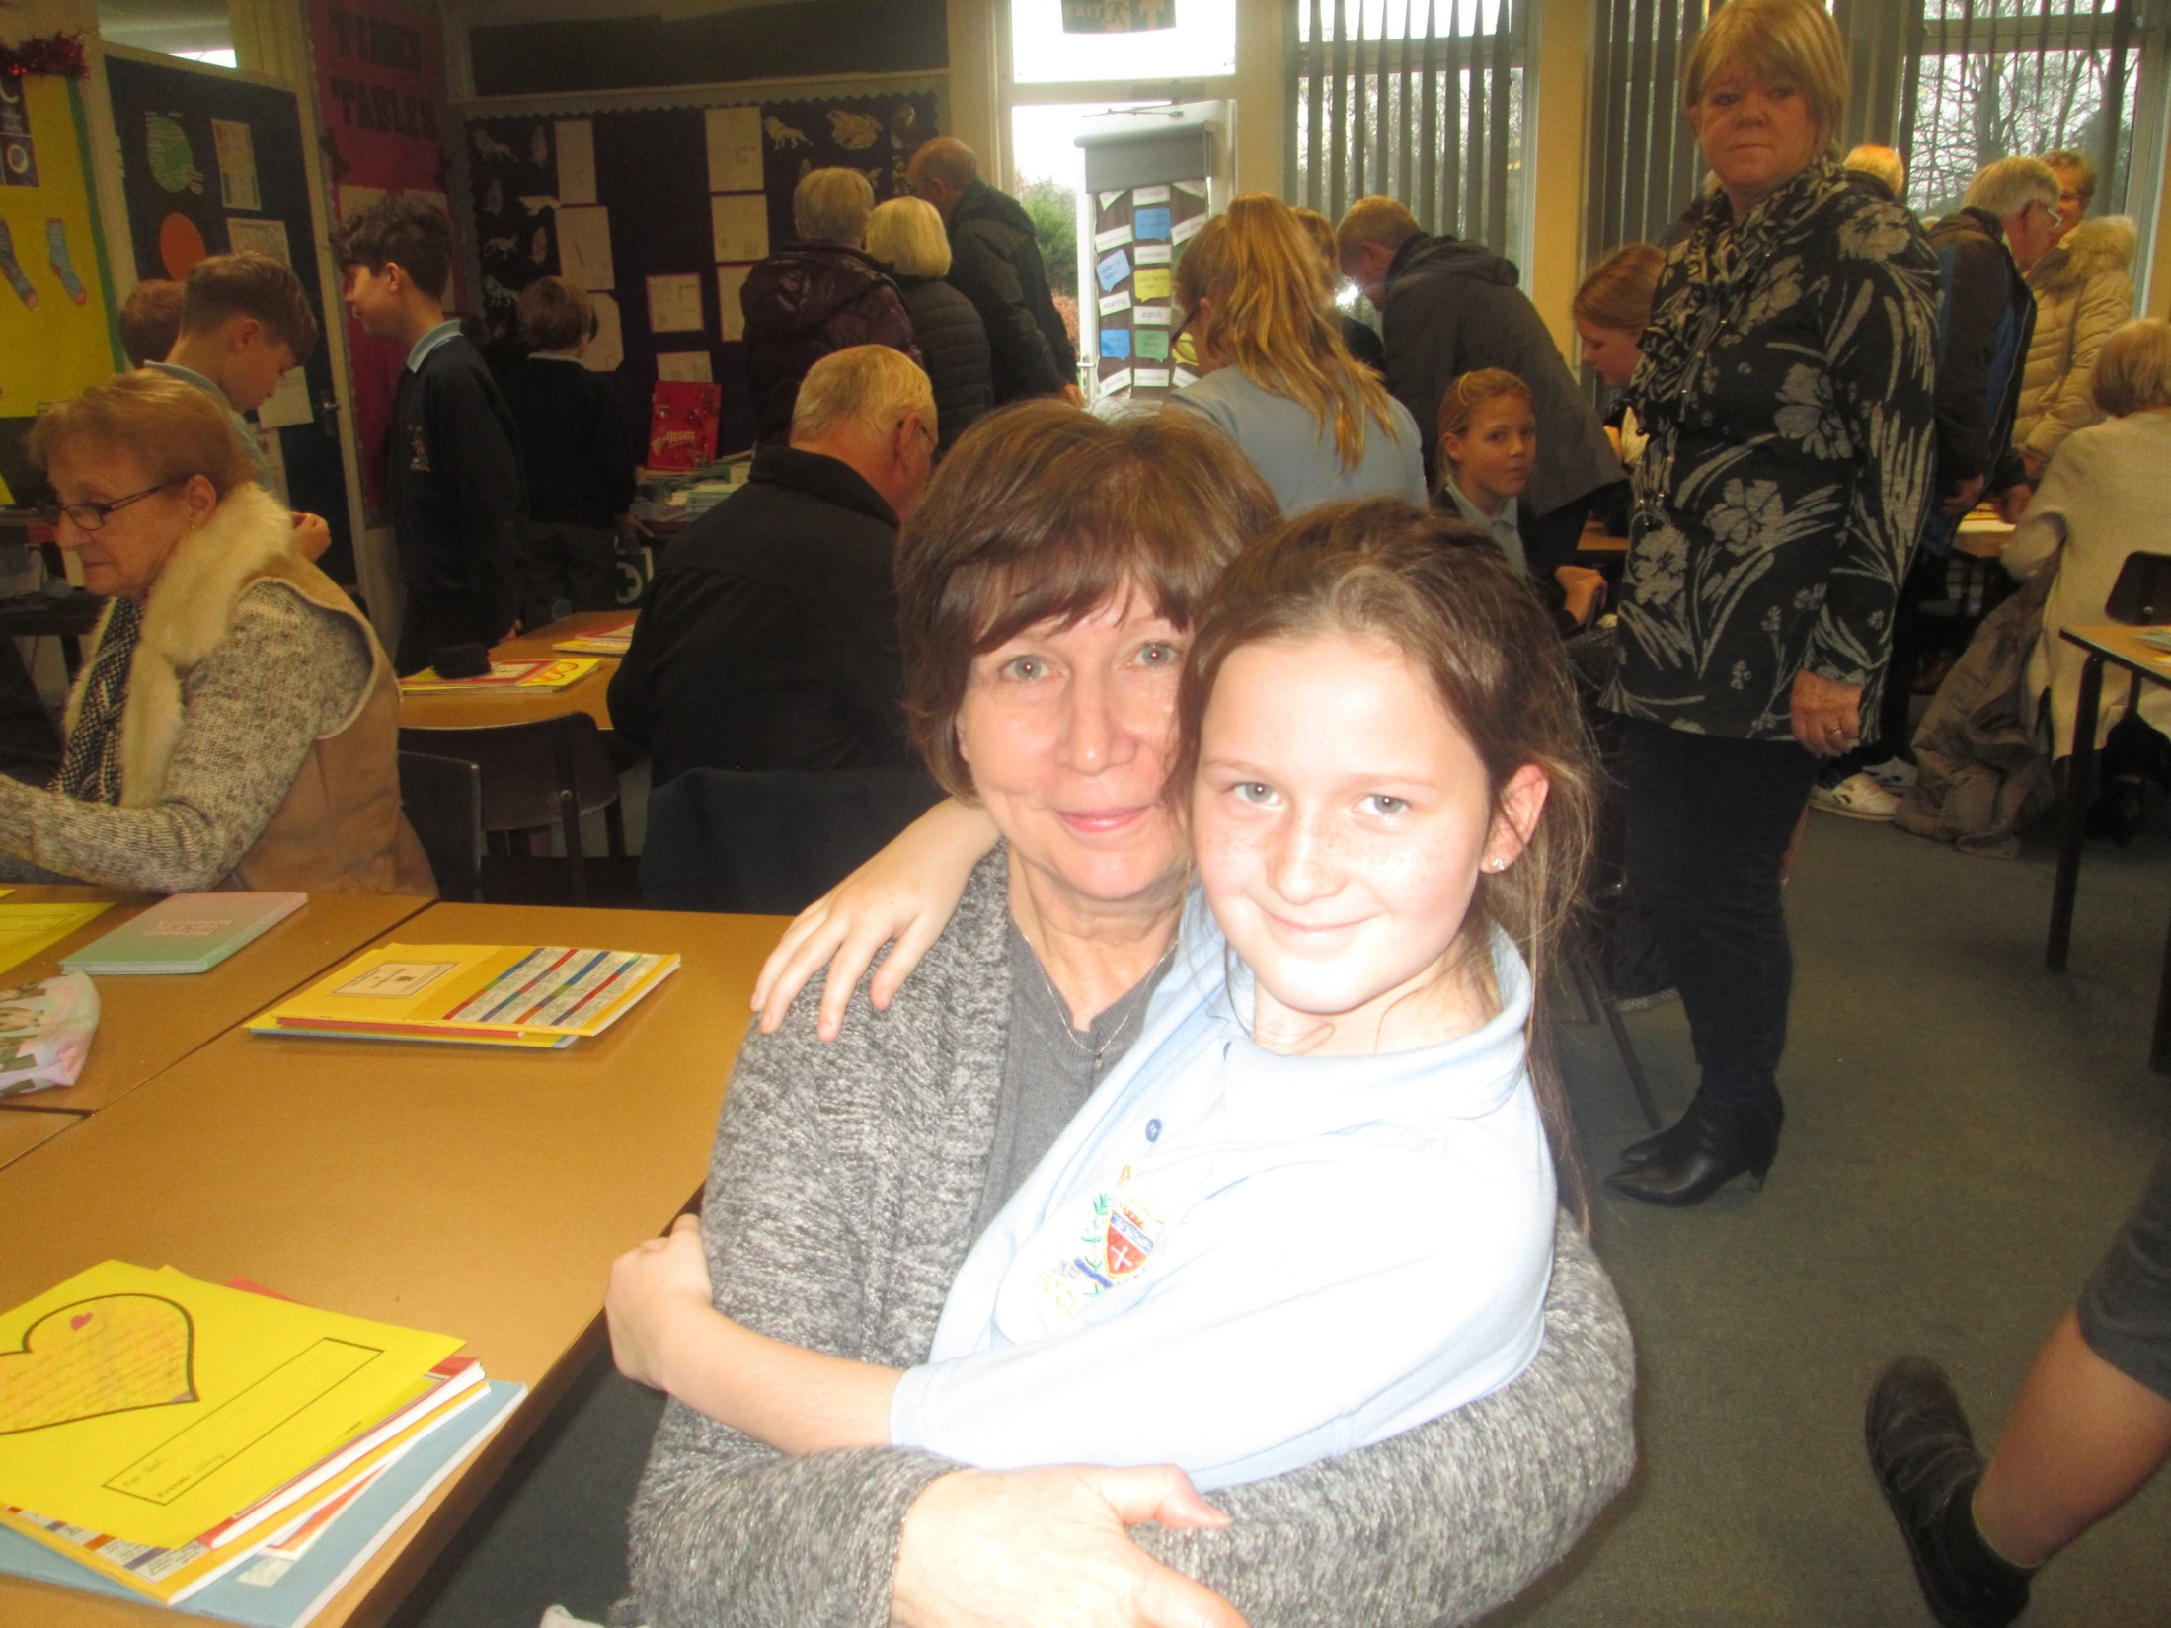

Slide 7
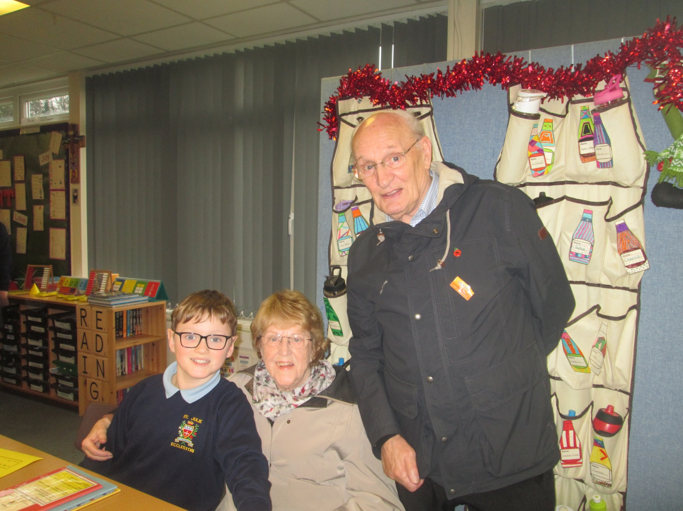

Slide 8
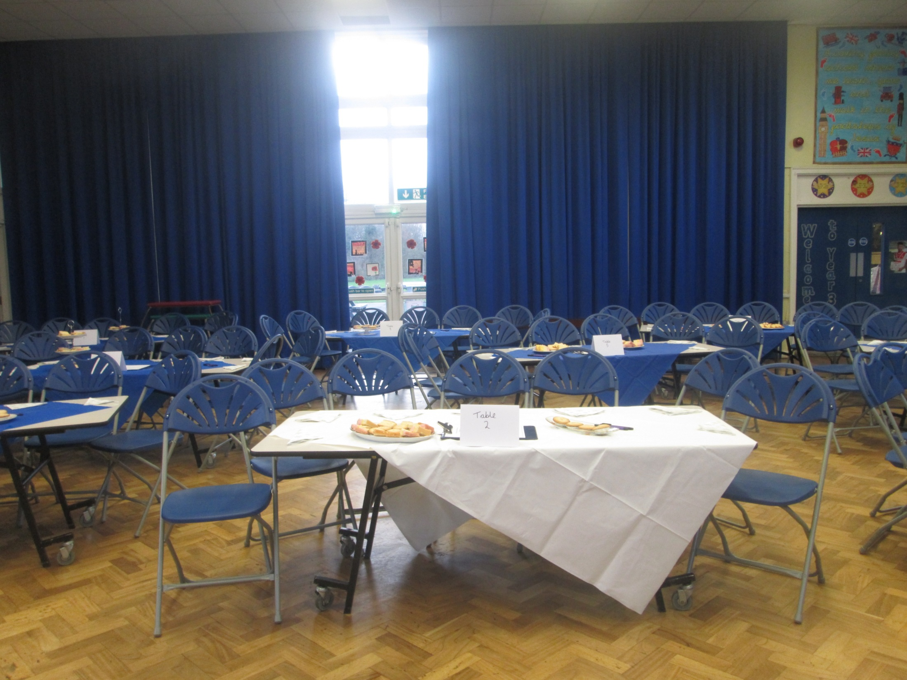

Slide 9
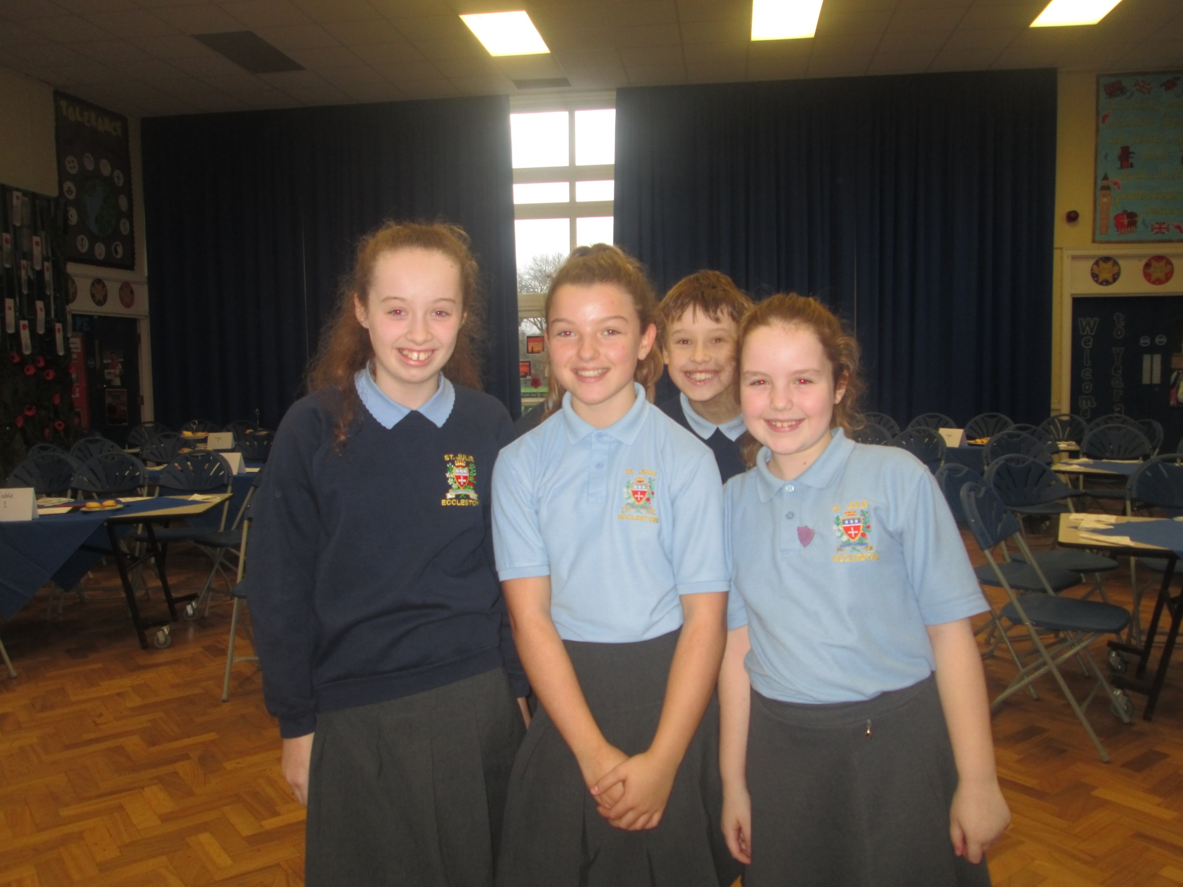

Slide 10
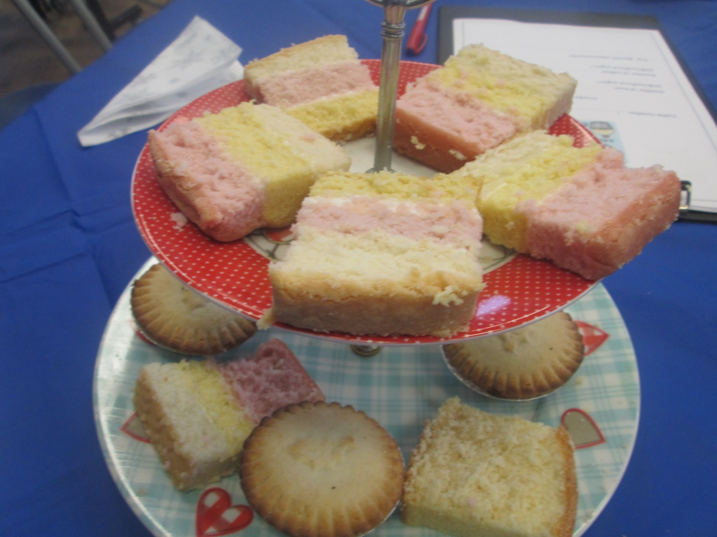

Slide 11
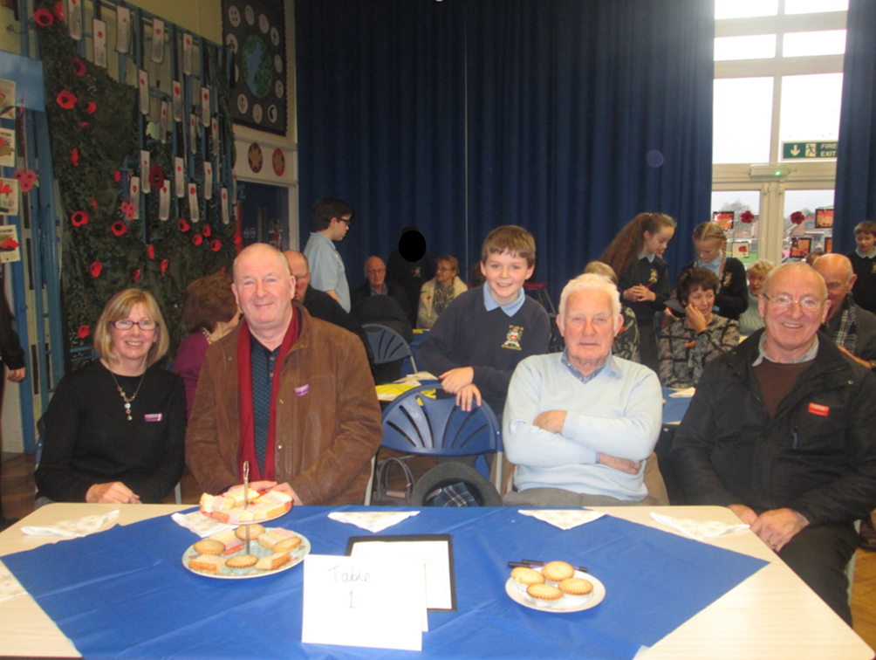

Slide 12
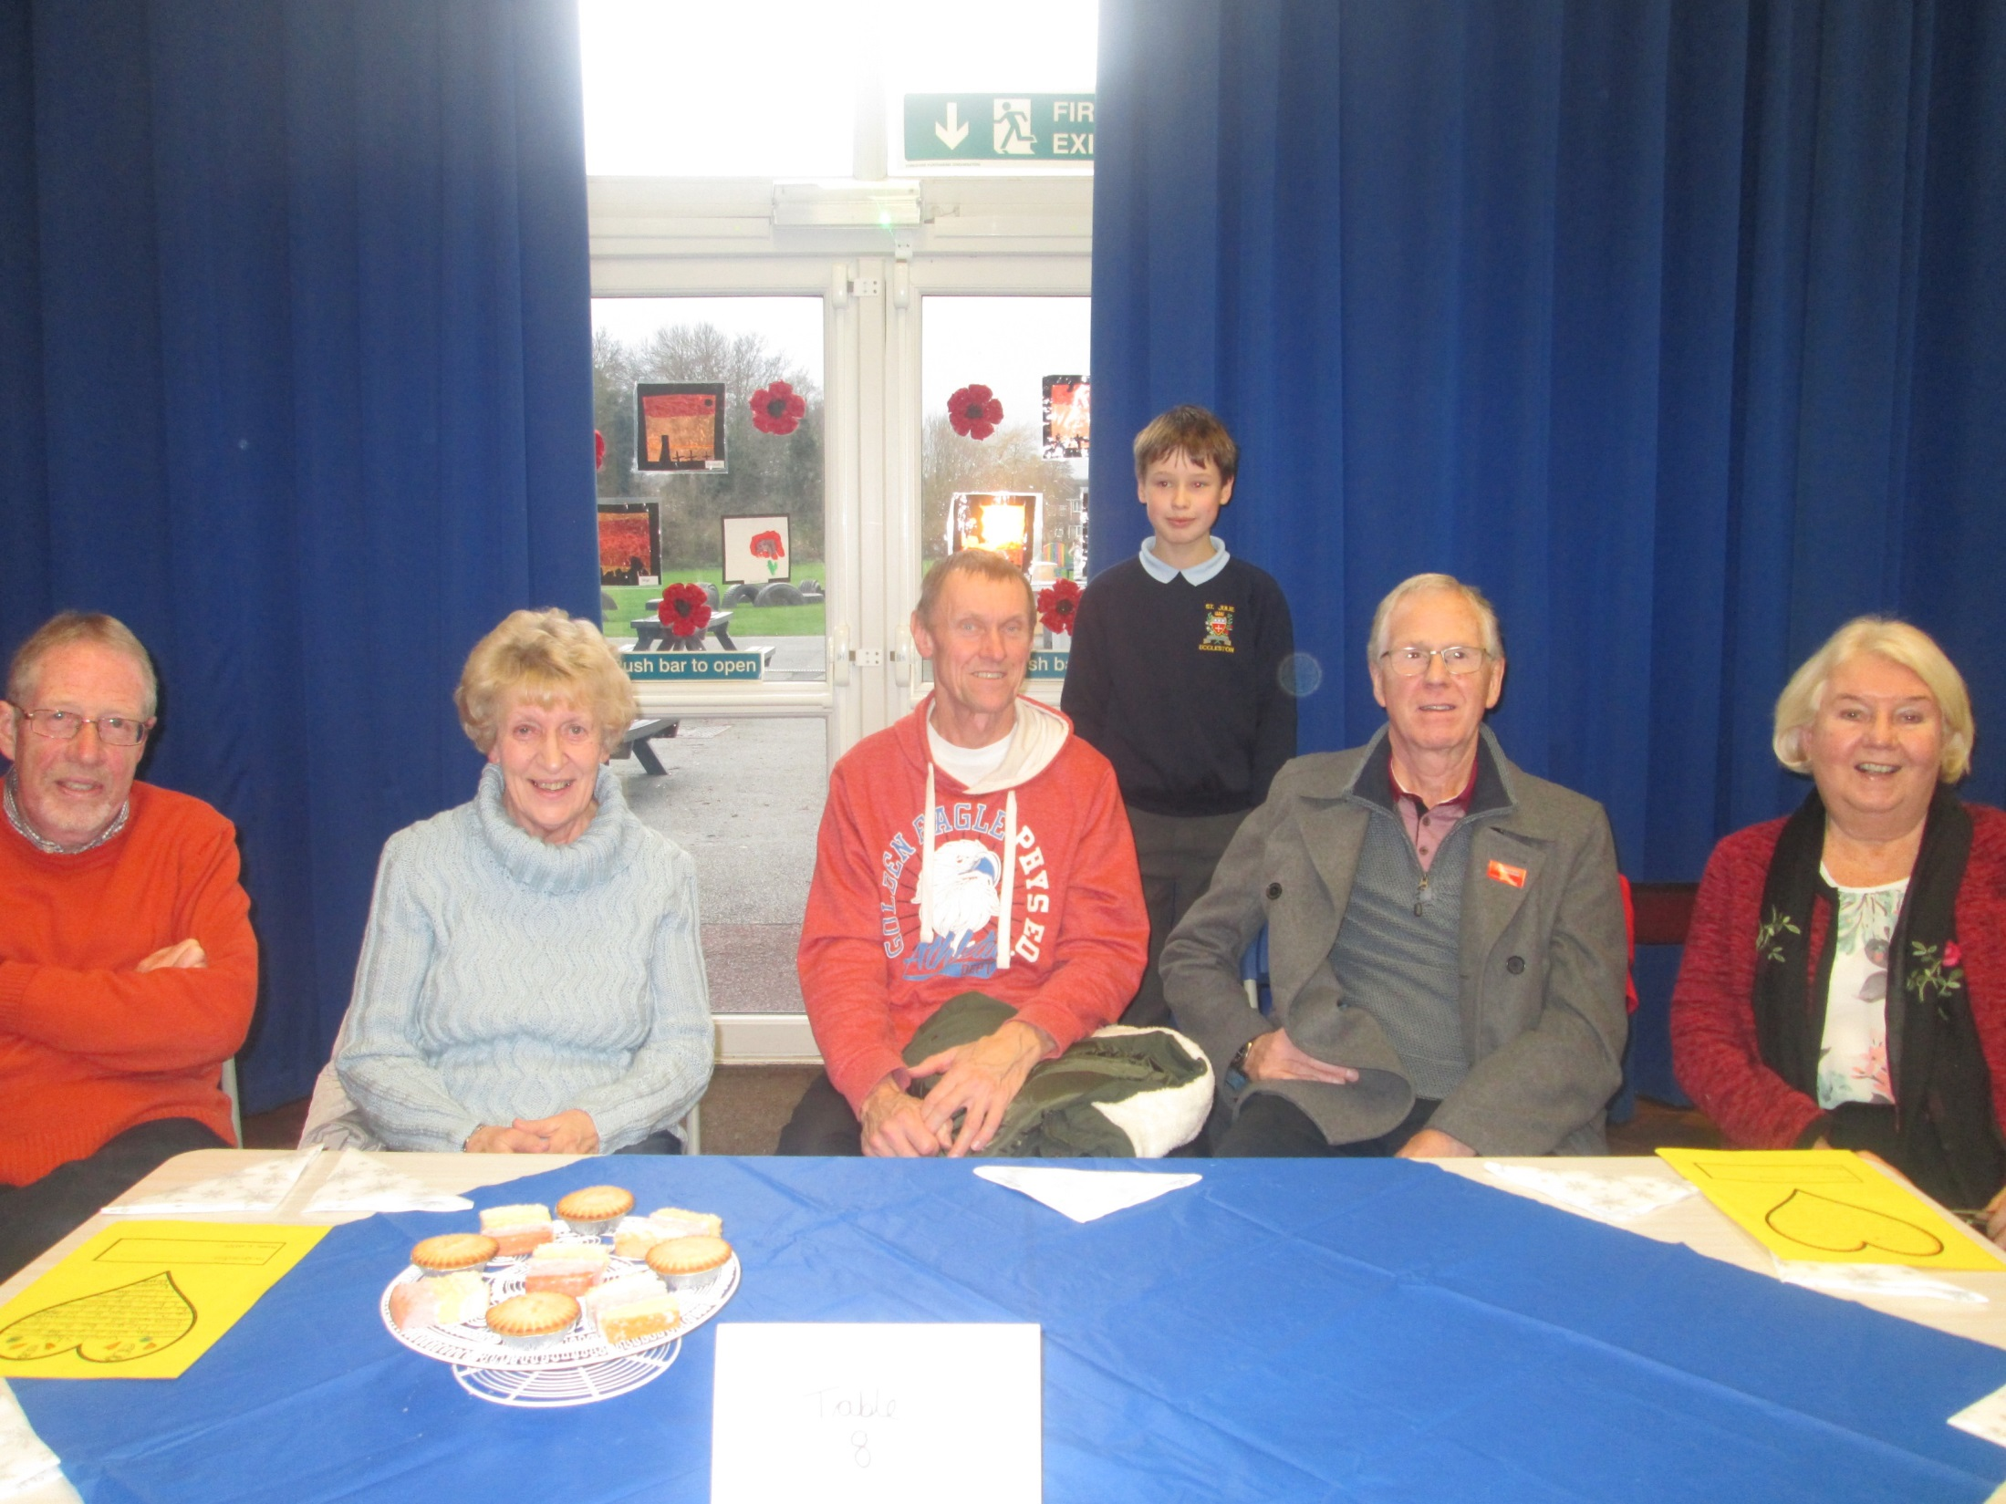

Slide 13
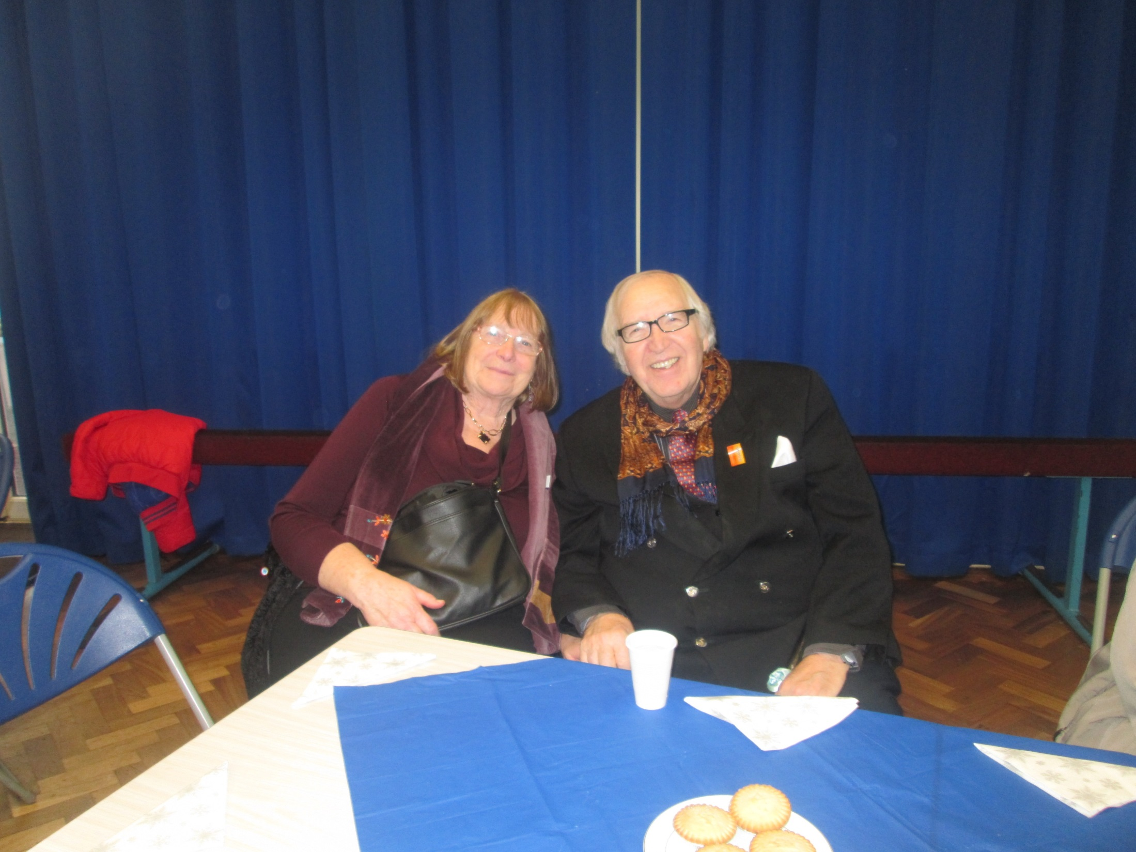

Slide 14
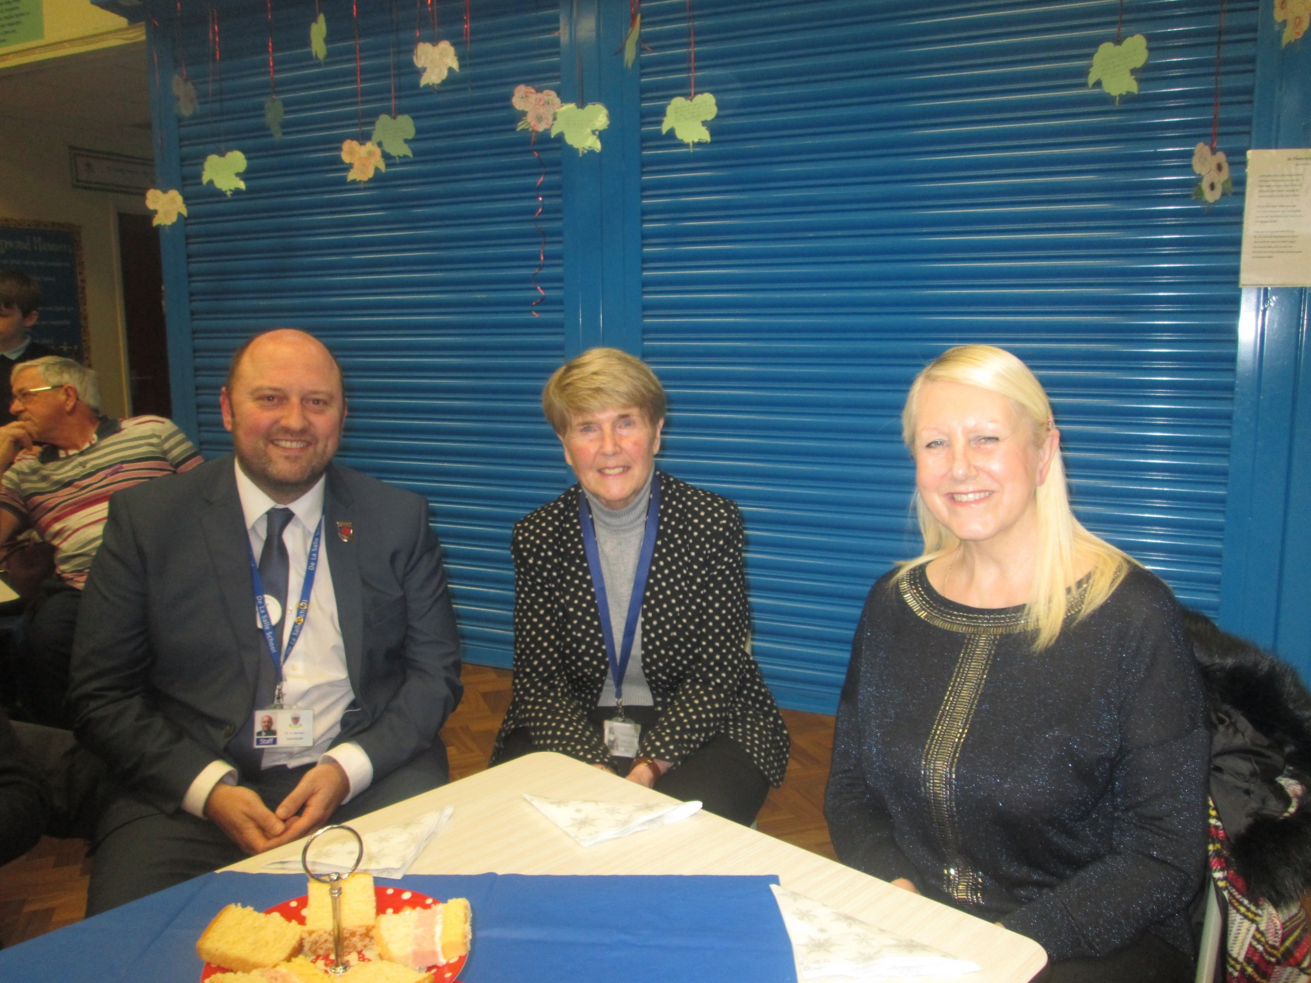
Our governors shared the afternoon with us.

Slide 15
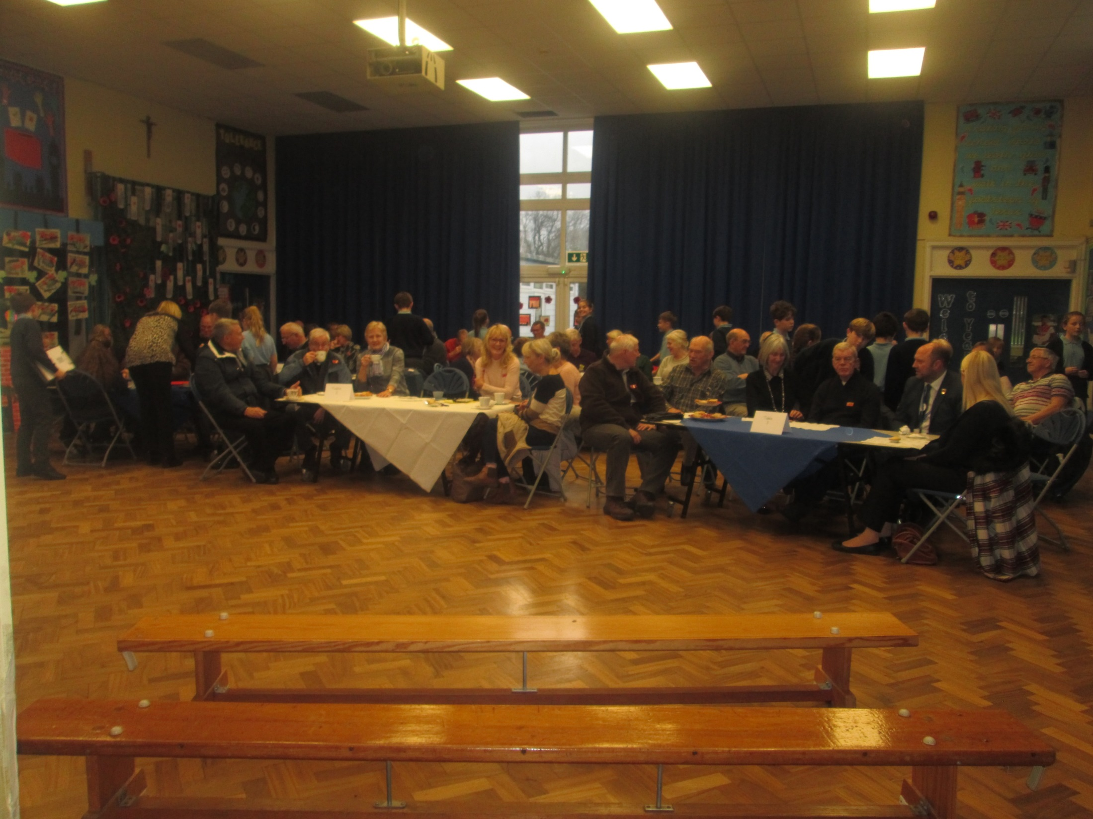

Slide 16
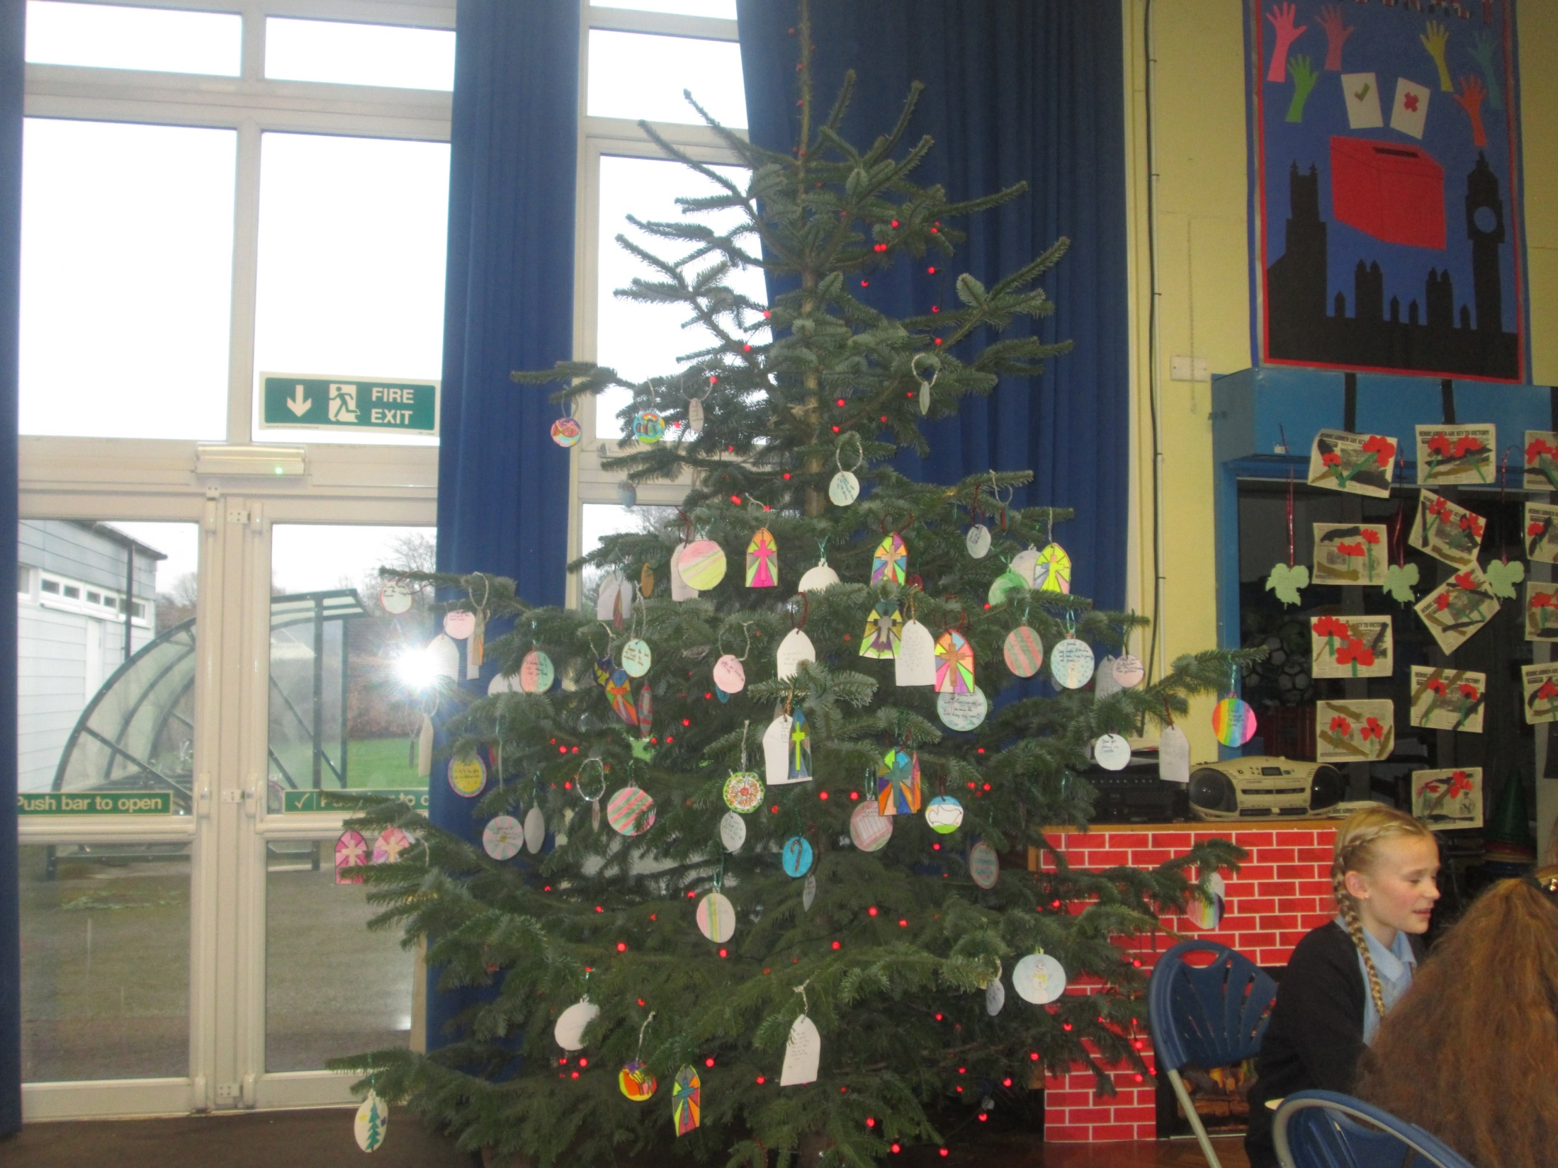

Slide 17
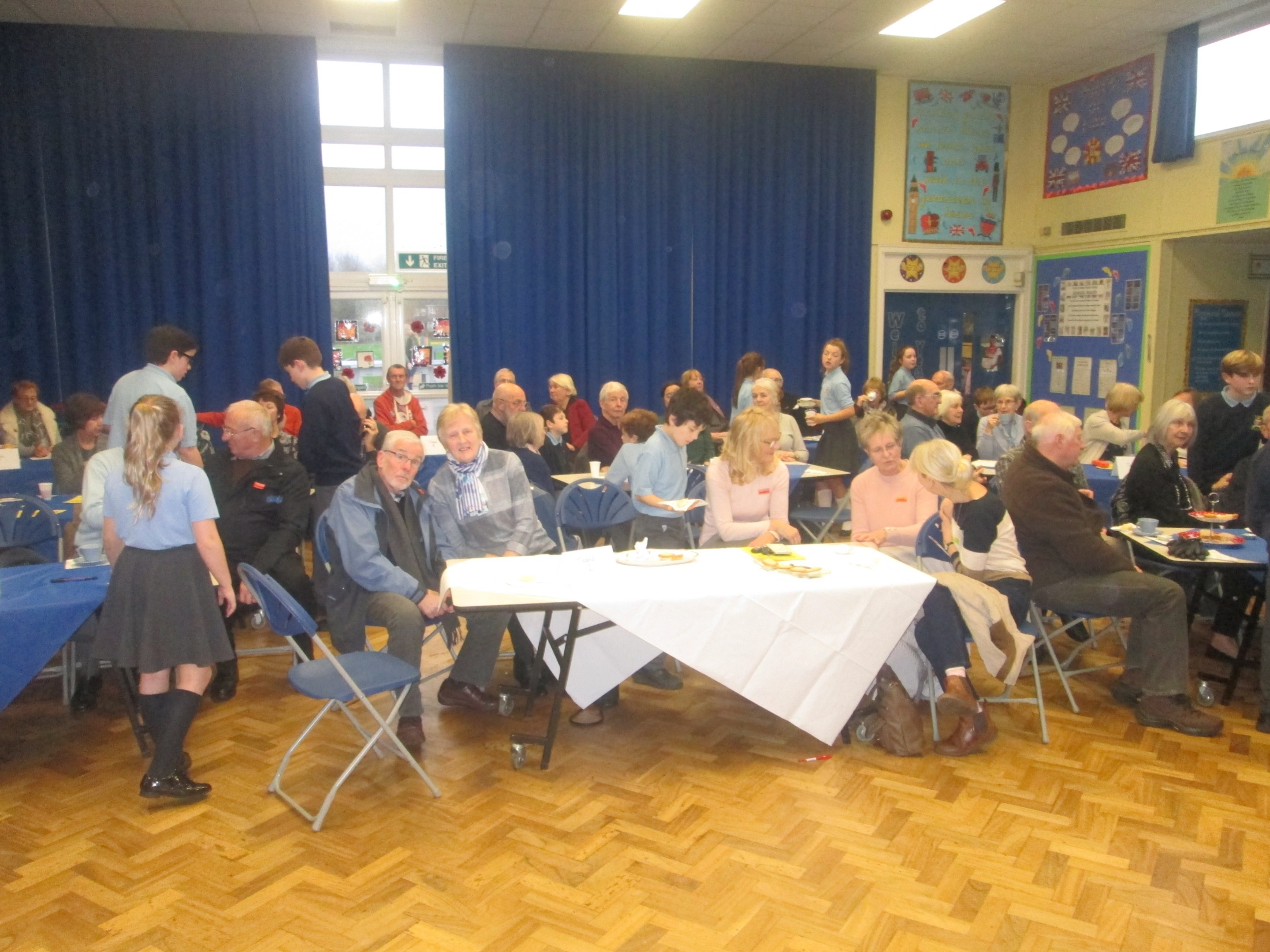

Slide 18
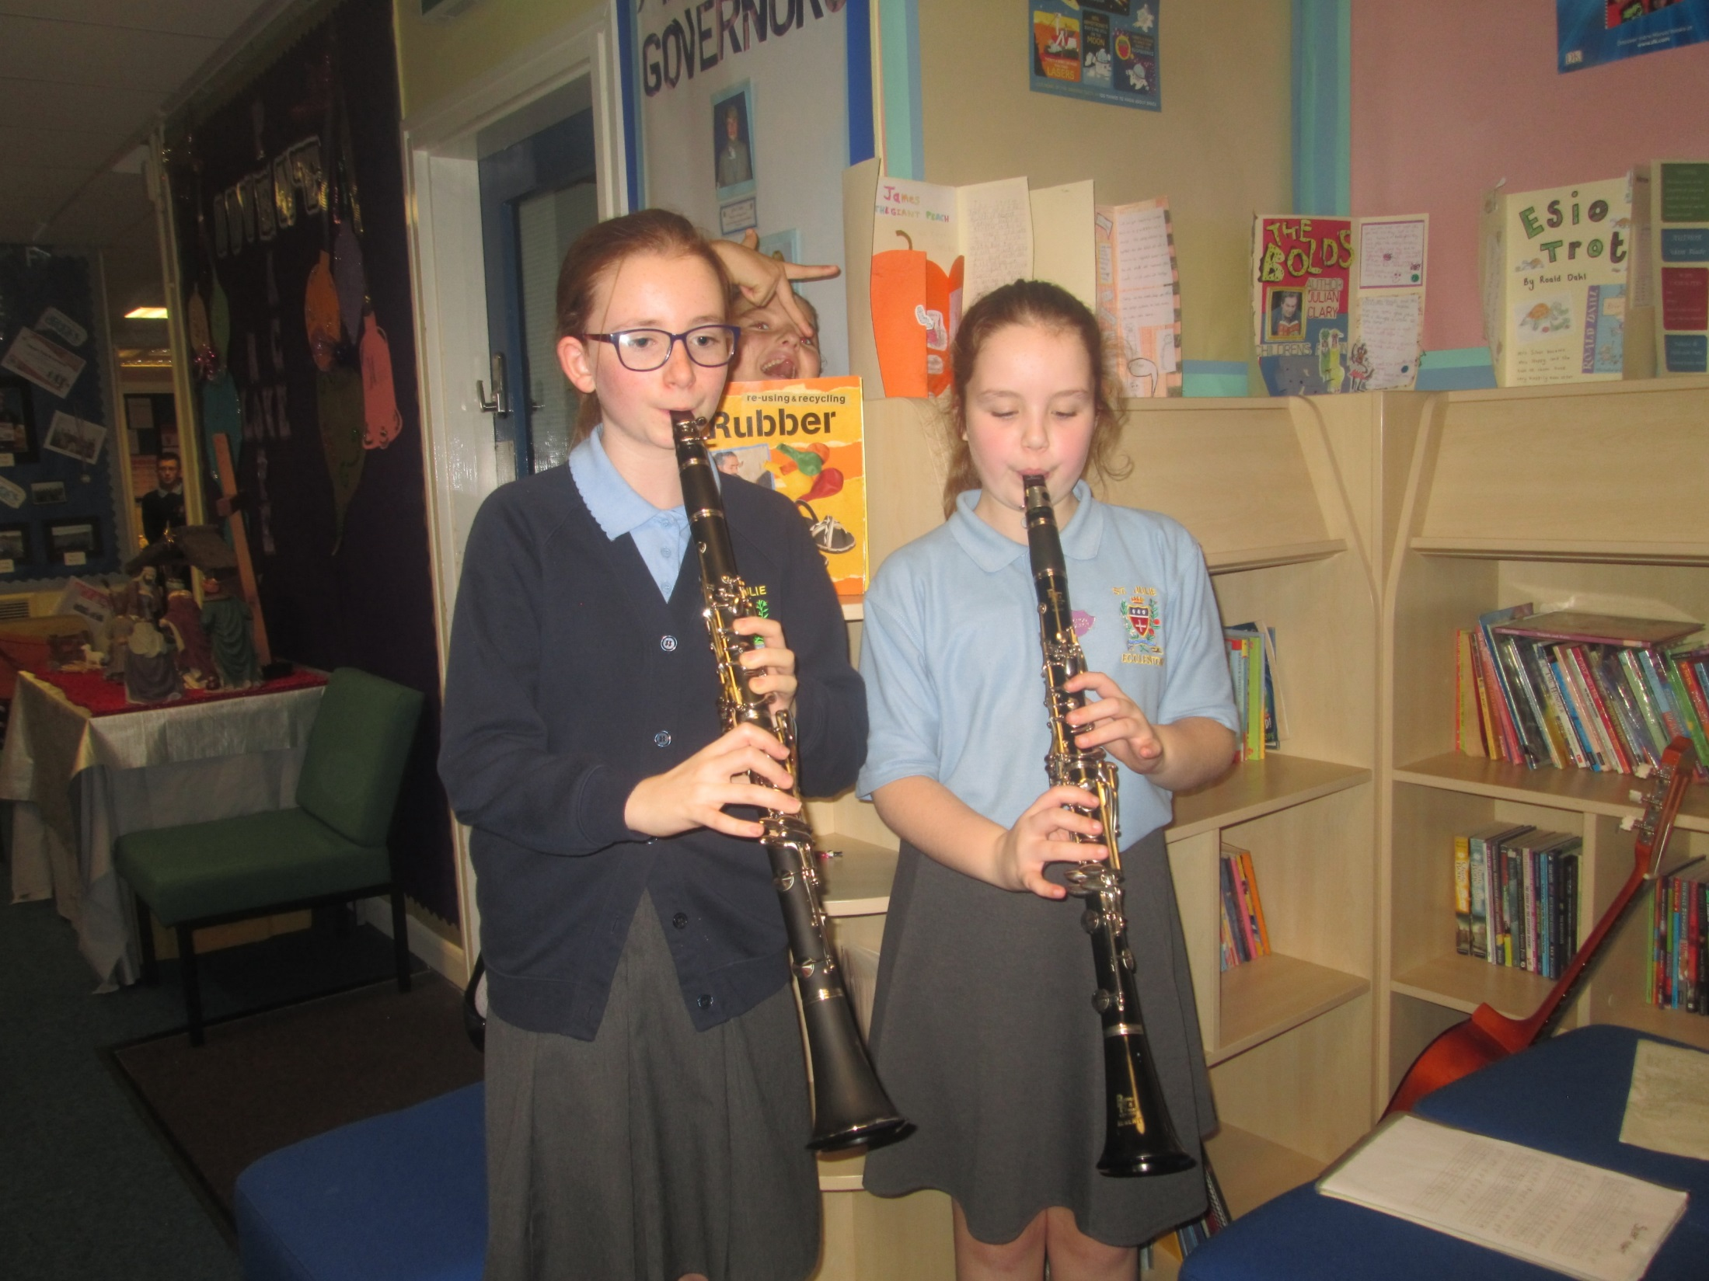

Slide 19
