Slide 1
Sky dive for Clatterbridge
Mrs Ashcroft

Slide 2

Clatterbridge Cancer Care
Mrs Ashcroft took part in a sky dive from 15,000 feet in aid of Clatterbridge Cancer Care.Thank you to all those who have made donations via her Just Giving page; she has now raised well over £3,000 for this worthy cause.
Well done Mrs Ashcroft!

Slide 3
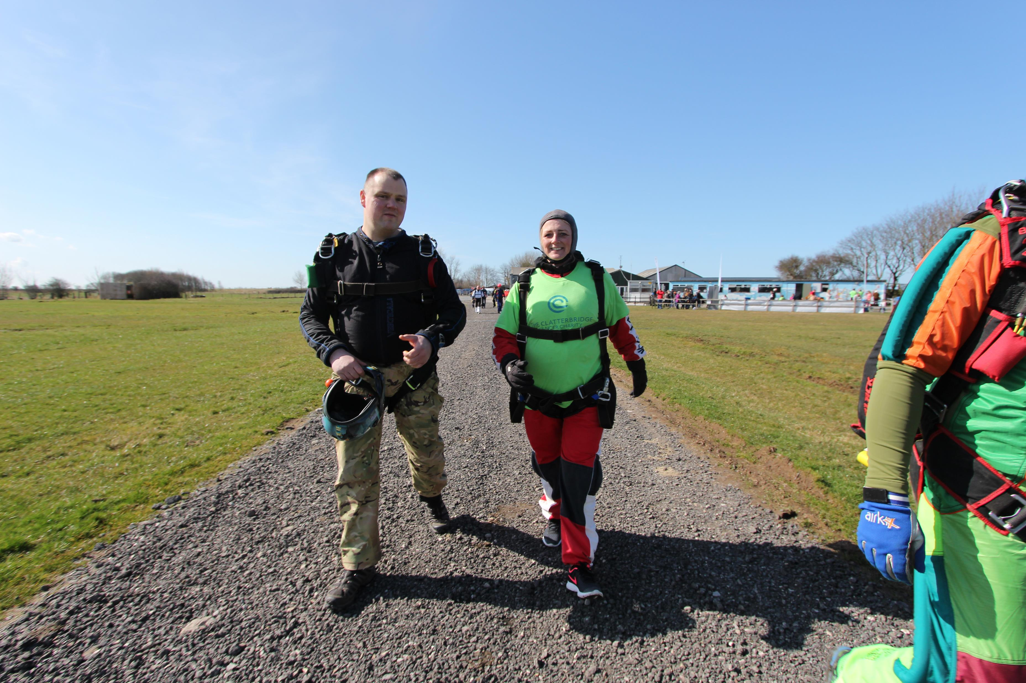


Slide 4
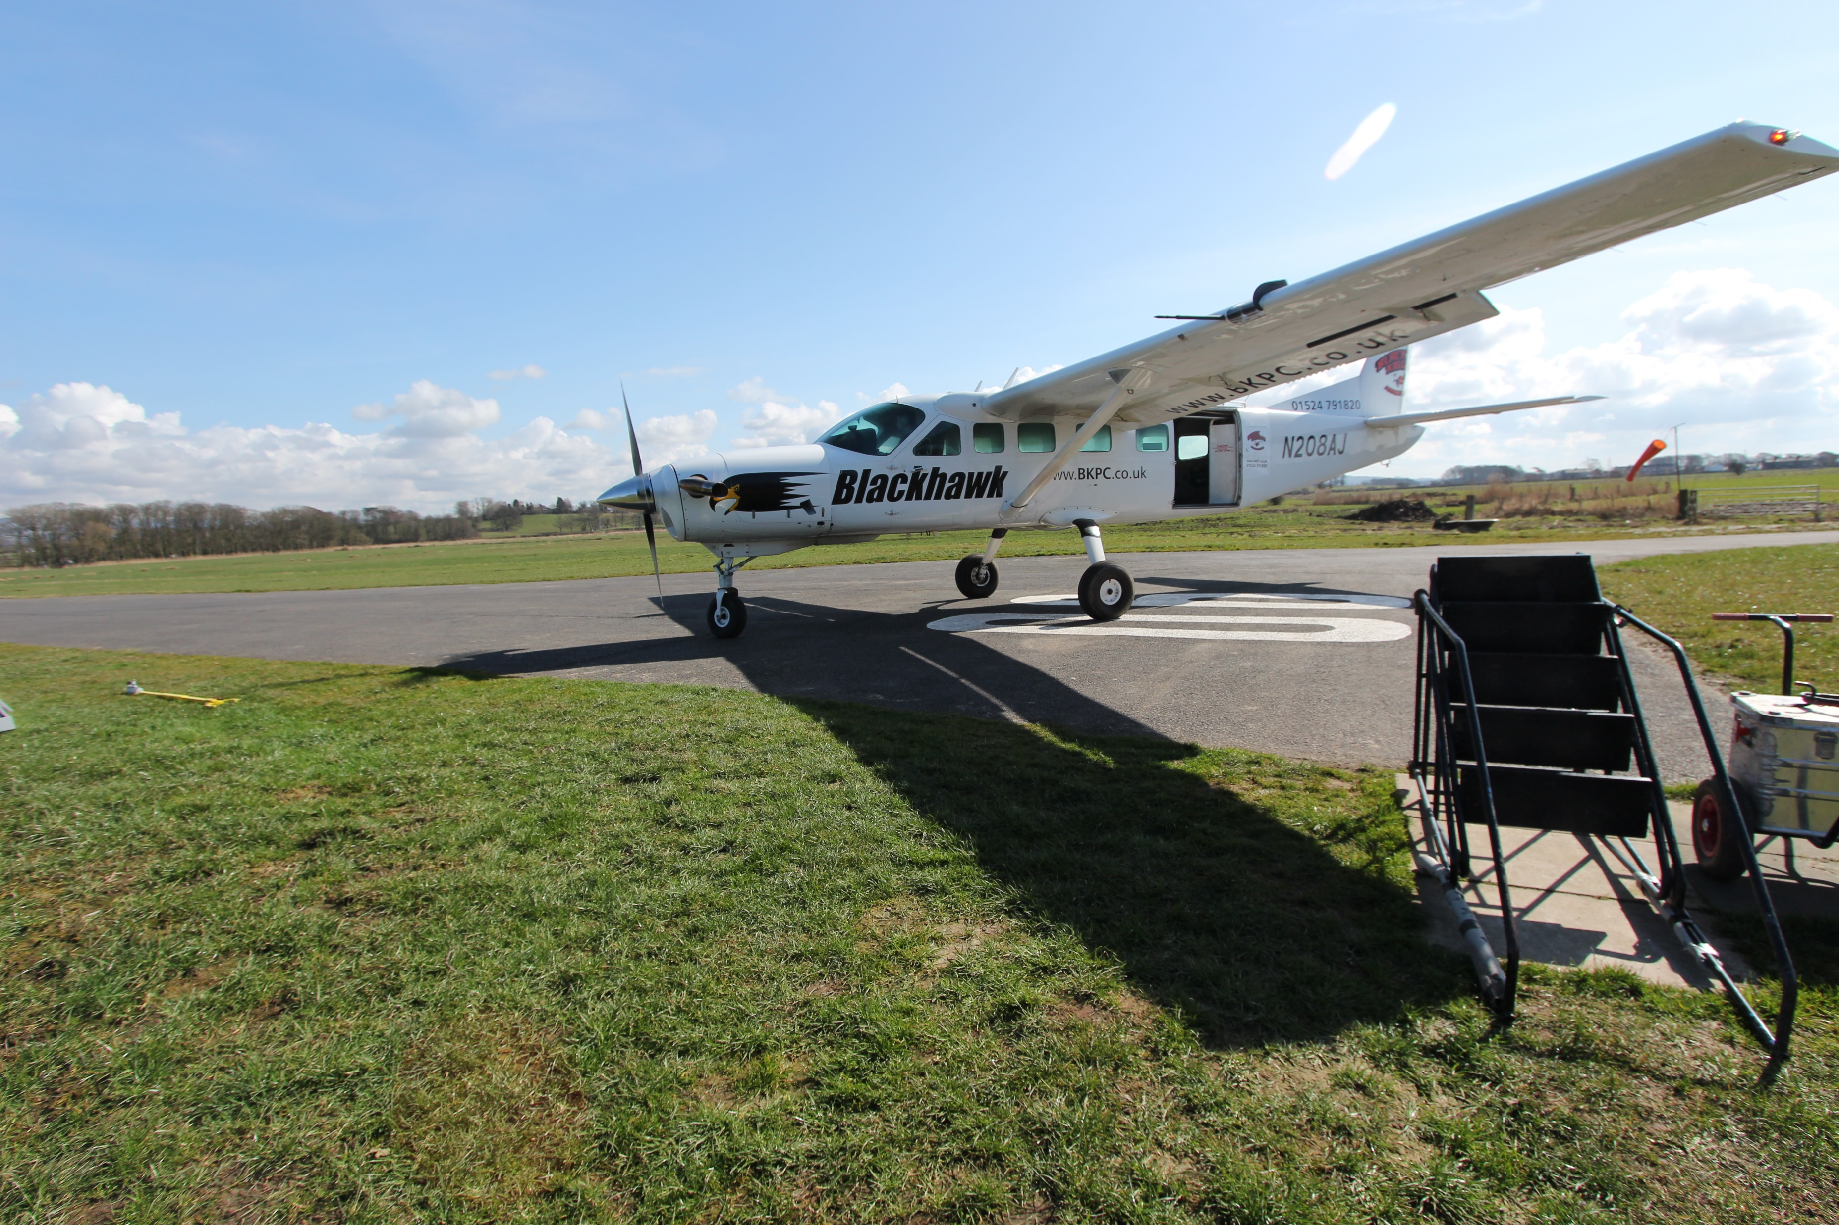
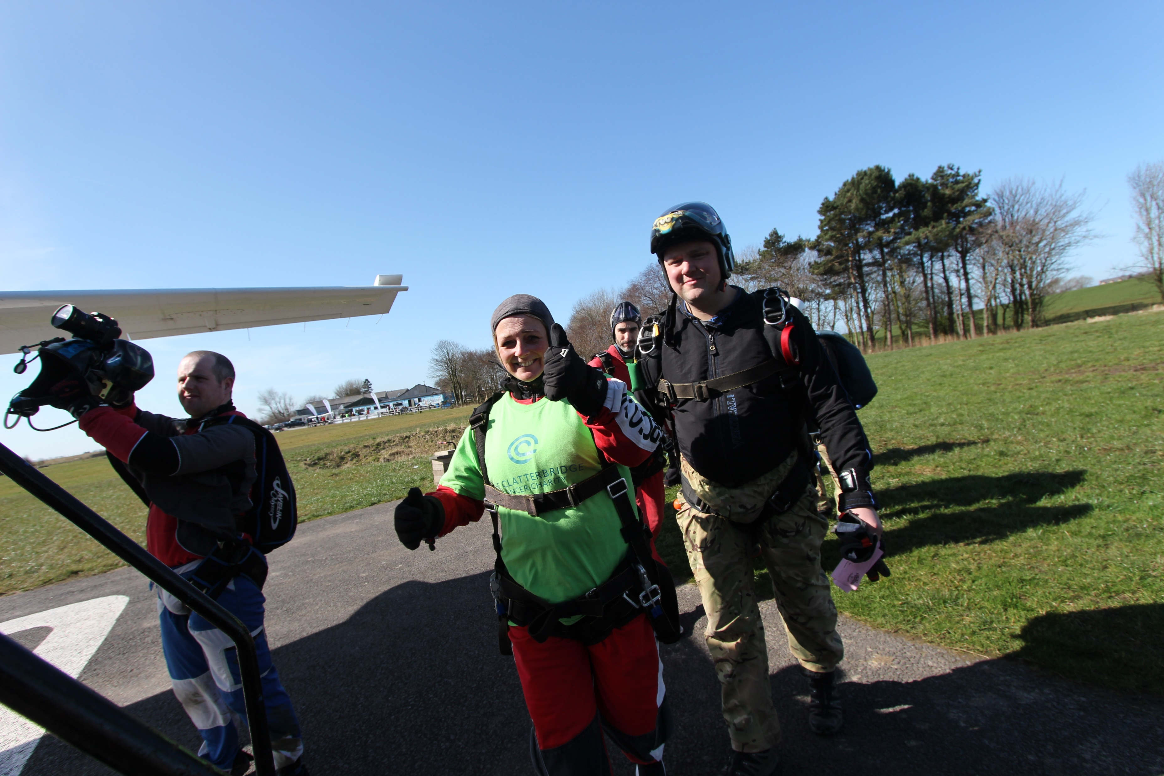

Slide 5
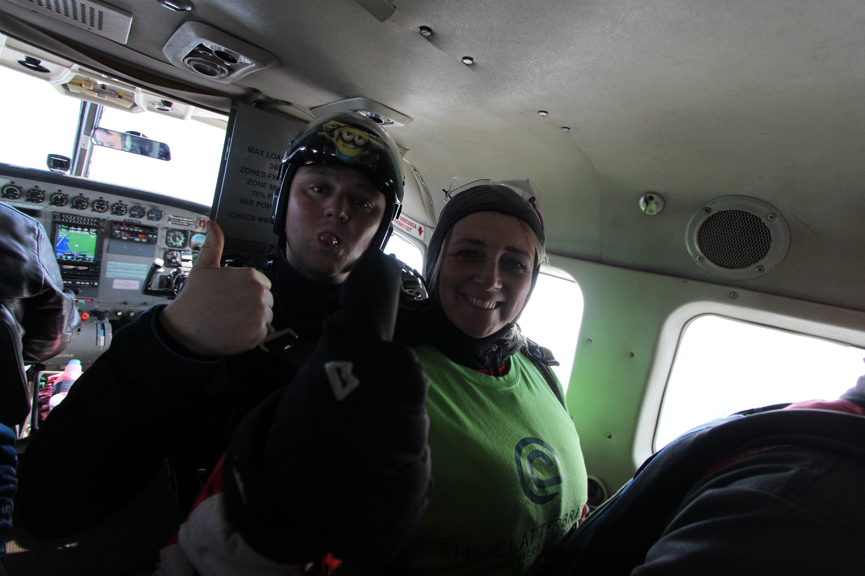

Slide 6
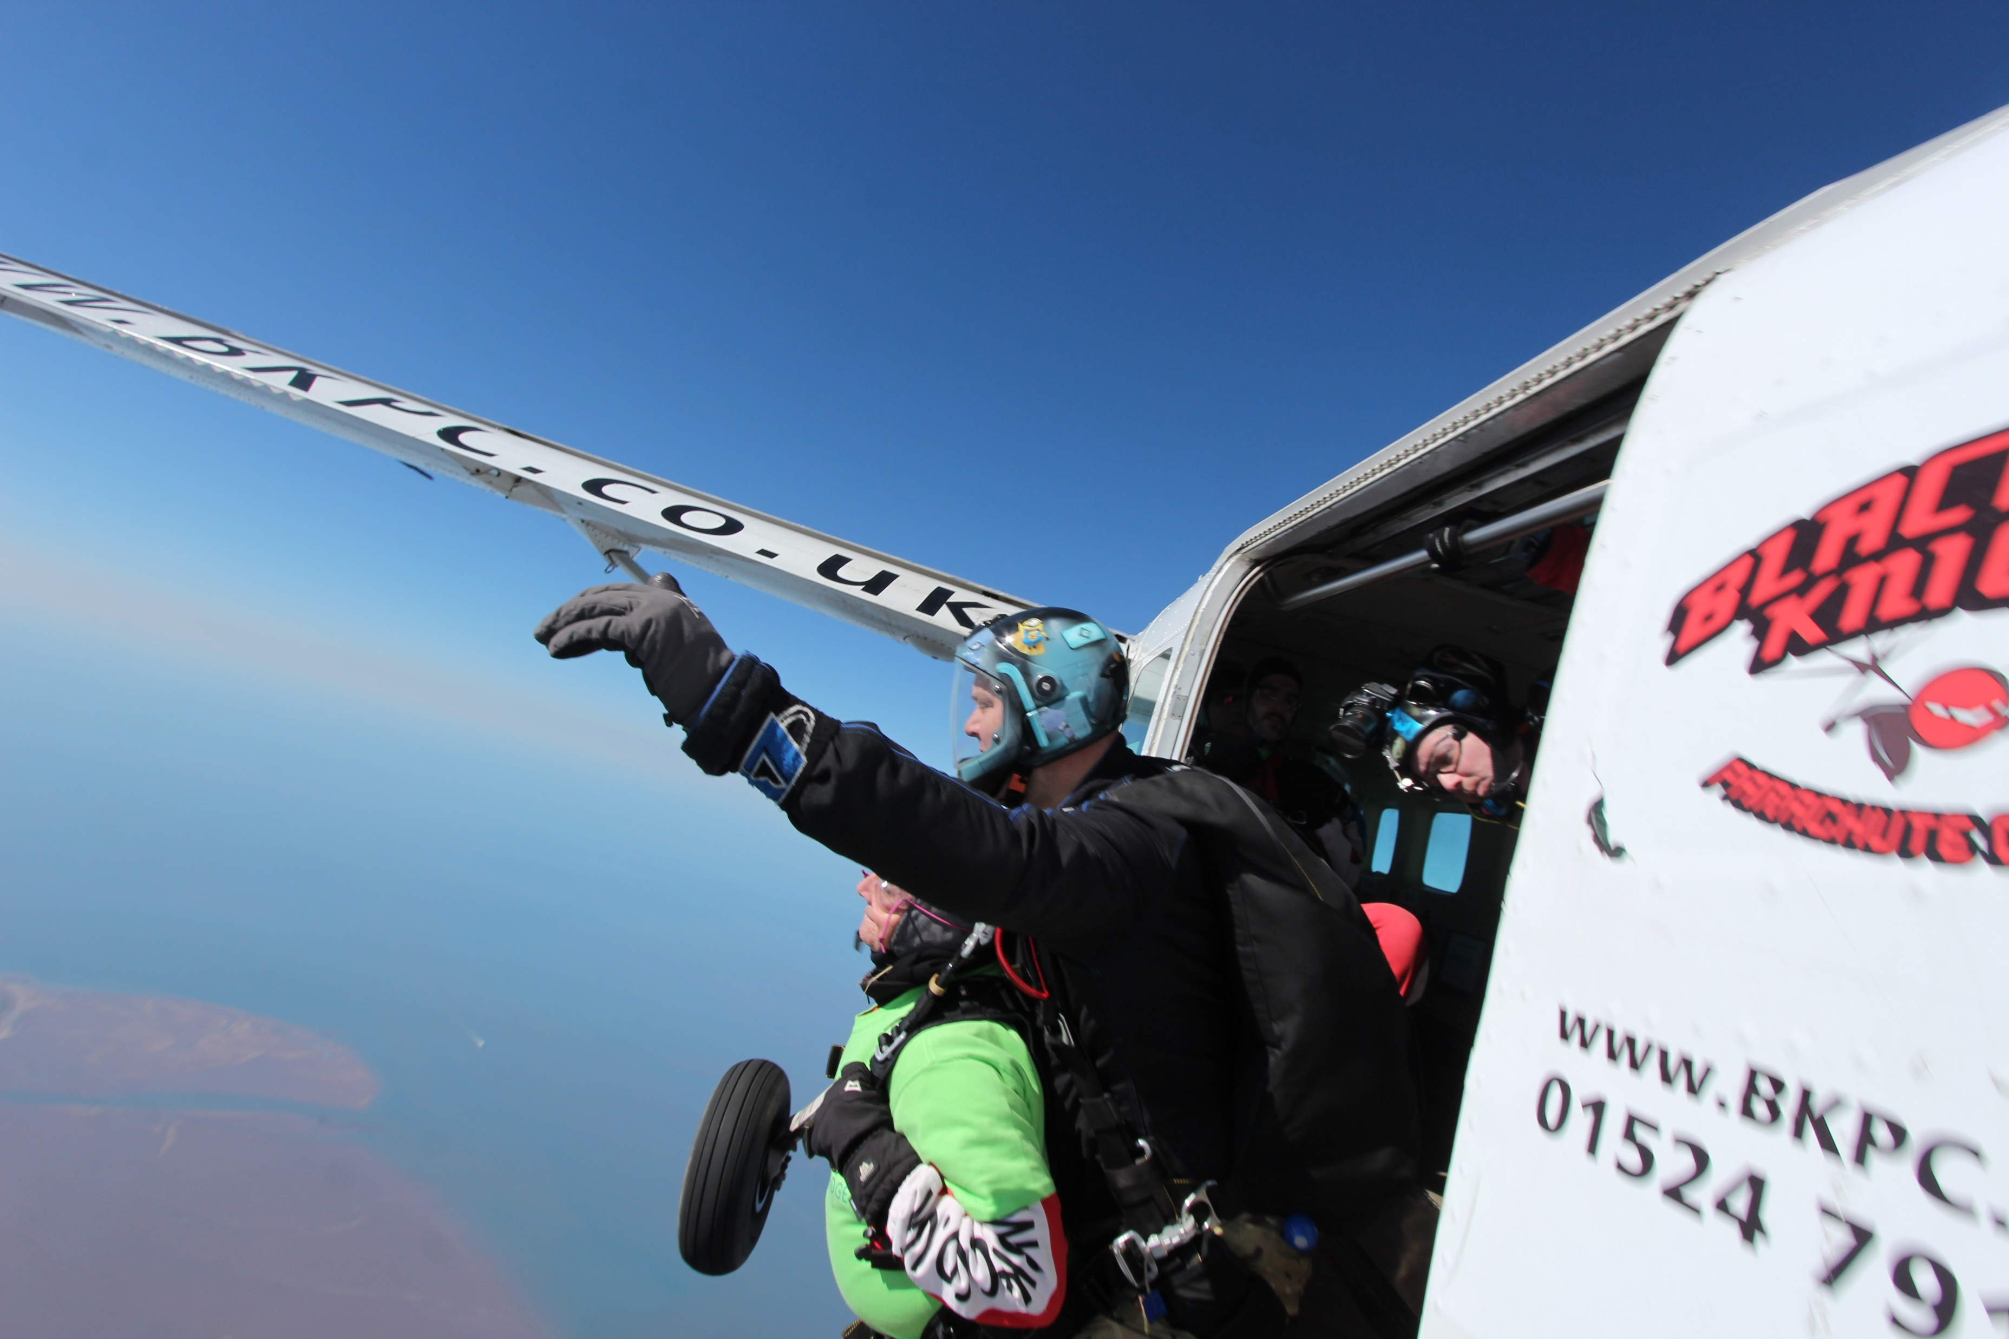

Slide 7
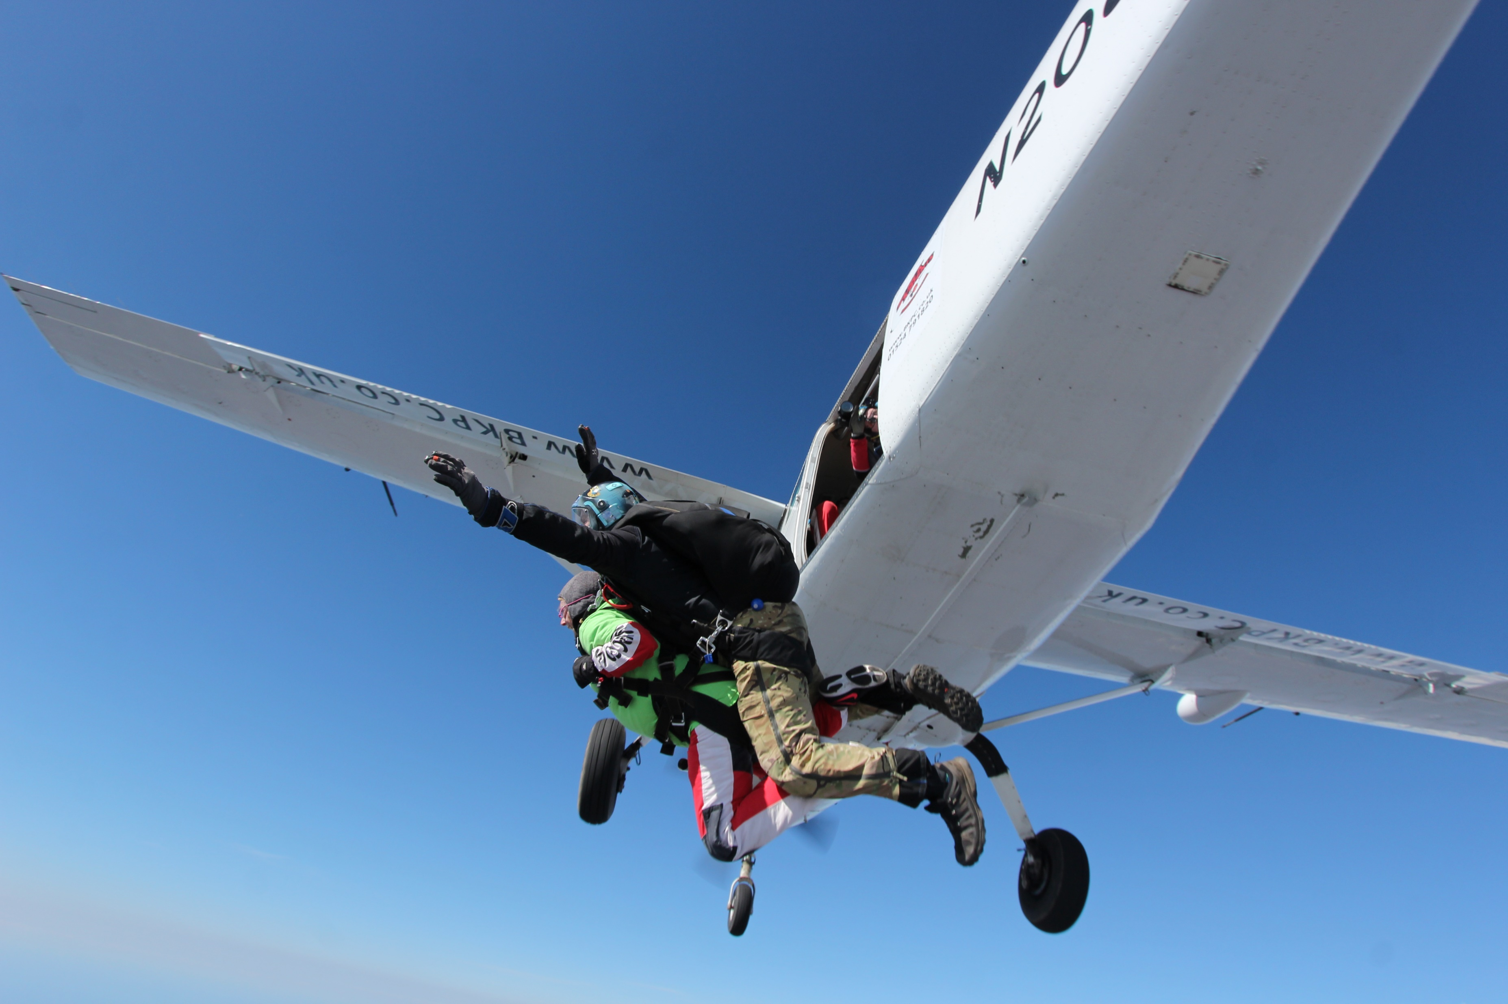

Slide 8
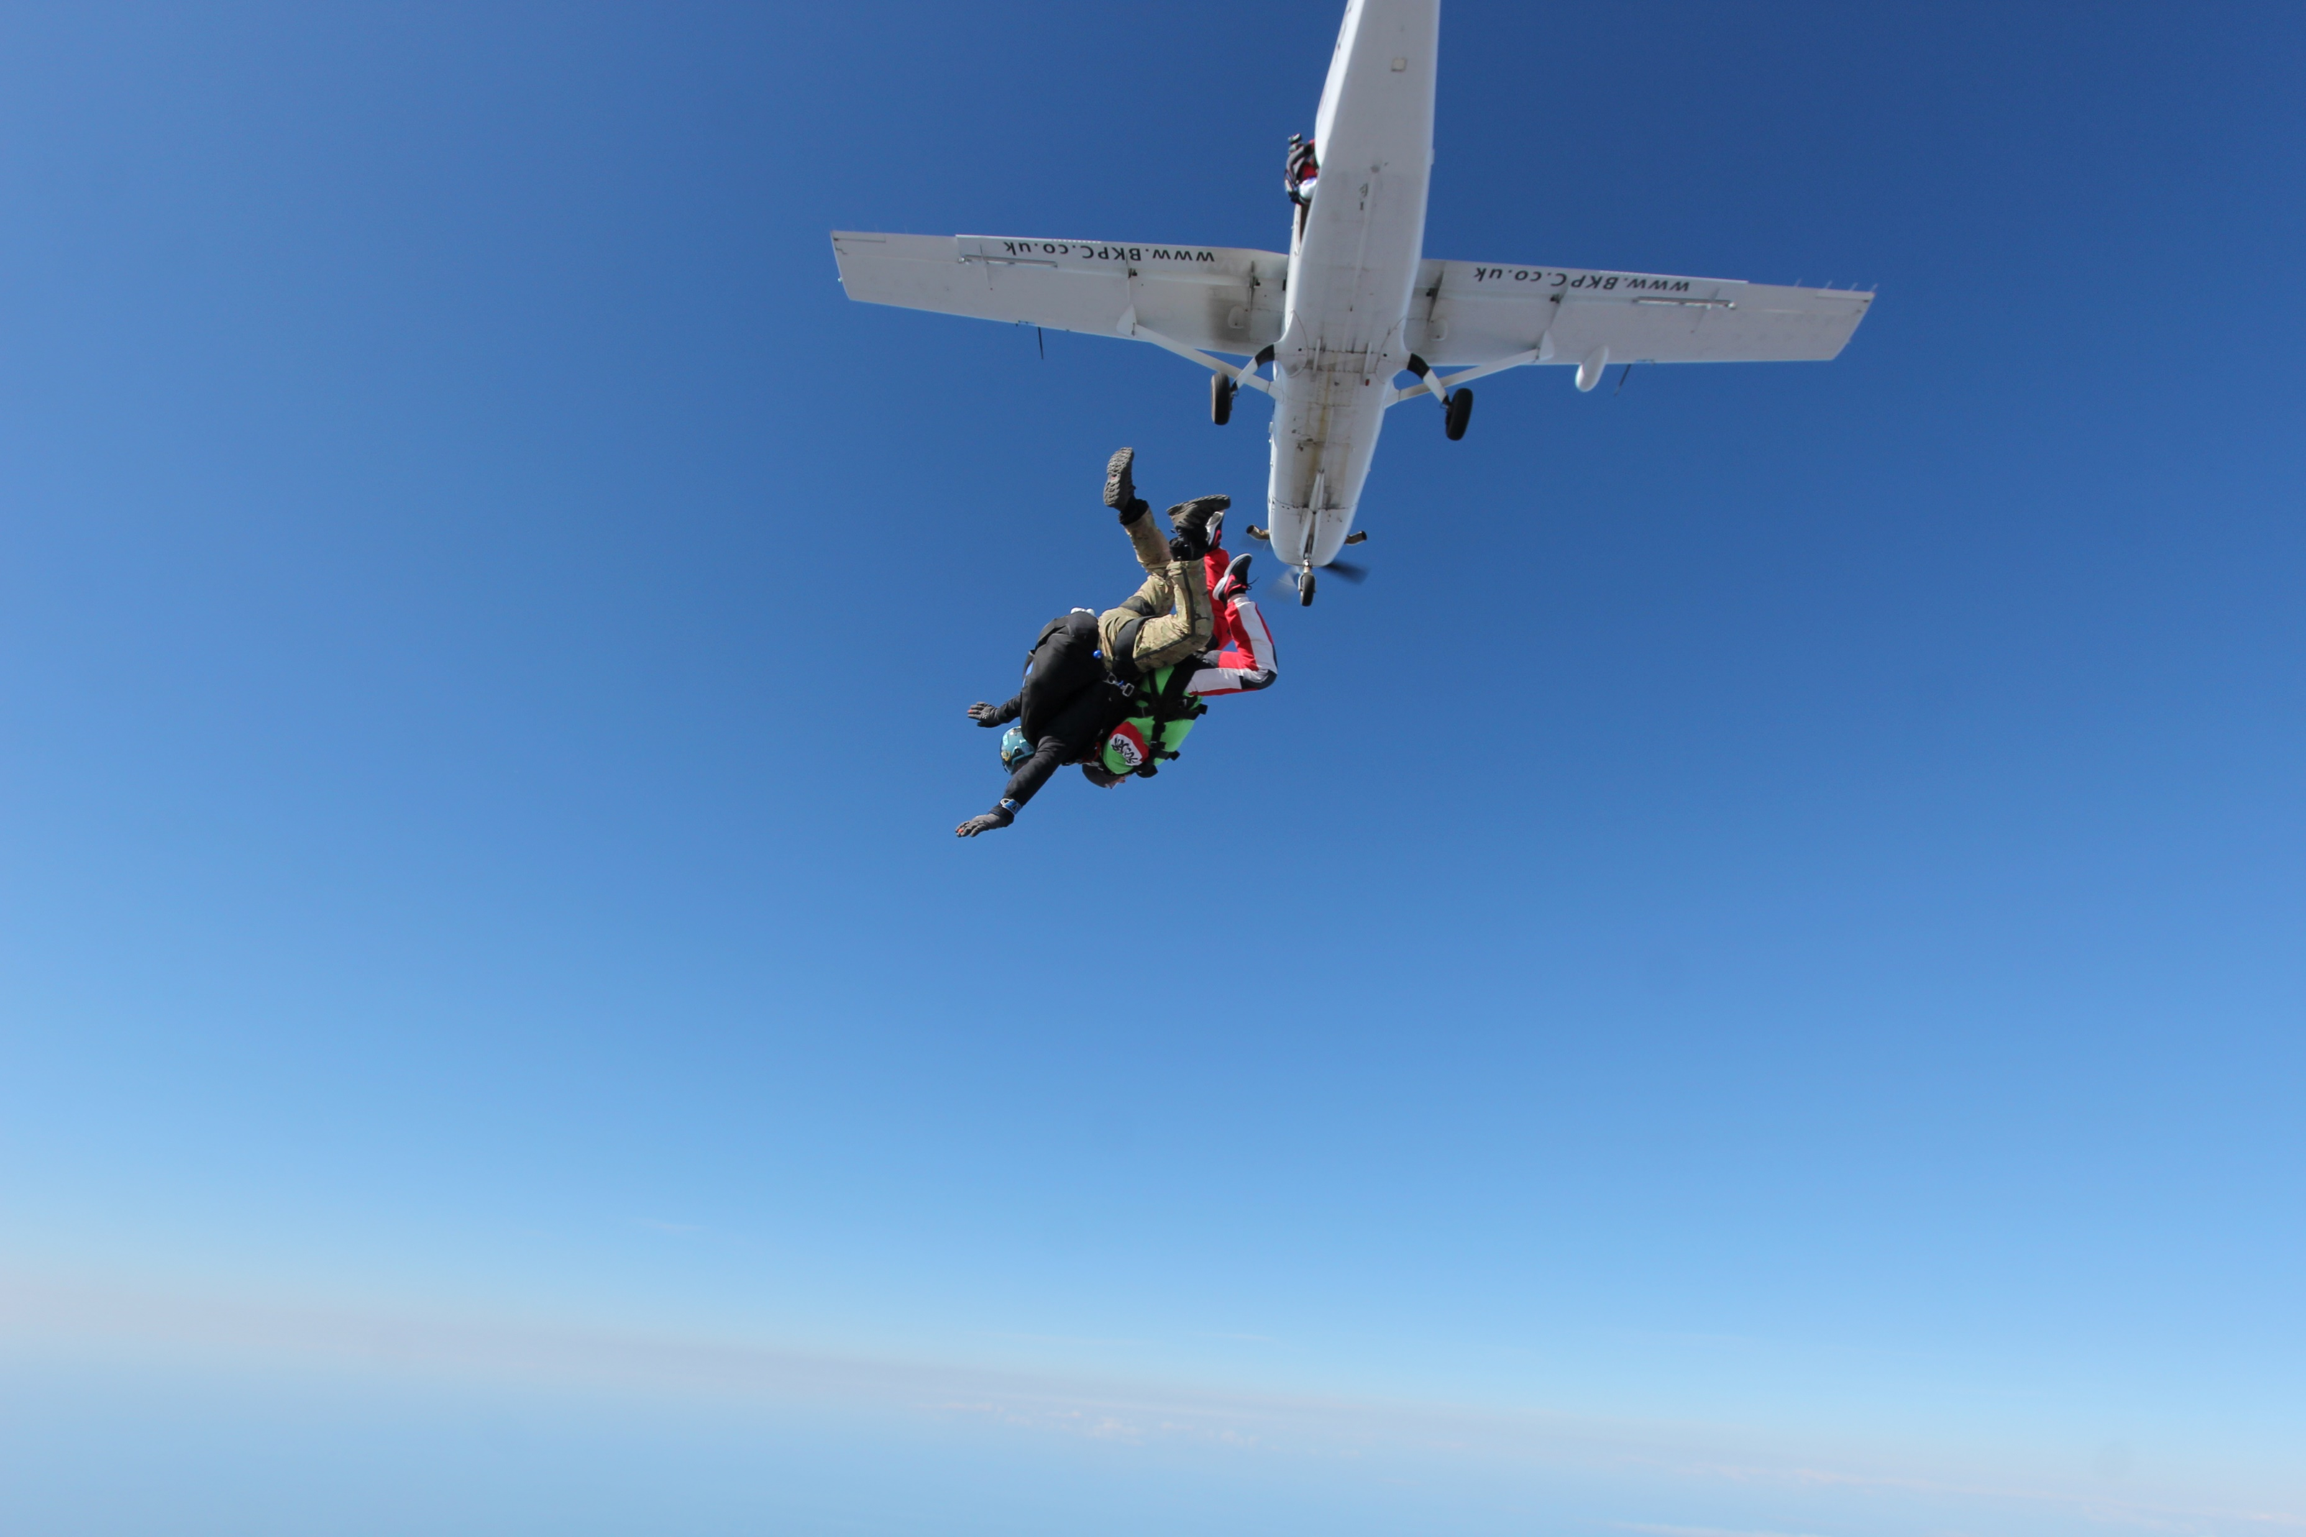

Slide 9
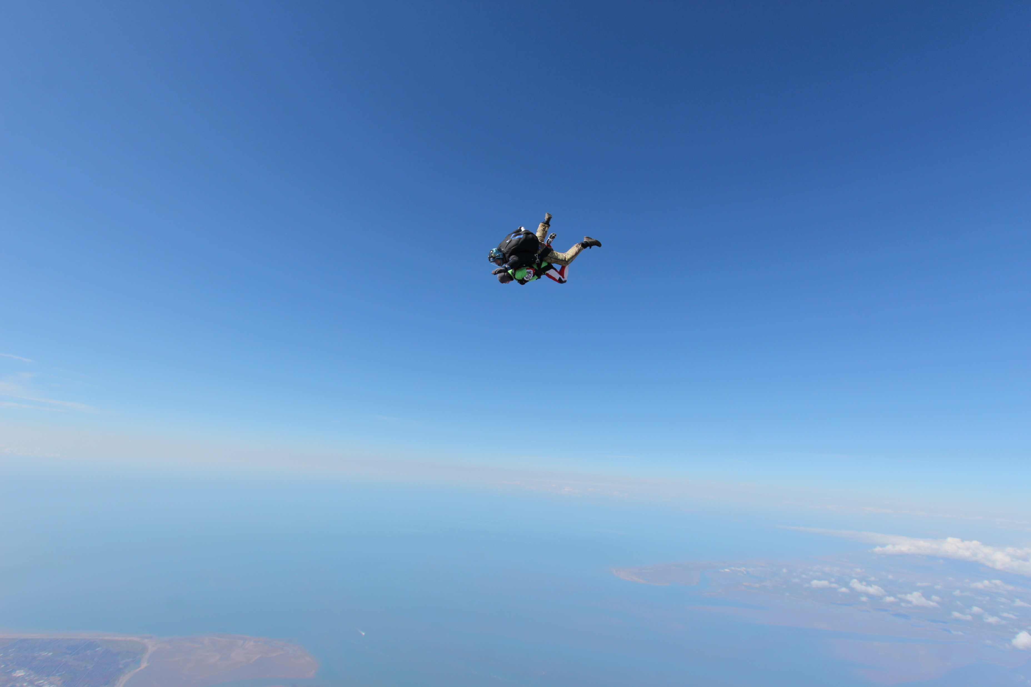

Slide 10
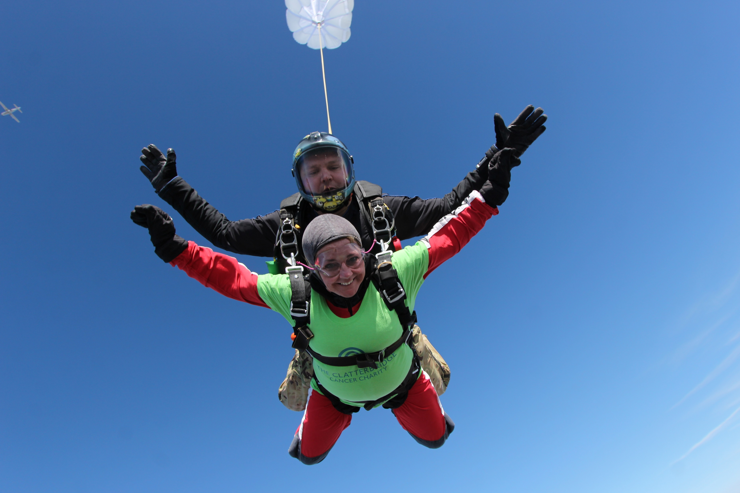

Slide 11
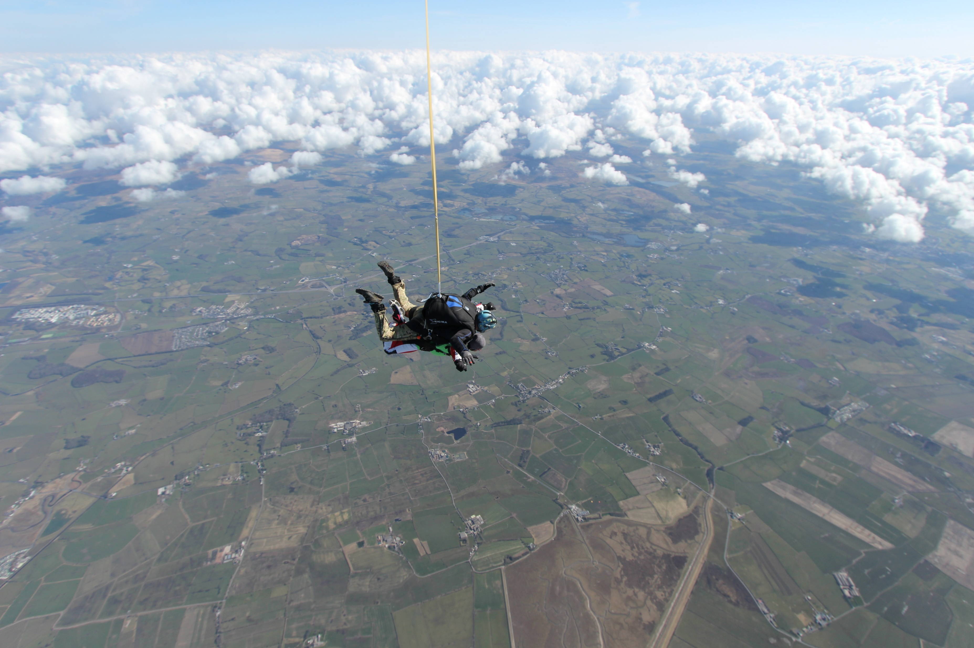

Slide 12
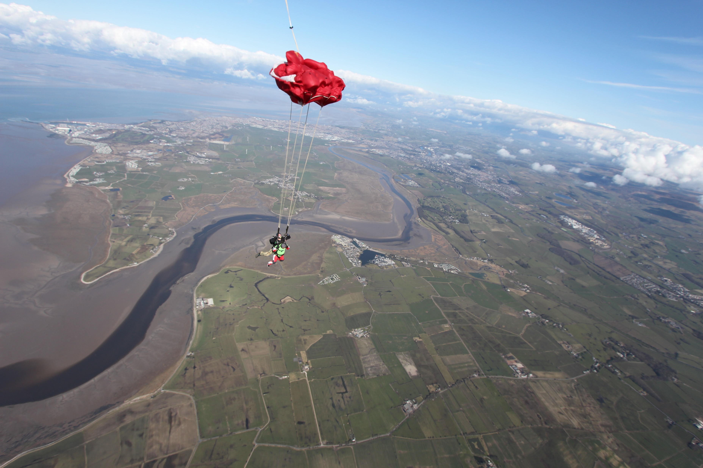

Slide 13
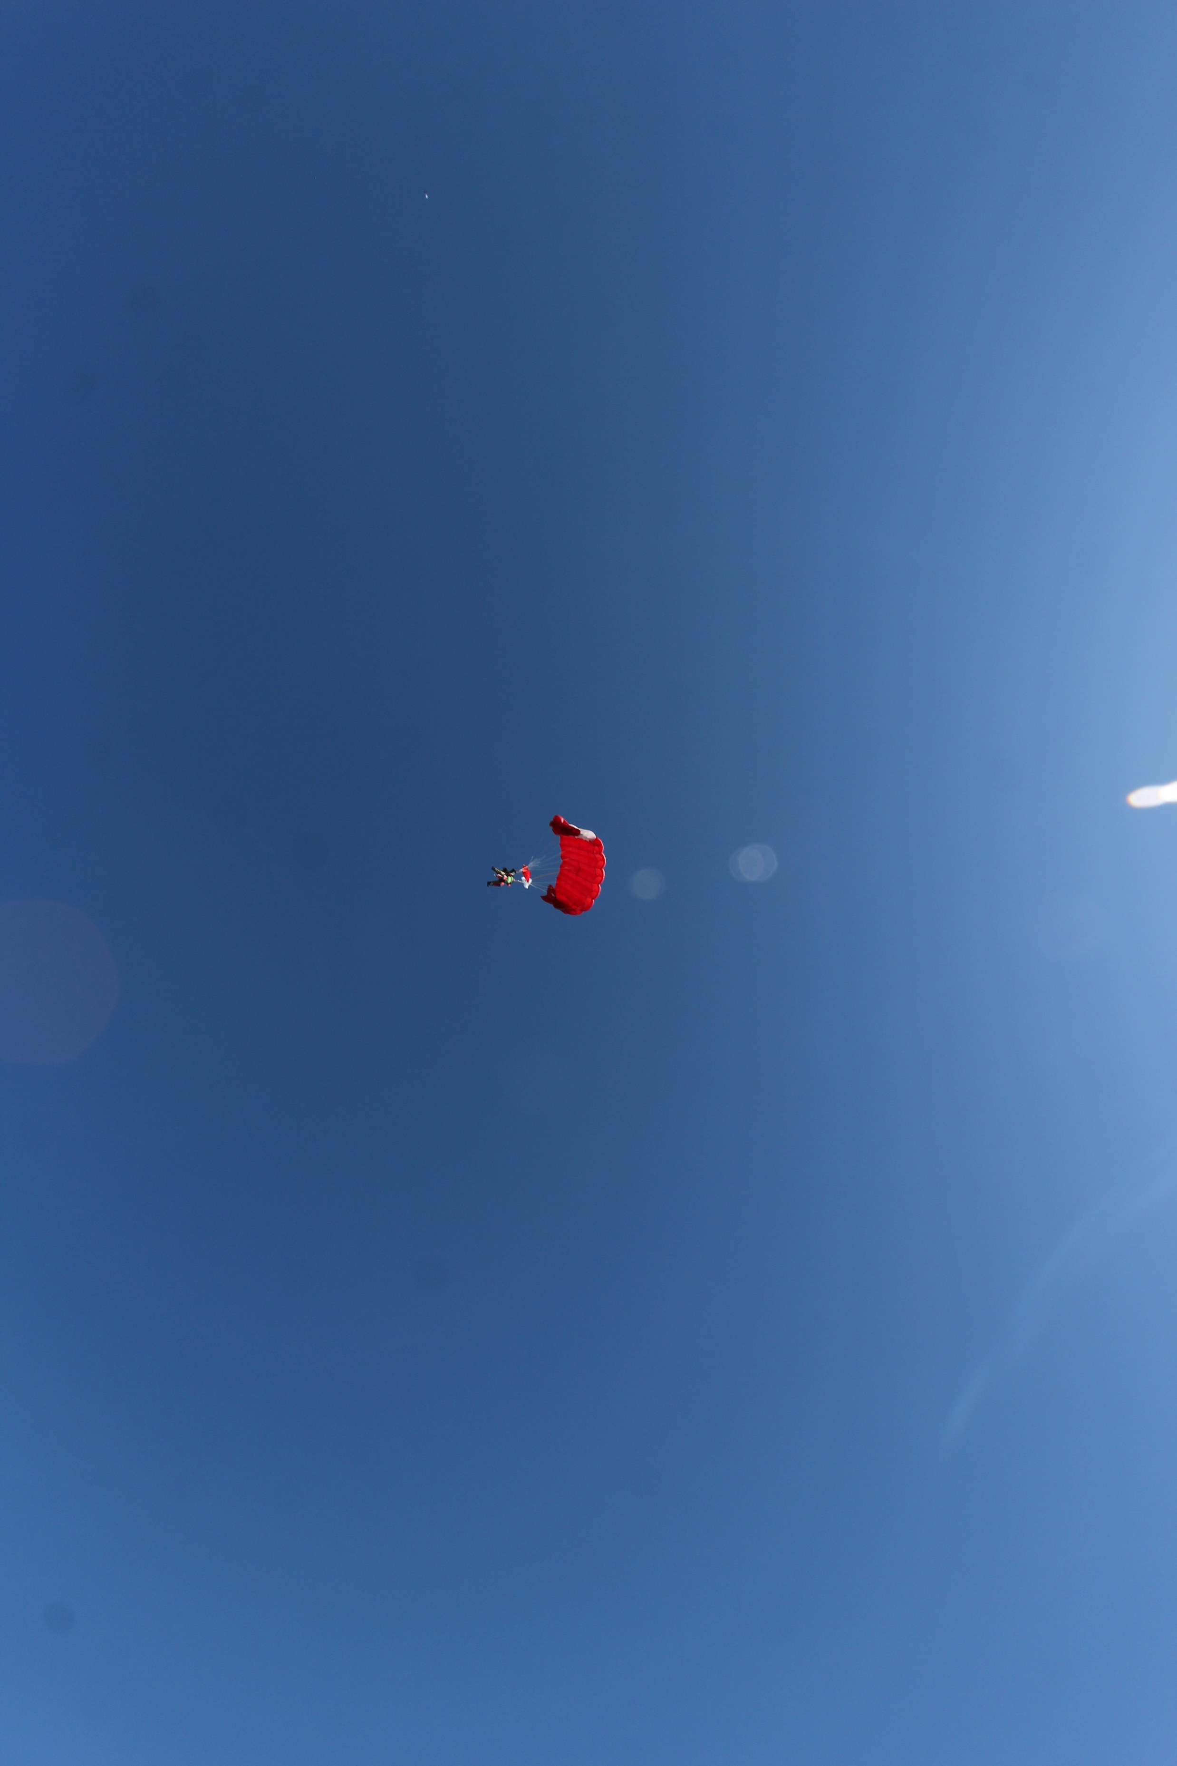

Slide 14
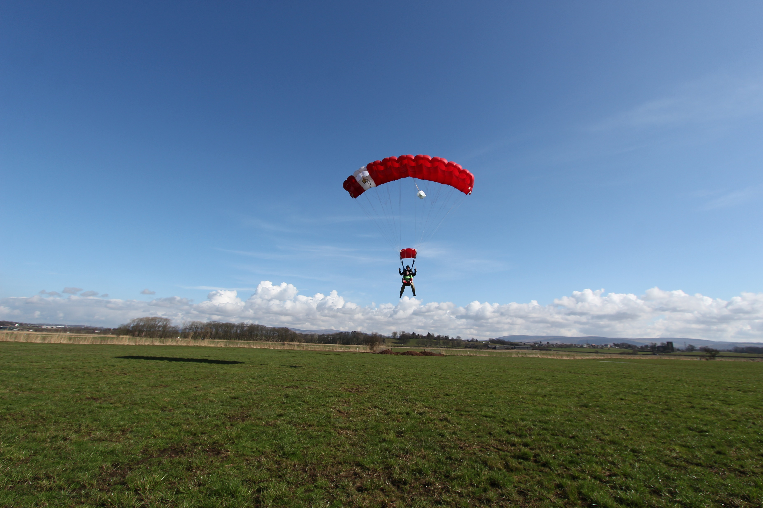

Slide 15
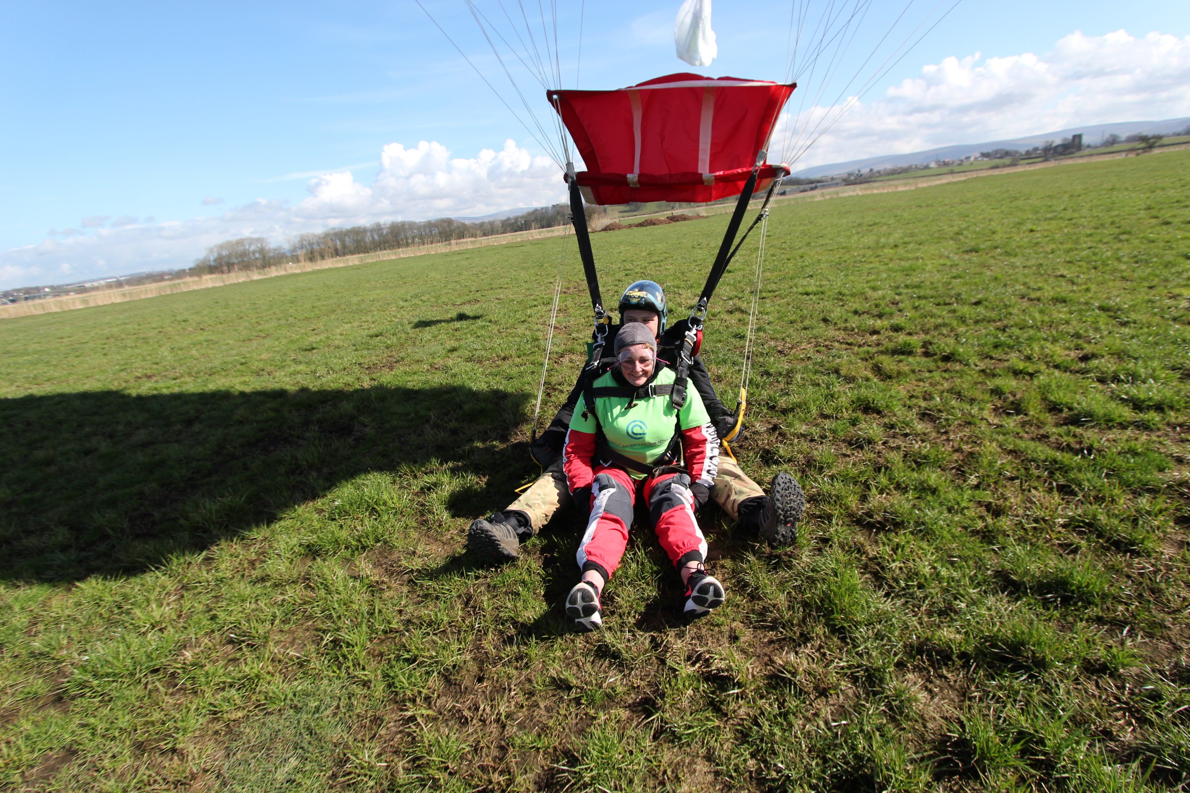

Slide 16
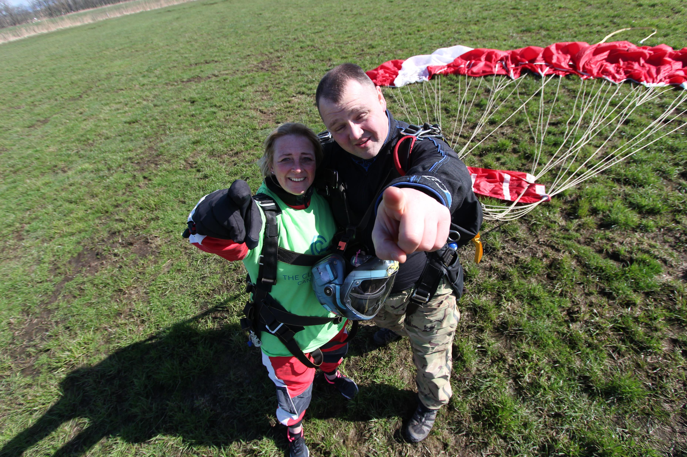

Slide 17

If you would like further information about Clatterbridge, or if you would like to support their work, you may wish to look at the following website :
https://www.clatterbridgecc.nhs.uk/charity/home

