Slide 1
Resilience week
OR
…how to bounce back!

Slide 2
RESILIENCE
Resilience is an important part of our learning but it is not always easy to be resilient.
We have been sharing lots of ideas in class to help us with resilience
During Resilience Week, students from Hope University worked with Resilience Ambassadors from each class.
The Ambassadors helped to support their classmates and shared their new ideas.

Slide 3



Slide 4
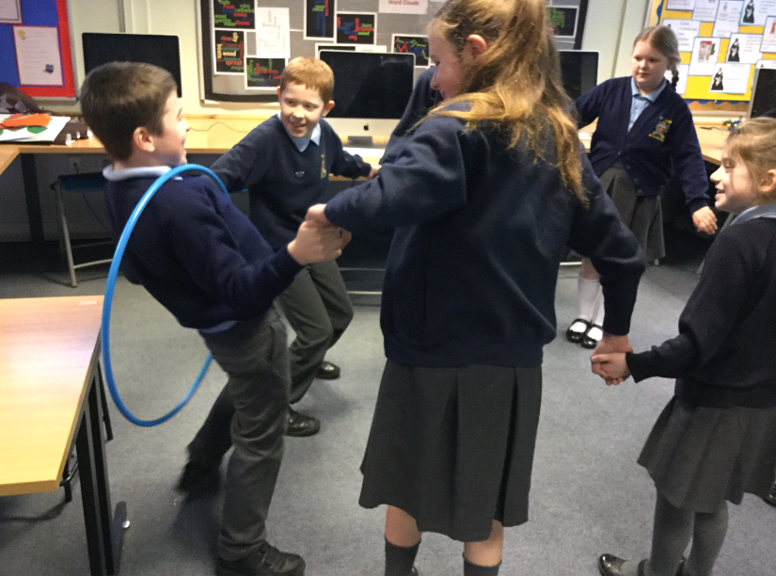

Slide 5
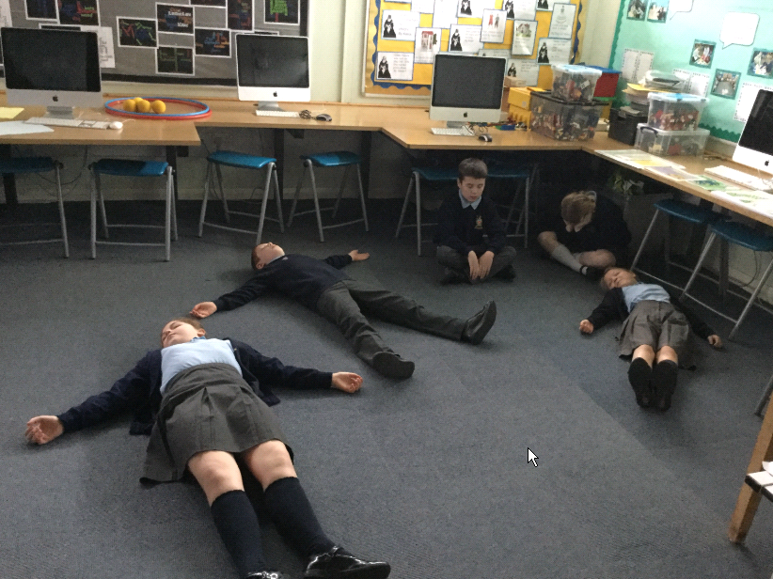

Slide 6
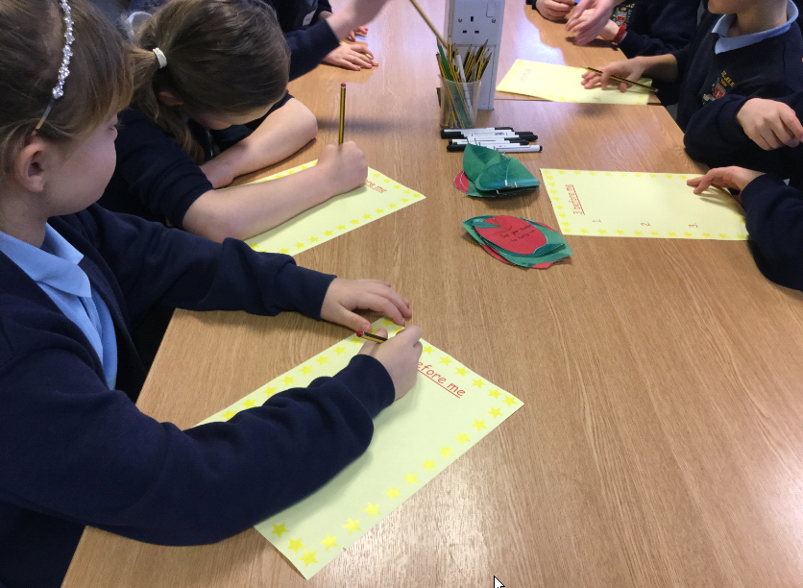

Slide 7
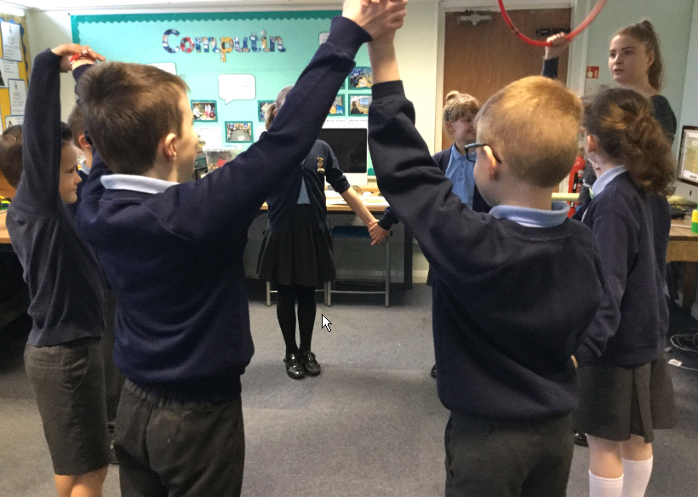

Slide 8
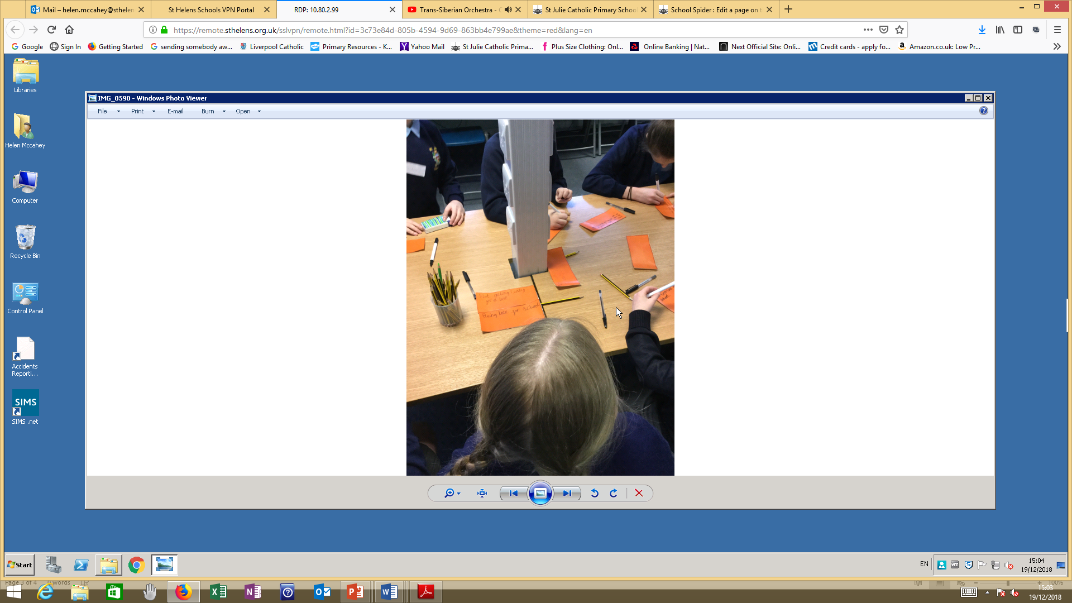

Slide 9
