Slide 1
Multi Faith Event Year 6
Eccleston Community Library

Slide 2
The Year 6 children sang Christmas carols at this community multi-faith event. We learnt about the beliefs of many other faiths, from the leaders present. We heard about the similarities and differences between our own religion and those of others. Leaders of the Jewish, Muslim, Hindu and Islamic faiths participated in this wonderful event.

Slide 3
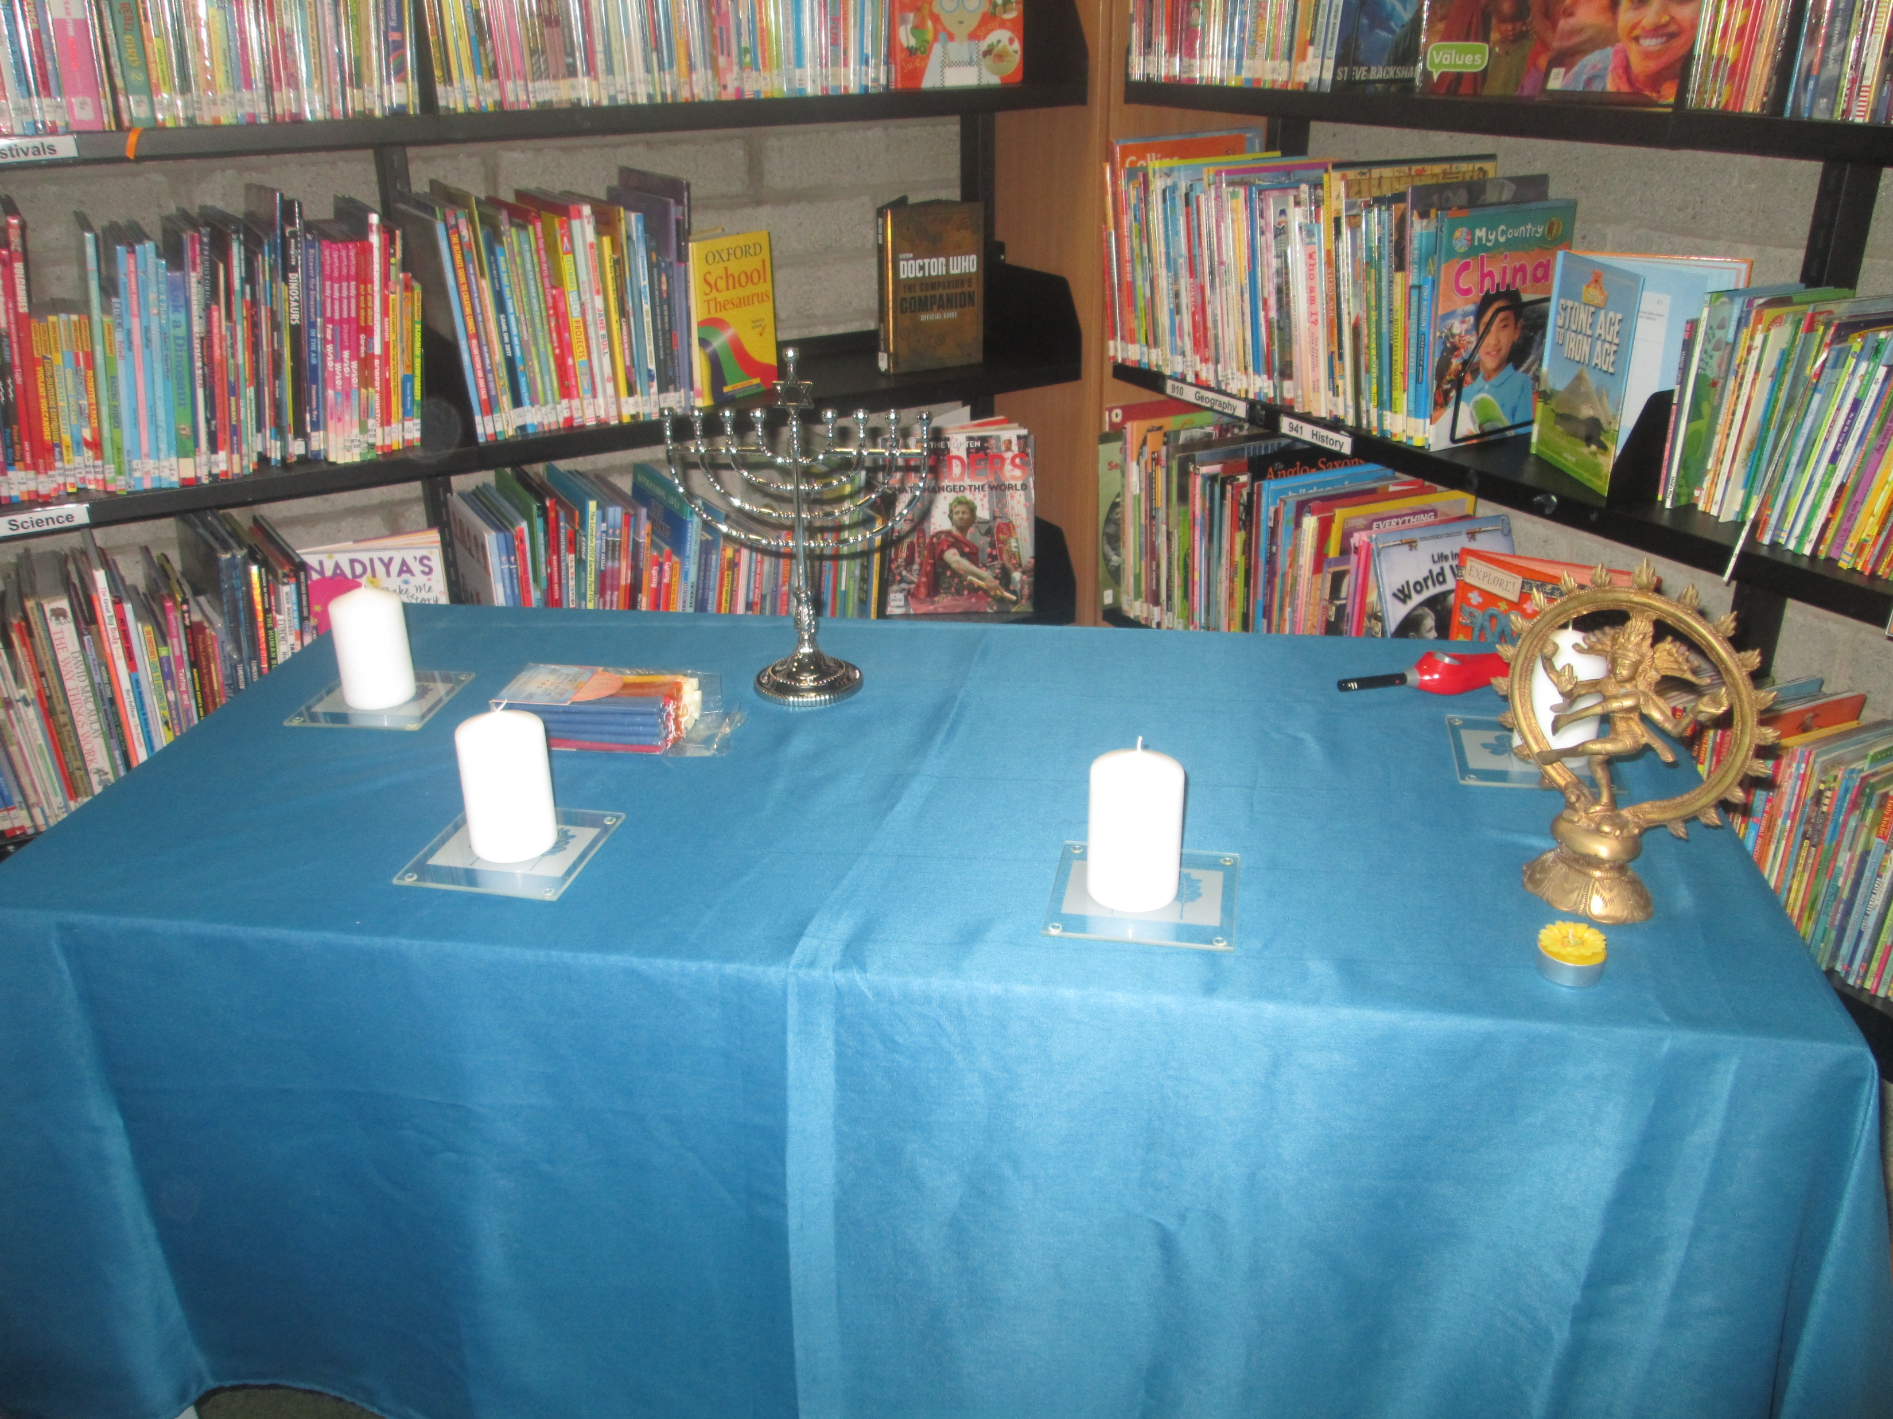

Slide 4
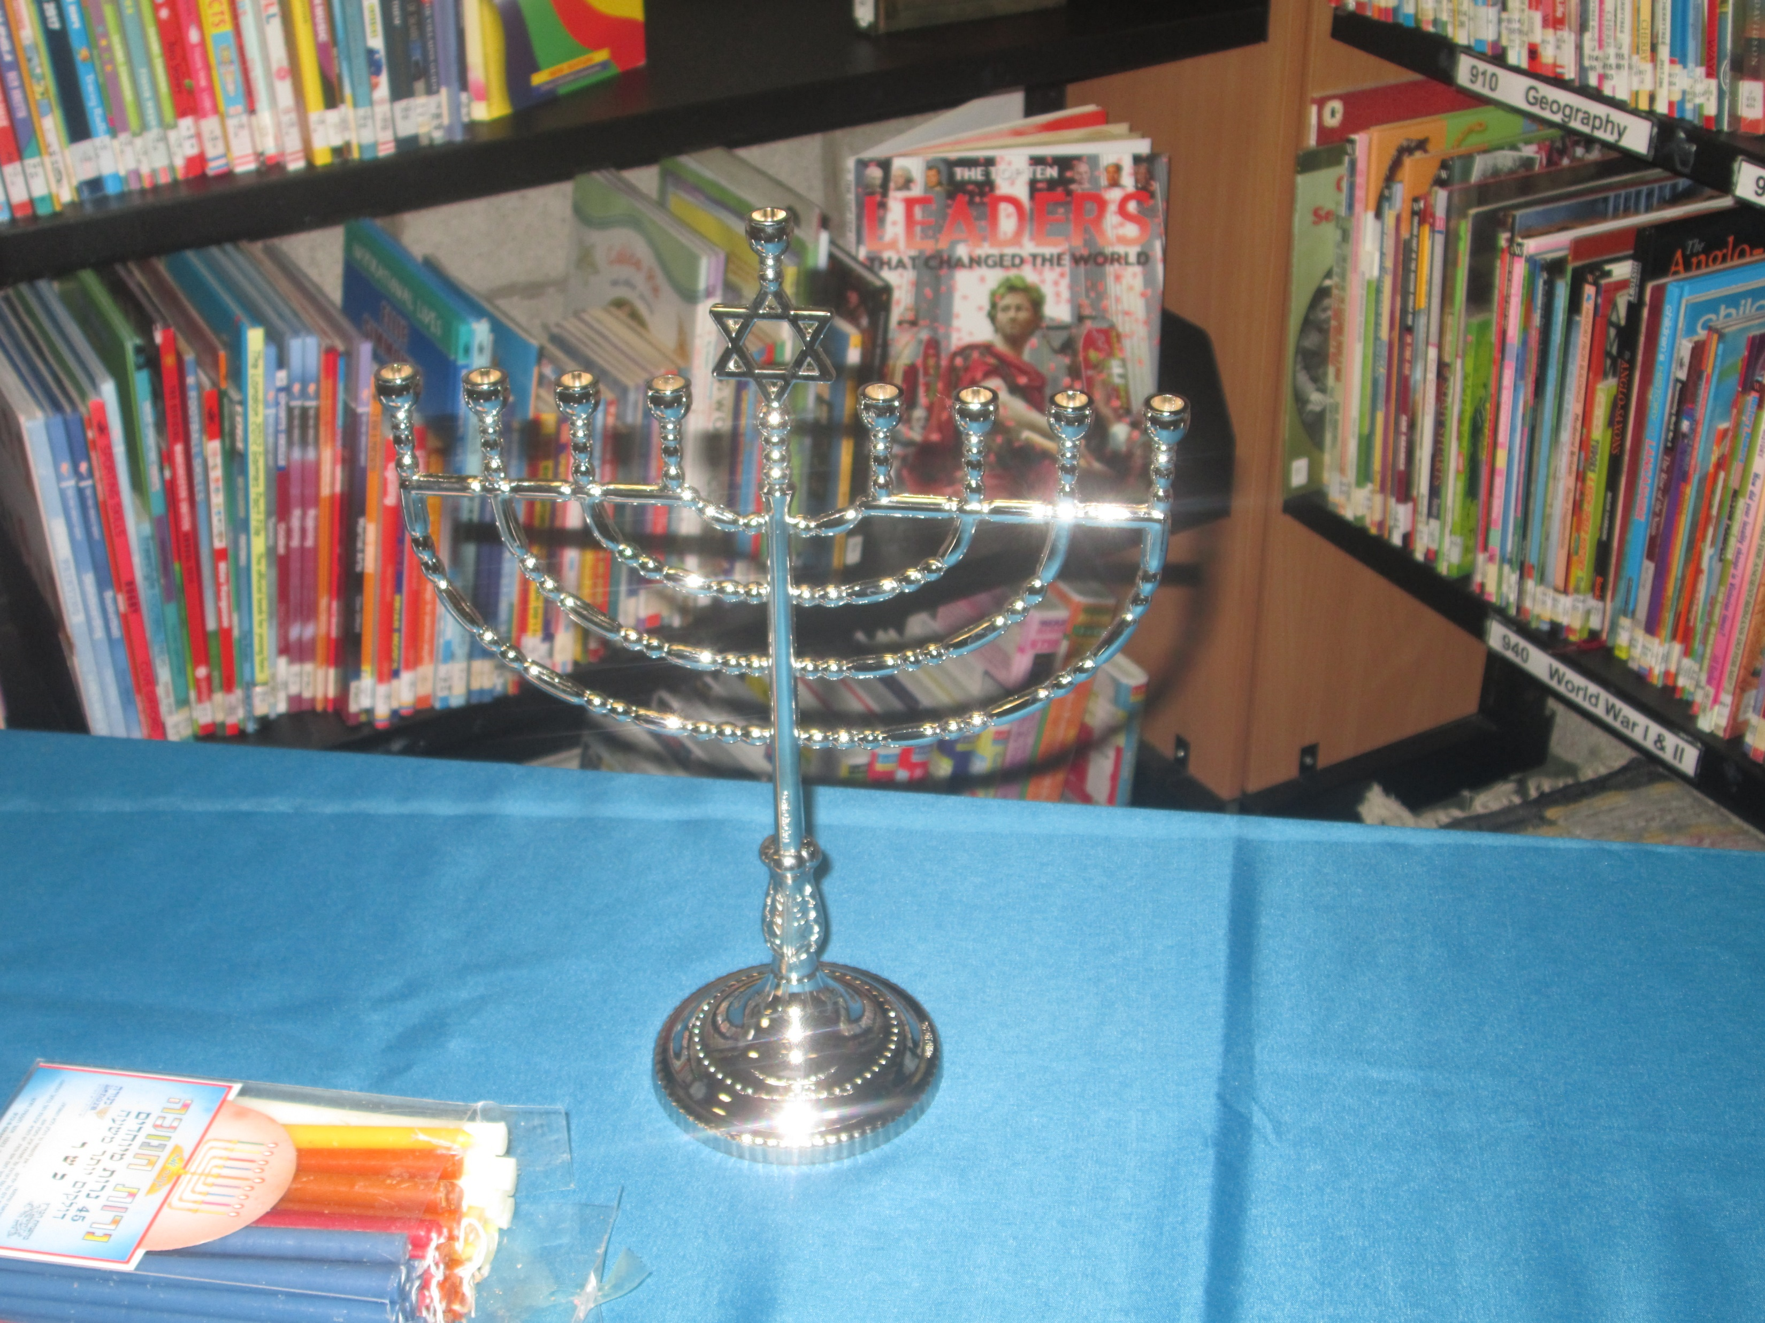

Slide 5
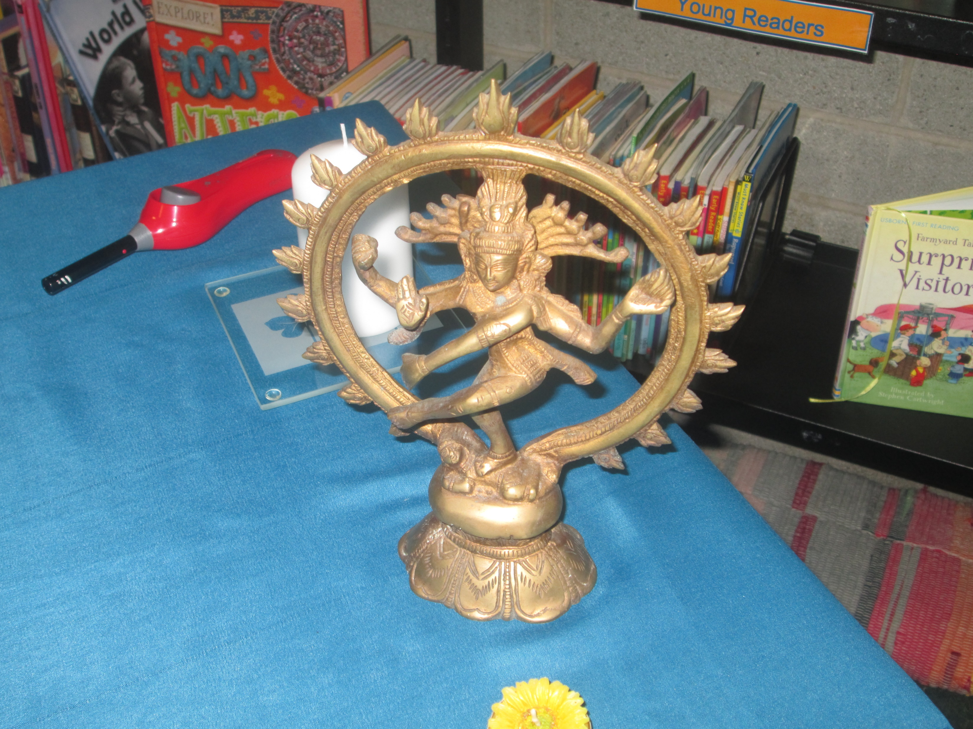

Slide 6
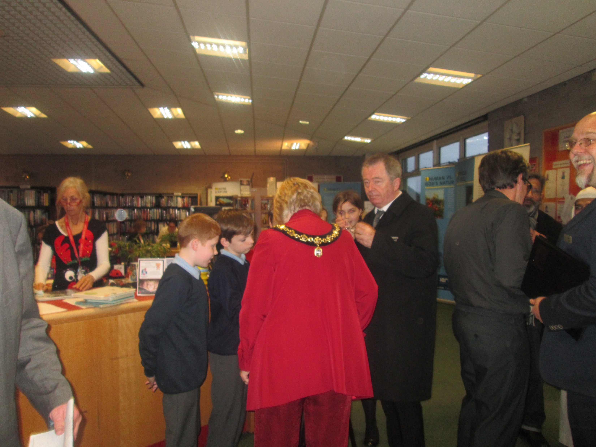

Slide 7
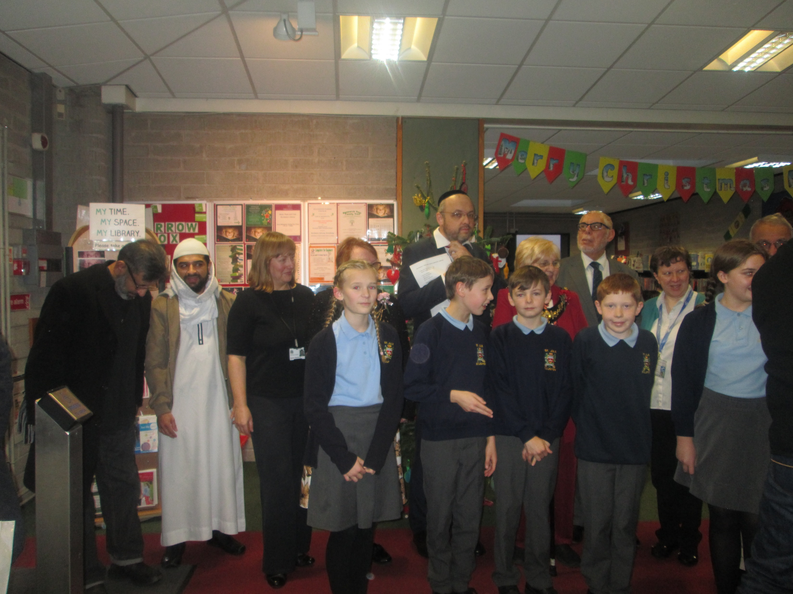

Slide 8
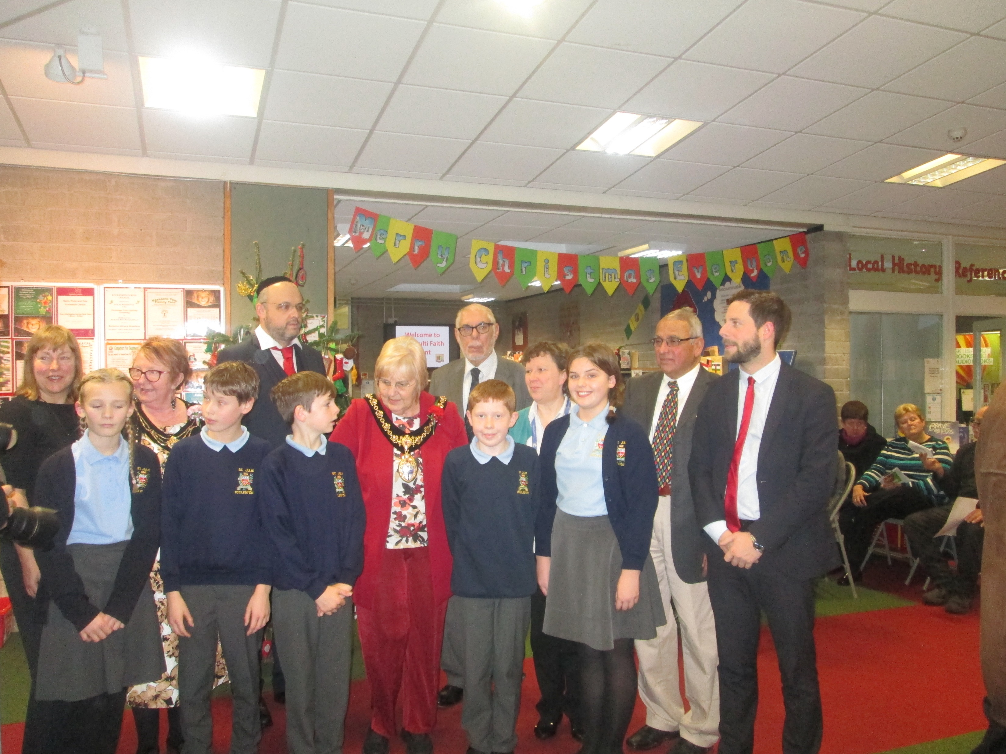

Slide 9
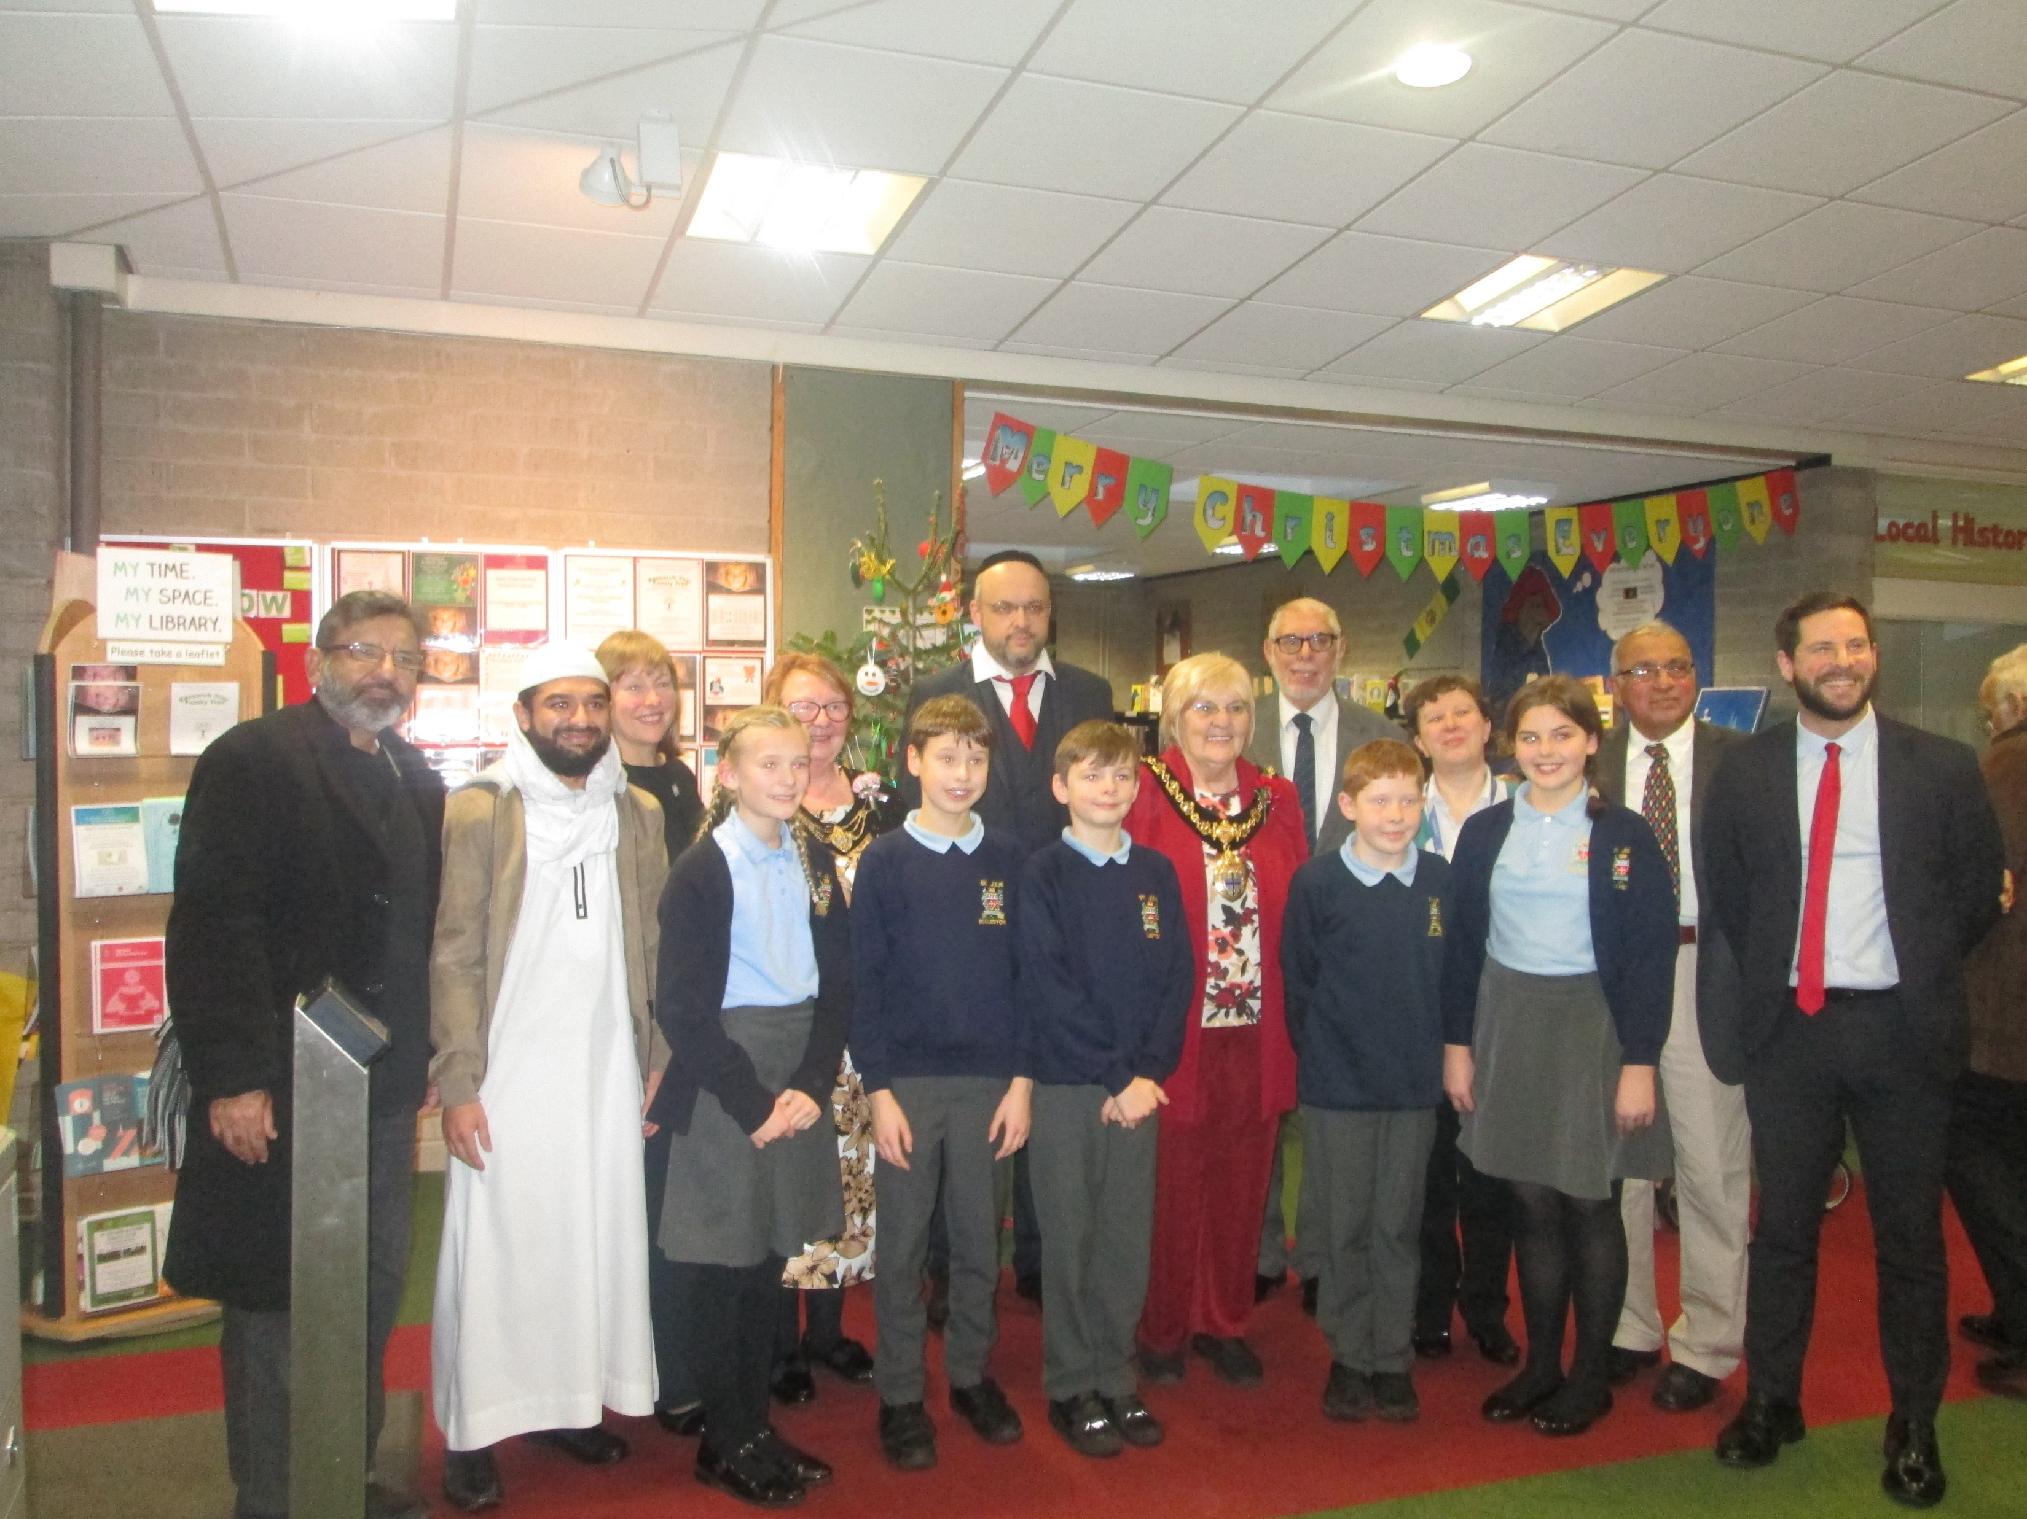

Slide 10
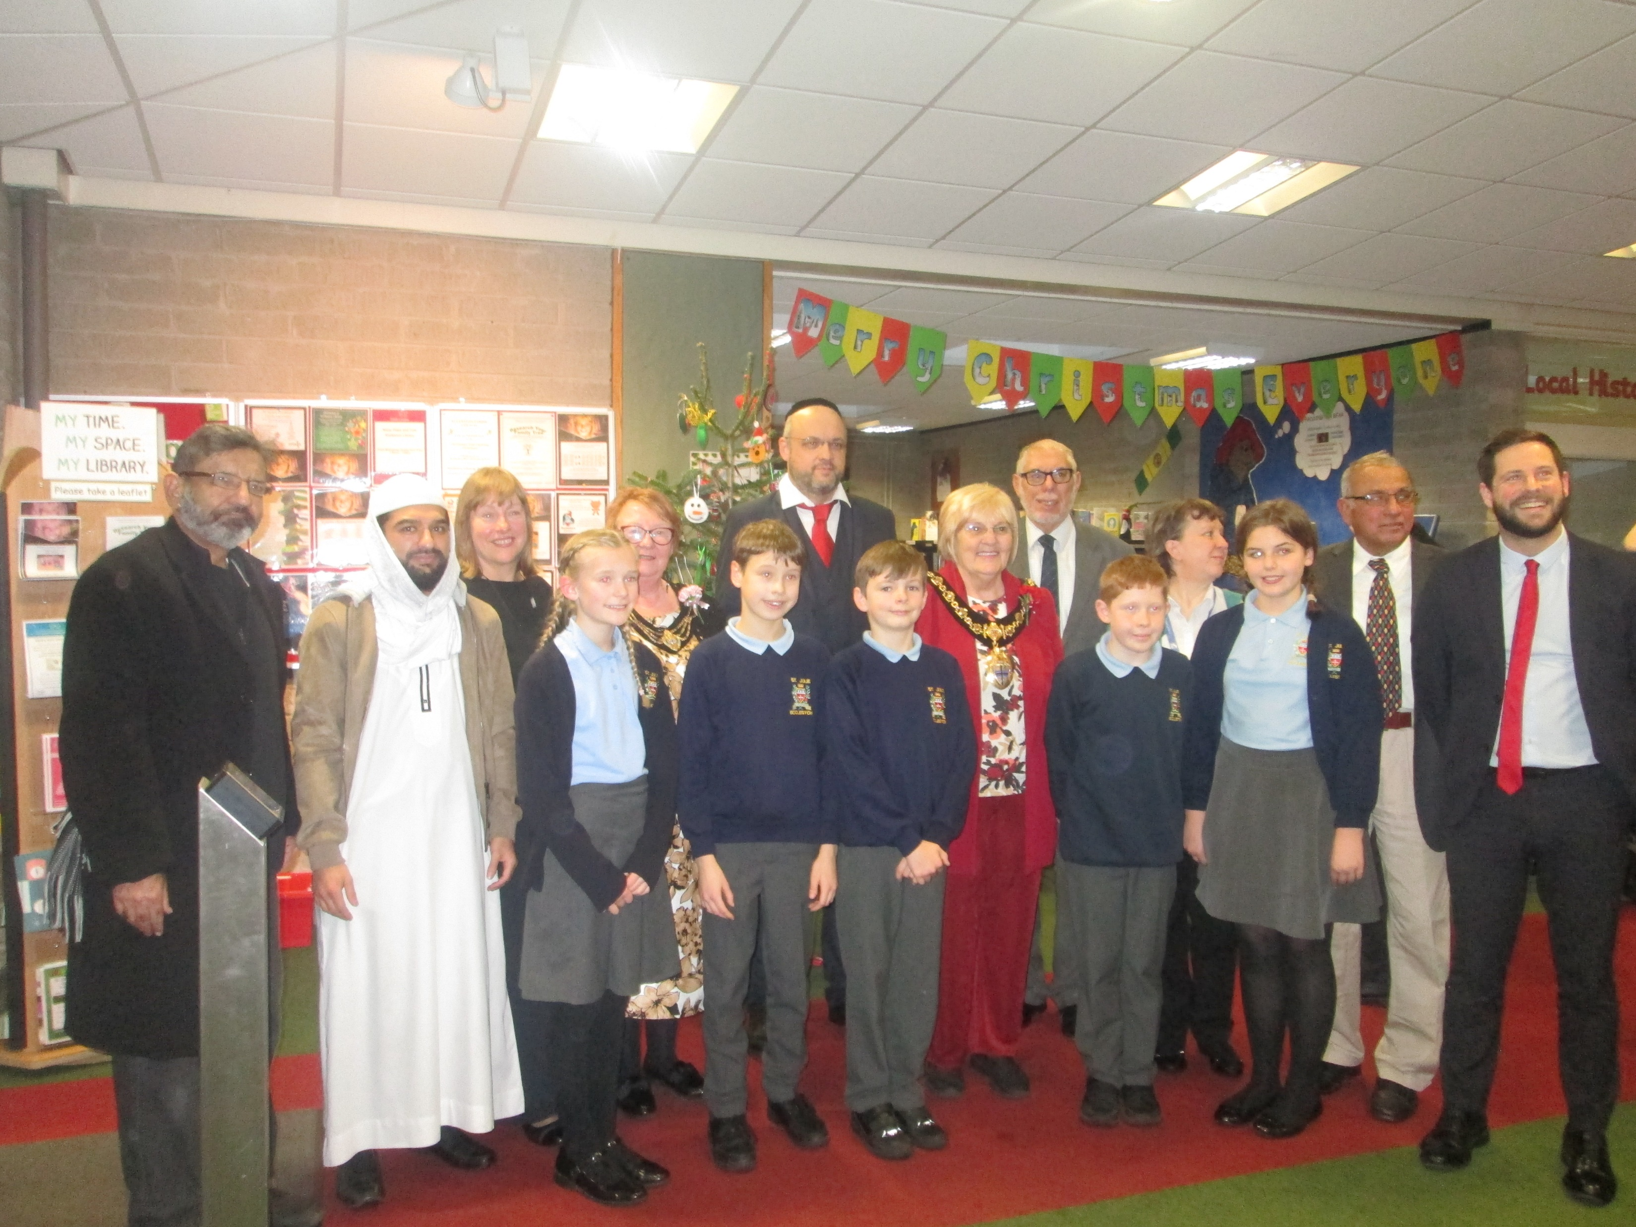

Slide 11
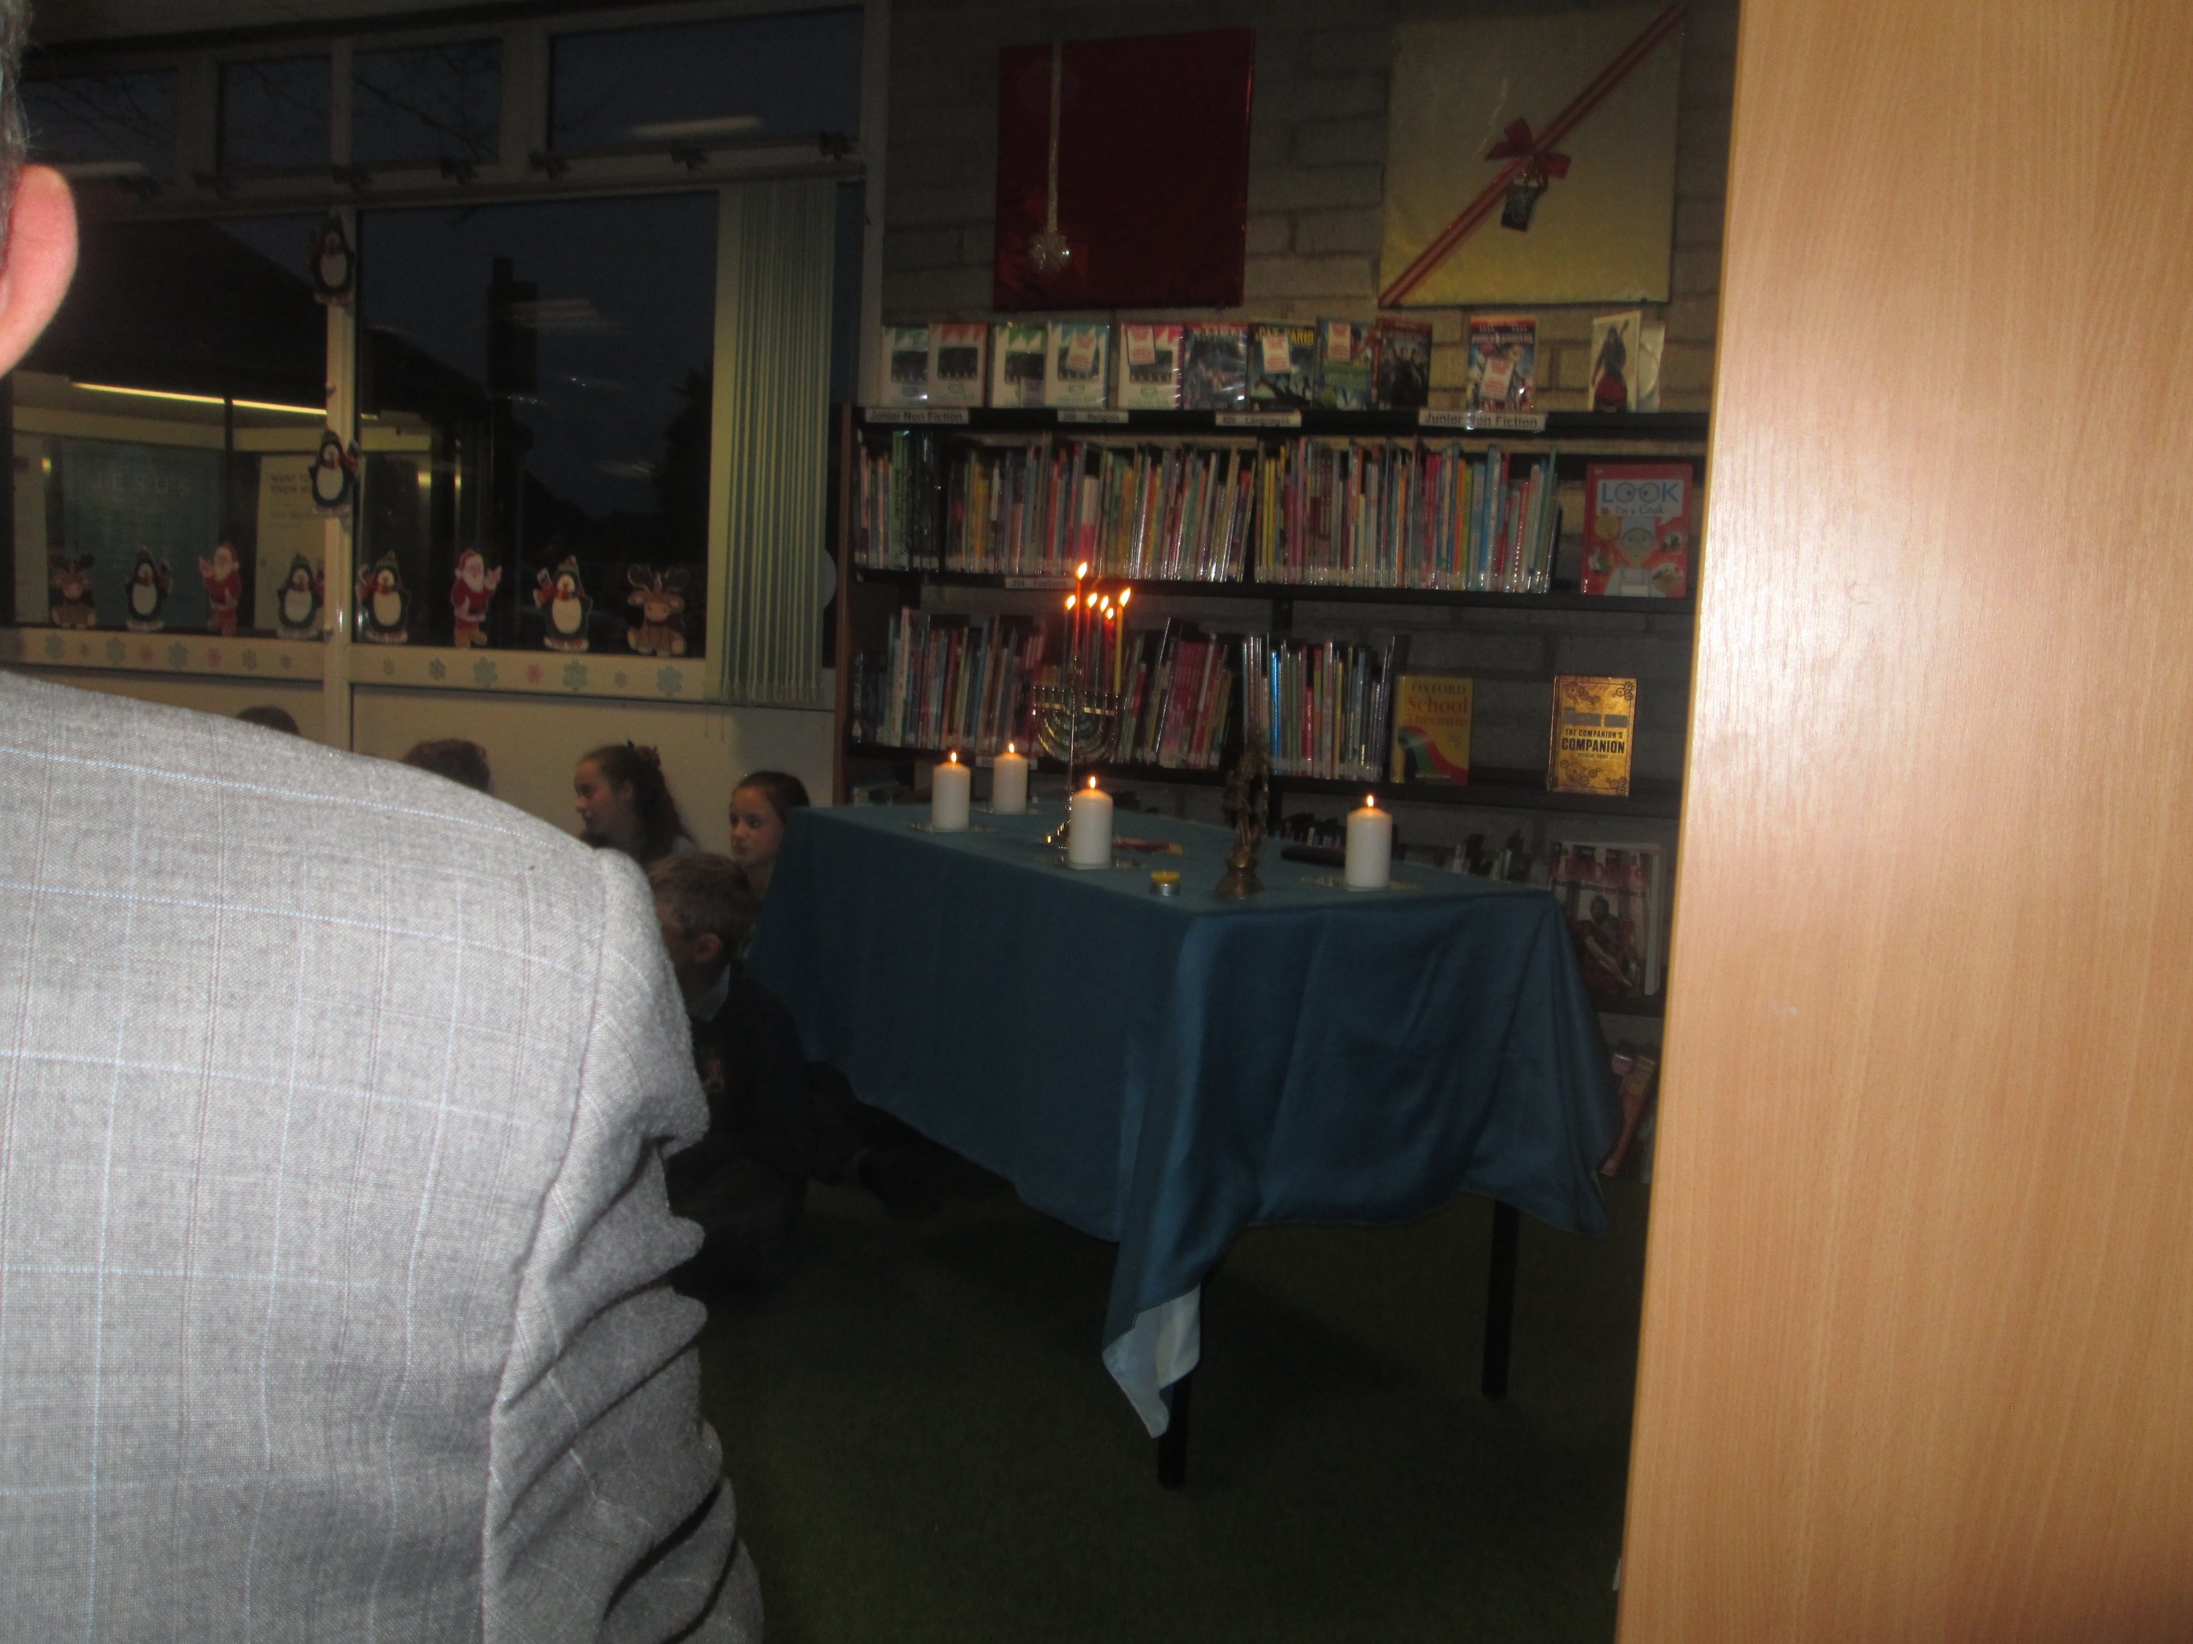

Slide 12
