Slide 1
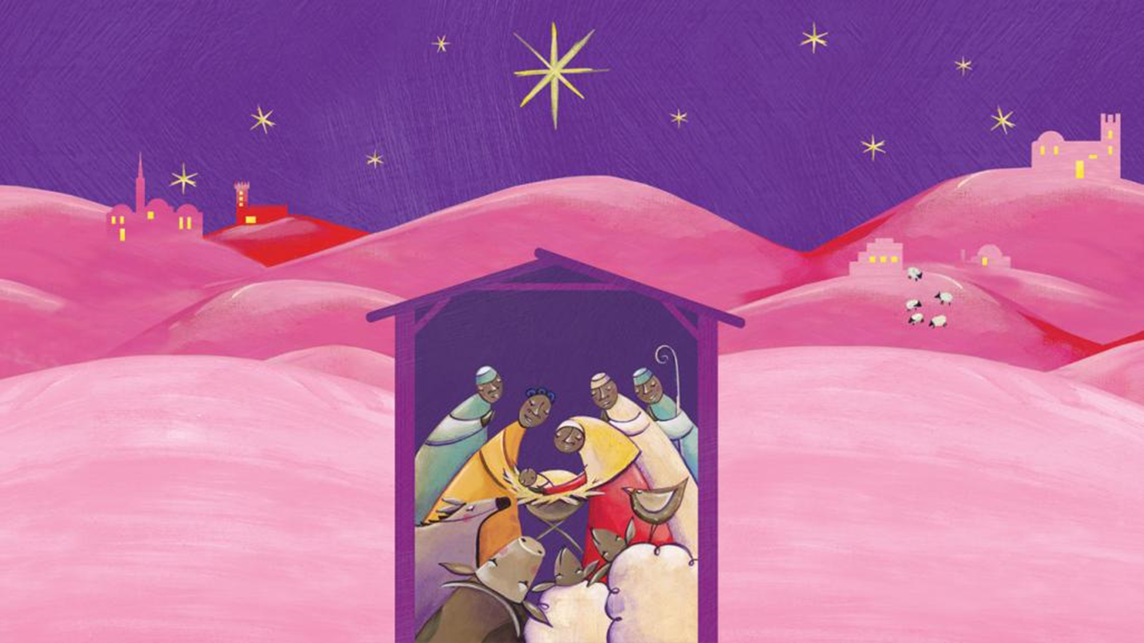

























Advent calendar
2018

Slide 2


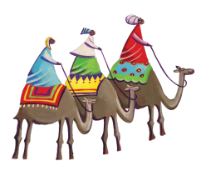
Sunday
2 December
First Sunday of Advent
Luke 21:25-28, 34-36
The gospel story is telling us that we must be ready when Jesus comes again, but that we cannot be exactly sure when that will be, so we must try to be ready all the time.
Advent is a special time where we get ready for the coming of Jesus.
When we look around, we sometimes see people who need our help.
Let’s remember this.
This Advent, let’s look out especially for people who have lost things that are important to them and their lives.

Slide 3

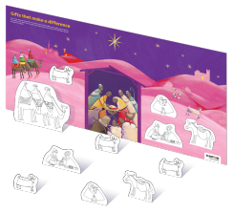
Monday
3 December
At this time of year, we remember Mary and Joseph’s long journey to Bethlehem and how they relied upon the kindness of strangers to provide them with food and shelter.
This Advent, we think about all the people who rely on the kindness of the global Catholic family for food and shelter.
How can we show kindness to others this Advent?
Download our World Gifts resources to set up a nativity
scene in class.

Slide 4

Tuesday
4 December
Make your own Advent wreath
Get crafting this Advent! Why not start by making you own Advent wreath?
The Advent wreath is a special symbol.
The evergreen leaves mean everlasting life.
The circle of the wreath (with no beginning and no end) reminds us of the eternity of God and the four candles are the four weeks of Advent.
    Draw or make an Advent wreath:
    1. Cut a hole in the middle of a paper plate
    2. Draw around your hands on green recycled paper and ask others to do the same
    3. Stick the cut-out hands around the outside of the paper plate to make the leaves
    4. Make four candles by rolling paper into tubes (3 purple and 1 pink)
    5. Attach a paper flame to one candle on each
    Sunday of Advent

Slide 5
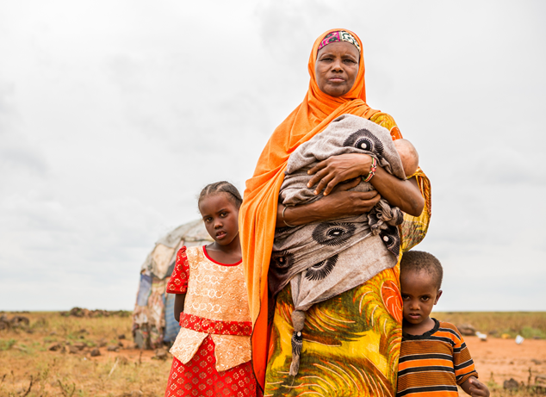
Wednesday
5 December
Kushi’s Story
Kushi lives in Marsabit in Kenya. The animals she relied on to feed her family died in a huge drought. Now she has nothing.
She has only a basic shelter and has to travel a long way to get food. She receives food vouchers to help her survive, but life continues to be a struggle.
Soon the emergency help will run out.
Let us pray together for Kushi, her family and all those in need.
Loving Father, all your children are precious to you.
May we work together in shared respect,
so that all may come to the fullness of life you have promised.
Amen.

Slide 6
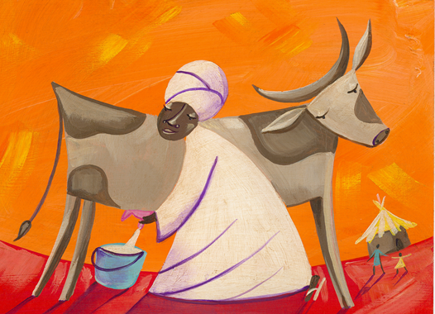
Thursday
6 December
We all like giving and receiving presents at Christmas, but have you ever given a gift which has changed someone’s life?
CAFOD’s World Gifts are needed to continue to help the lives of people around the world.
There are lots of different World Gifts, including a marvellous moo cow!
Find out what gifts there are here. Vote for your class favourite and plan ways to raise money for it. Use our A-Z of festive fundraisers to help.

Slide 7
Friday
7 December
Let us pray
Gather at your nativity scene and say a prayer together.
Loving God,
Your Son was the greatest gift for the world.
Help us to remember all that he taught us
about loving our sisters and brothers,
wherever they live in the world.
Amen
Remember to add templates of the World Gifts to the nativity scene each time you raise money for them.

Slide 8
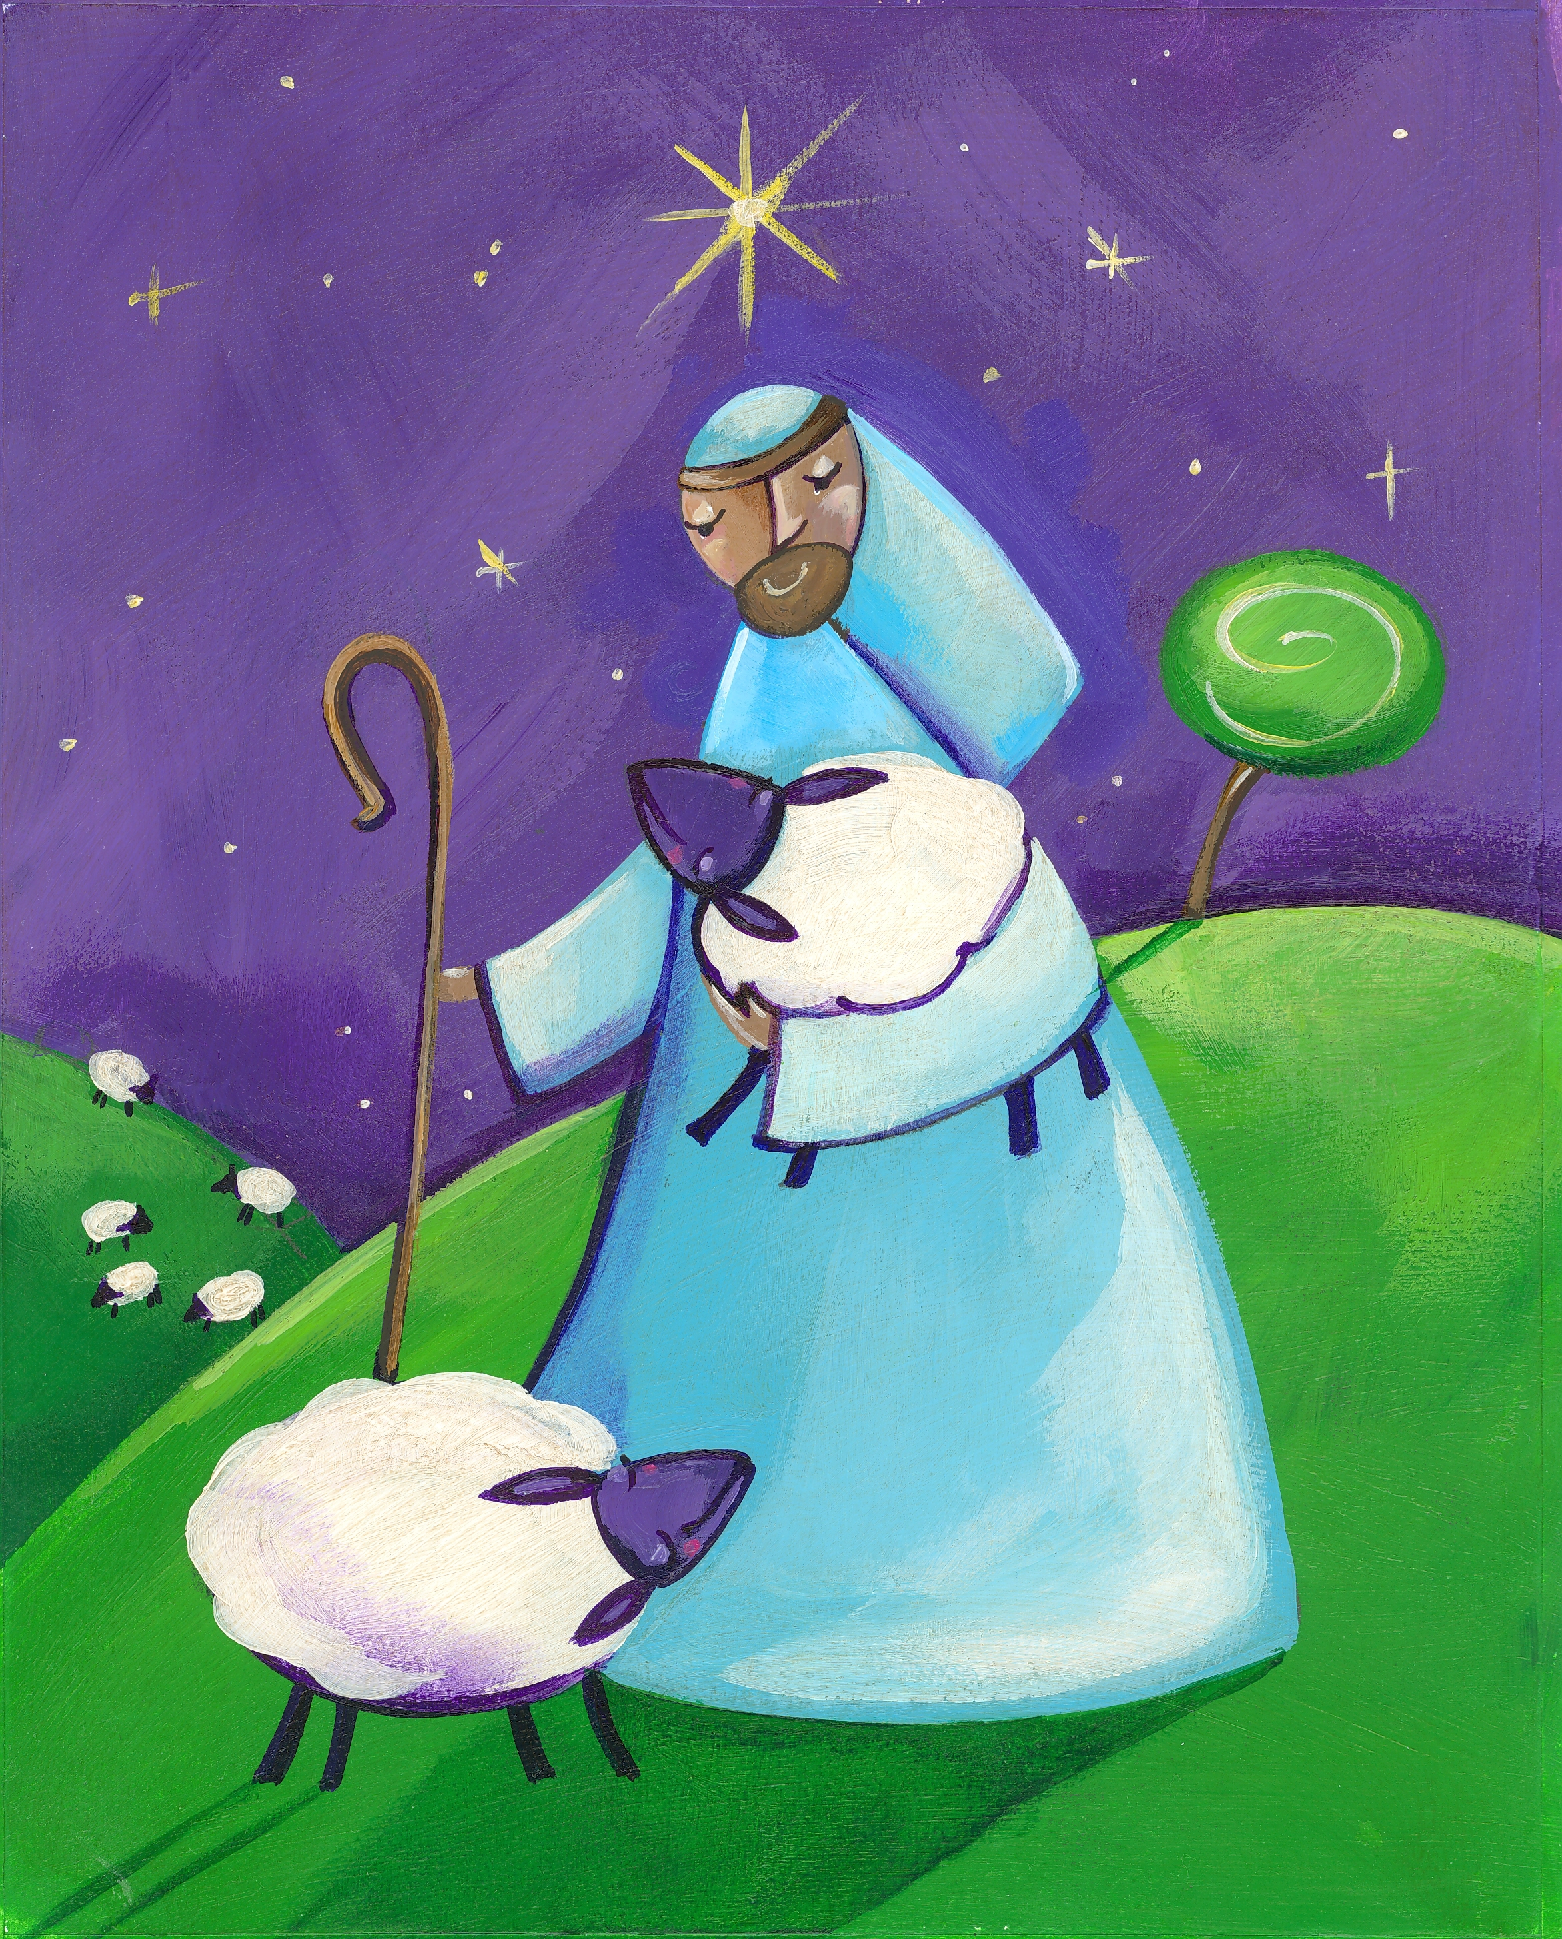
Saturday
8 December
A Christmas star
In the Christmas story, a star guides the shepherds and the kings to the stable where Jesus was born.
Draw a Christmas star on a piece of recycled paper.
Write the name of someone you know that you think has been a true Christmas star and say something nice about them. Give them the star and tell them why.

Slide 9
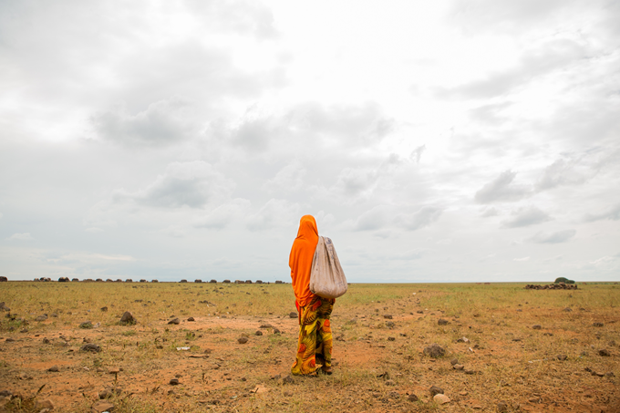
Sunday
9 December
Second Sunday of Advent
Luke 3:1-6
Today we hear about John the Baptist and how he was a messenger for God, preparing people for the coming of Jesus. How do we prepare during Advent?
Have you ever been to another country during Advent or for Christmas?
Find out how people celebrate Christmas in other countries around the world.

Slide 10
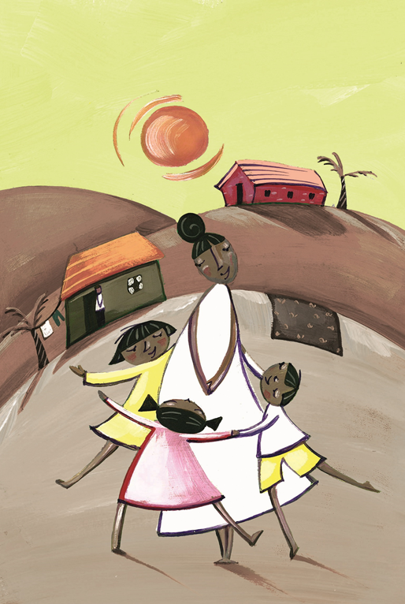
Monday
10 December
Human Rights Day
Today is Human Rights Day. All people have the right to basic things like water, food, shelter and education.
It is often difficult for refugees to have these basic things they need.
CAFOD supports families around the world to achieve their Human Rights.
CAFOD’s World Gift,
Help a refugee child,
brings happiness to
families of refugees.
What makes you happy?
Check out our refugee animation here

Slide 11

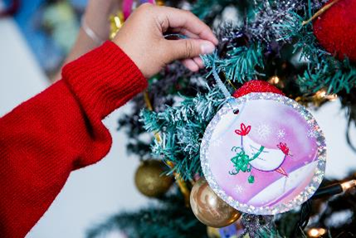
Tuesday
11 December
Classroom decorations
Time to get crafty! Why not spend some time decorating your house and your classroom with eco-friendly decorations.
Make colourful paper chains by using recycled magazines!
You may wish to organise a Christmas sale and use the money to buy World Gifts.
You could make Christmas cards, decorations or cakes to sell.

Slide 12
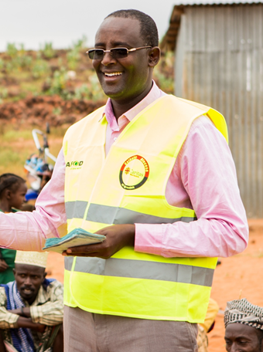
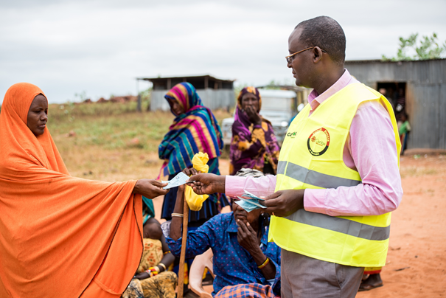
Mr Jirma’s Story
Wednesday
12 December
Last week, we heard about Kushi from Kenya. At the moment, she receives vouchers to feed her family.
But soon the emergency help will run out.
Mr Jirma is in charge of giving out the food vouchers to help people like Kushi.
He is part of our
global Church family.
“If it wasn’t for the Catholic church,
I wouldn’t be here.”
Let us pray together for Mr Jirma
and for those who work to help others.
Loving Father, all your children are precious to you.
May we work together in shared respect,
so that all may come to the fullness of life you have promised.
Amen.

Slide 13
Thursday
13 December
Let us pray
Gather at your nativity scene and say a prayer together.
Loving God,
Your Son was the greatest gift for the world.
Help us to remember all that he taught us
about loving our sisters and brothers,
wherever they live in the world.
Amen
Remember to add templates of the World Gifts to the nativity scene each time you raise money for them.

Slide 14
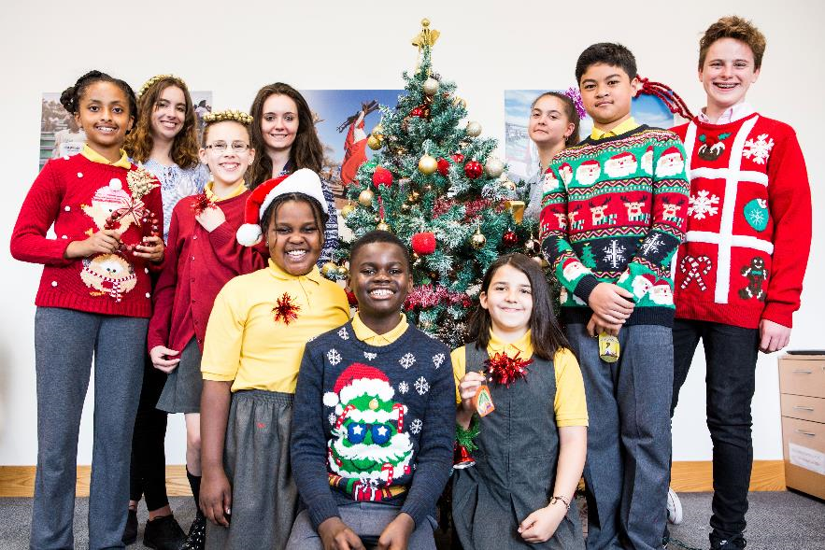
Get Christmassy!
Friday
14 December
Christmas is getting close! Get in the spirit by organising a
Christmas jumper fundraising day.
You could design your own
Christmas jumper.
Use the money you raise to put towards World Gifts.

Slide 15
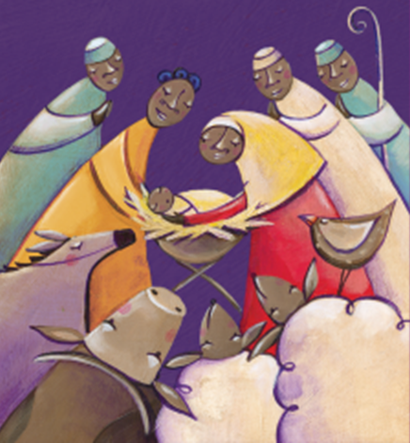
Saturday
15 December
Christmas is coming…
Read the Christmas story with a friend or
someone in your family.
Draw pictures to illustrate each step of the story.

Slide 16
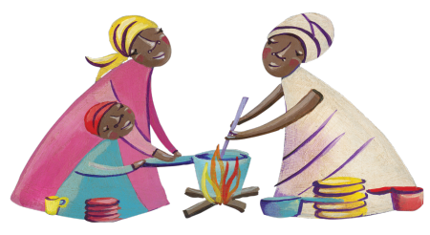
Sunday
16 December
Third Sunday of Advent
Luke 3:10-18
Today we hear John the Baptist, God’s messenger, explaining how people can prepare for the coming of Jesus.
Did you know today is Gaudete Sunday?
We light the pink candle, representing joy.
How could you bring joy to others this Advent?

Slide 17
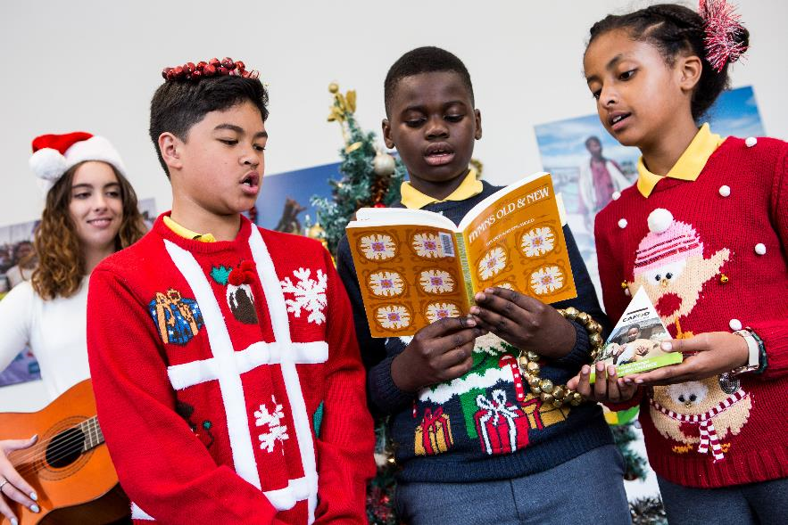
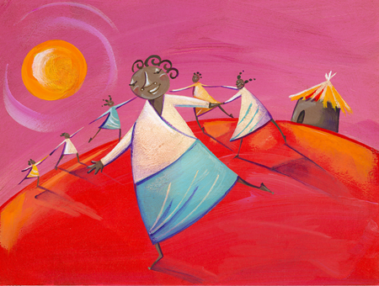
Monday
17 December
Christmas is almost here!
Get in the spirit by organising a carol singing fundraiser.
You could sing a carol in class!
Use the money you raise to put towards
World Gifts.

Slide 18

Tuesday
18 December
International Migrants Day
In many parts of the world, refugees are fleeing violence.
This year, responding to Pope Francis’ invitation, you have been Sharing the Journey to show you care about the millions of people forced to flee their homes.
So far, you have walked over 100, 000 miles, enough to go around the world 4 times!
You can still contribute your miles to the totaliser here
Meanwhile, say a prayer for people who are away from their home this Christmas.
Lord, help us to welcome all those who are away from their homes this Christmas. Amen
Check out our refugee animation here

Slide 19
Wednesday
19 December
Kushi and Mr Jirma’s Story
Remember we heard about Kushi and
Mr Jirma last week?
Kushi relies on help from Mr Jirma and others in our global Church family
to feed her family.
But soon the emergency help will run out.
Let us pray together for Kushi and Mr Jirma.
Loving Father,
you have blessed us with the good things of creation
and we thank you.
Help us to be thoughtful and not selfish, generous and not greedy.
May we learn to respect the earth and be willing to share its gifts with all our sisters and brothers.
Amen.

Slide 20
Thursday
20 December
Let us pray
Gather at your nativity scene and say a prayer together.
Loving God,
Your Son was the greatest gift for the world.
Help us to remember all that he taught us
about loving our sisters and brothers,
wherever they live in the world.
Amen
Remember to add templates of the World Gifts to the nativity scene each time you raise money for them.

Slide 21
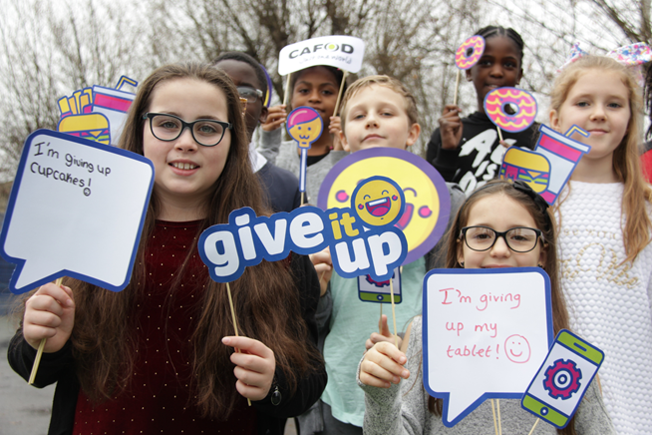

Friday
21 December
Give it up
This year you gave up your treats and apps to help reach out to communities in the poorest parts of the world. Thank you!
Think about how else you can help people this Advent.
Look out for how to get involved again in Lent in 2019!

Slide 22
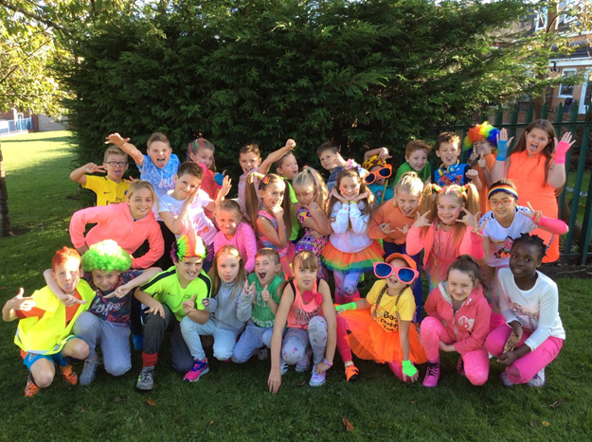

Saturday
22 December
Brightening up the world
During Harvest, thousands of you Brightened Up to raise money and build a brighter world.
Thank you!
CAFOD clubs are brightening up the world all year round.
Find out more about them here

Slide 23
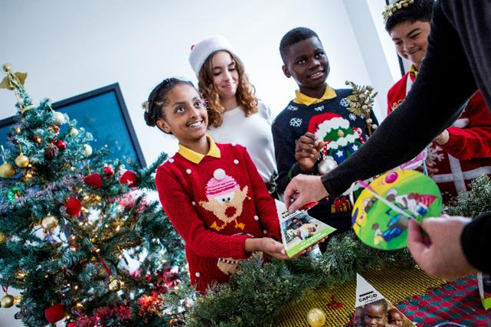
Sunday
23 December
Fourth Sunday of Advent
Luke 1:39-44
In today’s Gospel we hear how Mary went to meet Elizabeth, to share her good news.
What could you share with someone else this Advent?

Slide 24
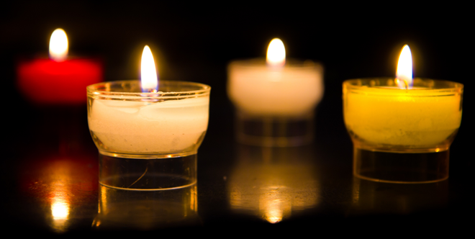
Monday
24 December
It’s Christmas Eve
The wait is almost over, it’s Christmas Eve.
Today is a really exciting day with lots of last minute things to prepare, presents to wrap and stockings to hang up.
Even though today is very busy and exciting remember to stop and think about the true meaning of Christmas.
Give time to help out, share time with your family and friends and make time to give thanks.
Light a candle and prepare to welcome Christ, the Light of the World, into your lives.

Slide 25
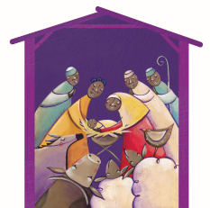
Tuesday
25 December
Happy Christmas

