Slide 1

Reading in EYFS at St Julie

Slide 2

Reading is so important for children’s development.
Research shows that reading helps children to acquire a wide range of vocabulary and this will support them to reach their full potential in education.
At St Julie we want to help the children to not only become confident readers but also to develop a love of reading for pleasure and information that will last a lifetime.

Slide 3


Slide 4

Phonics – Floppy Phonics
Reading books
Helpful Words
Homework – Phonics folder
Reading Book Spine

Slide 5

Phonics
New phonics scheme - Floppy Phonics
Synthetic, Systematic daily approach to teaching
Daily phonics session
Reading books relate to the phonemes and graphemes we have covered in school.

Slide 6

Reading Books
Reading books from school will come in different forms.
Phonetically decodable books matched to Floppy Phonics
Free choice banded books.
Bug Club – decodable books with comprehension questions.
Guided reading and 1:1 reading with adults in school.

Slide 7
EYFS Helpful Words
A list of words that children are expected to be able to read and write correctly by the end of EYFS

Slide 8
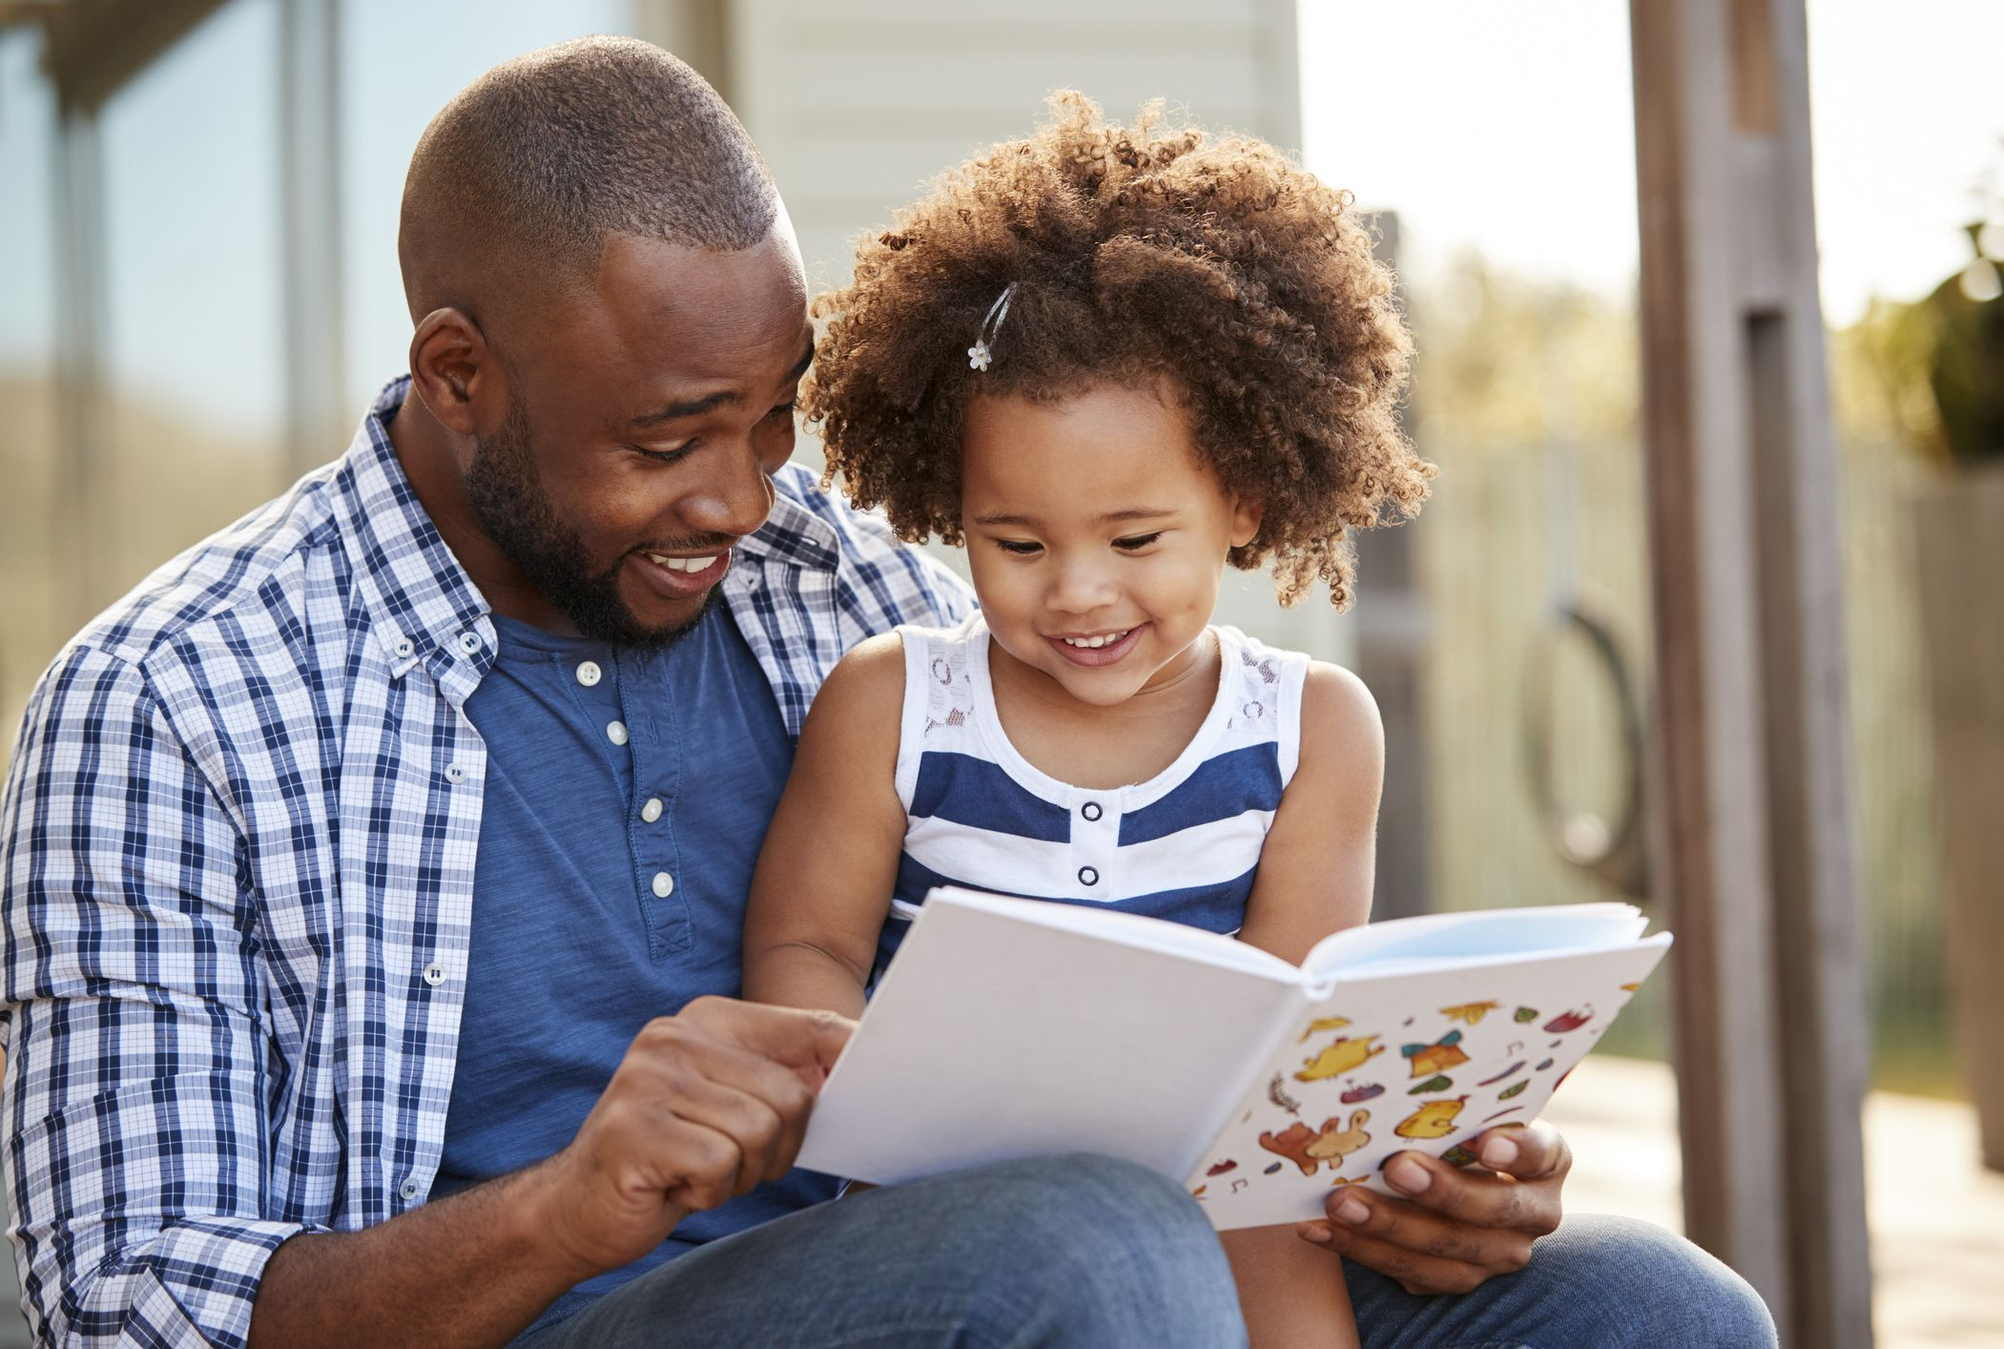
Homework
Reading – Reading records
Monday – Free choice after Christmas
Friday – decodable text
- Floppy Phonics reinforcement sheets
Wednesday – Bug Club reading comprehension
- Additional task
Common exception words.

Slide 9
Reading Spine
A set of key books that the children will have read to them frequently throughout the year during our daily story time sessions.
The Spine in the backbone to the children’s love of books and cover a wide range of age appropriate literature that will grow throughout their time in school.
The children should know these books really well by the end of the year so feel free to share these books at home.

Slide 10
By the time the children leave St Julie they will have been immersed in more than 50 books on the reading spine, as well as being introduced to many more
EYFS - Reading Spine
Owl Babies – Martin Waddell
We are Together – Britta Teckentrup
Happy in our Skin – Fran Manushkin
The Gruffalo – Julia Donaldson
Mr Gumpy’s Outing – John Burningham
Rosie’s Walk – Pat Hutchins
Six Dinner Sid – Inga Moore
Mrs Armitage – Quentin Blake
Farmer Duck – Martin Waddell
Peace at Last – Jill Murphy
Lost and Found – Oliver Jeffers
The Bog Baby – Jeanne Willis
Shhh! – Sally Grindley
Sharing a Shell – Julia Donaldson
The books from the ‘Reading Spine’ will be shared with the children during the year

