Slide 1
EYE OF THE STORM
Vocabulary helper

Slide 2
CONTENTS
Click on the list to take you to the page
WORD LIST
EYE OF THE STORM NOUNS
EYE OF THE STORM VERBS
EYE OF THE STORM ADJECTIVES
EYE OF THE STORM SYNONYMS

Slide 3
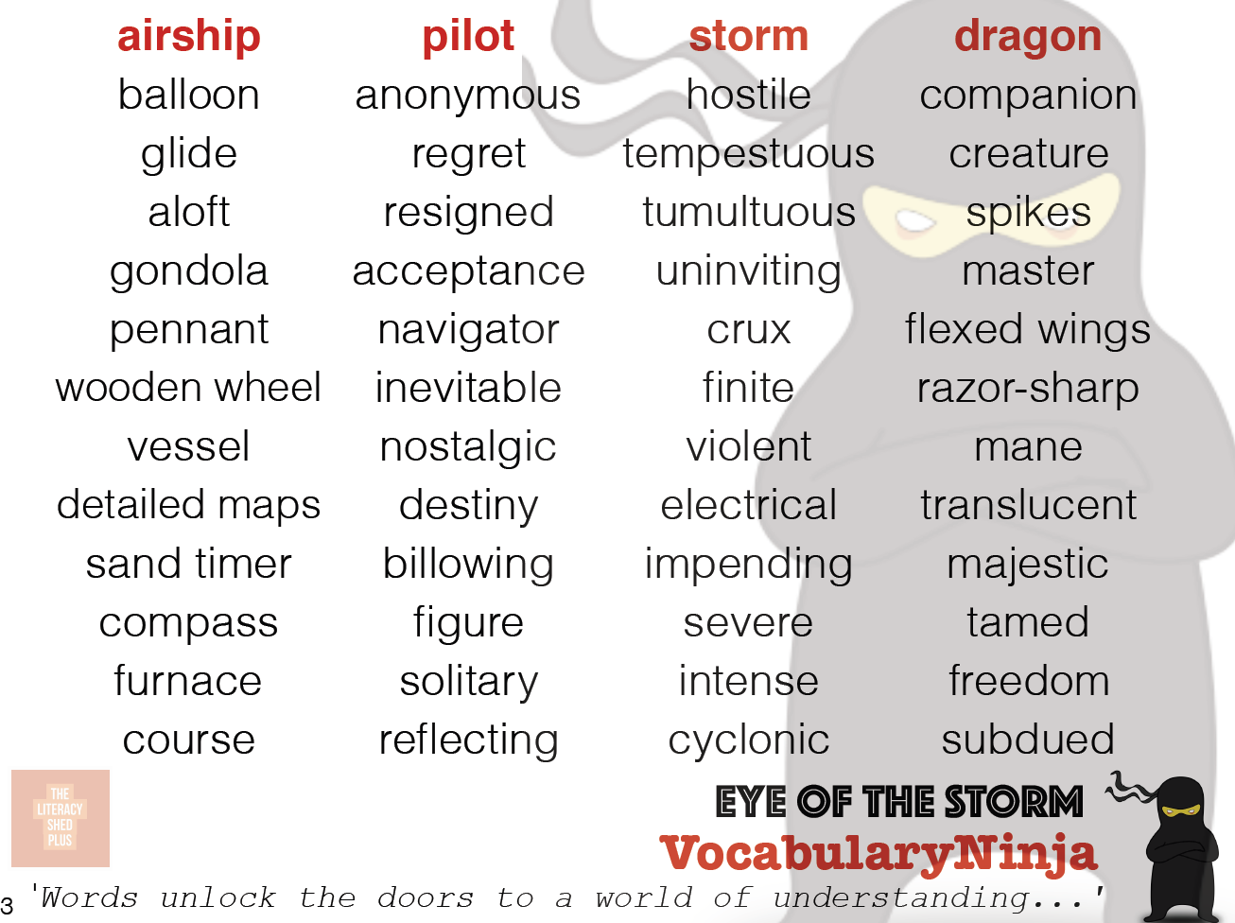
CONTENTS PAGE

Slide 4
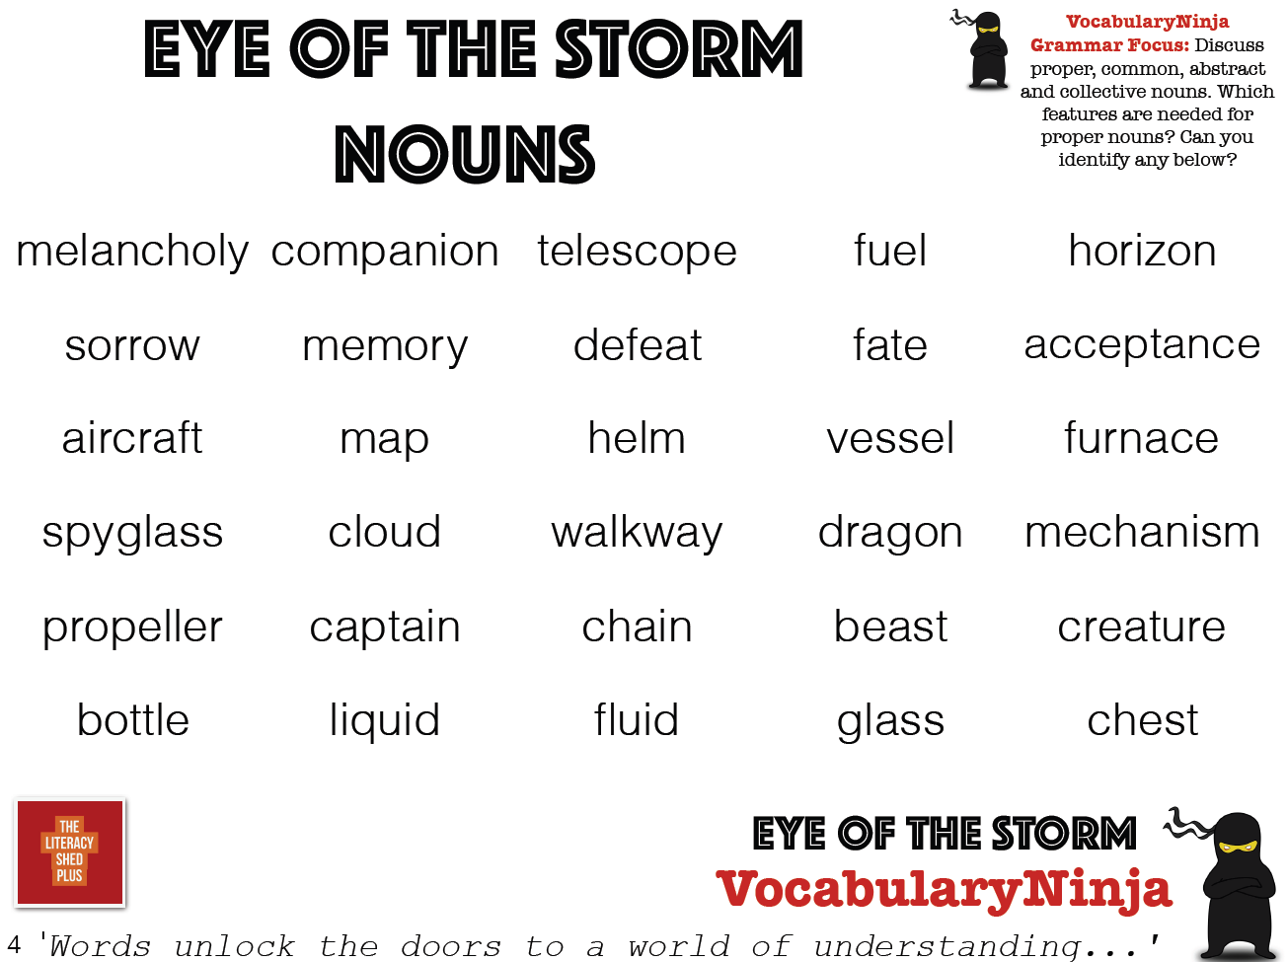
CONTENTS PAGE

Slide 5
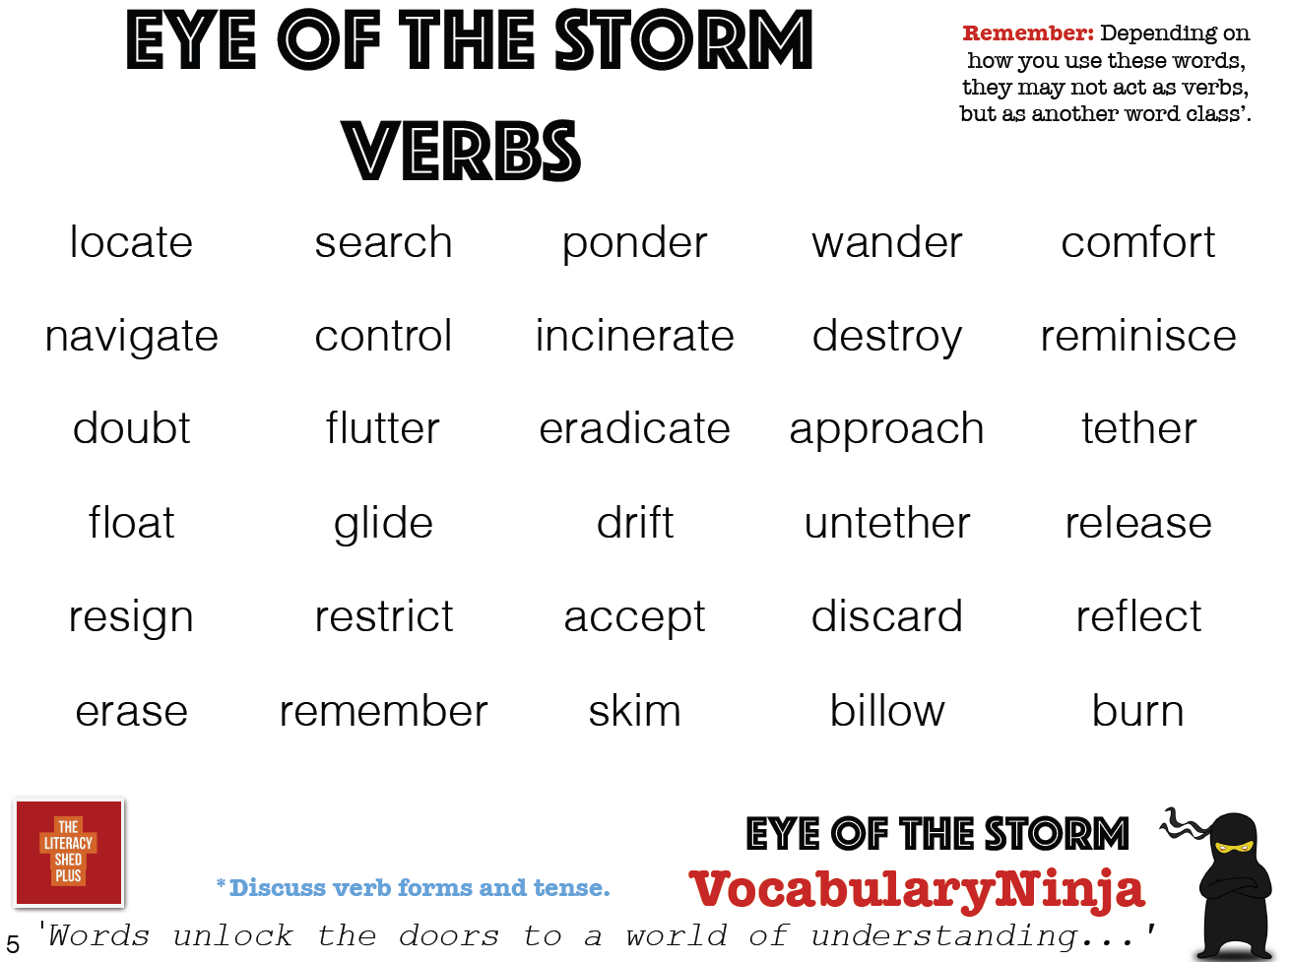
CONTENTS PAGE

Slide 6
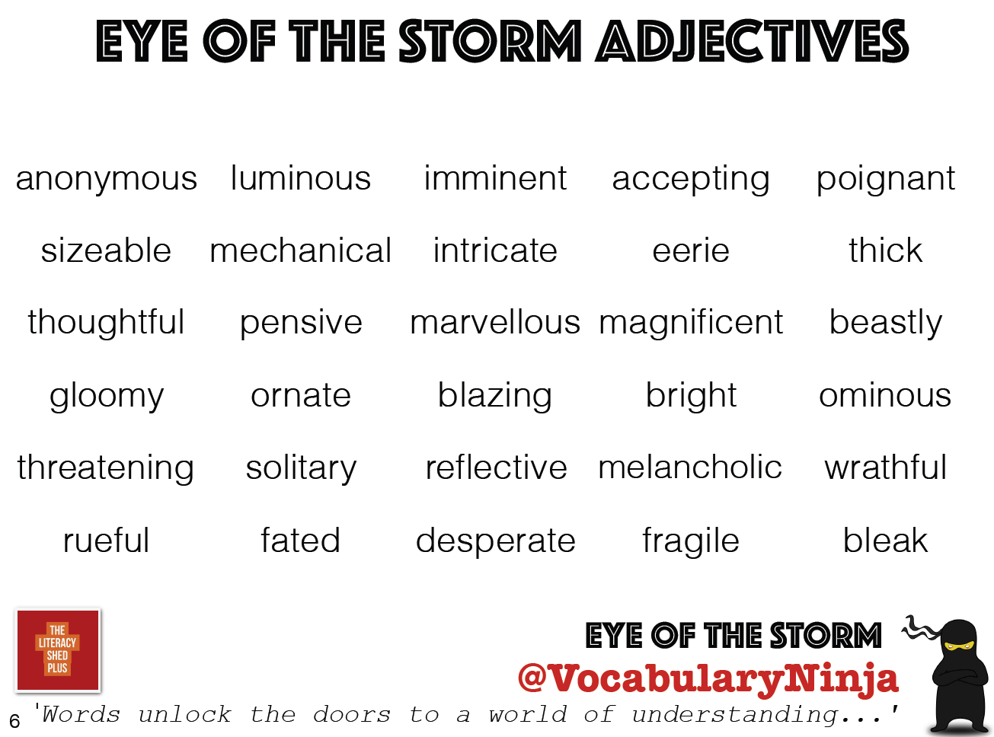
CONTENTS PAGE

Slide 7
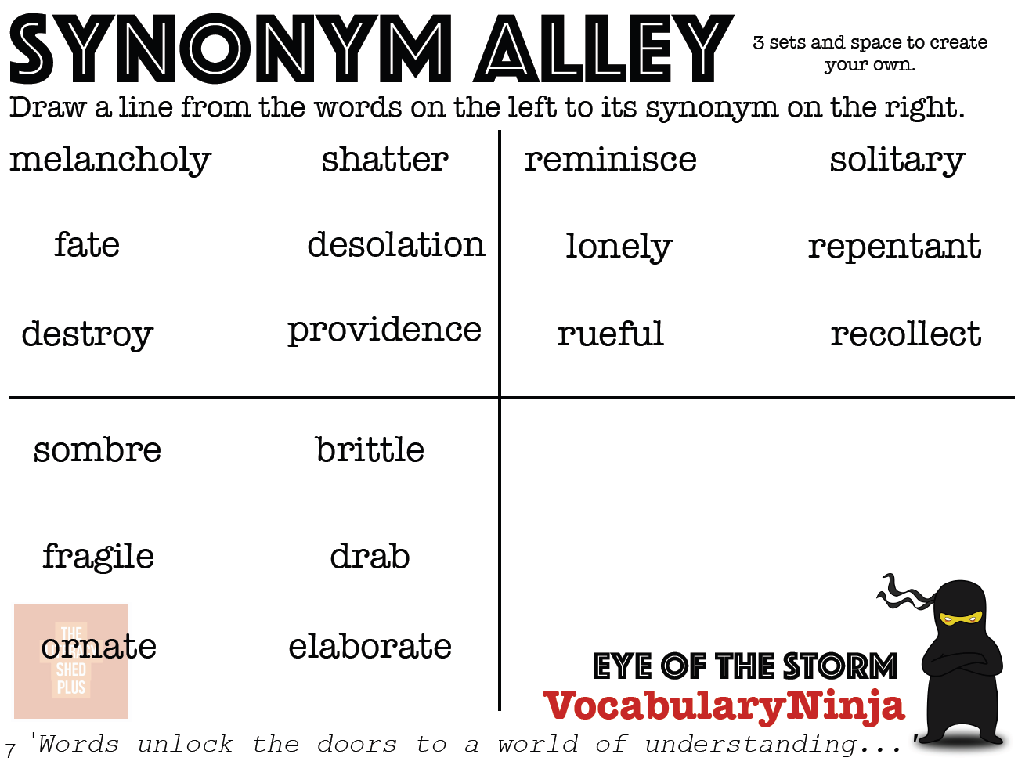
CONTENTS PAGE

