Slide 1
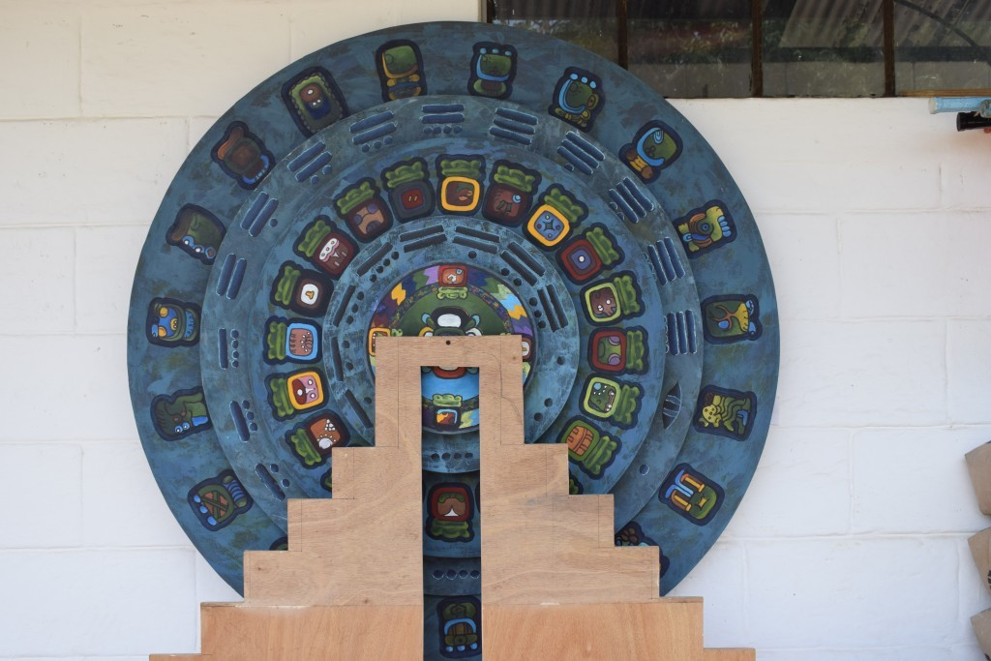
How did the Ancient Maya tell the time?
This is a contemporary Maya calendar used at Melody Primary School in Guatemala

Slide 2
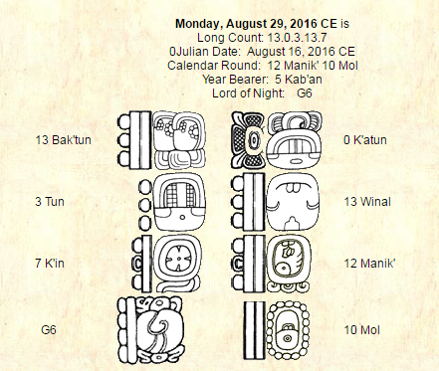

Slide 3
Using their knowledge of astronomy and mathematics, the Maya developed one of the most accurate calendar systems in human history.
Maya Calendar Cycles
For counting the days in a year, the Maya used two counting cycles, called the tzolk’in and the haab.
THE TZOLK’IN (the sacred year)
The tzolk’in is a cycle of 260 days, composed of 20 day names (similar to our Monday, Tuesday, etc.) plus the numbers 1 to 13 (similar to our saying Monday is the first day of the week, Tuesday the second day of the week, etc.). These days and numbers are intermeshed for example: 1 Imix, 2Ik, to 13 Ben. Each day had its ritual significance, similar to an astrology chart.
Notes:
Interestingly, 260 days (the sacred year) is the number of days between the conception and birth of a child. The ancient Maya certainly understood the cycle of human conception, and perhaps the tzolk’in is based on this natural human cycle.

Slide 4
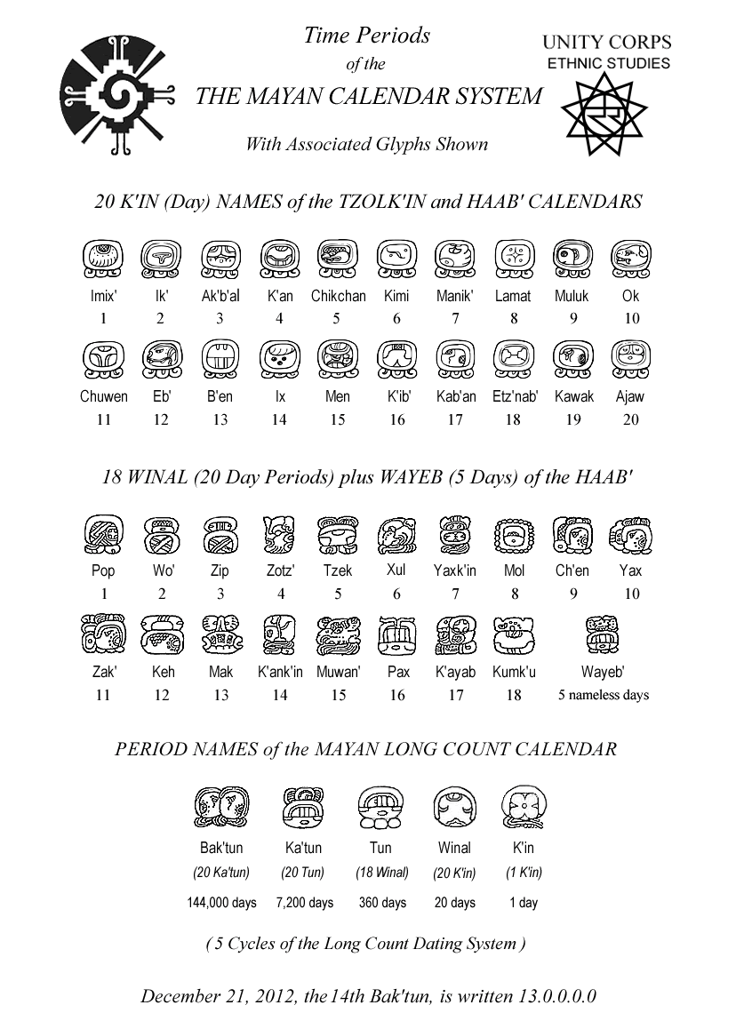
These glyphs all are from a wall painting unearthed at Ek Balam, Yucatan, dating to the early ninth century AD

Slide 5
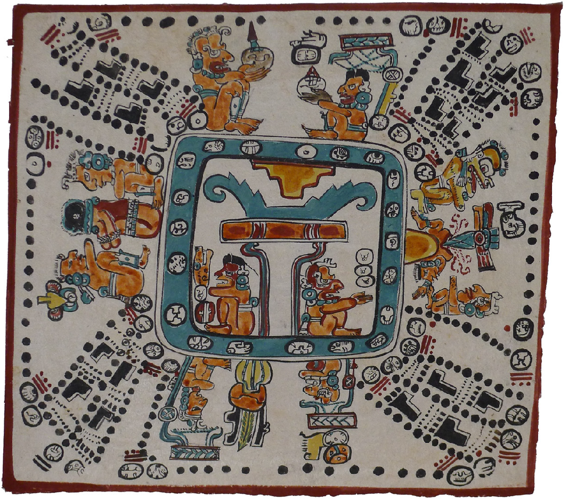
A Maya representation of the Tzolk’in from the Madrid Codex. Time is represented by 260 dots marking a path or a journey of twenty days and thirteen numbers.

Slide 6
THE HAAB
The other cycle is the haab, a 365-day cycle similar to our solar year. The haab consists of 18 months of 20 days each; the first day of the first month, Pop, was 0-Pop, and the last day of the month was 19 Pop. The haab was made to coincide with the solar cycle by adding a 5-day “short month” called the Uayeb (or Wayeb) at the end of the cycle.

Slide 7
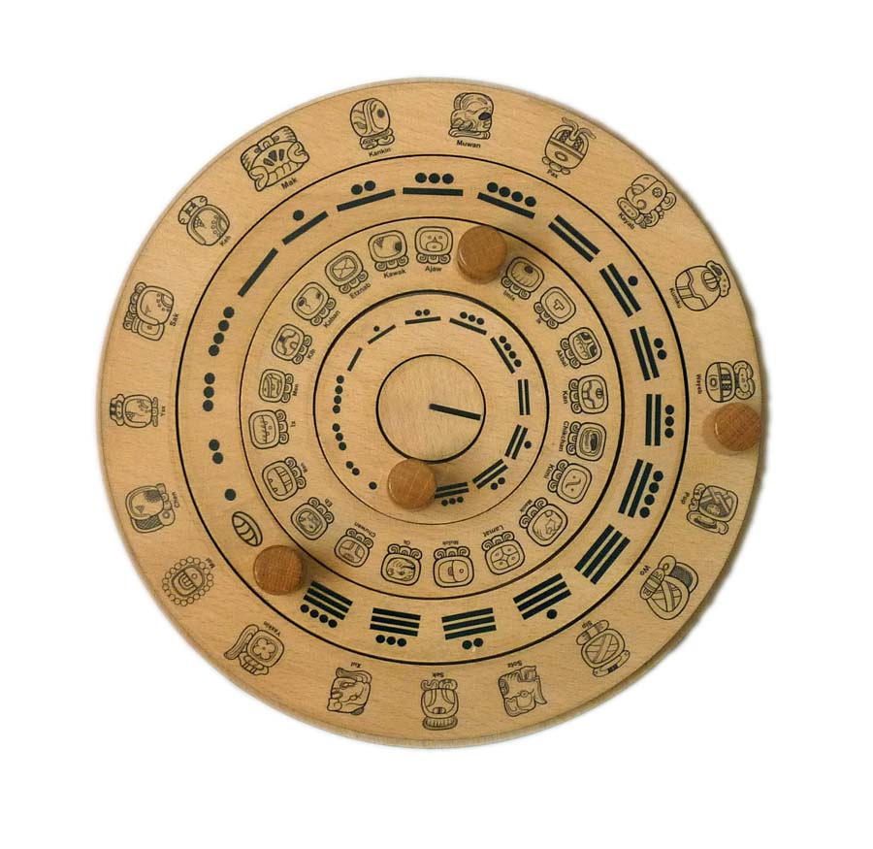
A contemporary representation of the Tzolk’in (inner two circles) and Haab (outer two circles) calendars from www.mayaarchaeologist.co.uk

Slide 8
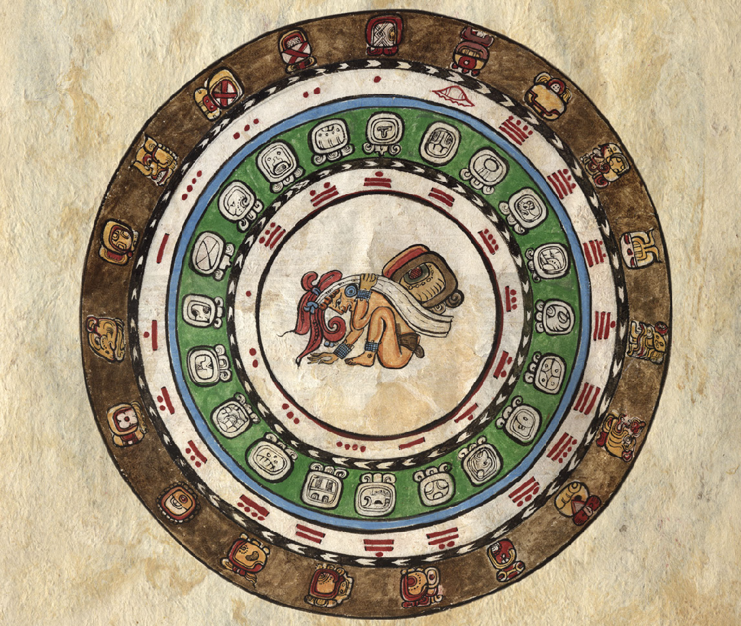
A contemporary representation of the Tzolk’in (inner green circle) and Haab (outer brown circle) calendars.

Slide 9
THE CALENDAR ROUND
The linking together of the tzolk’in and haab cycles results in a larger cycle of 18,980 days, or 52 years. Only after the completion of 52 years would the same combination of tzolk’in and haab occur again. This 52-year cycle is called the Calendar Round.
Both the tzolk’in and haab calendars were used by the ancient Maya for the planning of important events such as the best time to plant crops, hunt certain animals, cure sickness, ascend to the throne of kingship, or wage a battle against enemies.
The Calendar Round was also used to plan religious and ritual events and perhaps used to predict the future.

Slide 10
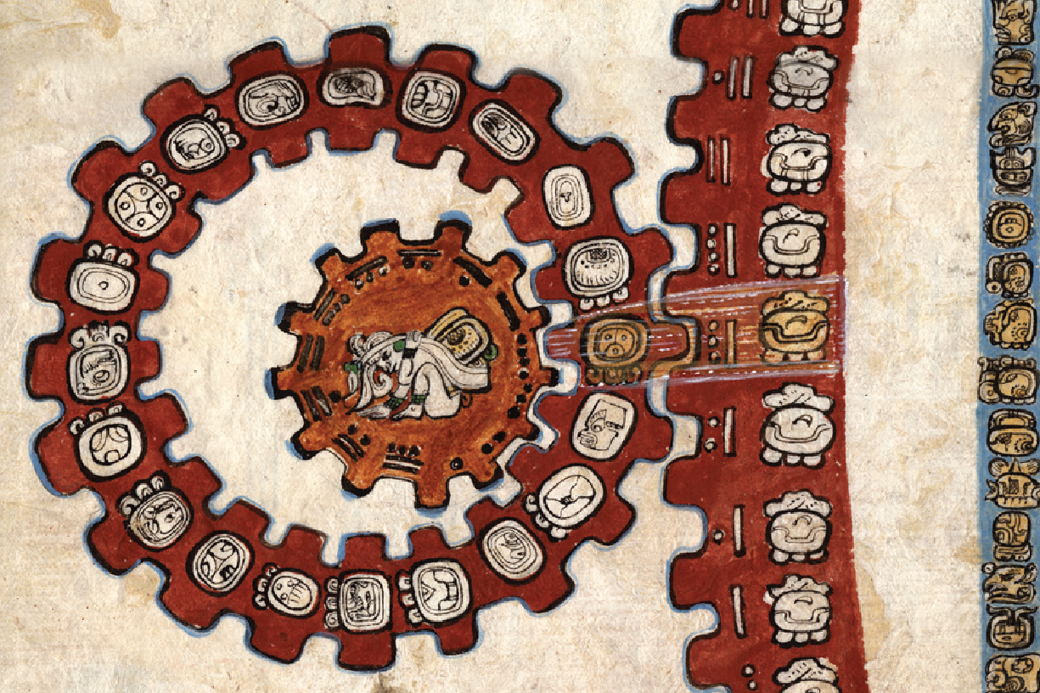
Calendar Round
A contemporary representation of the Calendar Round, interlocking the Tzolk’in (left) with the Haab (right).

Slide 11
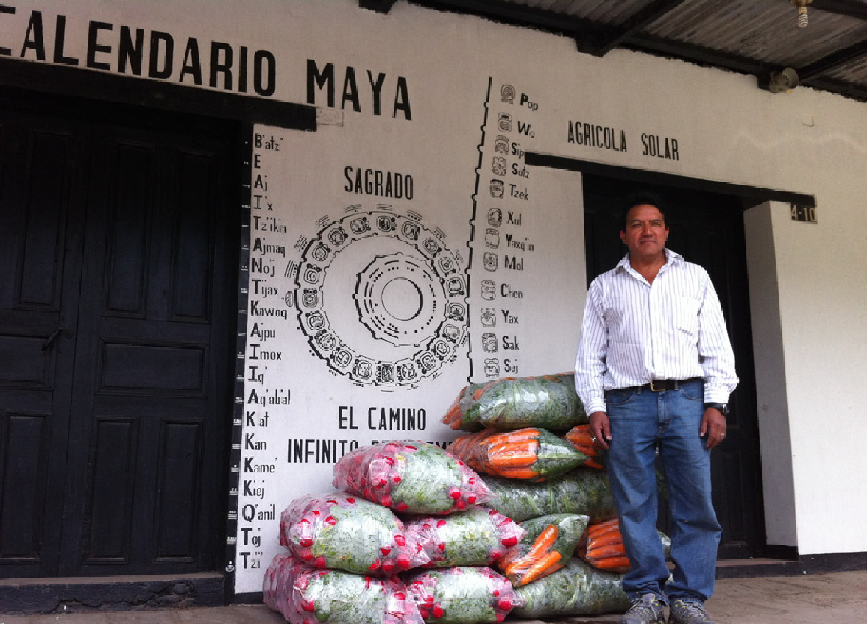
Roberto Poz Pérez, K'iche', is a calendar Day Keeper in a village near
Quetzaltenango, Guatemala.

Slide 12
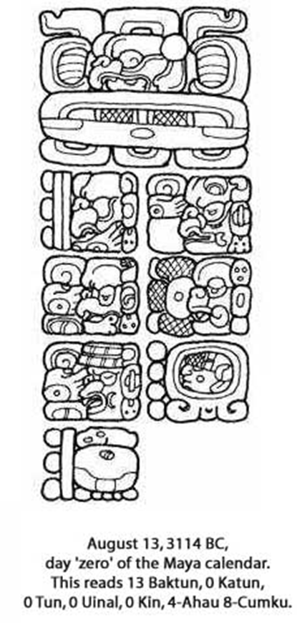
Long Count Calendar
The Long Count Calendar lasted for 5125 years. Like our own calendar, the Maya marked dates for more extensive time from a fixed starting point. In our calendar this begins with the birth date of Jesus Christ. For the Maya the beginning of present creation was 13th August, 3114 B.C. and it ended on 21st December 2012. This round is then repeated.
The first glyph at the top of the image is the introductory glyph

Slide 14

Did the Maya predict the end of world?
The Ancient Maya calendar finished one of its great cycles (Long count of 5125 years) in December 2012, which fuelled countless theories about the end of the world on December 21, 2012. There was even a movie made about it!
Of course this didn’t happen. The following day a new cycle began. Just like our New Years Day or the start of the Millennium.

Slide 15
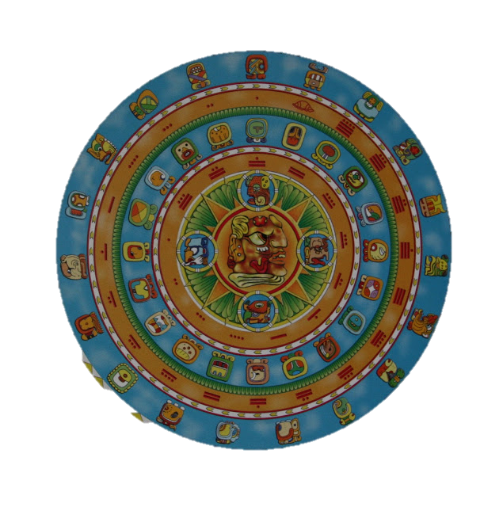
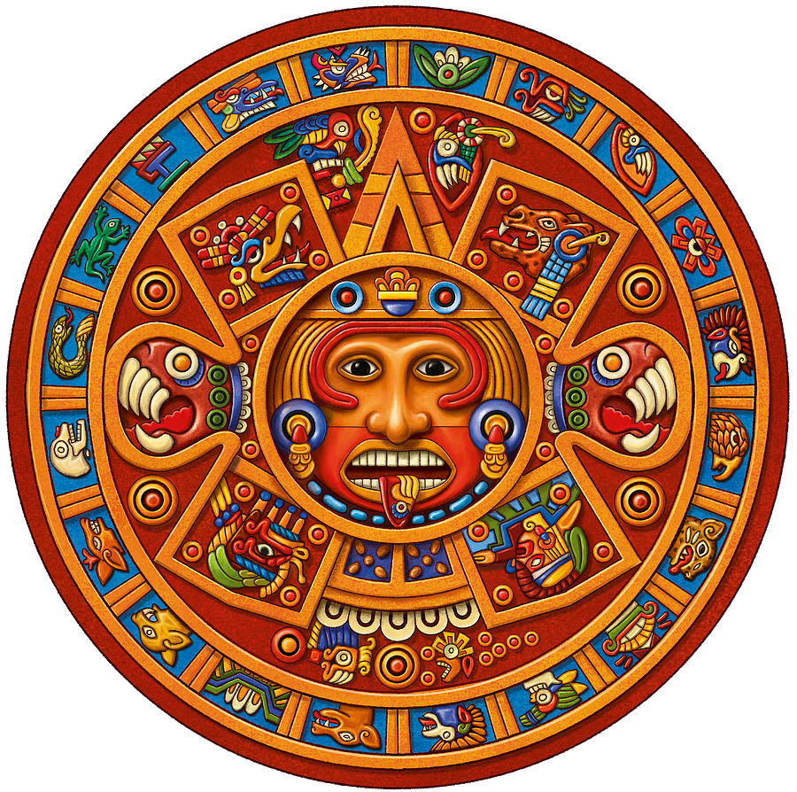
Aztec or Maya?

Slide 16


Blackpool Tower in England, UK
Eiffel Tower in Paris, France

Slide 17
Additional Resources
Maya Calendar System:
http://www.mayan-calendar.org
http://www.ancientscripts.com/maya.html
http://maya.nmai.si.edu/
http://www.famsi.org
http://www.pauahtun.org/Calendar/Default.htm
http://www.mesoweb.com
Glossary List in this “Living Maya Time” Website (In Resources Section)

