Slide 1
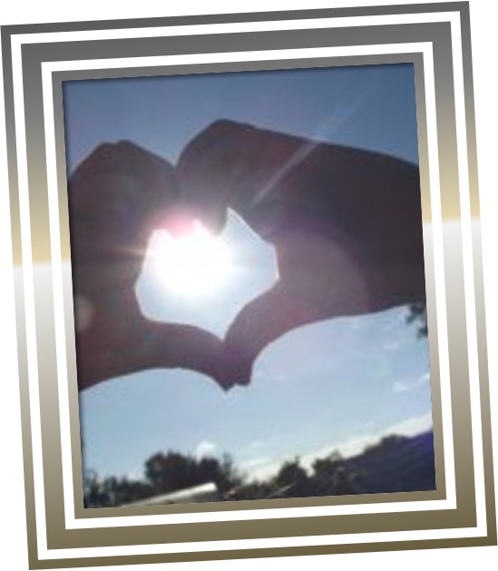
St Julie Catholic Primary School
Our RSHE, PSHE and Equalities Curriculum

Slide 2
RSHE – A Journey in Love
A Journey in Love is a resource created by Sister Jude Groden of BRES. It is the recommended programme of study for Catholic schools for Relationship, Sex and Health Education, and has been written as a progressive scheme of work that supports the Religious Education, PSHE and Science curriculum taught within the school.
As children progress through school, they discover more and more about themselves and the wider world. This thirst for learning new things in all aspects of life is fostered by the school, who attempt to create a safe, stimulating environment for learning; supporting all children in their development. Our mission statement which drives the school, attempts to achieve this goal following the Gospel values of truth and respect, understanding our journey as children of God, both special and unique.
Central to our work within the school is learning about our faith, including understanding ourselves, our position in our community and how we develop as human beings – our spiritual, social, emotional and physical development. This is how A Journey in Love fits in to the school’s curriculum. The scheme permeates through all levels of learning throughout the school. It focuses on friendship, family, community, relationships and spirituality; a guide to the children’s development as young Catholics.
As you would expect, not all issues related to personal development are covered by the end of Year 6. The content is age appropriate and is taught with sensitivity, taking into account the children’s level of maturity in regard to the delivery of the lessons.
As with all aspects of learning, children are naturally curious, and many will have questions related to their lessons. Opportunities to discuss questions form part of the lessons and, again, these are treated with care and understanding

Slide 3
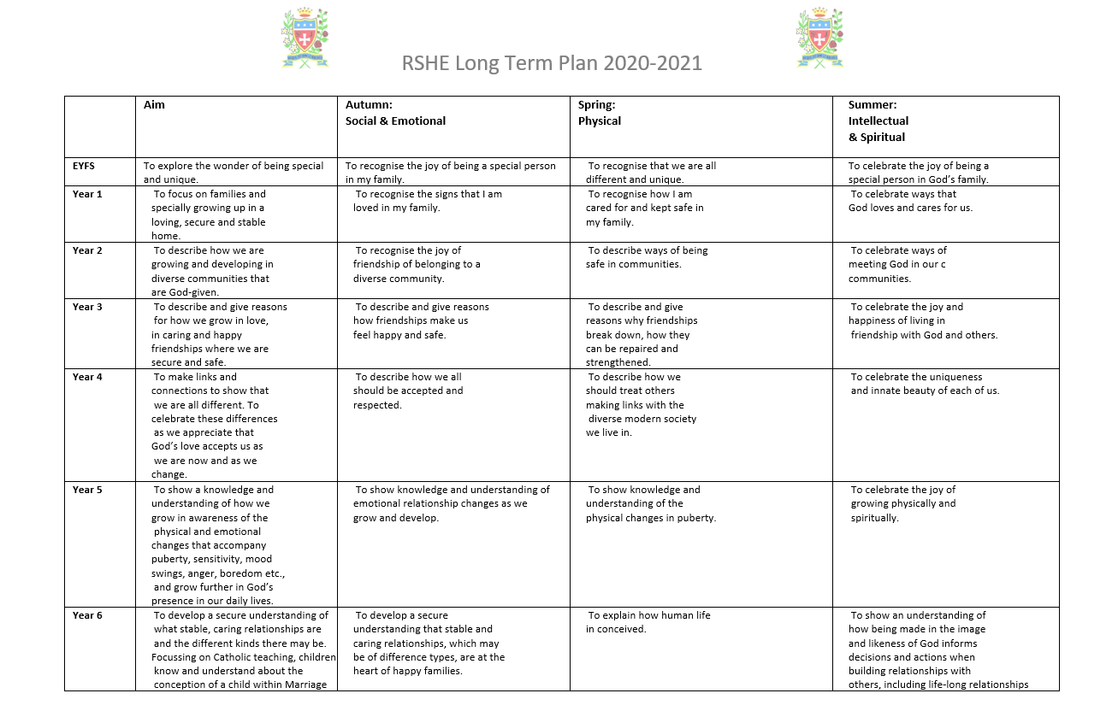
RSHE – Content of our Work

Slide 4
PSHE
Intent
Our intention is that when children leave St Julie’s, they will do so with the knowledge, understanding and emotions to be able to play an active, positive and successful role in today’s diverse society. We want our children to have high aspirations, a belief in themselves and realise that anything is possible if they put their mind to it. In an ever–changing world, it is important that they are aware, to an appropriate level, of different factors which will affect their world and that they learn how to deal with these so that they have good mental health and well-being.
Our PSHE curriculum develops learning and results in the acquisition of knowledge and skills which will enable children to access the wider curriculum and prepare them to be a global citizen now and in their future roles within a global community. It promotes the spiritual, moral, cultural, mental and physical development of pupils, preparing them for the opportunities, responsibilities and experiences for later life.
Implementation
As a Roman Catholic school, PSHE permeates throughout our daily practice. The “Come and See” religious education scheme allows for significant scope to address most aspects of PSHE, including relationships, sex and health education, which is taught using the “A Journey in Love” resource. In addition, links are made with other areas of the curriculum, such as science and physical education, in order to offer children a broad and balanced approach to PSHE education.
To ensure children are receiving a well—rounded PSHE education, we follow the PSHE Association in key stages 1 and 2. In addition, we use themed weeks such as Anti-Bullying Week and Safer Internet day to offer children immersive experiences. In order to enable us to further promote an ethos of inclusion and tolerance, we have decided to incorporate ‘Everyone’s Welcome’ programme into our PSHE lessons. 'Everyone's Welcome' is a whole school approach that uses the picture books resources to teach children about equality and diversity, in line with British Values, Ofsted guidelines and the Equality Act (2010) Our approach, ensures that PSHE education is valued as an important aspect of school life and provides our children with a structured approach to their learning.

Slide 5
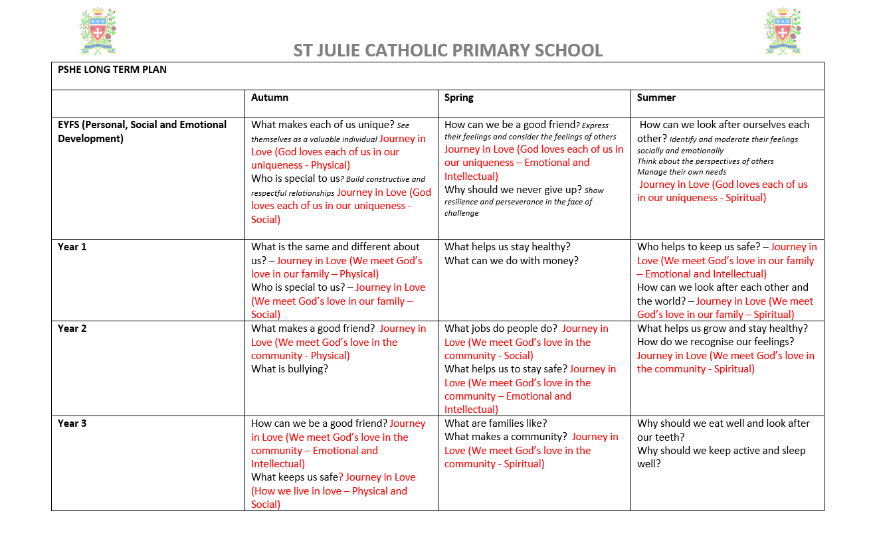
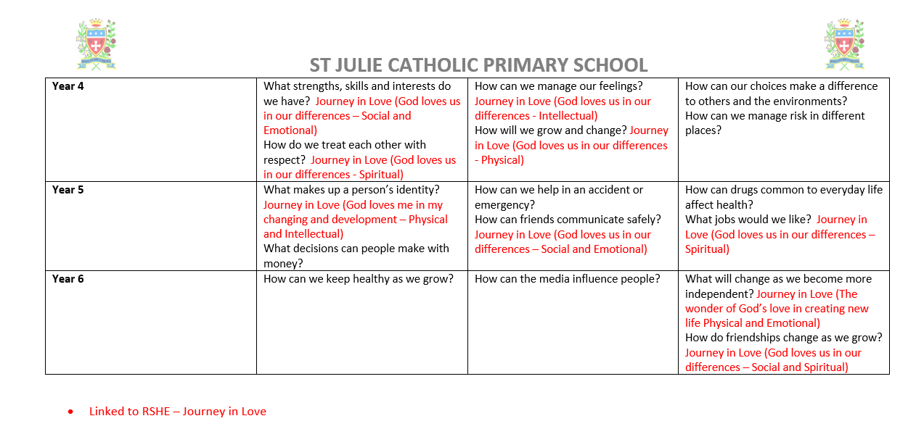
PSHE – Content of our Work

Slide 6
Equality
At St Julie Primary School we aim to provide equality of opportunity for all children whatever their age, ability, gender, race, religion, or background. We aim to create an environment that values each pupil and enables them to achieve their full potential. As an educationally inclusive school the teaching and learning, achievements, attitudes and well-being of every pupil matters, and our inclusive practice means that all learners are supported. We provide a broad and balanced curriculum that is accessible to all learners, providing the opportunity for all pupils to achieve their potential.
The opportunities and experiences we provide enable all our pupils to participate fully and give their best across all aspects of school life. We place great value on the quality of relationships within our school community. We aim to develop a culture of inclusion and diversity in which success is celebrated and all those connected to the school feel proud of their identity and able to participate fully in school life. We will tackle discrimination by the positive promotion of equality and the creation of an environment which champions respect for all.
Through our ethos and school values we emphasise the uniqueness of the individual made in the image of God. We celebrate diversity and promote acceptance and respect. Our broad and rich curriculum provides opportunities for children to regularly learn about, and be inspired by, individuals of all abilities from all backgrounds, cultures, genders, sexualities, religions and ethnicities. Representation and the celebration of differences is embedded throughout the curriculum and discussed frequently at every opportunity possible throughout the year.

Slide 7
Everyone's Welcome - Aims
It is important that all pupils gain an understanding of the world they are growing up in, and learn how to live alongside, and show respect for, a diverse range of people. ‘Everyone's Welcome'’ is a recommended resource to teach pupils to respect and accept difference and diversity using the Equality Act 2010 (British Law) as a solid foundation. It promotes a proactive approach to bullying, teaches British Values, reduces potential for radicalisation and prepares children for life in Modern Britain.
Aims:
• Promote equality of opportunity in schools and prevent discrimination.
• Teach children about the Equality Act 2010.
• Create a positive culture in the school where all groups of people are welcome.
• Teach children to feel comfortable in themselves while recognising and celebrating difference and diversity in others.
• Prepare children to leave primary school happy and excited about living in a community full of difference and diversity.
• To contribute positively to society and life in Britain as they grow up.
How is it taught?
• 42 picture books: 6 in each year group from EYFS to Y6.
• Picture books deal with all equalities in the Equality Act (race, religion, gender, gender identity including transgender, age, disability, sexual orientation)
• Each characteristic is taught in context with British Law.
• Creates and develops a whole school ethos.

Slide 8
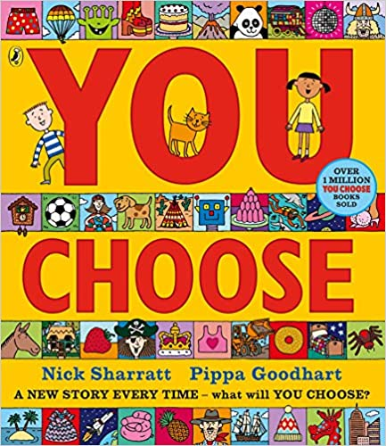
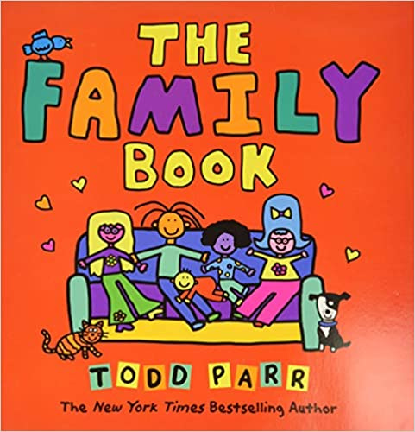
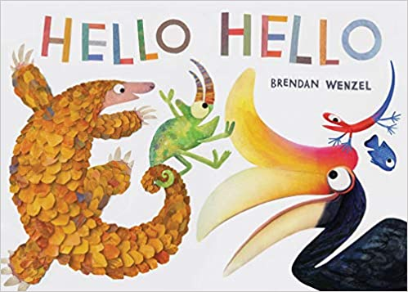
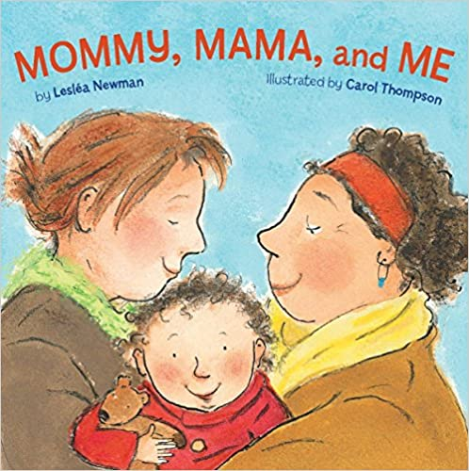

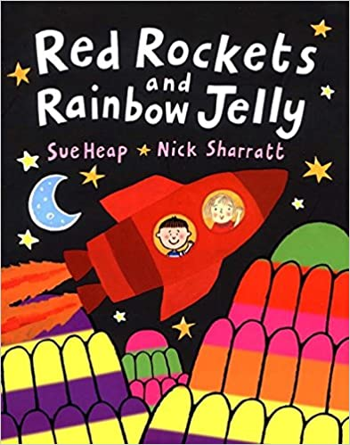
EYFS – Picture Books
You Choose by Nick Sharratt and Pippa Goodheart
I can choose what I like
I can make up my own mind and tell you thinks I like
I can ask others what they think
The Family Book by Todd Parr
All families are different
I know who my family is
I know all families are different
Hello Hello by Bendan Wenzel
To say hello
I know in my class we are not all the same
I know we are different
I know I can make friends with different people
I know how to make friends
Mommy, mama and Me by Leslea Newman and Carol Thompson
To celebrate my family
I know people in my family are special
I can tell you who loves you
Blue Chameleon by Emily Gravett
To make new friends
I know everyone is different in my class
I can make friends with anyone
Red Rocks and the Rainbow by Sue Heap and Nick Sharratt
It’s ok to like different things I know my friends can like different thingsI know we can still be friends

Slide 9
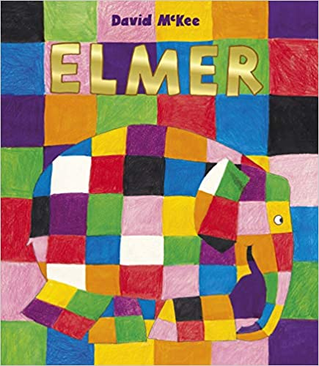
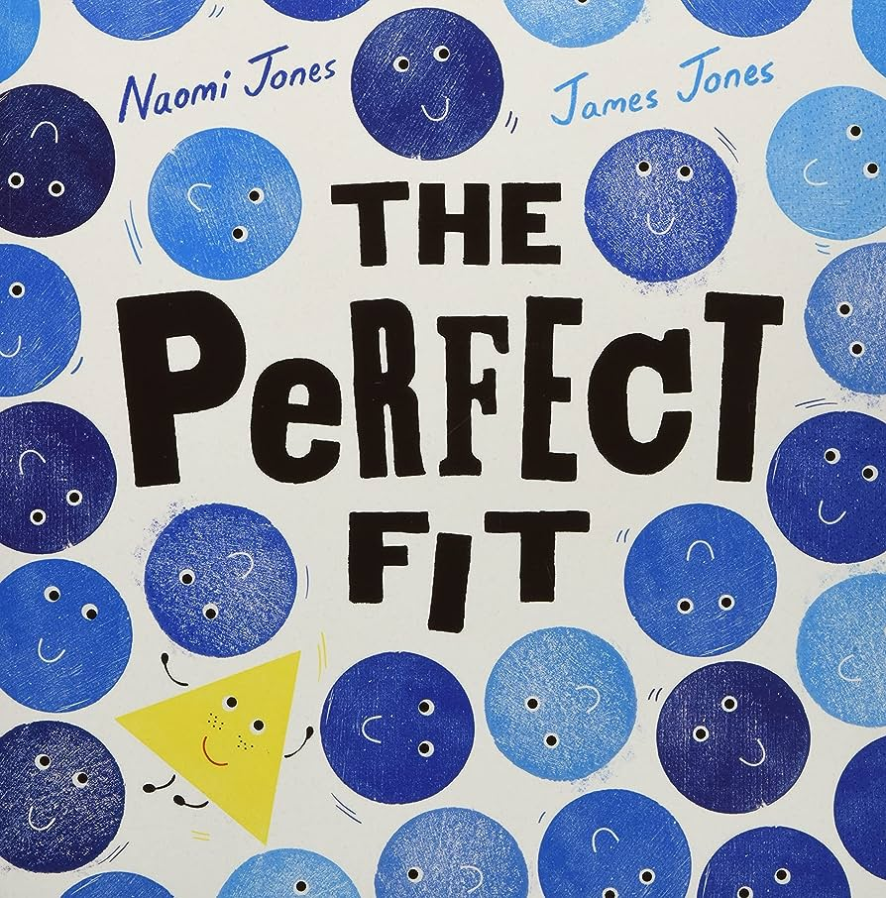

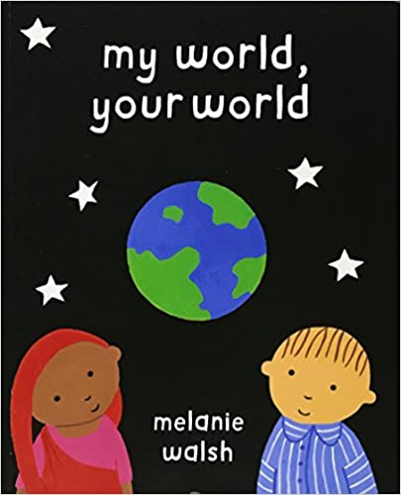

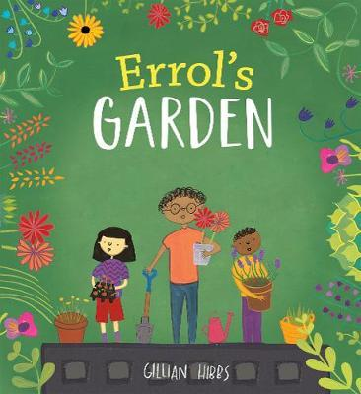
Year 1 - Picture Books
The Perfect Fit by Naomi Jones and James Jones
I know that I am not exactly the same as you.
I know we all have differences
I can think of ways everyone can join in.
Elmer by David McKee
I recognise the ways in which I am the same and different to others
I recognise that we are all unique and what makes me special
I can recognise different feelings and understand how they affect our bodies and how we behave
Going to the Volcano by Andy Stanton
I understand that bodies and feelings can be hurt by words and actions
I understand what is kind and unkind behaviour, and how this can affect others
I recognise that we are all unique and what makes me special
My World, Your World by Melanie Walsh
I recognise that we are all unique and what makes me special
I recognise the ways in which I am the same and different to others
Ten Little Pirates By Mike Brownlow and Simon Rickerty
I know boys and girls can play exciting games?
I know boys and girls can play together?
Errol’s Garden by Gillian Hibbs
I can identify people who love and care for me and the role they have in my life
I know how I can help look after their environment

Slide 10
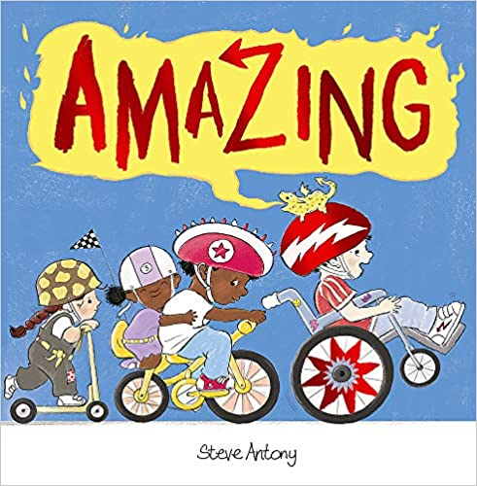
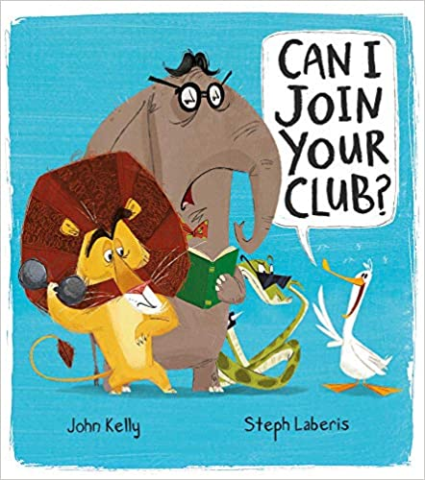
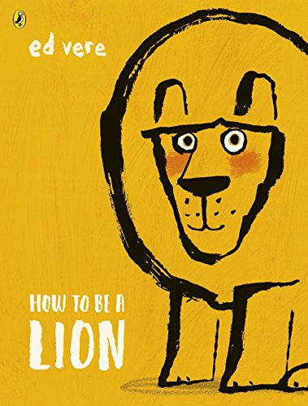
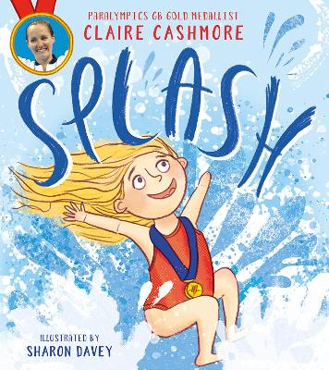
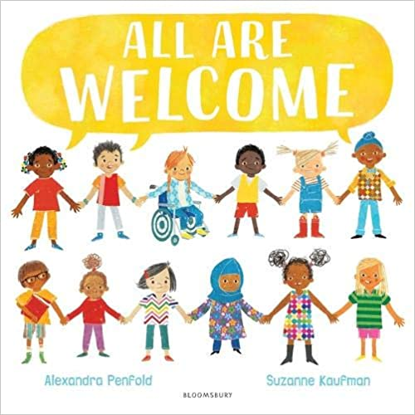
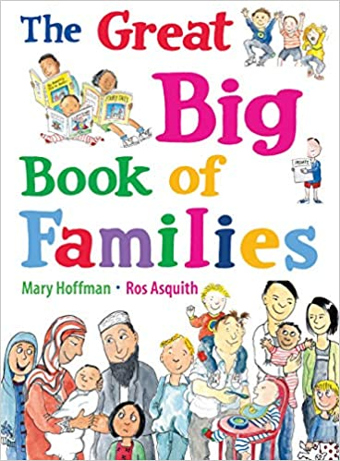
Year 2 - Picture Books
Amazing by Steve Antony
I can treat myself and others with respect
I can use simple strategies to resolve arguments between friends positively
I understand how people and other living things have different needs
I understand the responsibilities of caring for others
Can I Join Your Club? By John Kelly and Steph Laberis
I can identify how I am the same as, and different to, other people
I can use simple strategies to resolve arguments between friends positively
How to be a Lion by Ed Vere
I can treat myself and others with respect
I can use simple strategies to resolve arguments between friends positively
I can identify how I am the same as, and different to, other people
Splash by Claire Cashmore
I know that we all have dreams.
I know it is sometimes hard to feel confident.
I can set myself a target
I know I can achieve my dreams
The Great Big Book of Families by Mary Hoffman and Ros Asquith
I can identify common features of family life
I understand how people and other living things have different needs
I know there are different types of families and that they might be different to mine
I can identify how I am the same as, and different to, other people
All Are Welcome by Alexandra Penfold and Suzanne Kaufman
I can treat myself and others with respect
I can identify how I am the same as, and different to, other people

Slide 11

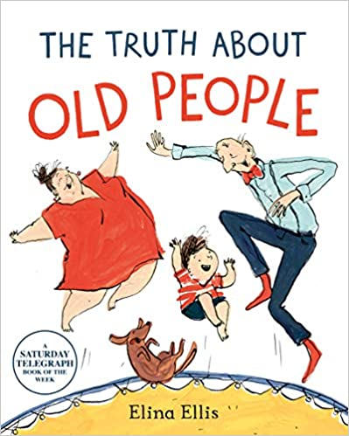




Year 3 – Picture Books
The Truth About Old People by Elina Ellis
I can identify and value different groups that make up my community and what living in a community means
I understand that my behaviour can affect other people
This Is Our House by Michael Rosen
I can identify and value different groups that make up my community and what living in a community means
I know the impact of bullying, including offline and online, and the consequences of hurtful behaviour
I understand that my behaviour can affect other people
Super Duper You by Sophy Henn
I can talk about what I am like, and I can describe my personality.
We’re All Wonders by RJ Palacio
I can use strategies for building positive friendships
I understand that my behaviour can affect other people
I can identify and value different groups that make up my community and what living in a community means
Beegu by Alexis Deacon
I can use strategies for building positive friendships
I know what constitutes a positive healthy friendship
I understand that my behaviour can affect other people
Planet Omar: Accidental Trouble Magnet by Zanib Mian
I can identify and value different groups that make up my community and what living in a community means

Slide 12
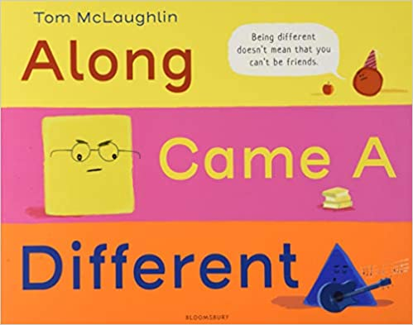

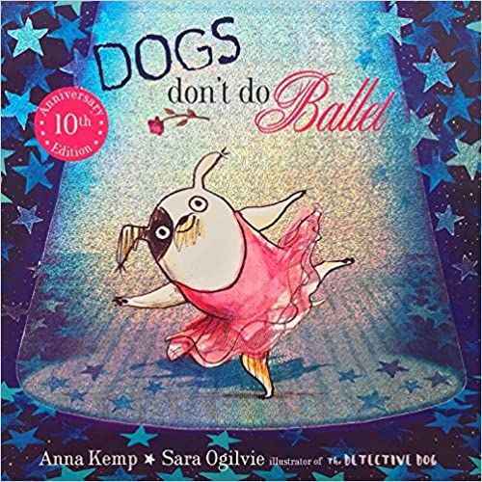
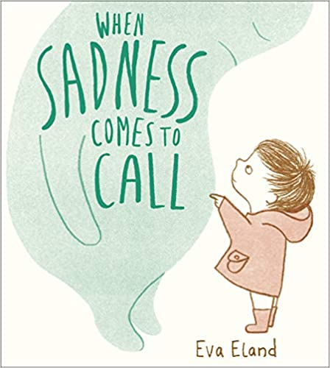

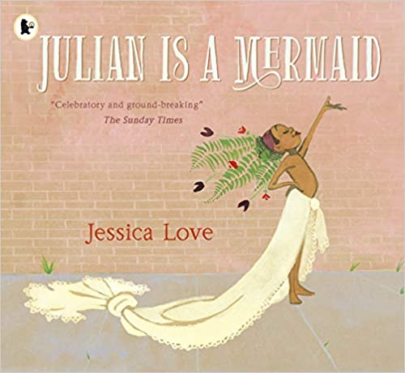
Year 4 – Picture Books
Along Came a Different by Tom McLaughlin
I understand and value diversity and the benefits of living in a diverse community
I can celebrate my personal identity (gender, faith, family, ethnicity, likes/dislikes, character)
Aalfred and Aalbert by Morag Hood
I recognise shared characteristics of healthy family life, including care, commitment, time together; support
I understand and value diversity and the benefits of living in a diverse community
Dogs Don’t Do Ballet by Anna Kemp and Sarah Ogilvie
I recognise the positive impact of self-respect
I understand and value diversity and the benefits of living in a diverse community
I can celebrate my personal identity (gender, faith, family, ethnicity, likes/dislikes, character)
I know how to form respectful relationships (inc online and in wider society)
I can use strategies to respond to feelings, including intense and conflicting feelings, in an appropriate and proportionate way
When Sadness Comes to Call by Eva Eland
I understand how regular exercise benefits physical and mental health
I understand that feelings can vary in intensity and can use a varied vocabulary to describe them
I can use strategies to respond to feelings, including intense and conflicting feelings, in an appropriate and proportionate way
Julian is a Mermaid by Jessica Love
I recognise the positive impact of self-respect
I understand and value diversity and the benefits of living in a diverse community
Red: A Crayon’s Story by Michael Hall
I recognise the positive impact of
self-respect
I can celebrate my personal identity (gender, faith, family, ethnicity, likes/dislikes, character)

Slide 13

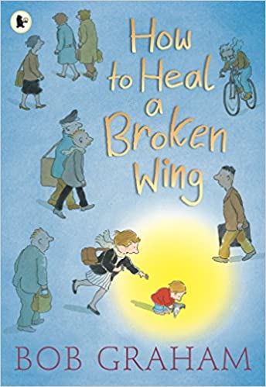

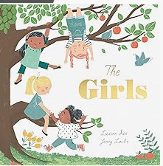
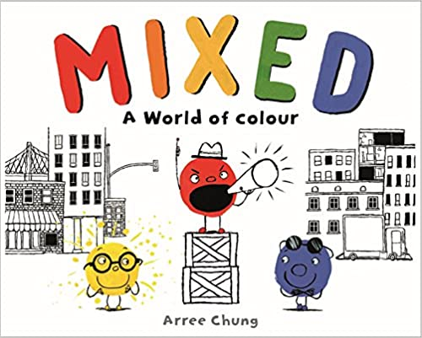
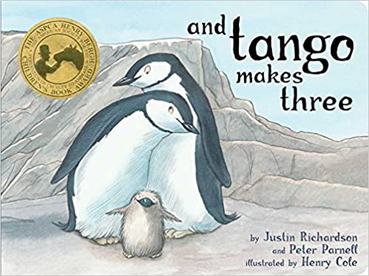
Year 5 – Picture Books
How to Heal a Broken Wing by Bob Graham
I know how to display my responsibilities we all have for caring for other people and living things
I understand the importance of having compassion
I respect the differences (beliefs, families, etc) and similarities between people and focus on recognising what I have in common with others
Kenny Lives with Erica and Martina by Olly Pike
I know how to display my responsibilities we all have for caring for other people and living things
I understand the importance of having compassion
Rose Blanche by Ian McEwan and Roberto Innocenti
I know strategies for recognising and managing peer influence/approval inc effect of online actions
I know what to do when under pressure from others to do something unsafe or that makes me feel uncomfortable
I know how to display my responsibilities we all have for caring for other people and living things
I understand the importance of having compassion
The Girls by Lauren Lee and Jenny Lovlie
I know friendships can change over time and the benefits of having different/new types of friends
I understand the importance of having compassion
Mixed by Arree Chung
I understand what discrimination is and how to challenge it
I understand what stereotypes are, their negative impact and how to challenge them
I understand the importance of having compassion
I respect the differences (beliefs, families, etc) and similarities between people and focus on recognising what I have in common with others
And Tango Makes Three by Justin Richardson and Peter Parnell
I respect the differences (beliefs, families, etc) and similarities between people and focus on recognising what I have in common with others
I respect that there are different types of family structure (including foster, same-sex and step-parents, blended families) and all types can give family members love, security and stability

Slide 14
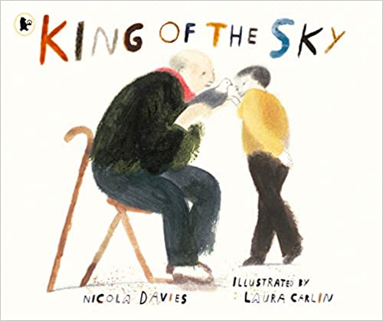

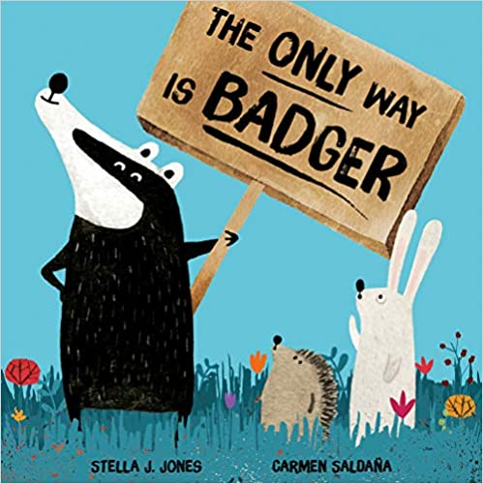
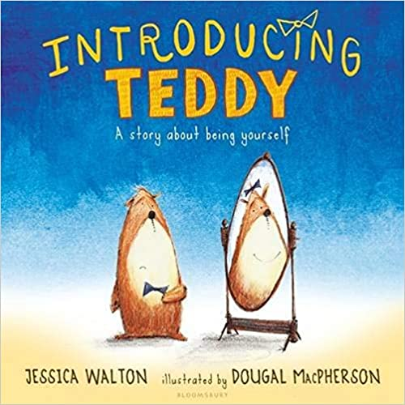
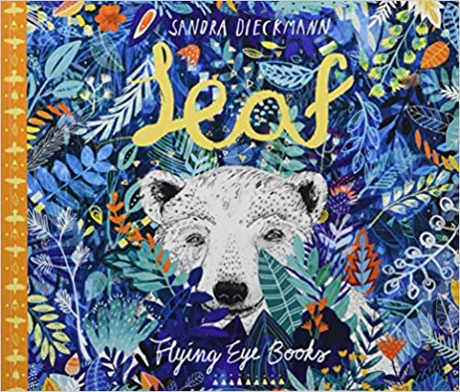
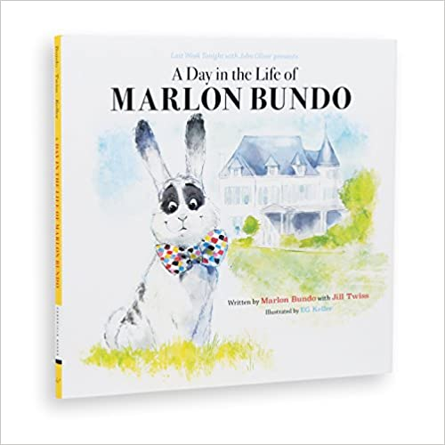
Year 6 – Picture Books
The Island by Armin Greder
I understand what prejudice is and how to recognise and react to behaviours/actions which discriminate against others
King of the Sky by Nicola Davis
I understand what prejudice is and how to recognise and react to behaviours/actions which discriminate against others
The Only Way is Badger by Stella J. Jones and Carmen Saldana
I can discuss and debate topical issues whilst respecting other people’s point of view and constructively challenge those I disagree with
I understand what prejudice is and how to recognise and react to behaviours/actions which discriminate against others
Introducing Teddy by Jessica Walton and Dougal MacPherson
I know that gender identity and sexual orientation are different
A Day in the Life of Marlon Bundo by Marlon Bundo and Jill Twiss
I can discuss and debate topical issues whilst respecting other people’s point of view and constructively challenge those I disagree with
I know ways of carrying out shared responsibilities for protecting the environment in school and at home and how everyday choices can affect the environment
I understand that new opportunities and responsibilities will arise as I gain independence
Leaf by Sandra Dieckmann
I can use problem-solving strategies to deal with emotions, challenges and changes such as transition to high school
I understand what prejudice is and how to recognise and react to behaviours/actions which discriminate against others

