Slide 1

Welcome
to
Year 5
Mrs Clayton, Mrs Johnson
Mrs Andrews, Mrs Gilchrist

Slide 2
What we will look at today ☺
Routines (PE days, being on time)
Uniform –long hair tied back, no earrings
Homework-comprehension, MyMaths, spellings, TTRockstars
Reading

Slide 3

Becoming Readers and Writers
Before children can learn to read and write they need to develop their understanding on the English language. For all of us this happens through talk.
Through talk we learn new vocabulary and the knowledge of how to structure sentences. Improve the spelling of new and ambitious words. This year we are encouraging ambitious words that more specific to the subject.
In school, oracy is a focus. We encourage the children to talk in a variety of situations, including debating, reciting poetry and reading aloud.

Slide 4
Closed vs Open Questions
Do you like this book?
Do you like this character?
It’s a good story isn’t it?
Do you like reading?
Are you good at reading?
Do you like this kind of story?
Change these questions so that the answers cannot be yes or no.
What do you like about this book?
What do you notice about this character?
Why do you think this is a good story?
What’s great about reading?
Why are you a good reader?
What is it about these stories you like so much?

Slide 5

Helping to make good readers…
Talk about the text
Ask questions
Offer your own ideas
Support school reading
Be enthusiastic about any Reading Challenges
Read a range of things (From newspapers to game instructions!)
Encourage

Slide 6
How can you help at home?
Make books a part of your day.
Listen to your child everyday.
Join and visit the library.
Ask your child about what they have read.
Be a role model- let your child see you reading.
Let your child see everyone in your house read.
Practice number bonds and tables together
Do homework together (if necessary)
Encourage independence in your child-they give you any letters (instead of you looking in their bags), they put completed homework etc in bags

Slide 7

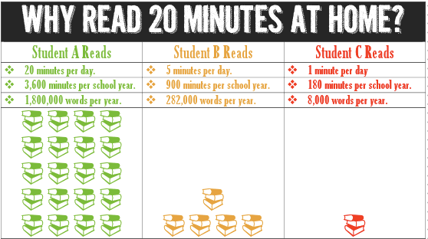


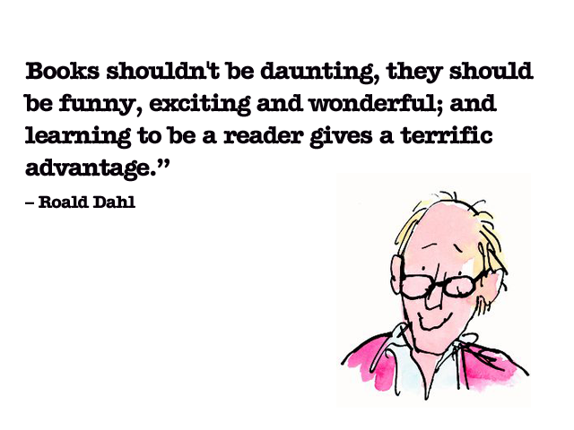
Thank you for coming! ☺

