Slide 1

Year 5 (Rowling Class) Meet the Teacher
Mr Adam Griffiths

Slide 2
The Year 5/6 Team
Mr Griffiths
Mrs Maguire
Mr Flaherty
Mr Beesley
Mrs Best

Slide 3
What is our class all about?
Becoming more independent
Focusing on being the best version of ourselves
Learning new skills
Challenging ourselves
Learning to work with everyone in the class - a real team effort
Developing the independent learning skills needed to thrive as they continue through the school

Slide 4
Our Timetable
Day | 8:40-9:00 | 9:00-9:30 | 9:30-10:40 | 10:40-11:00 | 11:00-11:20 | 11:20-12:20 | 12:20-1:15 | 1:15- 1:30 | 1:30-2:25 | 2:25-3:20
Monday | SODA (Handwriting) | Assembly (whole school) | Maths | Breaktime | My Happy Mind | PE | Lunchtime | Maths Fluency | English | RE
Tuesday | SODA (PAG) | Guided Reading | Maths |  | Spelling Activity | English |  | Maths Fluency | History / Geography |  |  | Music
Wednesday | SODA (PAG) | Guided Reading | Maths |  | Handwriting | English |  | Maths Fluency | PSHE |  | Art / DT
Thursday | SODA (PAG) | Guided Reading | Maths |  | Spelling Activity | English |  | Homework Mark | Science
Friday | Arithmetic Test | Assembly (whole school) | PE / Times Tables Test |  | Spelling Test | English |  | Arithmetic Mark | Computing | French

Slide 5

Reading
Daily home reading – encourage children to do this – support reading skills in school.
Vital children have regular practice to read aloud to support fluency, confidence and expression
Please record when your child reads at home on Boom Reader.
Monthly Reading Raffle – at least 5x reads weekly (3 independent, 2 adult) wins a raffle ticket and 5 house points.
Can be other reading too, does not just need to be school book. Good for variety and interest in reading.
Reading books are available in school – we encourage children to take responsibility.
Shared reading in class – develop different comprehension skills, alongside ‘decoding’ of text.
When children finish a book, they can take a quiz on Accelerated Reader to assess their comprehension on this text.

Slide 6
Spellings
Focus on National Year 5/6 expected words.
Over the course of a half term we will have a focus on a group of these words.
First week introduce 6 of these words.
Week 2 we will add three more, then two more every week until the end of the half-term.
Test on Friday will include all of the words learnt so far.
Learning sequence
Learn the meaning of the Expected Words
2 – 4. Learn a spelling pattern specific to the year group
5. Spelling test focusing on the Expected Word list

Slide 7

Ready Steady Write
Rose Blanche
Anne Frank
The Ways of the Wolf
Hansel and Gretel
A Story like the Wind
On the Origin of Species

Slide 8

Homework
TT Rockstars and learning their specific times table based upon their previous times table grid.
Reading which is added to Boom Reader and can be tested on Accelerated Reader at home or in school.
Weekly spellings.
Maths CGP booklet.
Reading Comprehension CGP booklet

Slide 9
Assessments
PIRA and PUMA tests will be administered each term to assess reading and maths progress
GAPS will assess grammar and spelling progress
Accelerated Reader Star Reader Tests will be used each half term to assess the children’s reading level and book band. This is given as a numerical range (e.g. 2.1 – 3.2)

Slide 10
Class Assemblies
These are a genuine highlight and help the children with a whole host of valuable skills.
A list will be sent out detailing when the children will be presenting and their presentation topic.
We will aim to do most of them on a Thursday morning but will have some flexibility depending on the events of the week or the topic of the Assembly.
Each child will have 2 presentations in Year 5.

Slide 11

PE – Mondays and Fridays
PE days – indoor and outdoor
P.E Kit Indoor (white or black shorts, blue T-shirt and pumps)
P.E Kit Outdoor – trainers, black joggers/leggings and royal blue hoodie.
Long hair – tied back .
No jewellery.
Earrings should be removed or taped over.

Slide 12
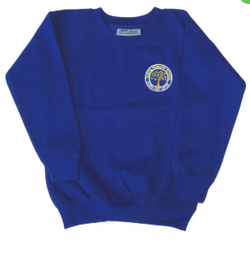
Uniform expectations
Please ensure the uniform policy is followed so our children are smart and ready to learn.
Grey tailored trousers/ shorts/ skirt/ dress
Pale blue polo shirt (available with school badge)
Appropriate, black school footwear
Royal blue school sweatshirt or cardigan (available with school badge)
Grey socks or tights
Blue and white checked dress and white socks (optional, April - October)
PLEASE LABEL ALL JUMPERS, CARDIGANS AND COATS!

Slide 13
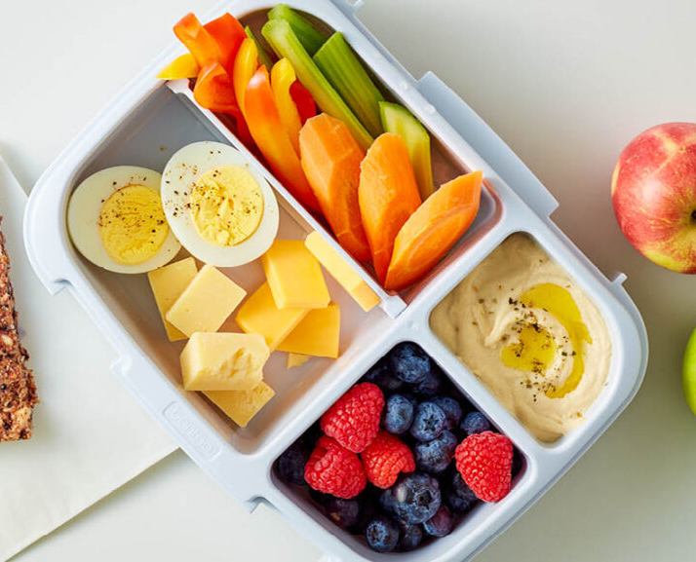
Snacks
Children are encouraged to bring in a healthy snack for morning break
No peanuts or nuts please
Water bottles (Water only please) can be stored in the classroom - please label and ensure they are taken home daily

Slide 14

Trips, Residentials and Special events
To include:
Mayan History Day with Doctor Diane
Junior Carol Concert
Exhibition
Residential (Year 5 Manchester – date TBC)
Junior Summer Play

Slide 15
Collection and Practicalities
School starts at 8:40 (gates are open from 8:40).
School ends at 3:20.
Please keep me informed if you want your child to be collected by a different adult.
Collect from the red classroom door facing the MUGA.
No need for pencil cases.
Please remember coats, especially in the winter.

Slide 16
Contact details
Please get a message to me if there is an emergency through the office or someone on the gate.
Emails will be responded to as soon as possible.
I am normally available after school if you need anything.
agriffiths@tarvinprimary.school

