Slide 1
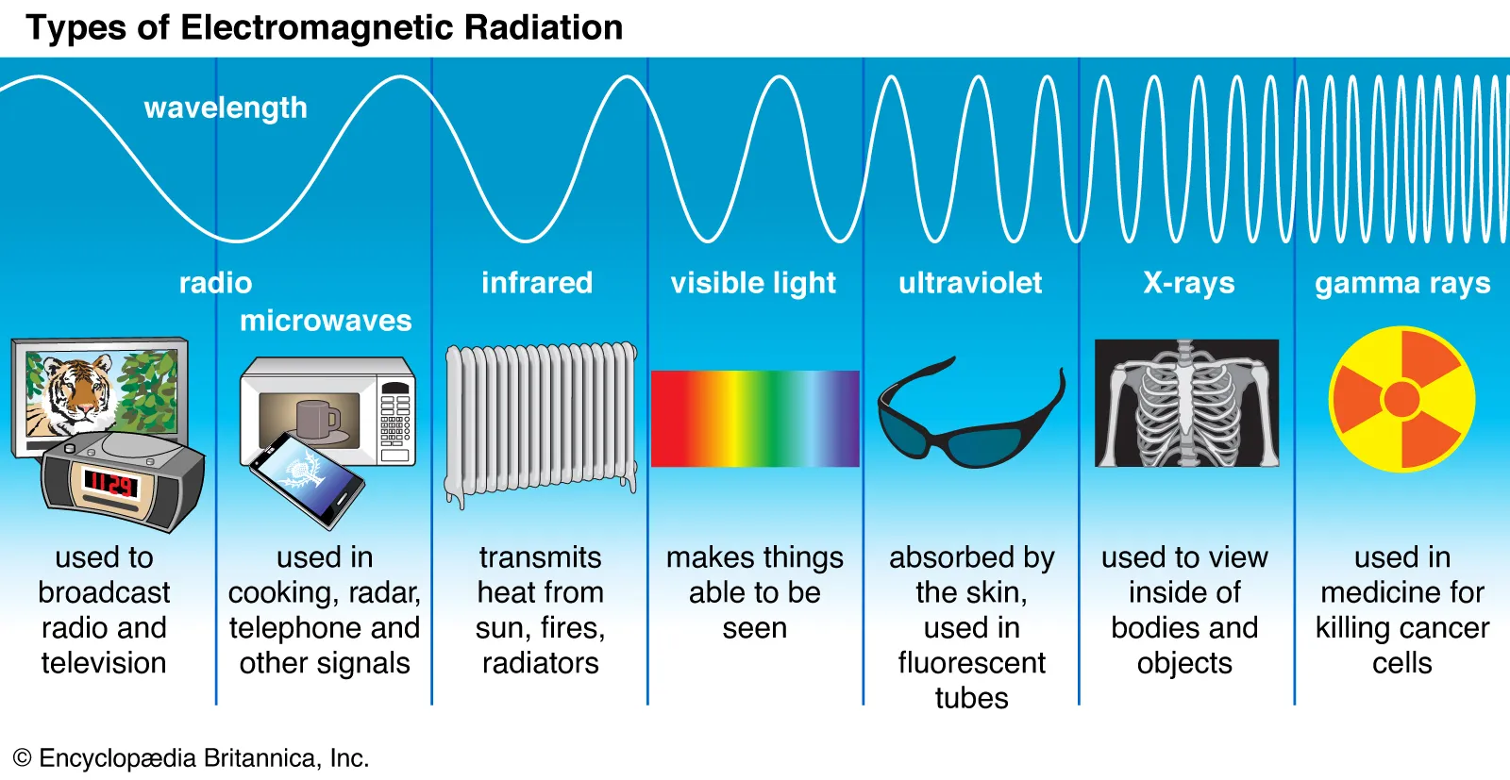

Slide 2
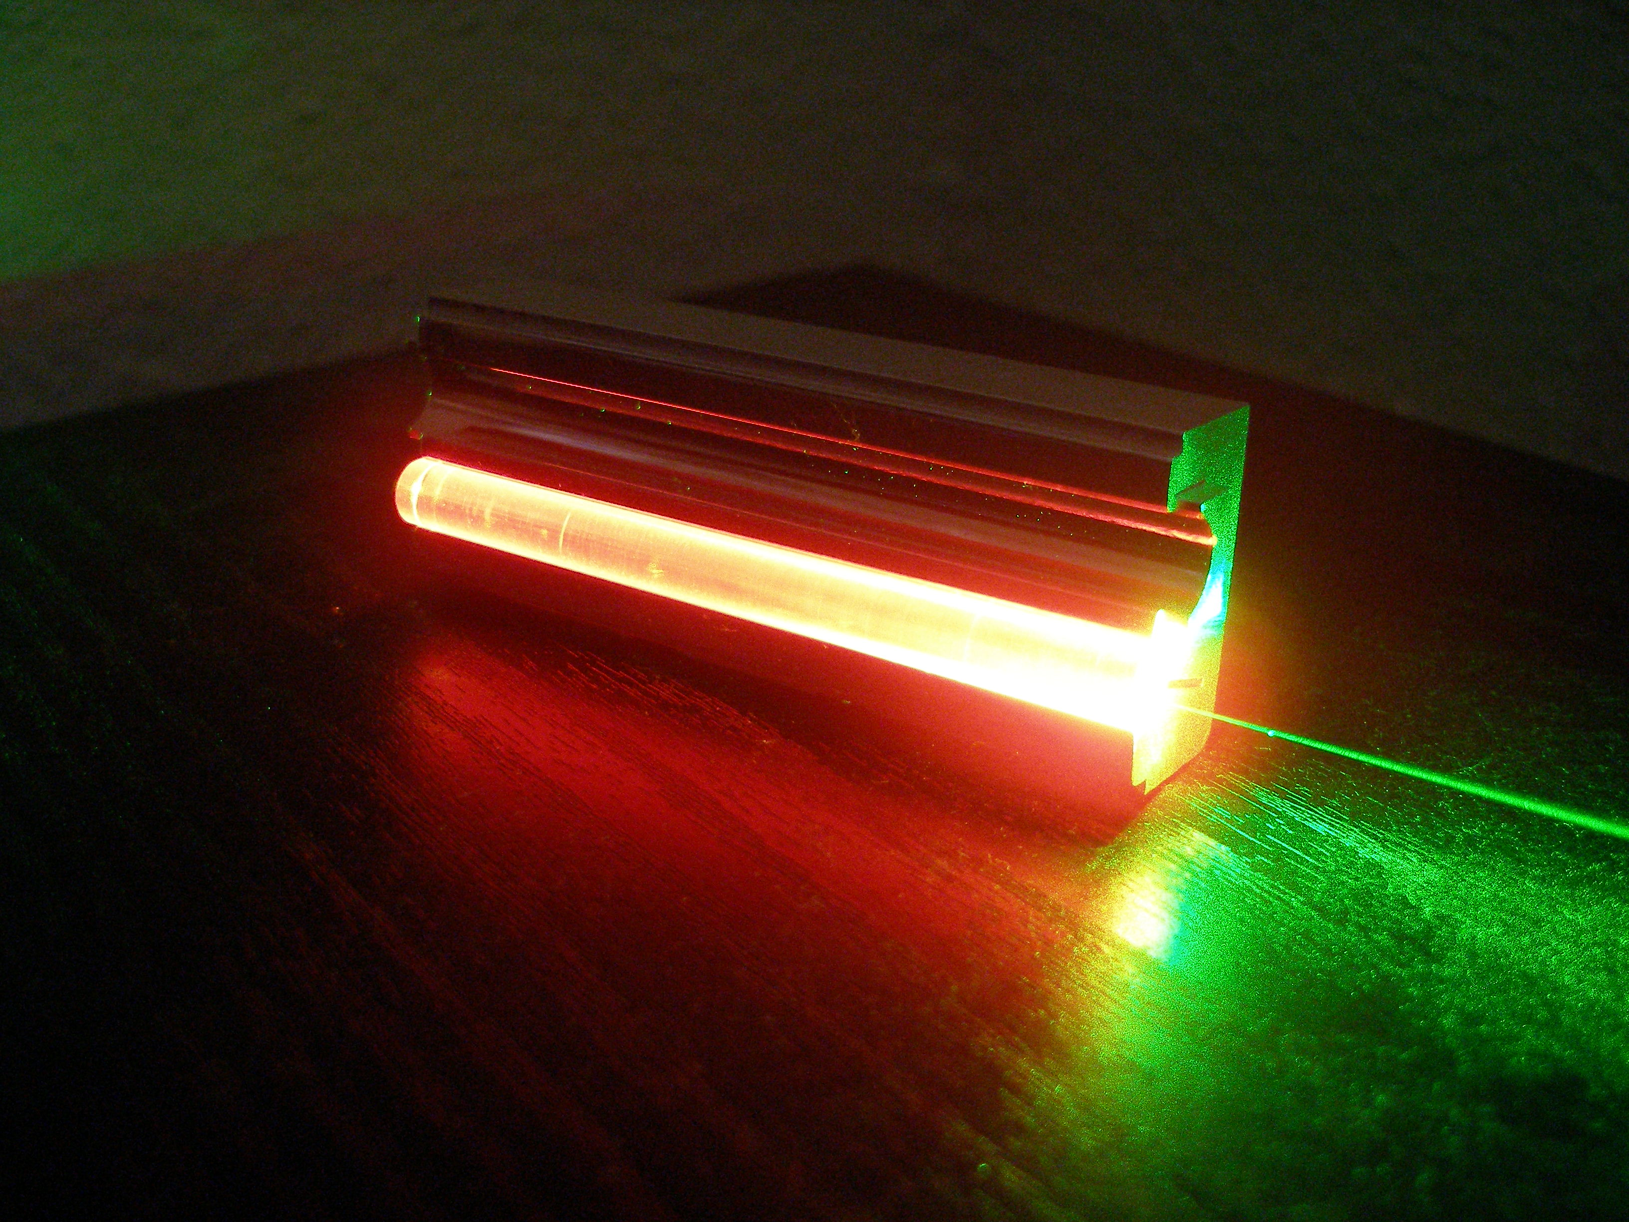
A Ruby Rod Optical Laser

Slide 3
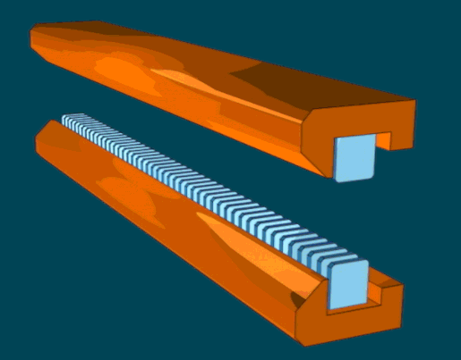
A particle accelerator can also be a Laser

Slide 4
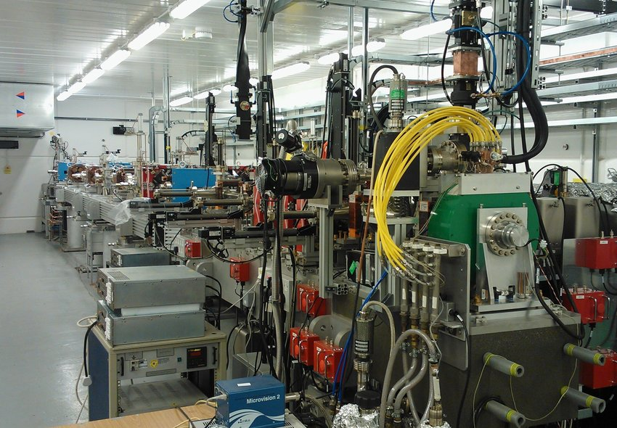
This is CLARA where I work

Slide 5
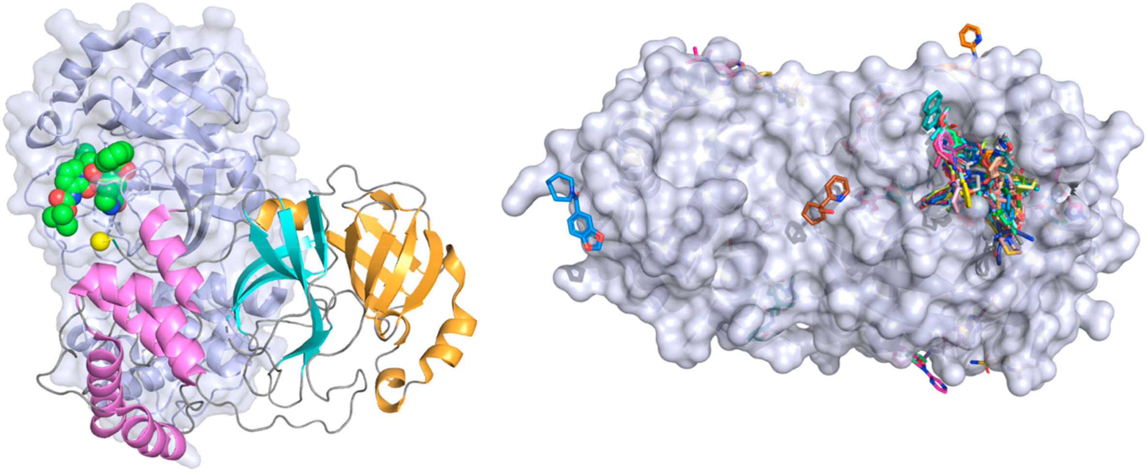
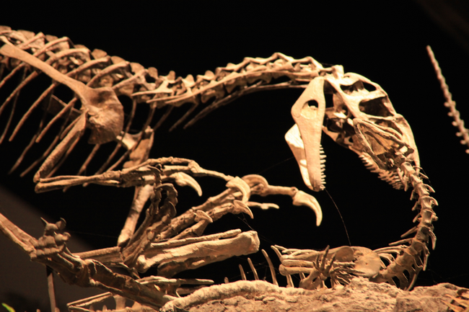
Short pulses of x ray light have many uses in science
Imaging viruses
Study dinosaur fossils

Slide 6
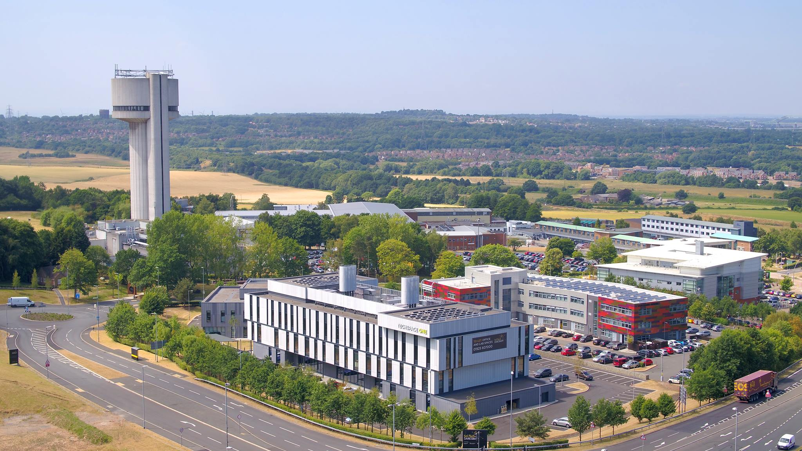
Daresbury Laboratory is part of UKRI

Slide 7
Links
Daresbury Laboratory, Warrington enquiries@stfc.ac.uk
https://www.ukri.org/about-us/stfc/locations/daresbury-laboratory/
UKRI
https://www.ukri.org/
Diamond Light Source
https://www.diamond.ac.uk/Home.html

