Slide 1
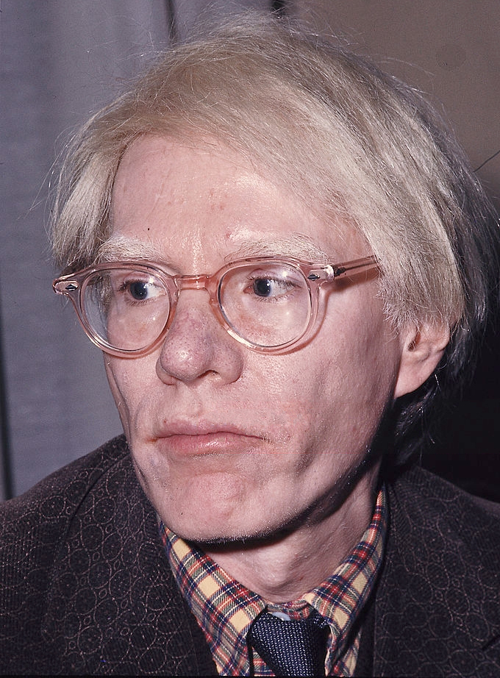
Andy Warhol 1928 -1987

Slide 2
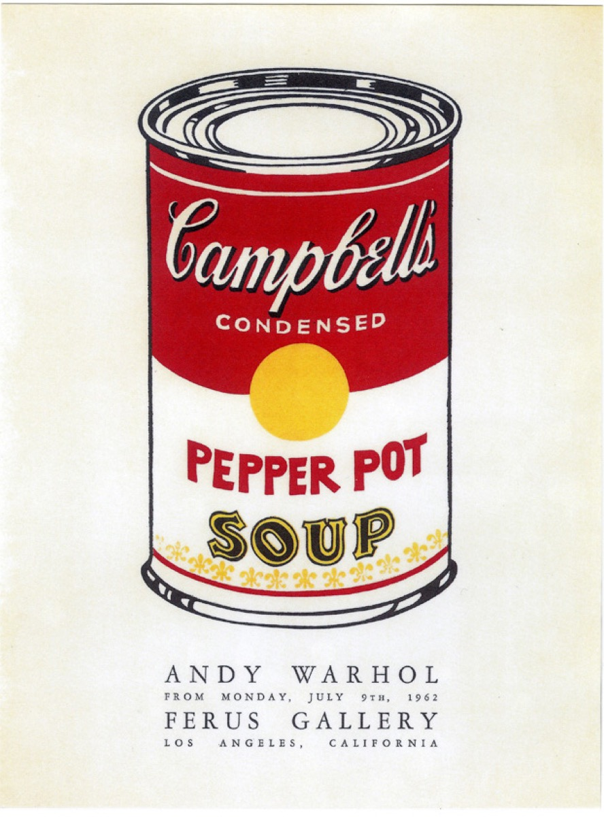
Andy first piece of art was a campbell soup can
ANDY DREW SOUP CANS BECAUSEHE LIKED SOUP AS WHAT GOOGLE SAID
ANDY WARHOL STRATED POP ART

Slide 3
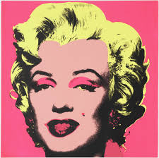
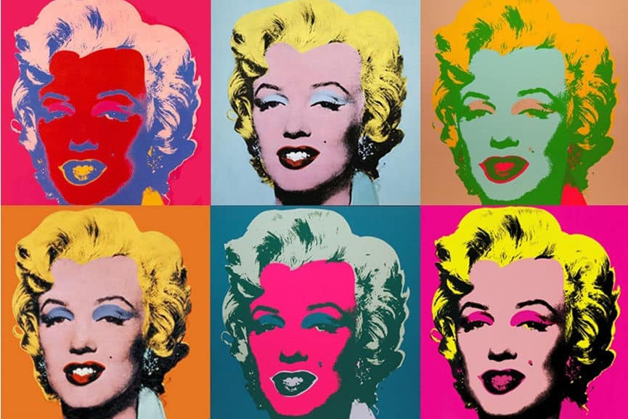
ANDY WARHOL’S ART PIECE OF MARILYN MONROE
ANDY PIECE OF MARILYN MONROE STRATED POP ART

Slide 4
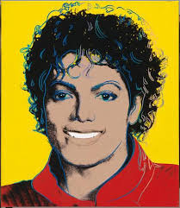
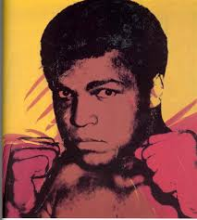
ALSO ANDY MADE DIFFERENT PORTRATS OF OTHER FAMOUS PEOPLE
AS MICHAEL JASCKSON
AND MUHAMED ALI

Slide 5

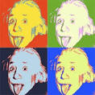
He made pop art

Slide 6
bUT ANDY WARHOL DIED IN 1987

