Slide 1


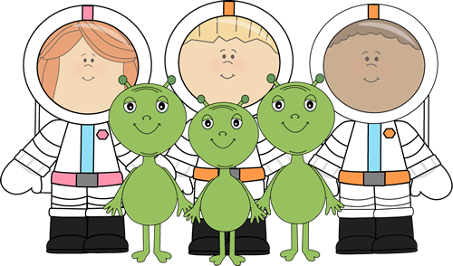



Happy New Year and welcome back to what will be a very interesting term for Year 1! There are plenty of fun and exciting things planned for the coming weeks and we have lots to do. Below is an outline of what will be happening in school. As always, please continue to do as much work as you can at home with your child; especially on reading and phonics!
Year One
Spring Newsletter
Classes 1CO and 1A
Our Theme ‘Space’
We will be looking at:
•English – Fantasy stories based on Beegu and Bob the Man on the Moon / Information texts and posters based on space and aliens.
•Maths – Reading and writing numbers to 20, ordering and understanding numbers, place value, + and – numbers to 20, Time, Money and
3D shapes.
Creative Learning Journey Work -
Light and Dark – light sources, day and night.
Astronauts and conditions of planets.
iPad work with photos and voice recording .
Using Robots and basic programming language.
Space designs, mixing colours and experimenting with line and form
Creating space sounds and listening to Holst’s planets.
Reading
Please continue to make time to read daily with your child and sign his/her reading record book (it doesn’t matter if you don’t complete a book each night!). It would also be beneficial for your child if you ask him/her questions about what has already happened in the book and what they think may happen next and why.
Homework Books
The children will continue to bring home their
homework books on a Friday to be returned
the following Wednesday. Please do not return
them before this date as often the activities we set are best practiced over a number of days.
Library Books
Library books will continue to be changed fortnightly. Please could you ensure that your child has their library book in by the 27th January and then the 10th February in order for them to be changed.
Children should bring their P.E kits in at the start of each half term where they will remain until the end of the half term when they will be sent home. If your child attends an after school club they will require an additional kit (see letter sent home for more information on this).
Phonics Screening
12/06/17 to 16/06/17
The screening check is a national test for all Year 1 children. Each child has to read 20 real words and 20 nonsense words. Further details will be sent home soon along with extra phonics work. Please ensure that your child is in school during this week!
And finally…
If you have anything that you wish to discuss relating to your child please do not hesitate to contact us before 8:30am or after 3:30pm and we will be happy to try and help. Please keep up to date with everything that is going on in school via the school website.
Mrs. C Cook, Mr. Allaby, Mrs. Oldfield, Mrs. L Chapman, Miss L Heaton.

