Slide 1

Lesson 1
LACEY GREEN PRIMARY ACADEMY
Nonfiction: Arachnophobia
Notes:
Introduce the author and book title

Slide 2

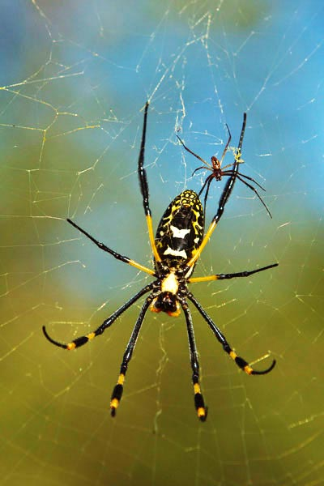
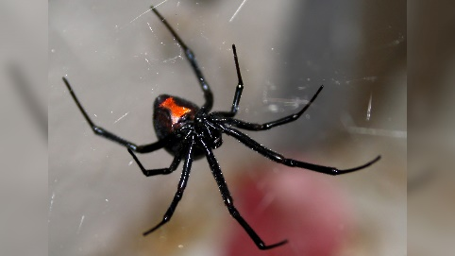
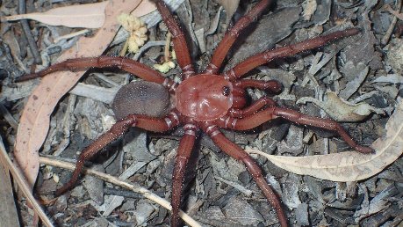
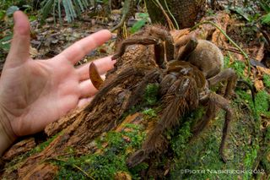
Begin with the basics
Where else have you heard the word phobia? What does it mean?
golden orb weaver
giant trapdoor spider
arachnophobia
black widow
Arachnids are eight-legged creatures. It can refer to spiders and also scorpions and ticks.
Why are some people scared of spiders?
goliath spider
Notes:
Begin with the basics: depending on the text, pupils can do one of the following:
think about what they already know about a topic, from reading or other experiences, and try to make links. This helps pupils to infer and elaborate, fill in missing or incomplete information, and use existing mental structures to support recall.
predict what might happen next, based on book cover/author/title/blurb/short extract, and discuss how this might motivate them to move on
identify and discuss features of the text, focussing on specific features of fiction/nonfiction/poetry.

Slide 3
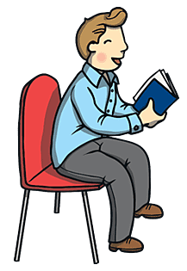
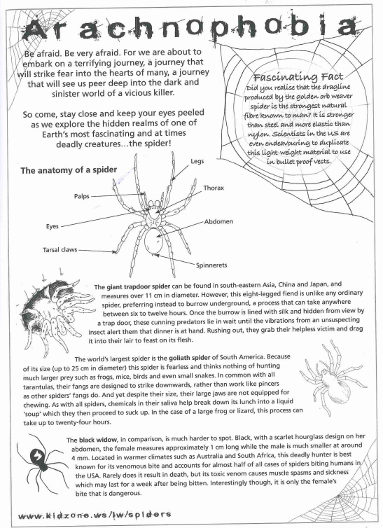
Teacher Read
Notes:
Teacher Read: act as a model of fluent reading, bringing characters to life and capturing the right tone of the text. Teachers may:
model how a skilled reader fills in gaps as they read
explain how ideas in the text and ideas from background knowledge are combined to make meaning
think out loud about the content of the text, for example commenting on an unexpected plot twist
share a key piece of knowledge (for example briefly explaining the historical context to an event)
connect the story to pupils’ own experience

Slide 4
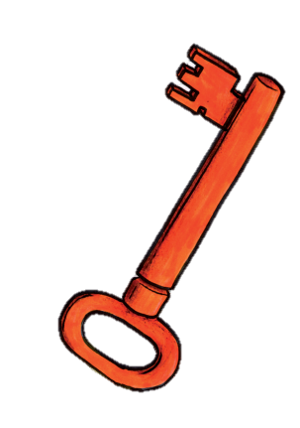

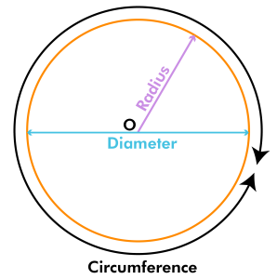
Vocabulary
realm | sinister | endeavoring
duplicate | diameter | cunning
Notes:
Vocabulary: focus on up to 6 tier two vocabulary words from the extract. Use My Turn Your Turn (MTYT) to introduce. Decode relevant words, particularly those with prefixes/suffixes. Colour the word: succinctly demonstrate the word’s meaning through providing pupils with an action, example, image or brief explanation. Teacher to write word and draw a related picture on Flip Chart, which is then displayed on the working wall.
Vocabulary recap: Use quick questions/prompts to establish meaning of the words. (e.g. Which word is a synonym of…? Show me what … looks like. Why might someone…? Use … in a sentence). Refer to Flip Chart.

Slide 5


Echo Read
Capture the tone, VOLUME and speed of the text.
Respond to punctuation.
Notes:
Echo Read: Pupils chorally echo back a section reread by the teacher, emulating their intonation, tone, speed, volume, expression, movement, use of punctuation, etc.

Slide 6

Paired Read
Read the text together with your partner.
You can read a sentence, paragraph or section each.
Compliment your partner’s reading and help them if you need to.
Let’s try that word again…
Try and speed up just a little…
Great expression!
You read at a steady pace – well done.
You read some tricky words accurately.
Notes:
Paired Read: Pupils take it in turns to read a sentence or paragraph each. Encourage good partner work, focusing on specific compliments or points for improvement. Check spotlight pupils: can they read all words accurately and most words speedily? Encourage decoding/chunking where appropriate.

Slide 7

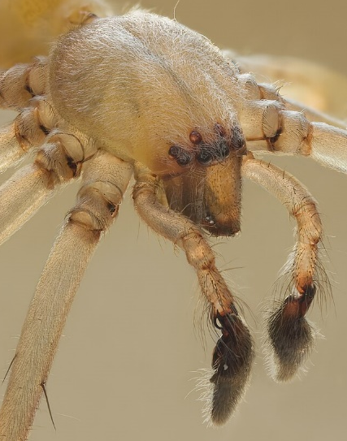
Fastest Finger: Retrieval Questions
What is a golden orb weaver spider’s dragline stronger than?
What causes the giant trapdoor spider to strike at its prey?
List some of the goliath spider’s potential prey.
What could a black widow’s venom cause?
Identify this part of a spider.
Notes:
Fastest finger: Retrieval Questions: Up to six quick-fire, teacher-led retrieval questions, which pupils quickly answer, one at a time, by highlighting the text. Feedback is instant. Encourage children to skim and scan for the correct section and key word/s.

Slide 8

Your turn: Retrieval Questions
Look for a simple key fact or key point in the text.
Write a question on a post-it note. The answer will link to your simple key fact or point.
Questions can begin with who, what, when, where or why.
Notes:
Your Turn: Retrieval Questions: Pupils to generate their own retrieval questions about the text on a post-it note.

Slide 9

Evaluative Question
How might someone with arachnophobia feel after reading this text?
Notes:
Evaluative question: Pupils to discuss a question that reflects on the tone, purpose and overall effectiveness of the text, providing ideas, raising issues and facilitating discussion.

Slide 10
Lesson 2
LACEY GREEN PRIMARY ACADEMY
Nonfiction: Arachnophobia
Notes:
Recap the author and book title

Slide 11
Vocabulary
First | Second | Third
Forth | Fifth | Sixth
Notes:
Vocabulary: focus on up to 6 tier two vocabulary words from the extract. Use My Turn Your Turn (MTYT) to introduce. Decode relevant words, particularly those with prefixes/suffixes. Colour the word: succinctly demonstrate the word’s meaning through providing pupils with an action, example, image or brief explanation. Teacher to write word and draw a related picture on Flip Chart, which is then displayed on the working wall.
Vocabulary recap: Use quick questions/prompts to establish meaning of the words. (e.g. Which word is a synonym of…? Show me what … looks like. Why might someone…? Use … in a sentence). Refer to Flip Chart.

Slide 12
Fastest Finger: Your retrieval questions
Notes:
Fastest Finger: Your Questions: Teacher to choose up to four of the retrieval questions generated in Lesson 1 and pupils to quickly answer, following the same process.

Slide 13
Teacher Read
If the teachers indicates to do so, the class will jump in and all say the next word.
If you are tapped on the shoulder, pick up, reading from where the teacher left off.
Carry on until the teacher takes over.
Notes:
Teacher Read: Intersperse with the following techniques to ensure that all pupils are engaged with their reading.
Jump in: Use intonation to indicate that all of the class should ‘jump in’ and chorally say the next word. To get the children to focus, use the phrase ‘Eyes set…’ and the children repeat ‘you bet’
Pick up: Tap a pupil on the shoulder to indicate that they have to pick up from where you have left off; this keeps transactions silent and allows the text to flow. Keep durations short but unpredictable. Read between pupils reading to bridge the gap. Model expectations clearly.

Slide 14
Paired Read
Read the text together with your partner.
You can read a sentence, paragraph or section each.
Compliment your partner’s reading and help them if you need to.
Let’s try that word again…
Try and speed up just a little…
Great expression!
You read at a steady pace – well done.
You read some tricky words accurately.
Notes:
Paired Read: Pupils take it in turns to read a sentence or paragraph each. Encourage good partner work, focusing on specific compliments or points for improvement. Check spotlight pupils: can they read all words accurately and most words speedily? Encourage decoding/chunking where appropriate.

Slide 15
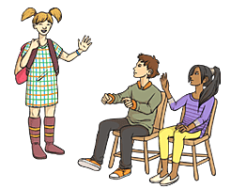
Vocabulary: Engage
Act out how the cunning giant trapdoor spider captures its prey.
What are the key steps that we need to include?
Drama
Notes:
Vocabulary - Engage: Refer to target vocabulary and/or particularly difficult phrases. Further pupils’ understanding through one of the following:
Draw it: Pupils to draw an object or person, based on a descriptive section of the text.
Quiz Quiz Trade: Pupils to have vocabulary on paper/whiteboards. Their partners are to give definition/act it out/use it in a sentence.
Drama: Pupils to act out a section of the text. Focus on how vocabulary conveys meaning in action or dialogue.
Freeze frames: Pupils to create an image using their bodies, with no movement. They can represent people, objects or scenes, either individually or in groups.
https://www.theteachertoolkit.com/index.php/tool/quiz-quiz-trade

Slide 16
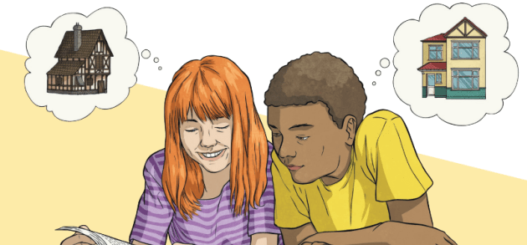
Vocabulary: Questions
Which word is closest in its meaning to embark?
Look at Fascinating Facts. Find a word that is similar in its meaning to try.
Look at the phrase keep your eyes peeled. What do you think this means?
Why do you think that the giant trapdoor spider is described as cunning? (2 marks)
Challenge: Create a mind-map of adjectives to describe the black widow.
Notes:
Vocabulary – Questions: Pupils to answer questions in books, which give/explain the meanings of words in context or identify/explain how meaning is enhanced through the choice of words and phrases.

Slide 17

Summarise
Stand-and-Share: Facts from the text about golden orb weaver spiders, giant trapdoor spiders, goliath spiders or black widows.
Notes:
Summarise paragraphs/the whole text, reiterating how this skill is essential for retaining key information. Complete one of the following:
Sequencing: Pupils to sequence key events, either in a narrative or the key steps in a process. This could be through numbering the events or drawing/acting them out. KATE
True-or-false: Pupils to demonstrate understanding of the text through determining whether or not a series of statements are true or false.
Stand-and-Share: This activity is for retaining key information, particularly from a nonfiction book. Base activity around an open-ended question (e.g. Tell me everything the text tells you about…). Pupils stand up if they have any information about that topic. The teacher calls upon one pupil at a time to share. Pupils will sit down as soon as they have heard about everything they know about the topic, with subsequent points being new learning for them.

Slide 18
Lesson 3
LACEY GREEN PRIMARY ACADEMY
Nonfiction: Arachnophobia
Notes:
Recap the author and book title

Slide 19
Vocabulary
First | Second | Third
Forth | Fifth | Sixth
Notes:
Vocabulary: focus on up to 6 tier two vocabulary words from the extract. Use My Turn Your Turn (MTYT) to introduce. Decode relevant words, particularly those with prefixes/suffixes. Colour the word: succinctly demonstrate the word’s meaning through providing pupils with an action, example, image or brief explanation. Teacher to write word and draw a related picture on Flip Chart, which is then displayed on the working wall.
Vocabulary recap: Use quick questions/prompts to establish meaning of the words. (e.g. Which word is a synonym of…? Show me what … looks like. Why might someone…? Use … in a sentence). Refer to Flip Chart.

Slide 20
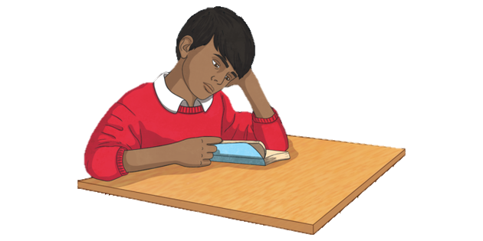
Independent Read
Notes:
Independent Read: Check spotlight pupils: can they read all words accurately and most words speedily? Encourage decoding/chunking where appropriate.

Slide 21
Questions
1a) Which spider has the strongest web?
b) Why are scientists trying to copy this material?
2a) What do you think is meant by hidden realm? (2 marks)
3) How does the goliath spider consume its prey and why? (2 marks)
4) The text refers to spiders as a vicious killer.
Do you agree or disagree with this statement? Use evidence from the text to support your answer.
Notes:
Main questions: Pupils to answer a variety of questions, based on the content domains, with a particular emphasis on inference. Questions may use the test-style format (see templates). The relevant images can help define the question types. Answers do not necessarily need to be written in full sentences; focus on the pupil’s understanding of the text. Pupils to identify and underline the key word/s in the question and text, if relevant. Pupils to self-mark, and then teachers to check, particularly focusing on subjective answers. Additional adult support may be given to SEN children.

Slide 22
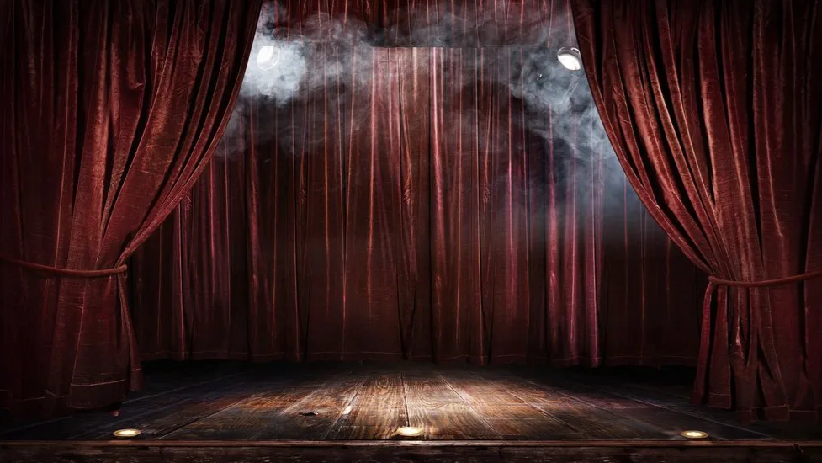
Reader’s Theatre
Notes:
Reader’s Theatre: A pupil/group performs the whole of the text to their peers. This could be recorded so that pupils can appraise their performance.

