Slide 1
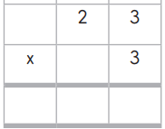




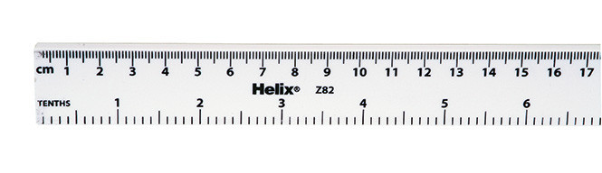
LACEY GREEN PRIMARY ACADEMY
Year 3 Spring 1 2026 Learning Overview
As Writers, we will…
draw inspiration from The Magic Finger by Roald Dahl.
We will write a narrative based on the book and a letter of apology.
We will:
write prepositional phrases to express time (e.g. during the lesson) and position (e.g. in the classroom)
use coordinating and subordinating conjunctions.
write direct speech using inverted commas.
use adverbs to show how something is done
use adjectives to describe, particularly feelings
Our class novel is The Wild Robot by Peter Brown.
As spellers, we will study…
the prefixes –dis, - in and –im
adding the suffix –ous and -ly
silent or quiet letters (answer, island, length, February)
As Mathematicians, we will… continue learning about multiplication and division and start learning about length and perimeter.
We will:
look at related calculations and reasoning about multiplication.
multiply a 2-digit number by a 1-digit number (without exchange and with exchange)
divide a 2-digit number by a 1 digit number (without exchange, by flexible partitioning and looking at numbers with remainders)
measure in mm, cm and metres.
look at equivalent lengths.
compare, add and subtract lengths.
measure and calculate perimeter.
As readers, we will…
Read accurately, with a good pace and expression
Demonstrate our understanding through inferring from the text and sequencing key events
As Scientists, we will …
explore ‘Light and Shadows’
We will:
look at different light sources and how light travels
learn about how we can protect ourselves from the sun look at how shadows are formed by objects
use different types of scientific enquiry to explore and support our findings
As Historians, we will… learn about The Ancient Egyptians.
We will…
Visit Manchester Museum to see real Egyptian artefacts
Understand when and where Ancient Egypt was
Learn about the River Nile and pyramids
Explore their society and about hieroglyphs
Find out what gods they believed in and about the afterlife

Slide 2

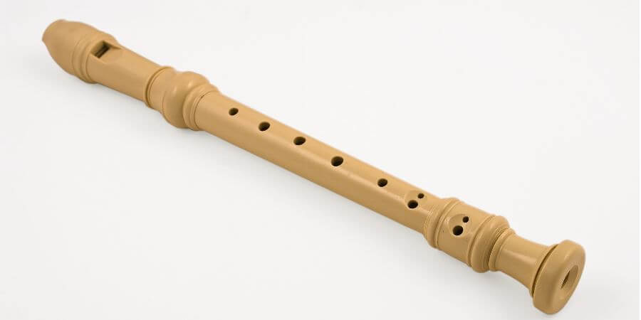
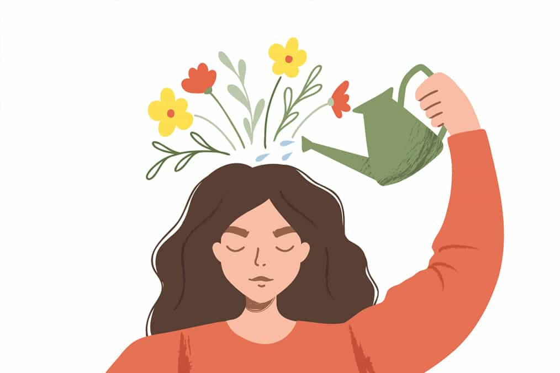
LACEY GREEN PRIMARY ACADEMY
Year 3 Spring 1 2026 Learning Overview
As programmers in Computing, we will be … Opinion Pollsters
Understand how the internet can help encourage communication and collaboration
Develop an awareness of how important it is to keep anonymity when collecting responses
Understand the purpose of surveys
Design a survey in Google forms using a range of response types
Ask unambiguous questions
Analyse results through the use of Charts
In P.E, we will…..
learn about dance and football
We will…
Develop a motif with some agility, balance, coordination and precision
Show different levels and pathways when travelling
Learn how to translate words, images and ideas into actions
Trap and cushion a ball
Pass the ball accurately
Dribble a ball and manipulate it between the feet
In Personal Development we will…
Learn about ‘Physical, emotional and mental health’
Ways to stay physically healthy,-exercise, nutrition, hygiene
What is the difference between physical and
mental health?
What is more important, a need or a want?
As Musicians, we will….
begin to play the recorder.
We will…
Explore the timbre of the recorder.
Understand the timbres of different families of instruments.
Learn three starter notes G A B
Recognise and use rhythm patterns -quavers/crotchets/minims
Singing – relate pitch of voice to instrument
Vocab: crotchets, paired quavers, minims, rests
As French speakers, we will learn about…
Animals
Colours
Adjectival agreements
Animals+ intro J’ai/je n’ai pas de
Opinions of pets
Cultural – Mardi Gras in Nice and mask competition
In RE, we will consider the key question…
Do Sikhs think it is important to share?
As Artists, we will look at... Value and line/mark making
Create a sketchbook to record their observations
Improve their mastery of art and design technique through drawing

