Slide 1
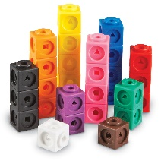


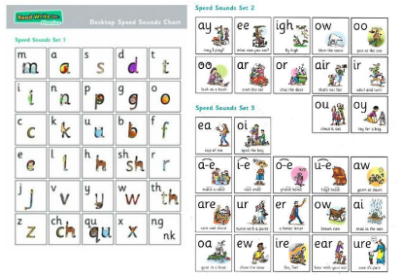

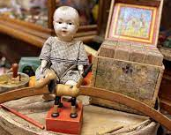

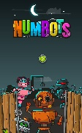
LACEY GREEN PRIMARY ACADEMY
Year 1 Autumn 2 2025
Learning Overview
Curriculum Guide for Parents and Guardians
As Mathematicians, we will
Learn about addition and subtraction and shape
Learning different addition and subtraction methods
Learn about different 2D and 3D shapes
As Writers, we will….
Read our vehicle text “Rapunzel” by Bethan Woollvin
The children will immerse themselves in this beautifully illustrated story, exploring different language features.
The children will learn to…..
Use capital letters at the start of sentences.
Use full stops at the end of sentences.
In Year 1 we focus on the importance of handwriting and the correct letter formation.
As Readers, we will…..
Explore a variety of different stories
We will……
- answer retrieval questions by finding evidence from the text.
- draw inferences such as inferring characters’ feelings, thoughts and motives from their actions.
In phonics we will…
Develop our knowledge of using phonics in spelling using our sound mats.
In History, we will…
Explore toys over time
We will learn about..
What toys were like in the past
Comparing toys now to toys in the past
As Scientists, we will……
begin our unit called ‘Autumn and Winter’.
We will learn to…
Understand the difference in seasons from Autumn to Winter
Identify a variety of different animals
Use NumBots to help build your child’s Maths skills.

Slide 2
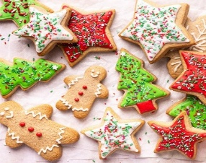
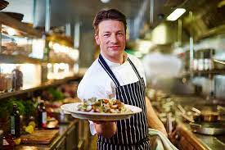
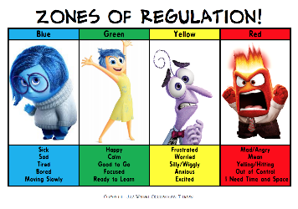



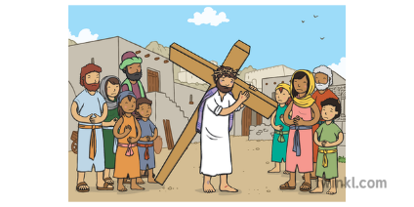

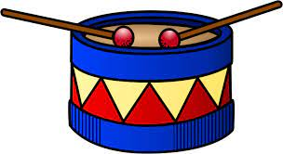
LACEY GREEN PRIMARY ACADEMY
Year 1 Autumn 2 2025
Learning Overview
In Personal Education we will…
Explore the zones of regulation
Explore a range of emotions and how to manage them
In Design and Technology we will
- Explore healthy diets and hygiene
Create our own festive biscuits
Research the designer Jamie Oliver
In P.E, we will be doing:
Gymnastics - exploring curling, rolling and balancing
Throwing and catching balls
Learning different methods to throw balls.
As French speakers, we will learn about:
Christmas in France
French storybooks
Petit Escargot rhymes
In Computing, we will becoming ‘TV Chefs’ and
Use technology purposefully to create, organise, store, manipulate and retrieve digital content
Recognise common uses of information technology beyond school.
As Artists, we will….
Research the artist Henri Matisse.
Learn about the primary colours.
Use a variety of skills
In RE, we will…
Consider the key questions:
What gift would I have given Jesus if he had been born in my town, not Bethlehem?
As Musicians,we will be….
Exploring sounds linked to traditional tales
Performing raps exploring Tempo / Volume
Learning and internalising Christmas Nativity songs & carols

