Slide 1


Year 3 and 4
Information Evening 2024
Becoming a more independent learner.

Slide 2
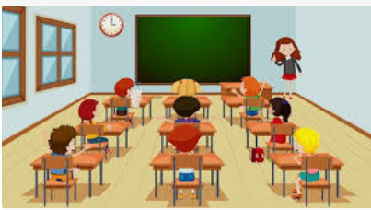
Class organisation…
Three Y3 and 4 classes – Mr Fuller’s class, Mr Dixon’s class & Mrs Hooper/Mrs Hughes’ class.
Children are taught as a class for all subjects by their class teacher.
Maths – children set in year/ability groups. Mrs Cook is our additional teacher for Maths.
Our teaching support - Mrs Pickering & Mrs Evans.
Mrs Fabby & Mrs Mitchell support PPA cover/management time.

Slide 3


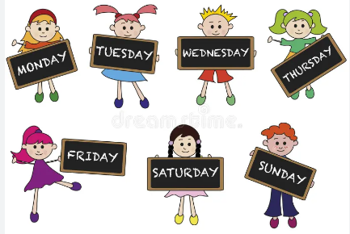
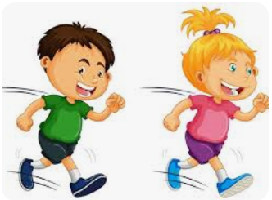
A typical school week…
Core subjects (Literacy and Maths) - taught every morning.
Foundation subjects (Topic, Science, French, PSHE, PE, RE, Computing)
- taught each afternoon.
Guided Reading – Friday mornings.
2 x PE sessions each week. This term - Badminton on Mondays &
House of Dance on a Thursday.
Laps run around the field/playground throughout the day.
Spelling and handwriting skills taught each morning.
Collective worship each morning.
Celebration assembly each Friday.

Slide 4


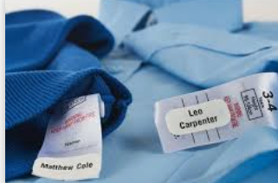

Expectations in Year 3 and 4…
To develop independence.
Water bottles in everyday - refilled at lunchtime/playtime.
Toilet visits ideally during breaktime and lunchtime.
Full PE kit in daily – trainers, white shorts, navy t-shirt, socks, warm clothes for Winter (outdoor PE.) bobble for long hair & earrings out on PE days (or cover with tape in school).
*Kit in on a Monday and sent home on a Friday.
Healthy snacks for break time (no nuts) or order toast via the office (no free fruit anymore in the Juniors).
All clothes to be labelled with names, including PE kits.
Reading records in school/go home daily.

Slide 5


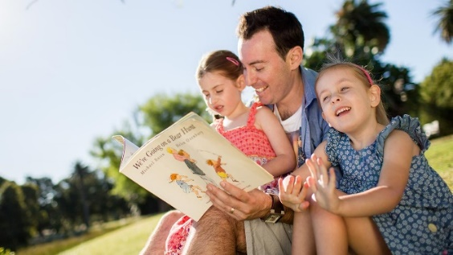
Reading…
~‘Reading for enjoyment’ is our biggest goal – all children choose and read books independently/with a buddy, in class daily for pleasure.
~ Guided Reading takes place together as a class every Friday morning. We use high quality chapter books and texts. Teachers will read aloud so the children can focus on enjoying the text and think about given questions.
~ We expect children to fill in their reading records at least 4 times a week – these can be a mixture of entries by themselves and parents.
~ Any reading can go into reading records – eg. books you read to them (from home, school or library), audio books, magazines, information about topics of interest looked up online, song lyrics they’re interested in, poems, recipe books and Get Epic etc!
~ Reading book colours are continuously reviewed: the aim is for Year 3 children to reach ‘dark blue’ by the end of the year and for Year 4 children to be a free reader as they head into Upper KS2.
~ Children encouraged to change their reading books each morning upon entry into class (if needbe)
~ Reading rewards to celebrate reading recorded in records.
~ We encourage children to discuss book recommendations with one another.

Slide 6


Literacy text this term…
SYNOPSIS - A boy and his grandfather watch as a baby seal is born on the rocks near their home and from that day a special friendship is created between them. Despite his disability, the boy is a keen surfer, and he enjoys many afternoons surfing with the seals. One day, however, he gets into trouble in rough seas, and the young seal saves him. Their friendship brings happiness and meaning at the important stages of the boy's life.

Slide 7


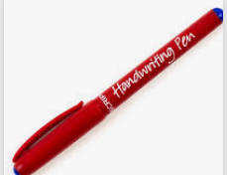
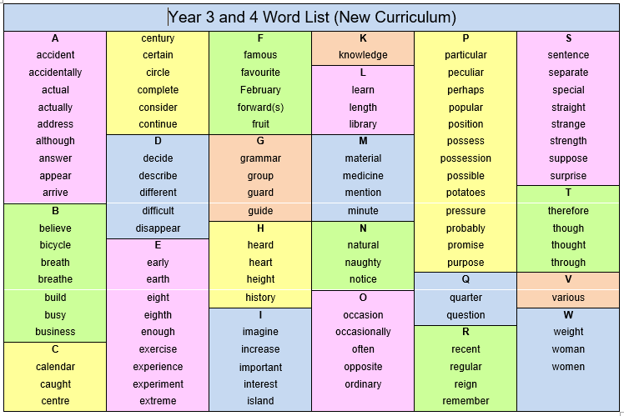
Handwriting & Spelling…
Handwriting – children are expected to develop a cursive style that is consistently joined, throughout books.
Children can move onto black pen once they have achieved this.
We have a subscription to the Letter-join scheme where children can request log-ons to practice their letter formation online at home.
Spelling – children are expected to learn and spell the common exception words on the Year 3/4 National spelling list with increasing accuracy. We practise other spelling rules through our Pathways Literacy programme too.
We have high standards of presentation and encourage all to take pride in their work.

Slide 8
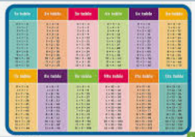


Maths…
~ We follow the White Rose scheme for Maths lessons.
~ Help children at home learn their times tables by using TTRS (Times Table Rock Stars – all have their own log-in.
End of year expectation for Year 3 (x , ÷, out of order)
3s, 4s, 8s - in addition to recalling the 2s, 5s and 10s from Year 2.
End of year expectation for Year 4 (x , ÷, out of order)
6s, 7s, 9s - all facts up to 12 x 12.
~ Formal national testing of times tables takes place for all Year 4 pupils towards the end of the year in the Summer term.

Slide 9


Homework…
Given out on Thursdays and handed in on Tuesdays.
Maths - 1 sheet per week, set by the maths teacher.
Times tables -30 minute sessions on TTRS.
Spellings – learning a list of words & connected task.
Reading – a minimum of 4 times each week.
*Reading records handed in the following week.
+ Learning Logs sent home each term – research tasks linked to Topics.
If there is any reason as to why your child is unable to hand in their homework, please send in a brief note to let us know.
*We do provide a homework club on a Thursday.

Slide 10
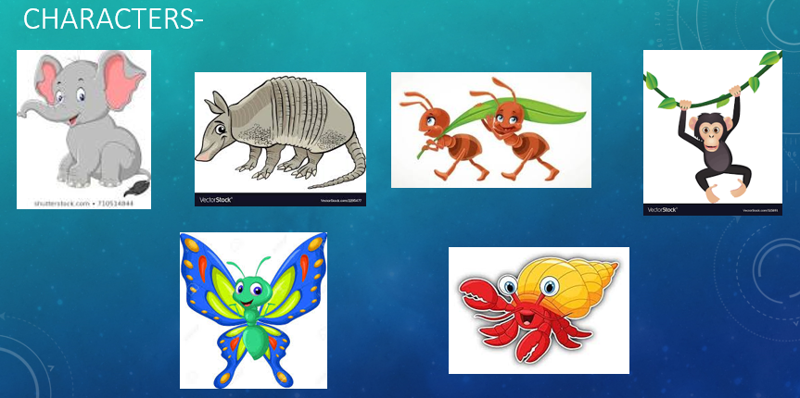




Our school learning powers…
The learning powers are well-established throughout the school. We focus on one learning power each half term and encourage children to think about that learning power in lessons and how they conduct themselves within the school day.

Slide 11



Extra info…
Small pencil cases and bags only please.
Coats in wet/cold weather (with names in).
Toys etc should be kept at home.
Any questions/information to share each day – please feel free to speak to us briefly at the classroom door in the morning/end of the day.
Events coming up…
Friday 27th September – all Y3/4 children will sing for parents at the Macmillan coffee morning.
All Y3/4 will be involved in a carol service at Christmas.

Slide 12

Thankyou for attending.

