Slide 1


Whilst You Are At Home
We are going to stay in touch
Edition 12
23rd June 2020

Slide 2
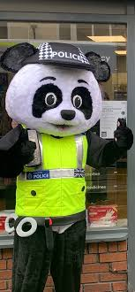

Positive messages of the week
Hello Everybody
Well we have all seen plenty of rain this week! and as the saying goes:
When Life Throws You A Rainy Day, Play In The Puddles!
As we have previously said everything that we do has a consequence, therefore we need you to really think about your safety while at home and out and about.
Remember Pc Panda wants you all to play your part in keeping safe!
We have seen some terrific Road Safety posters that some of you have created and put in your windows. it would be lovely to see even more. Over the coming weeks we will display them on this presentation.
Doing Our Bit for Great Britain the NHS and all key workers

Slide 3

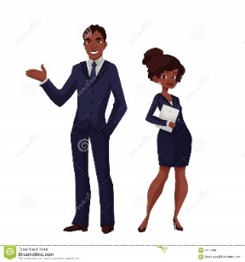
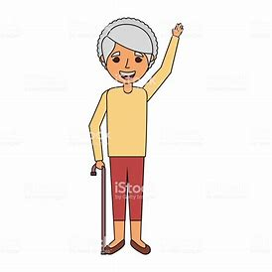
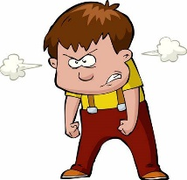
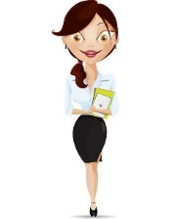


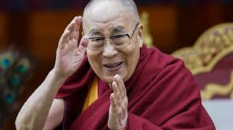
Personal Messages From Your Local PCSO
PCSO Steve davenport said. "Please don’t talk to strangers Online!”
PCSO Karen Nixon: Said…
“When outside for your exercise Always use the Green Cross Code.”
PCSO Mandy Simpson, quoted the Dalai Lama, who said ….
When ever possible be Kind, It is always possible!
PCSO Dylan Thomas Said…
“Always wear a helmet when on your bike”

Slide 4
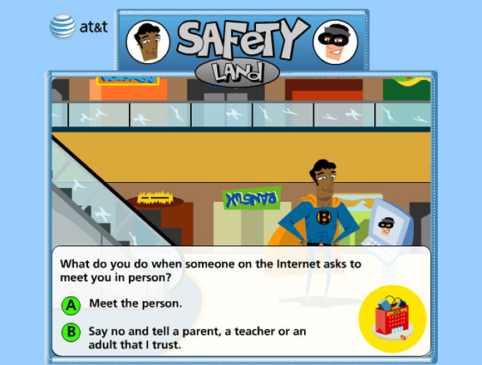
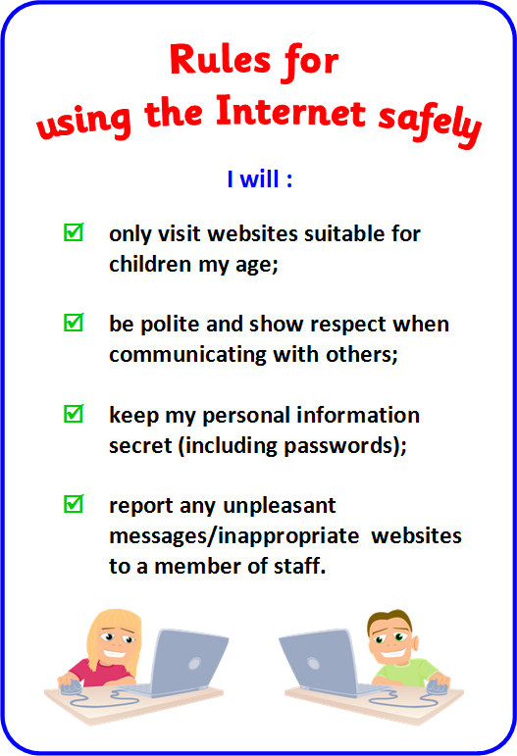

INTERNET SAFETY

Slide 5
INTERNET SAFETY
Be Internet Awesome
SMART: SHARE WITH CARE
ALERT: DON’T FALL FOR FAKE
STRONG: SECURE YOUR PASSWORD
KIND: IT’S COOL TO BE KIND
BRAVE: WHEN IN DOUBT, TALK IT OUT

Slide 6
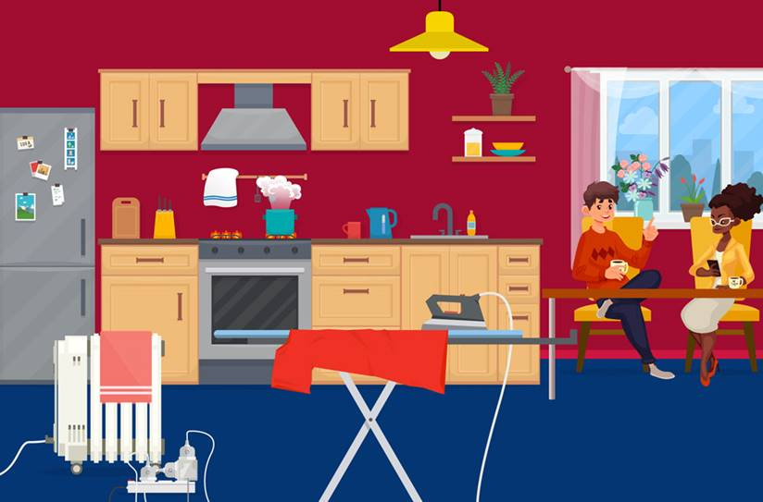
Activity
Have a look at this picture and see how many hazards you can find?

Slide 7
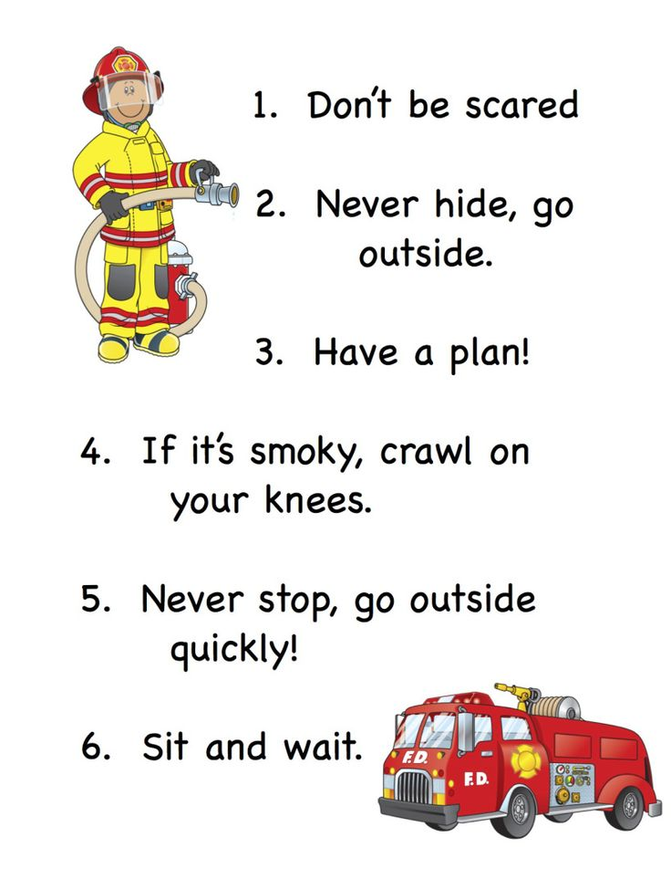
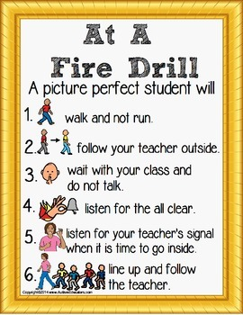
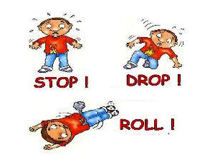
FIRE SAFETY

Slide 8
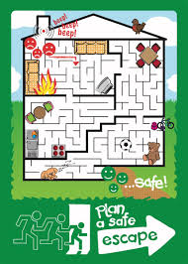
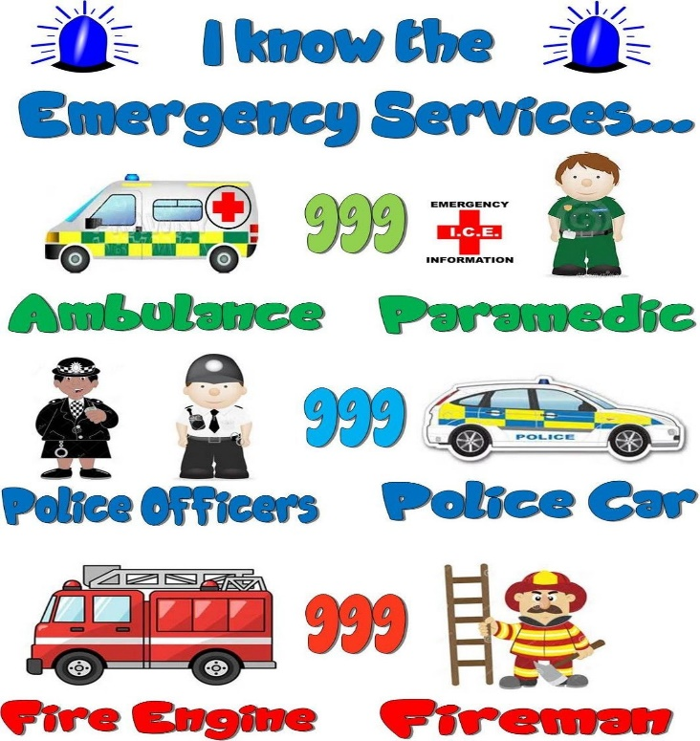
Safety at home is very important
In the event of a fire in your home, it is important to plan a safe escape to make sure you get out as quick as you can.
Use the activity as a guidance but you can make your own plan with your parent(s) of your own home.
Activity

Slide 9
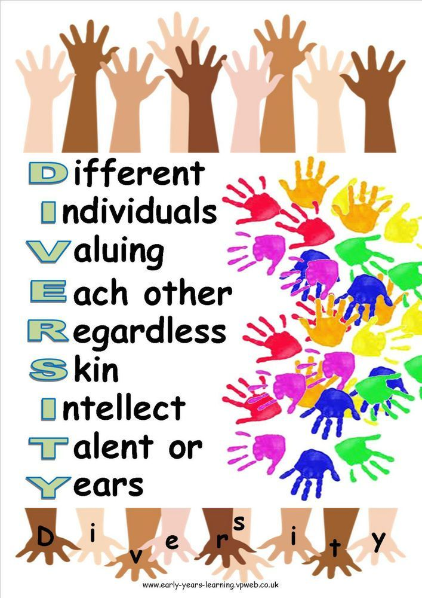
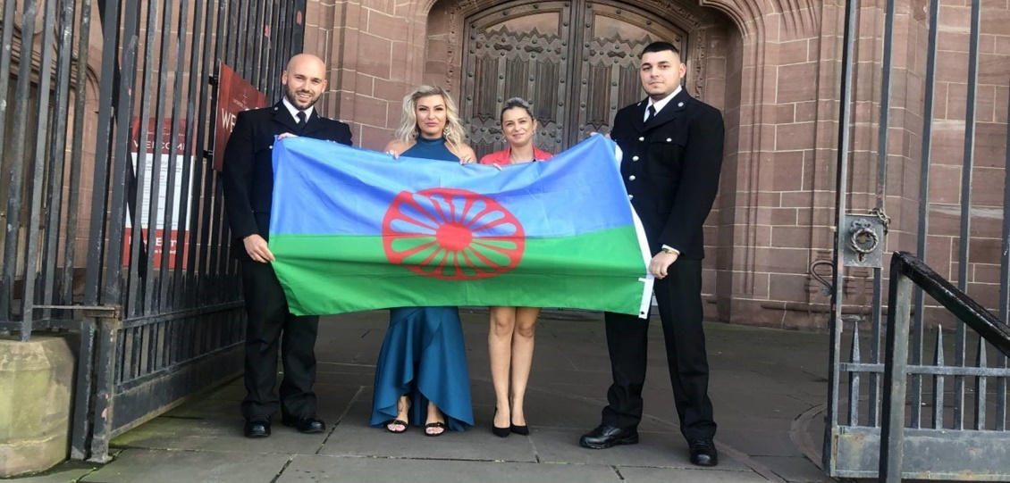
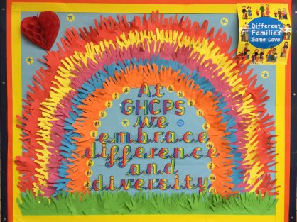
Great Britain is a Wonderfully Diverse Country
DIVERSITY
This month is Gypsy Roma Traveller History Month.
See what you can find out about this community and where they might have come from around the world.
Here we can see Grappenhall Heys Primary School
Embracing Difference & Diversity

Slide 10
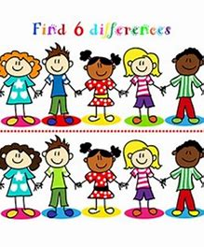
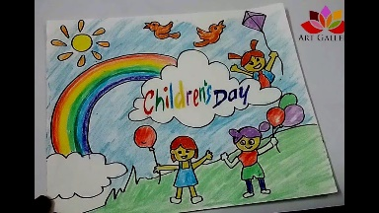


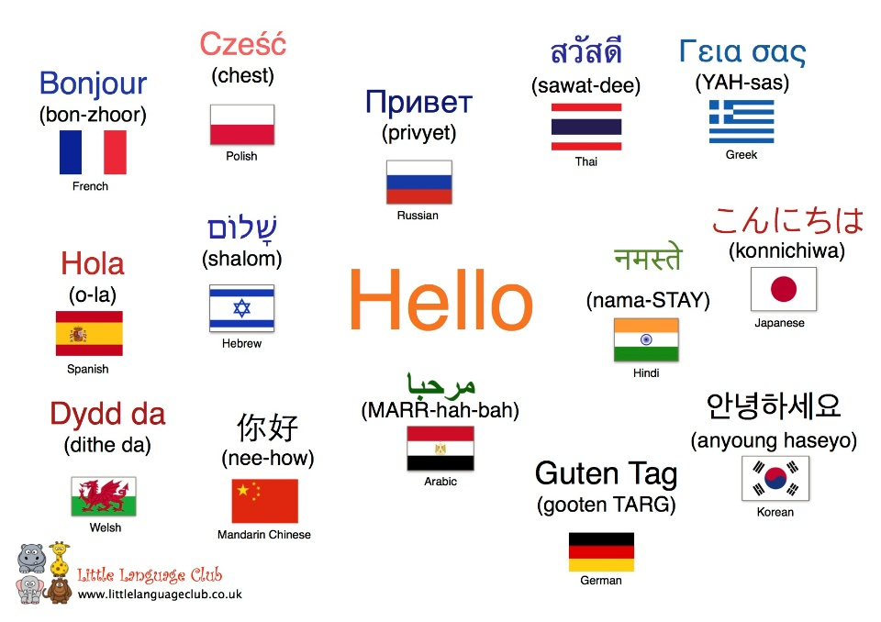
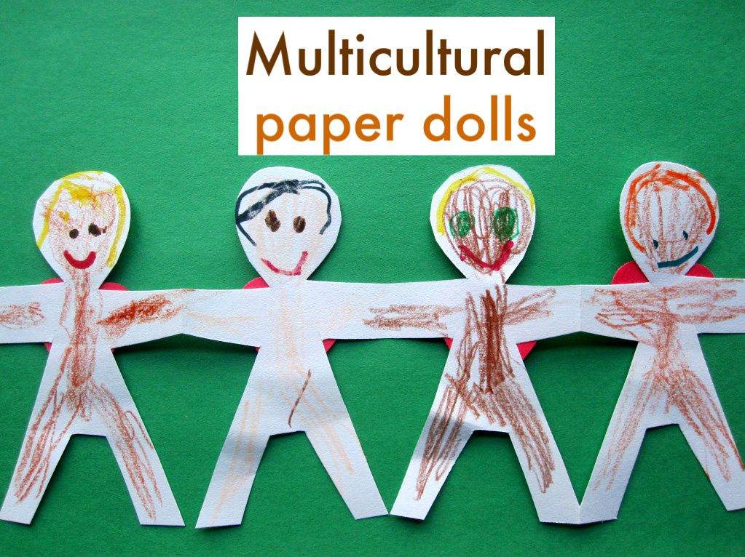
DIVERSITY ACTIVITY
Could you create your own diversity poster for your home or school.
'Hello' In Many Languages
How many languages can you say hello in? If you think of the many different languages that children within your school can speak, see if you can learn to say hello in all of them! Here are a few to have a go at.
How to Make a Multicultural Paper People Chain - Draw and cut a large circle in the middle of the paper.
  Fold the circle in half four times.
  Draw either a single or multi-figure person in the middle of the triangle.
  Cut out the person.
  Unfold the paper.

Slide 11







If it is your Birthday this week
Happy Birthday
Happy Birthday to you, Happy Birthday to you, Happy Birthday Special person Happy Birthday toooo yoooou

Slide 12

Until next Time 30th June 2020
Keep washing your hands and carry on with your exercise.
Stay healthy, by doing a bit of exercise every day.
Keep positive, by reminding yourself, You are an Amazing Child.
Do Your Bit for Great Britain and the NHS
Childline | Childline
https://www.childline.org.uk
Get help and advice about a wide range of issues, call us on 0800 1111, talk to a counsellor online, send Childline an email or post on the message boards
NSPCC Helpline
0808 800 5000

