Slide 1


Whilst You Are At Home
We are going to stay in touch
Edition 11
16th June 2020

Slide 2

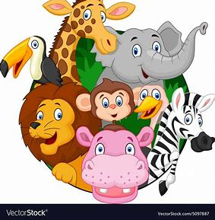

This week in and around Cheshire
Hello Everybody
Another busy week for lots of us, we hope you have all had a great week.
You may have heard that your six weeks Summer holiday is going to be even longer this year!
It also looks like a lot of the shops will be starting to open up again and we may even be able to visit the Zoo and wildlife parks.
As you are aware there are still issues of unrest regarding racial tensions. If this is worrying you, please speak to people you trust.
Slowly, the world is getting back up on its feet, however we must carry on, washing our hands regularly and keeping our distance from each other.

Slide 3

It is Great to be YOU, it is Great to be DIFFERENT and something to be proud of!

Slide 4
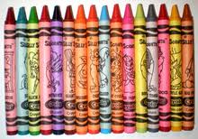
Your Poets Corner +
Wouldn’t it be terrible
Wouldn’t it be sad?
If just one single colour
was all the colour we had?
If everything was purple?
Or red? Or blue? Or green?
If yellow, pink, or orange
was all that could be seen?
Can you just imagine
How dull the world would be
If just one single colour
Was all we got to see?
Activity
Maybe you could make up your own poem, about how great it is to be uniquely different, to be you, the only you in the world and at the same time the same as everyone else.
This poem could be really goofy or be wise, thoughtful and full of feelings.
Poets we recommend
Benjamin Zephaniah
Michael Rosen
Roald Dahl
Maya Angelou
Shel Silverstein

Slide 5
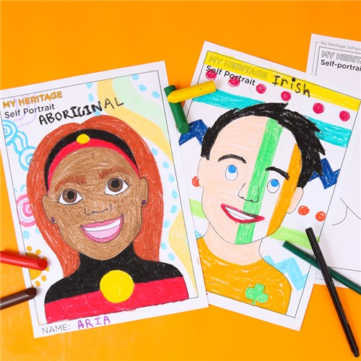

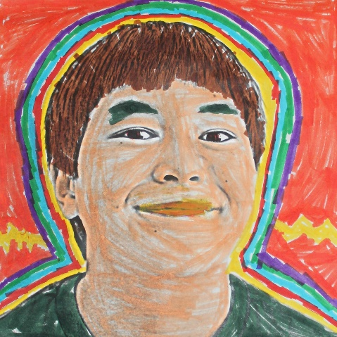
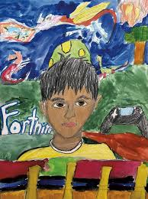
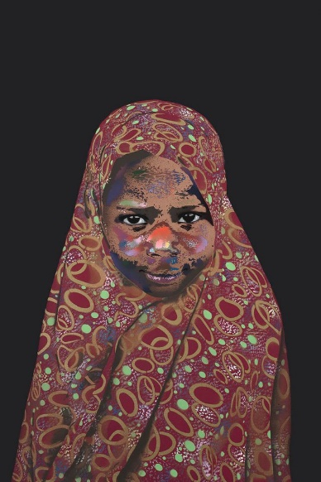
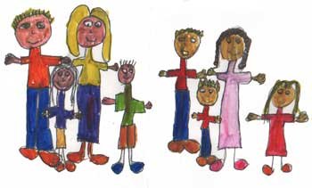
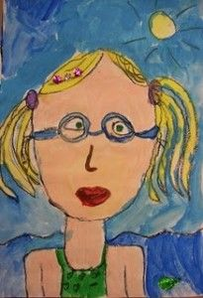
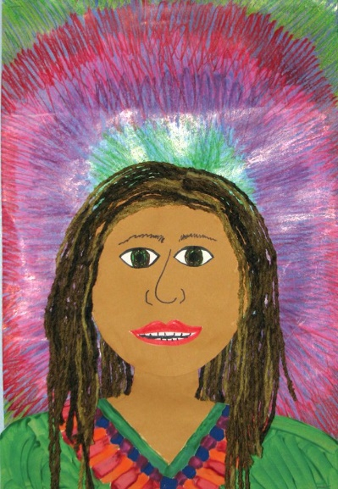
Activity
Why don’t you have a go at drawing a picture of yourself and another, showing the differences between you but also how much alike you are.

Slide 6

OTHER ACTIVITIES
Here are a few other activities you could do to learn about how other people live, speak and look like:
Read books about other countries and their special cultures
Listen to a recording of a person speaking another language
Learn how to say hello and goodbye in a different language.
Talk about animals that live in each country
Listen to music from other countries
Spelling the country names with food – you can cook, or use other items to spell names for fun!
Print out a world map or use a globe to see where the Countries are located. You could even talk about how many hours it would take to fly to that country.
Bake or cook a special recipe from other countries

Slide 7

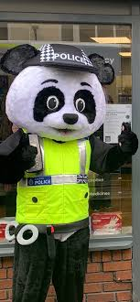




PC Panda, says
PCSO’s Well wishes
PCSO Karen Nixon says
Please remember all the Road Safety information that we have given you, over the pass few weeks.
PCSO Sarah Brown would love t0 see all your amazing work that you are doing at home!
PCSO Eleanor Estcourt
Would like you to use all the tips and advice about
Safety On-Line.
Remember

Slide 8

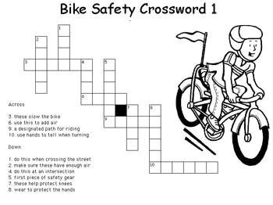
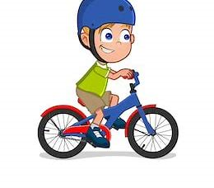

Bike Safety crossword
What happened to the frog that broke down ??
He got 'toad' away...!!!
Why didn't the banana cross the road ??
Because he wasn't peeling well !!
What did the traffic light say to the car ??
Don't look while I'm changing !!!!!
Across
3. These slow the bike
Use this to add air
A designated path to riding
Use hands to tell when turning
Down
Do this when crossing the street
Make sure these have enough air
Do this at a crossing
First piece of safety gear
These help protect knees
Wear to protect the hands

Slide 9
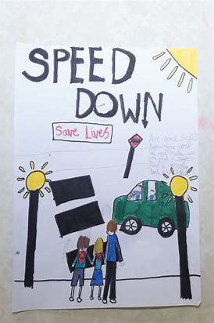
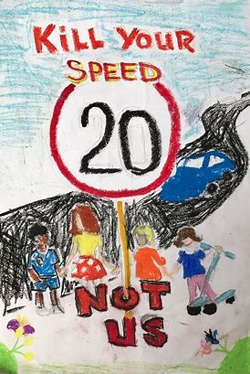

POSTER TIME
So we would still like you to get creative and design your very own Road Safety poster.
We are really sorry to inform you that You cannot display your posters on the Wheelie bins. (For legal reasons).
However, they can go in your windows. And if you are at school, you can still ask your teacher to display them on the school gates.
These pictures will put smiles on everyone’s faces and hopefully your local PCSO might see them and take a picture, we can then share them with everyone on these news letters.

Slide 10







If it is your Birthday this week
Happy Birthday
Happy Birthday to you, Happy Birthday to you, Happy Birthday Special person Happy Birthday toooo yoooou

Slide 11

Until next Time 23rd June 2020
Keep washing your hands and carry on with your exercise.
Stay healthy, by doing a bit of exercise every day.
Keep positive, by reminding yourself, You are an Amazing Child.
Do Your Bit for Great Britain and the NHS
Childline | Childline
https://www.childline.org.uk
Get help and advice about a wide range of issues, call us on 0800 1111, talk to a counsellor online, send Childline an email or post on the message boards
NSPCC Helpline
0808 800 5000

