Slide 1


Year 3 and 4
Information Evening 2026
Saughall All Saints CE Primary School
We all love, learn and grow together.
Mark 12:31 'Love your neighbour as yourself.'
Becoming a more independent learner.

Slide 2
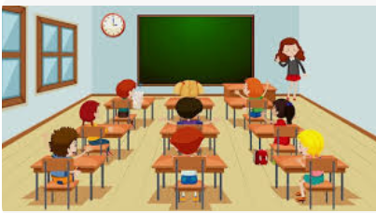
Class organisation…
Three Y3 and 4 classes – Mr Fuller’s class, Mr Dixon’s class & Mrs Hooper/Miss Humphreys class.
Children are taught as a class for all subjects by their class teacher.
Maths – children set in year or ability groups.
Our teaching support - Mrs Evans, Mrs Hand, Mrs Beaumont & Miss Bunn
Mrs Fabby supports PPA cover/management time.

Slide 3

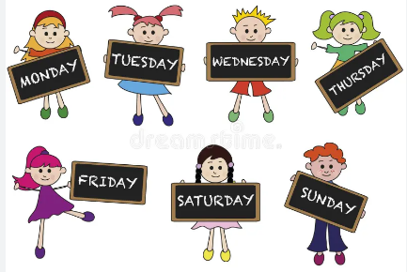

A typical school week…
Core subjects (Literacy and Maths) - taught every morning.
Foundation subjects (Topic, Science, French, PSHE, PE, RE, Computing)
- taught each afternoon.
Guided Reading – Friday mornings.
2 x PE sessions each week. This term - Badminton on Mondays & Tag Rugby on a Friday.
Laps run around the field/playground throughout the day.
Spelling and handwriting skills taught each morning.
Collective worship each morning.
Celebration assembly each Friday.

Slide 4


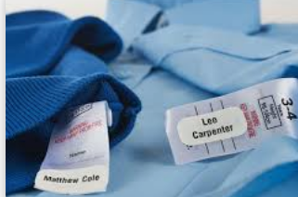

Expectations in Year 3 and 4…
To develop independence.
Water bottles in everyday - refilled at lunchtime/playtime.
Toilet visits ideally during breaktime and lunchtime.
Full PE kit to be worn on PE days (Monday and Fridays) – trainers, white shorts, navy t-shirt, socks, warm clothes for Winter (outdoor PE.), bobble for long hair & earrings out on PE days (or cover with tape in school).
Healthy snacks for break time (no nuts) or order toast via the office (no free fruit anymore in the Juniors).
All clothes to be labelled with names, including PE kits.
Reading records in school/go home daily.

Slide 5
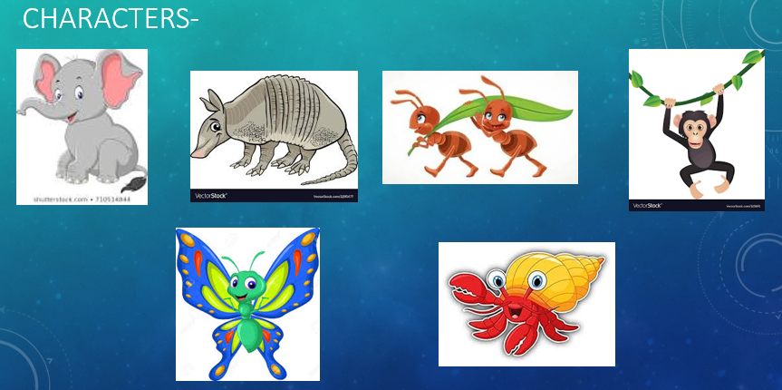




Our school learning powers…

Slide 6


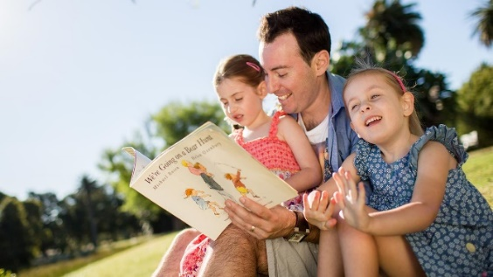
Reading…
~ Guided Reading takes place together as a class every Friday morning. We use high quality chapter books and texts. Teachers will read aloud so the children can focus on enjoying the text and think about given questions.
~ We expect children to fill in their reading records at least 4 times a week – these can be a mixture of entries by themselves and parents.
~ Any reading can go into reading records – eg. books you read to them (from home, school or library), audio books, magazines, information about topics of interest looked up online, song lyrics they’re interested in, poems, recipe books etc!
~ Reading book colours are continuously reviewed: the aim is for Year 3 children to reach ‘dark blue’ by the end of the year and for Year 4 children to be a free reader as they head into Upper KS2.
~ Children encouraged to change their reading books each morning upon entry into class (if need be).
~ Reading rewards to celebrate reading recorded in records.
~ We encourage children to discuss book recommendations with one another.

Slide 7


Literacy text this term…
Blurb: A boy and his grandfather watch as a baby seal is born on the rocks near their home and from that day a special friendship is created between them. Despite his disability, the boy is a keen surfer, and he enjoys many afternoons surfing with the seals. One day, however, he gets into trouble in rough seas, and the young seal saves him. Their friendship brings happiness and meaning at the important stages of the boy's life.
We will write descriptions, diary entries and our final piece will be a letter.

Slide 8


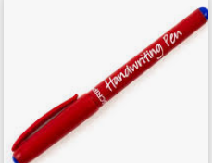
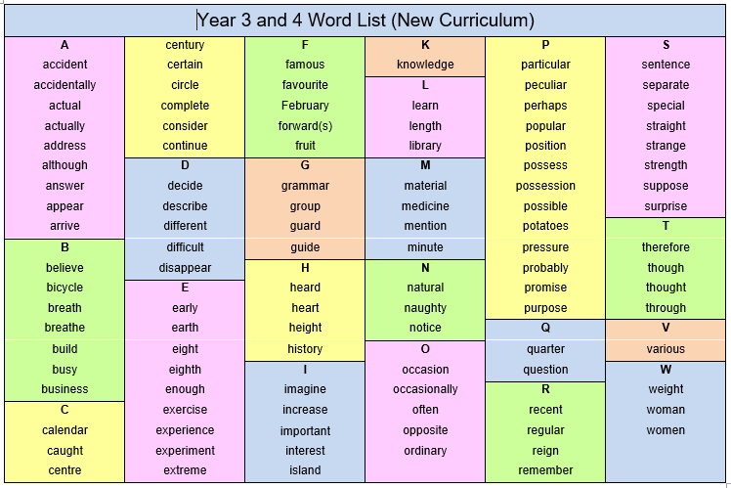
Handwriting & Spelling…
Handwriting – children are expected to develop a cursive style that is consistently joined, throughout books.
Children can move onto black pen once they have achieved this.
We have a subscription to the Letter-join scheme where children can log-on to practice their letter formation online at home.
(We will send a log on home this week)
Spelling – children are expected to learn and spell the common exception words on the Year 3/4 National spelling list with increasing accuracy. We practise other spelling rules through our Pathways Literacy programme too.
We also teach a specific HSPAG lesson every Monday.
We will test children on their spellings every Monday.
We have high standards of presentation and encourage all to take pride in their work.

Slide 9
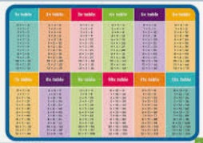


Maths
~ We follow the White Rose scheme for Maths lessons.
~ We also complete daily times tables practice following a new scheme called Number Sense – with a focus on quick retrieval.
~ Help children at home learn their times tables by using TTRS (Times Table Rock Stars) – all have their own log-in.
End of year expectation for Year 3 (x , ÷, out of order)
3s, 4s, 8s - in addition to recalling the 2s, 5s and 10s from Year 2.
End of year expectation for Year 4 (x , ÷, out of order)
6s, 7s, 9s - all facts up to 12 x 12.
~ Formal national testing of times tables takes place for all Year 4 pupils towards the end of the year in the Summer term.

Slide 10


Homework…
Given out on Tuesdays.
Maths –Times tables – 15/20 minute weekly sessions on TTRS set by their maths teacher.
Spellings – learning a list of words & spelling menu for ideas.
Reading – a minimum of 4 times each week. Reading records to be signed by parents.
*Reading records handed in the following week.
Learning Logs sent home each term – research tasks linked to Topics.
(Any PPTs send to school admin via email – these are then passed onto class teachers)
*We do provide a weekly homework club on a Thursday.

Slide 11



Extra info…
Small pencil cases and bags only please.
Coats in wet/cold weather (with names in).
Toys etc should be kept at home.
Any questions/information to share each day – please feel free to speak to us briefly at the classroom door in the morning/end of the day.
Check our Y3/4 page on the school website for all key info, topics, tasks, spellings, homeworks, QR code links for games to support learning etc.
Events coming up…
Friday 25th September – all Y3/4 children will sing for parents at the Macmillan coffee morning.
All Y3/4 will be involved in a carol service at Christmas.
Chester Zoo Trip – Tuesday 15th December
Panto – Wednesday 16th December
PGL – Wednesday 28th April – Friday 30th April

Slide 12

Thankyou for attending.

