Slide 1


Year 5 / 6
Information Evening
Becoming a more independent learner.

Slide 2
Welcome to our team
Yr 5/6 Teachers: Mrs Hughes, Mr Dewdney & Mrs Ashdown
Mrs Cook joins us for year 6 Maths.
Teaching Assistant: Mrs Williams.
Mrs Mitchell & Mrs Fabby support year 6 literacy, PPA and management time.

Slide 3
Typical Day in Year 5/6
Assembly every morning.
Spelling session
Maths
Break time
Literacy (SPaG, Writing, Reading)
Lunch
Foundation subjects: PE, Computing, Topic etc.

Slide 4

Reading
This term, we are reading Wonder, the inspiring story of August Pullman, a boy who wants nothing more than to be treated like everybody else.
Through this text, pupils will explore:
💙 Kindness and empathy
💙 Friendship and belonging
💙 Resilience and courage
💙 Understanding different perspectives

Slide 5

What can you do to at home?
🌟 Just 10-15 minutes of reading, 3 times a week, can have a huge impact on your child's confidence, vocabulary and learning.
🏠 Easy Ways to Support Reading at Home:
🎤 Be an audience
Listen to your child read aloud and celebrate their progress.
📚 Share the story
Take turns reading a page or chapter together.
💬 Talk about the book
Discuss favourite characters, exciting moments and surprising events.
🔍 Explore new words
Spot interesting vocabulary and work out meanings together.
📰 Read anything, anywhere!
Books, comics, magazines, recipes, websites, instructions, audio books and newspapers all count!
Reading Rocket

Slide 6
Literacy:
✍️ English This Term This term, our writing lessons are inspired by two engaging texts: ⭐ Star of Fear, Star of Hope – a moving story about 2 friends whose lives change forever during WWII. 🚀 The Darkest Dark a true story about Chris Hadfield’s dream of becoming an astronaut. Through these books, children will explore themes of courage, hope, resilience and determination while developing their skills as writers. 📖 Writing Children will immerse themselves in both texts, exploring characters, settings and key themes before creating their own pieces of writing. They will learn how to plan, draft, edit and improve their work, using ambitious vocabulary and a range of writing techniques to engage their readers. ✍️ Spelling, Handwriting, Grammar & Punctuation Alongside their writing lessons, children take part in regular spelling, handwriting and SPaG sessions. Skills are practised both in discrete lessons and applied across all areas of writing to help children become confident and effective communicators. 🌟 Supporting Every Child To ensure all pupils receive teaching that is closely matched to their age-related expectations, the Year 5 and Year 6 classes have been reorganised into two Year 5 classes and two Year 6 classes. This allows teachers to provide more targeted support and challenge, helping every child make the best possible progress throughout the year.

Slide 7
🔢 Mathematics Children are taught in ability-based groups within their year group to ensure teaching is closely matched to their needs. Year 6 pupils are taught by Mrs Ashdown and Mrs Cook, while Year 5 pupils are taught by Mr Dewdney and Mrs Hughes. All groups follow the same curriculum units throughout the year. However, lessons are carefully adapted to provide the right level of support and challenge, enabling every child to make progress while also extending those working at Greater Depth. Our experienced Teaching Support Staff provide targeted 'gap teaching' throughout the week. These additional sessions help reinforce key skills, address misconceptions and ensure children remain confident and on track with their learning. As part of their preparation for secondary school, Year 6 pupils will also become increasingly familiar with SATs-style questions, helping them develop reasoning, fluency and problem-solving skills in a supportive environment.

Slide 8
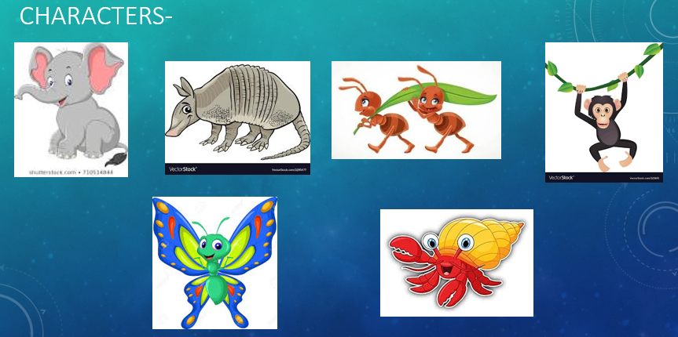




Our school learning powers:
This term

Slide 9
Expectations in Year 5/6
Water bottles are to be in school everyday.
Year 6 children have been given their new roles within school.
Children need to demonstrate greater independence.
Homework and reading records are to be brought into school everyday – to keep in their bags.
Healthy snacks. (no nuts please)

Slide 10
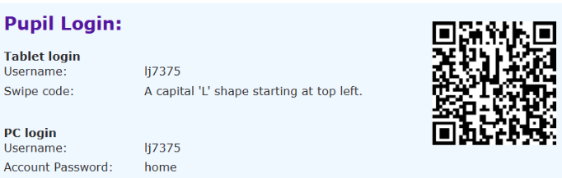
Homework:
Homework, as stated in the overview, will be sent home on a Wednesday/Thursday and is due in the following Tuesday. This will be a maths task, literacy task (grammar/punctuation or reading comprehension in their exercise books) or something relating to one of the foundation subjects.
Letterjoin -
For year 6, most of their homework is tailored to link with SATs.
Spelling homework will be given as well as the spellings to learn for their test on a Monday.
Timestable Rockstars is available for the children to continue using it.
And of course the reading!
If there is any reason as to why your child is unable to hand in their homework, please send in a brief note to let us know.

Slide 11
Additional information
MacMillan coffee morning will be held on the 25th September. Cake donations are very welcome and it would be lovely to see as many of you as possible.
Non-uniform days will be held in November to support the Christmas Fayre.
Year 5/6 Christmas service in December dates to be confirmed.
Panto Day – 16th December at the Ellesmere Port Civic Hall.
End of term - Friday 18th December.
SATs 10th – 14th May – information evening closer to the time.

