Slide 1


Year 5 / 6
Information Evening
Becoming a more independent learner.

Slide 2
Welcome to our team
Yr 5/6 Teachers: Miss Humphreys, Mr Dewdney & Mrs Ashdown
Mrs Cook joins us for Maths and anything else she can join in with!
Teaching Assistants: Mrs Beaumont, Mrs Williams & Mrs Hand
Mrs Mitchell & Mrs Fabby support PPA and management time

Slide 3
Typical Day in Year 5/6
Assembly every morning.
Spelling session
Maths
Break time
Literacy (SPaG, Writing, Reading)
Lunch
Foundation subjects: PE, Computing etc.

Slide 4

Reading For Pleasure
It’s been proven time and time again that children who read for pleasure regularly (ideally every day) are more likely to be successful and happy throughout their lives.
It is also one of the main contributing factors which will determine academic success.
As a result, reading is still our school’s top priority.
At home, children should read four times a week, including once with an adult. Reading Records are checked weekly, and we’ll be in touch if regular reading isn’t happening. All age-appropriate books are welcome, and library books are provided.

Slide 5


Reading:
Guided Reading Overview:
Each week, children enjoy high-quality chapter books read aloud by their teacher. This allows them to focus on the story and explore a key question linked to the text. The book is revisited throughout the week to encourage reading for pleasure.
Our Approach:
Reading for enjoyment is our main goal.
Teachers model key reading strategies, such as re-reading for understanding and using context to decode unfamiliar words—even making mistakes, which helps build children's confidence.
Sessions include rich discussion and opportunities for children to write about their thoughts.
Once a term, children take part in drama activities to act out extracts, boosting engagement and empathy.

Slide 6
Literacy:
Literacy in Years 5 & 6
Children develop key skills in writing, spelling, handwriting, punctuation, and grammar through daily literacy lessons.
Writing: Pupils explore a range of genres and learn to plan, draft, and edit their work with a focus on vocabulary, structure, and style.
Spelling: Weekly lessons cover spelling rules, patterns, and strategies for remembering tricky words.
Handwriting: Children work on fluency and neat presentation across all subjects.
Punctuation & Grammar: Taught both in isolation and through writing tasks, covering sentence structure, verb tenses, clauses, and accurate punctuation.
These lessons prepare children for the demands of Year 6 and beyond, helping them become confident and capable communicators.

Slide 7
Maths:
Maths classes are set within each year group. Year 6 are taught between Mrs Ashdown & Mrs Cook and Year 5 are split between Mr Dewdney & Miss Humphreys.
Each group will be taught the same units but at different speeds and at different levels; taking into account specific individual needs and abilities as well as how to further develop some children at Greater Depth level.
We are fortunate to have our Teaching Support Staff who do ‘gap’ teaching throughout the week to make sure that the children stay on track.
A real focus is on timestables – they will be set TTRS from their teacher. Some of Mrs Cook’s class have chosen to learn 13, 14 & 15.
For the Year 6 children, they will also become familiar with SATs-style questions.

Slide 8
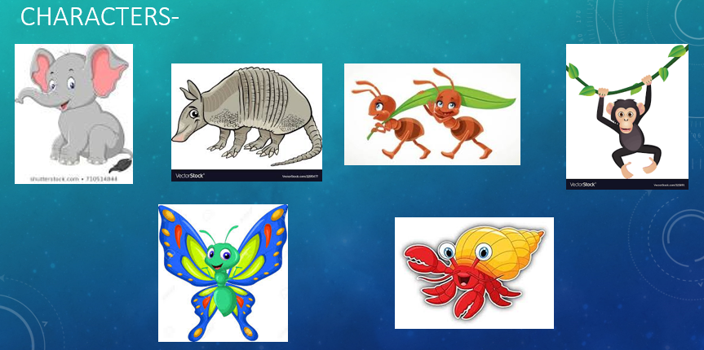




Our school learning powers:

Slide 9
Expectations in Year 5/6
A full PE kit needs to be brought in on Monday and we will send it home to be washed on a Friday. (black shorts/ leggings instead of white is fine)
Water bottles are to be in school everyday.
Year 6 children have been given their new roles within school.
Children need to demonstrate greater independence.
Homework and reading records are to be brought into school everyday – to keep in their bags.
Healthy snacks. (no nuts please)

Slide 10
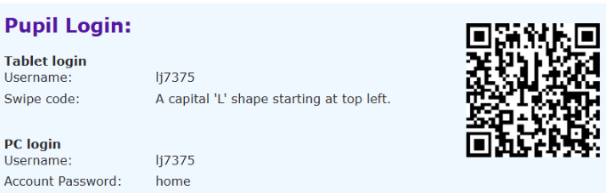
Homework:
Homework, as stated in the overview, will be sent home on a Wednesday/Thursday and is due in the following Tuesday. This will be a maths task, literacy task (grammar/punctuation or reading comprehension in their exercise books) or something relating to one of the foundation subjects.
Letterjoin -
For year 6, most of their homework is tailored to link with SATs.
Spelling homework will be given as well as the spellings to learn for their test on a Monday.
Timestable Rockstars is set by their math’s teacher and there is an expectation to practise their tables for at least 30 minutes per week.
And of course the reading – this will be from our reading menu!
If there is any reason as to why your child is unable to hand in their homework, please send in a brief note to let us know.

Slide 11
Additional information
Any photos that we take will be uploaded onto X, on our website and displayed in our group area window.
MacMillan coffee morning will be held on the 26th September. Cake donations are very welcome and it would be lovely to see as many of you as possible.
Non-uniform days will be held in November to support the Christmas Fayre.
Year 5/6 Christmas Production in Church 16th December.
Panto Day – 17th December at the Storyhouse.
Year 5&6 dress up day 60’s, 70’s, 80’s, 90’s on 25th November.
End of term - Friday 19th December.

