Slide 1

the business of life
Fiver Challenge 2017
Assembly
Notes:
Introduction time allowance: 5 Minutes
Slide 1-3

Slide 2

Young Enterprise
3,500
UK’s largest enterprise education charity
Over 50 Years’ experience
250,000 young people each year
5,000 volunteers from over 3,500 companies
Learning by Doing
YE Mission
To empower young people to discover, develop and celebrate their skills and potential
www.y-e.org.uk
UK BUSINESS
ENGAGED
Notes:
UK’s largest business-education charity –. Run a range of enterprise and entrepreneurship programmes for young people aged 4 – 25.
YE was created in the UK in 1963 - Merchant banker Sir Walter Salomon founded Young Enterprise It was based on the American Junior Achievement programme.
Over 250,000 young people each year - Every year we inspire and help 250,000 young people in over 5,000 schools, colleges, universities and local communities learn about business and the world of work in the classroom under the guidance of 5,000+ volunteers from 3,500 companies.
Our method is Learning by Doing.
YE’s mission statement is "To empower young people to discover, develop and celebrate their skills and potential”

Slide 3

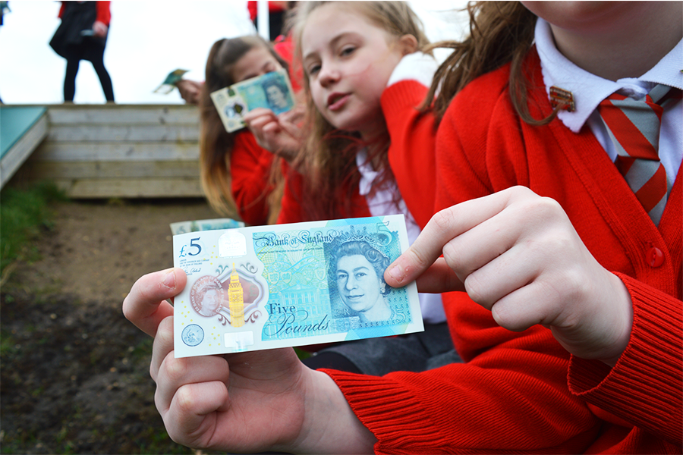
Introducing Fiver Challenge 2017
Notes:
An Entrepreneur is someone who starts a new business and usually risks their own money to get it started
Today we are introducing The Fiver Challenge – What can you do with £5?

Slide 4
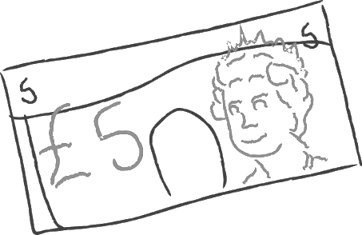
FIVER CHALLENGE 2017
You will be working in your groups or as individuals
Every pupil/group will be pledged £5 to start your own business
You are challenged to make a profit
You can enter weekly competitions and a National competition at the end of the Challenge
The Challenge starts 5th June and ends on 30th June
All pupils taking part will receive a Fiver Certificate at the end of the Challenge.
Notes:
The Fiver Challenge will take place throughout from 5th – 30th June You will be pledged £5 to start a business – from the Fiver Bank (YE).
You must PAY BACK this £5 + 50p legacy donation at the end of the month – sustains the Fiver Bank so more young people can take part next year. Only asked to give donation if business has made a profit
Community engagement – can you reach out to your local community? Ask them to help you with your business idea? Approach them to help you advertise? Invite them to your summer fete? Do something to help your local community?
Weekly competitions – logo design, sales pitch, advert and trade stand. Teachers will upload on teams behalf
National competition – to enter complete logbook, overview of the 4 weeks and give to your teacher
For inspiration please visit the website
More details on website – www.fiverchallenge.org.uk

Slide 5
What will your business be?
Product - home made or grown? personalised?
Food or drink?
Linked to a topic, theme, school event or local opportunity e.g. fair-trade, community
Providing a service or organising an event
Car washing
Disco or cinema night
Notes:
Developing your business idea
Examples to consider

Slide 6
THE FIVER COMPETITIONS
Weekly Competitions:
9th June Logo Design
16th June Sales Pitch (1 minute video or voice)
23rd June Advertisement (poster, TV, radio, leaflet)
30th June Pop Up Shop (photo)
Your teacher will upload your entries onto Fiver website.
If you complete your Fiver workbook you might be able to enter the Fiver National Competition – the Awards Ceremony takes place in London in September 2017,
Notes:
A maximum of 5 entries per school can be entered for the weekly competitions, once entries have been selected your teacher will upload your entry onto the website and enter for you. Winners announced weekly on Thursday in Fiver newsletter ‘Take Five’
A maximum of 3 entries per school can be selected for the National Competition – closing date is Friday 7th July. Winners will be contacted on Friday 14th July. Award ceremony takes place in September 2017

Slide 7
Wishing you every success with the
Fiver Challenge
And lots of fun too!
Notes:
Teachers - Keep in touch and share your news and photos we love to hear from you fiverchallenge@y-e.org.uk or via Twitter @TennerFiverye

Slide 8
