Slide 1

Collective Worship
Tuesday 5th May 2026

Slide 2


Friendship

Slide 3

Welcome Words
We have gathered in the name of God the Father, Son and Holy Spirit, to worship together and think about our value friendship.

Slide 4
Encouraging one another

Slide 5
“Encourage one another and build each other up.”
1 Thessalonians 5.11

Slide 6
The words of wisdom from the Bible for our school value friendship were written over 2000 years ago by St Paul.
“Encourage one another and build each other up.”
1 Thessalonians 5.11
St Paul wanted to teach people that the best way to live in friendship is to encourage one another rather than being critical and negative.

Slide 7
Reflecting
How do you think Danny felt when people were saying positive comments?
How did the negative comments make him feel?
A GOOD friend always builds up the friendship and makes it stronger.

Slide 8
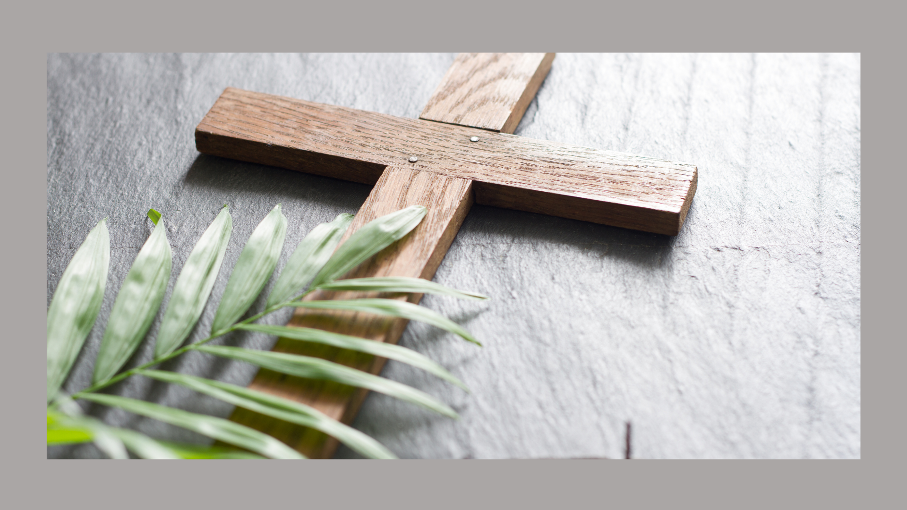
Prayer
Lord Jesus, thank you for the gift of our friends. At every opportunity, help us to encourage one another and build each other up.
Make us aware when our friends are sad or feel they have failed. Help us to encourage one another and build each other up.
When we are tempted to be negative or criticise our friends, instead, help us to encourage one another and build each other up.
Amen

Slide 9
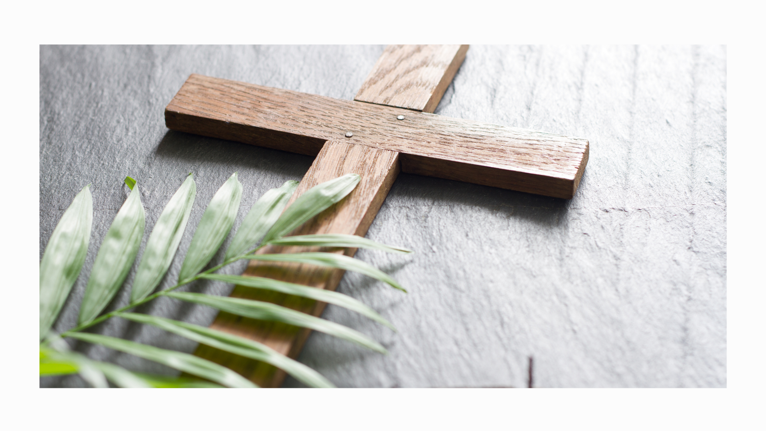
Song- Tilston Song

