Slide 1
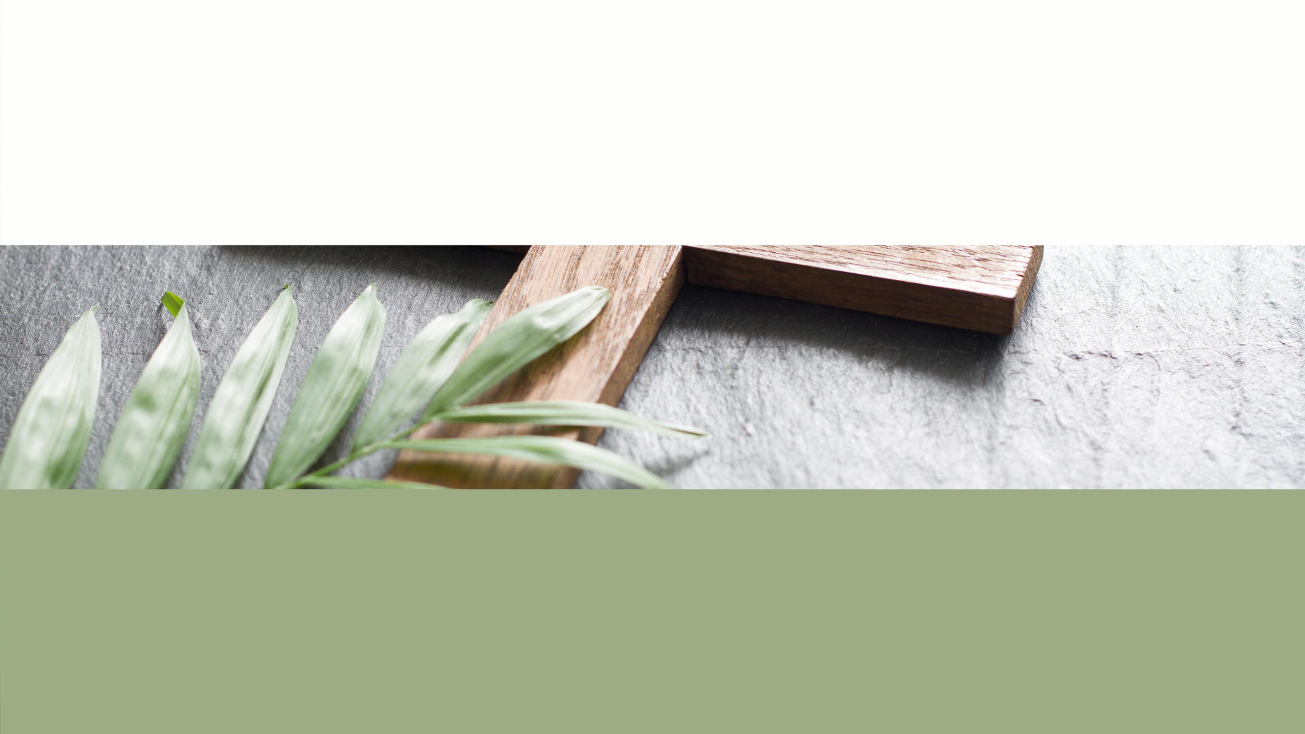
Collective Worship
Tuesday 28th April 2026

Slide 2

Friendship

Slide 3

Welcome Words
We have gathered in the name of God the Father, Son and Holy Spirit, to worship together and think about our value friendship.

Slide 4
Sticking Together

Slide 5
In the Bible there is a book of wise sayings called The Book of Proverbs. One saying is:
“There is a friend who sticks closer than a brother.”

Slide 6
Friendship is…
Finding things to do together
Relying on each other
Impossible on your own
Enjoying being together
Never selfish
Depending on someone else
Sharing hopes and dreams
Happiness and laughter
Including others
Precious

Slide 7
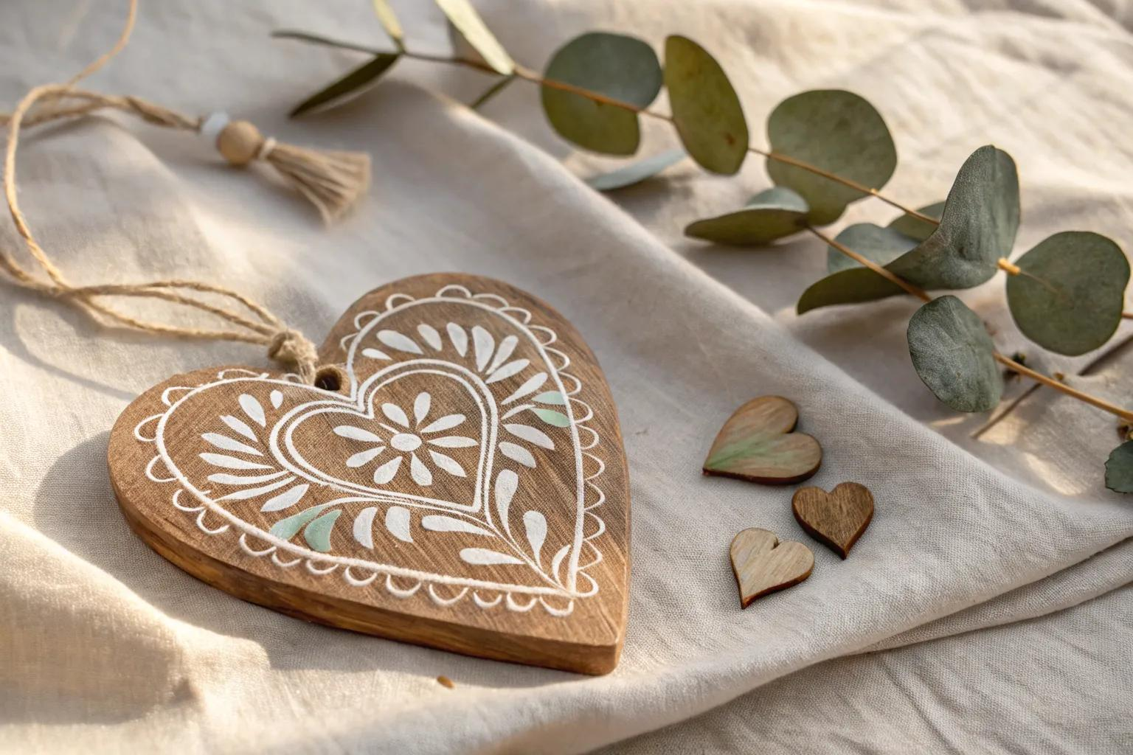
Friendship Hearts
Notes:
Look at the friendship bracelet. The three pieces have been plaited together and this makes the bracelet stronger. Plaiting the strands together needs time and effort, just like building a good friendship.
Spend a few moments thinking about one of your friends. What are the things that make your friendship stronger?

Slide 8
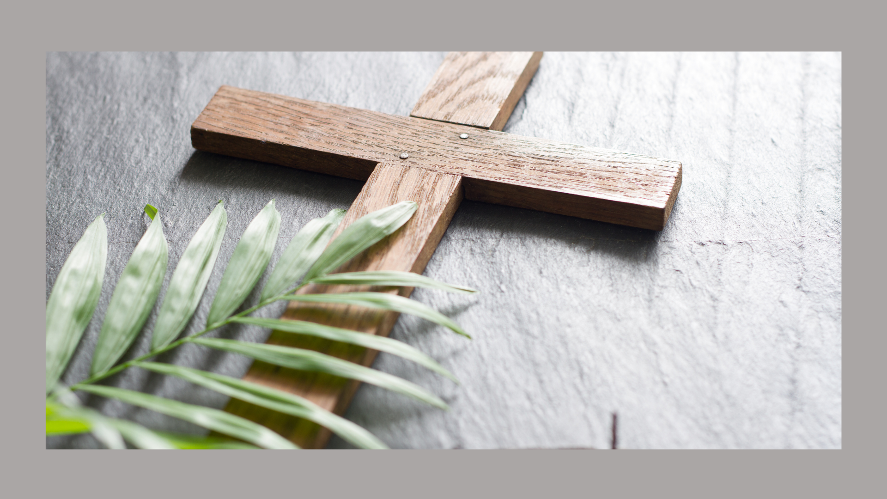
1 Thessalonians 5.11
Encourage one another and build each other up.

Slide 9
Prayer
Dear Lord Jesus,
You have shown us through the Bible that you want to be woven into our lives as our friend.
Thank you that we can talk to you at any time.
Amen.

Slide 10
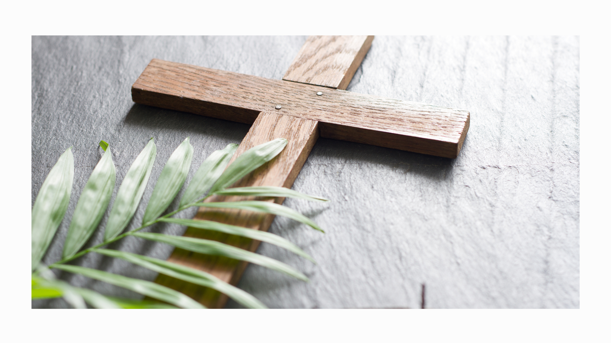
Song- We’re Better Together

