Slide 1

Collective Worship
Monday 20th April 2026

Slide 2

Friendship

Slide 3

Welcome Words
We have gathered in the name of God the Father, Son and Holy Spirit, to worship together and think about our value friendship.

Slide 4
Ingredients To Make a Good Friend

Slide 5

A Jar of Kindness

Slide 6
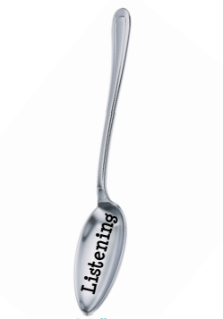
A spoon full of listening

Slide 7
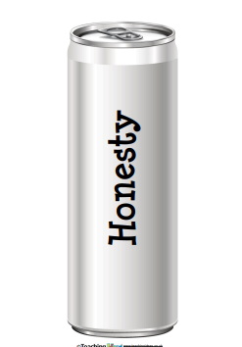
A can of honesty

Slide 8
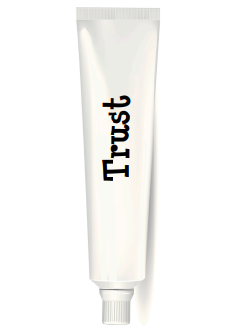
A tube of trust

Slide 9

A carton of patience

Slide 10

1kg of forgiveness

Slide 11

A box full of encouragement

Slide 12

A pot of respect

Slide 13
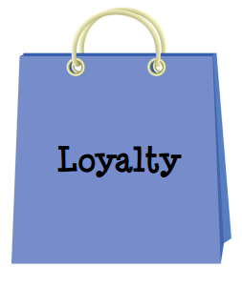
A bag of loyalty

Slide 14
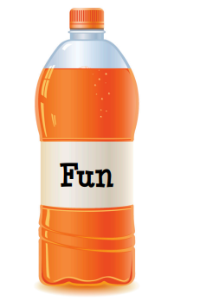
And…… a bottle of FUN

Slide 15
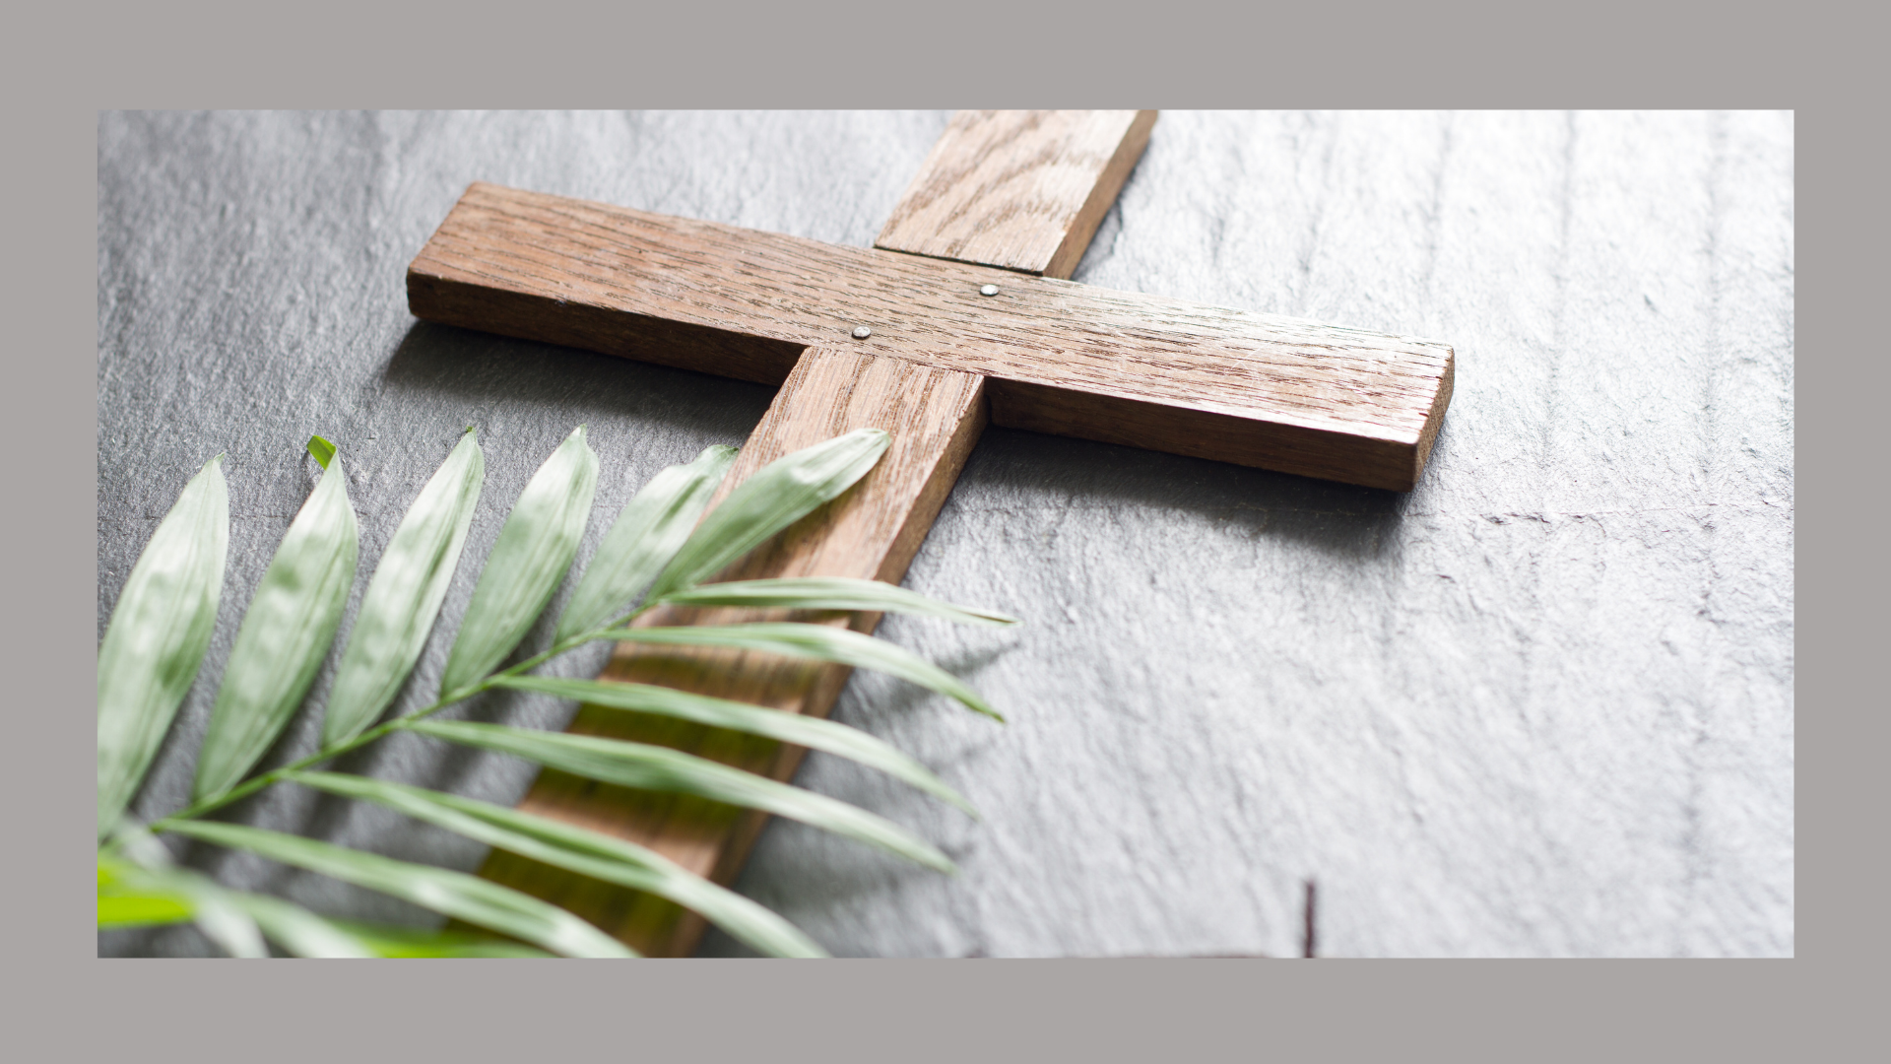
1 Thessalonians 5.11
Encourage one another and build each other up.

Slide 16
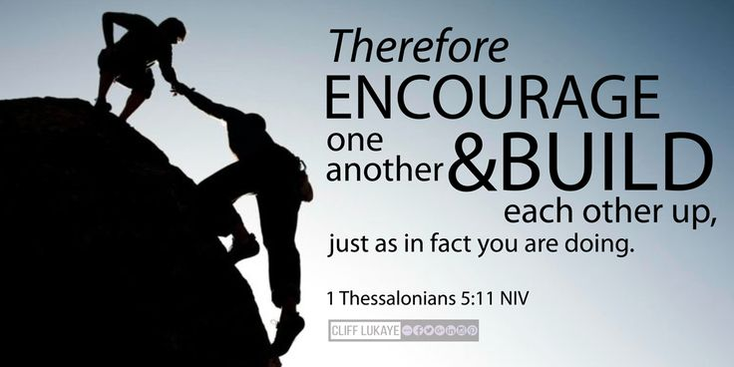

Slide 17
Prayer
Lord Jesus,
Thank you that you were kind and caring to all the people you met.
Please help me to be kind and caring, too.
Amen

Slide 18
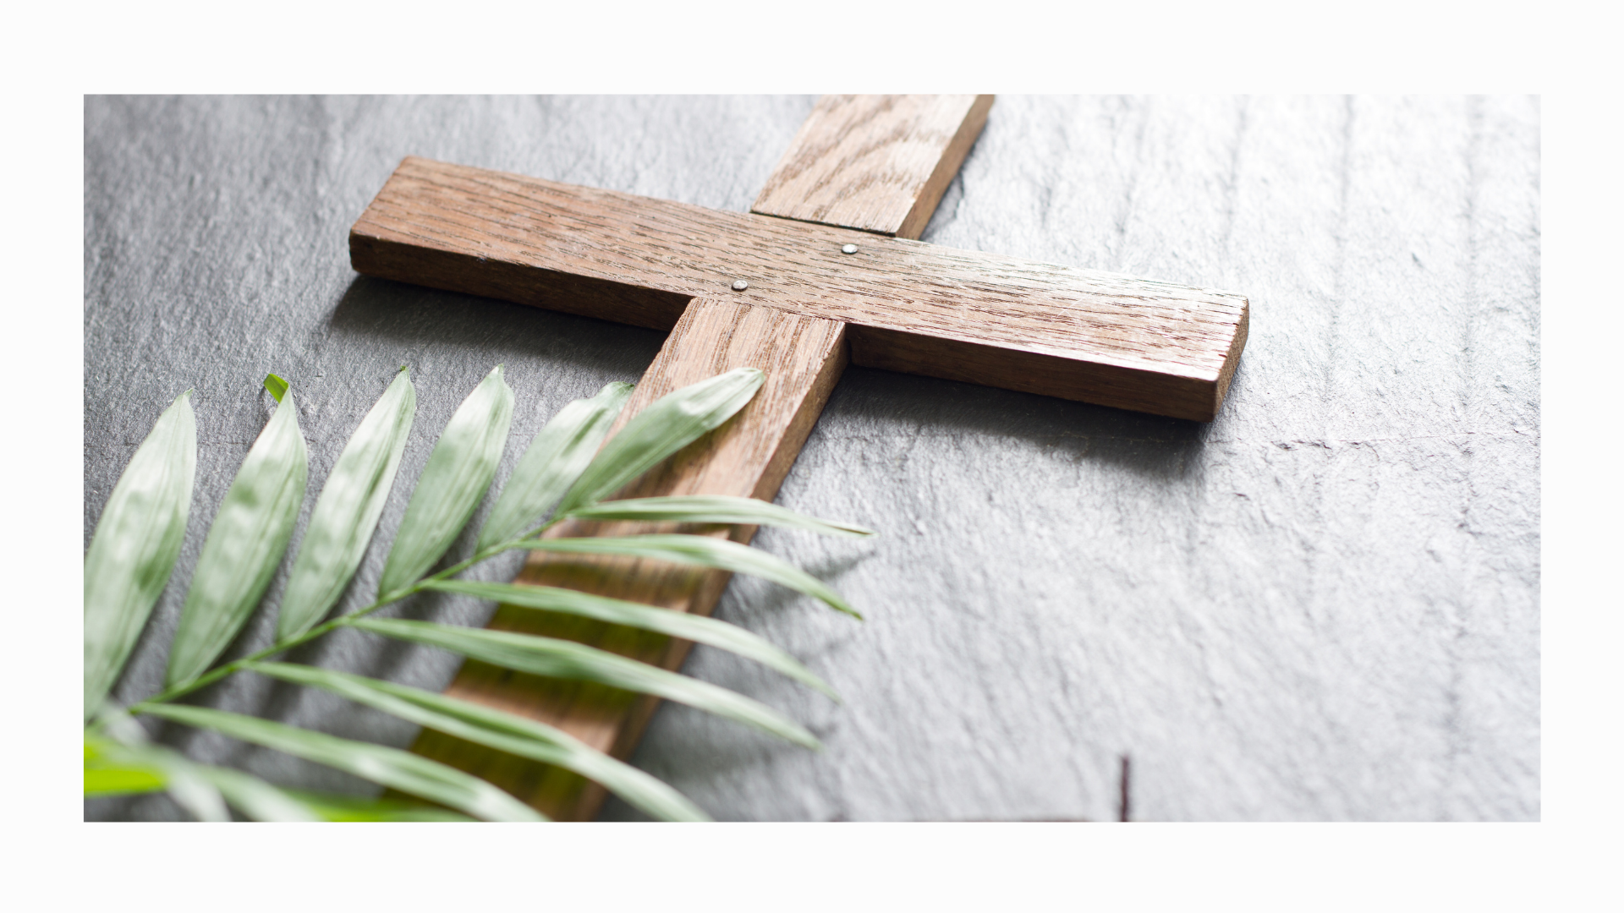
Song- We’re Better Together.

