Slide 1

Collective Worship
Monday 8th September 2025
Worship For Everyone – The Golden Rule (Official Lyric Video)

Slide 2

Generosity
Loving others as we love ourselves.

Slide 3

Welcome Words
We have gathered in the name of God the Father, Son and Holy Spirit, to worship together and think about our value generosity.

Slide 4



Our Words of Wisdom for the value service are
‘Love your neighbour as yourself.’ Mark 12.31
Windows- Exploring and engaging with the Bible

Slide 5

Johnny Appleseed

Slide 6
Reflection
What did Johnny do that showed generosity?
How did sharing his seeds help others?
How can we share and love others this week?

Slide 7

Generosity is….
Giving something we value to someone else
Encouraging the best in each other
Never selfish
Enjoying helping others
Raising support for a good cause
Offering what we can
Sharing our time and talents
Inviting someone to join in
Taking care of God’s creation for future generations
You first, me last.
Thinking deeply and reflecting on what we’ve Learned.

Slide 8

Lord, teach me to be generous. Teach me to serve you as you deserve; to give and not to count the cost, to fight and not to heed the wounds, to toil and not to seek for rest, to labour and not to ask for reward, save that of knowing that I do your will. Amen
Responding by doing something about what we've learned and committing to action or changes of mindset.

Slide 9
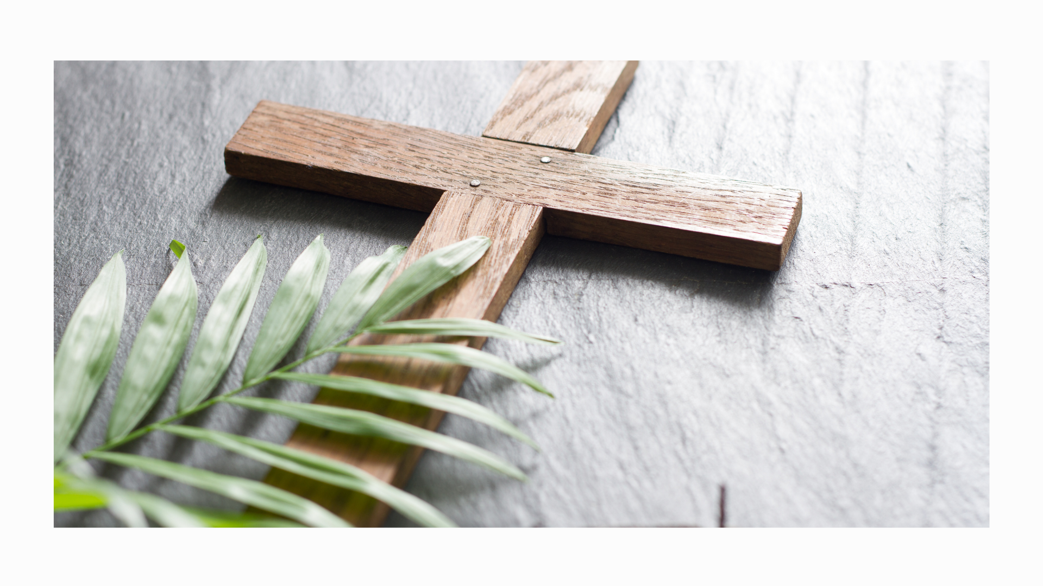
Song- Thank you Lord
S!ngchronize (outoftheark.co.uk)

Slide 10
Class Worship
Tuesday 9th September 2025
Worship For Everyone – The Golden Rule (Official Lyric Video)

Slide 11
Spiritual Development
The Gift of Giving

Slide 12
Thinking deeply and reflecting on what we’ve Learned.
Discuss:
What does generosity mean?
Can you only be generous with money, or are there other ways?

Slide 13
Thinking deeply and reflecting on what we’ve Learned.
God loves a cheerful giver.
(2 Corinthians 9:7)
Reflection: God is generous with us (love, life, creation), and we are invited to pass that generosity on.

Slide 14

Thinking deeply and reflecting on what we’ve Learned.
On a leaf, write or draw one way you can show generosity this week.
Display in your reflection area.

Slide 15
Lord, thank you for being generous with us. Help us to share what we have, give our time to others, and plant seeds of kindness wherever we go. Amen.
Responding by doing something about what we've learned and committing to action or changes of mindset.

