Slide 1

Collective Worship
Tuesday 16th September 2025
Worship For Everyone – The Golden Rule (Official Lyric Video)

Slide 2

Generosity
Giving Sacrificially

Slide 3

Welcome Words
We have gathered in the name of God the Father, Son and Holy Spirit, to worship together and think about our value generosity.

Slide 4

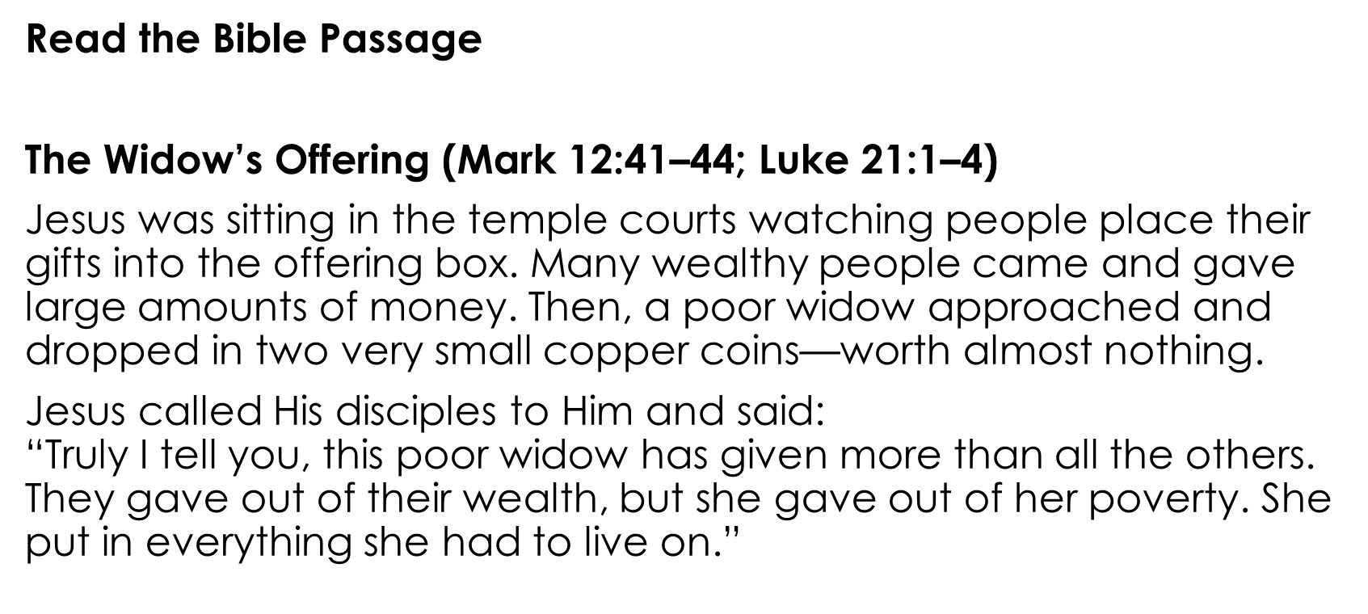


Windows- Exploring and engaging with the Bible

Slide 5

Does generosity always have to be about money or can we be generous in other ways?
Thinking deeply and reflecting on what we’ve Learned.

Slide 6

Dear Lord,
Help us to be generous and do all the good we can, by all the means we can, in all the ways we can, in all the places we can, at all the times we can, to all the people we can, as long as ever we can.
Amen
Responding by doing something about what we've learned and committing to action or changes of mindset.

Slide 7

Song- We’re So Thankful

