Slide 1


Little Wandle
Letters and Sounds
Early Years and Key stage 1
Parent Information Evening
Wednesday 13th October 2021

Slide 2




To develop a consistent and systematic approach to teaching phonics throughout the school
All teachers and TA’s to be trained in delivering a consistent phonics lesson.

Slide 3
Letters and Sounds
Phase 1 Phase 2/3/4 Phase 4/5
Nursery
Reception
Year 1

Slide 4
Phase One
Phase One activities are arranged under the following seven aspects.
Aspect 1: General sound discrimination – environmental sounds Aspect 2: General sound discrimination – instrumental sounds
Aspect 3: General sound discrimination – body percussion
Aspect 4: Rhythm and rhyme
Aspect 5: Alliteration
Aspect 6: Voice sounds
Aspect 7: Oral blending and segmenting

Slide 5
Phase 2
Introduction of the initial sounds and oral blending of sounds
Autumn 1 s,a,t,p,I,n,m,d,g,o,c,k,ck,e,u,r,h,b,f,l
Autumn 2 j,v,w,x,y,z,qu,th,ch,sh,ng,nk
NB: Correct pronunciation of sounds

Slide 6
Phase 3
Reception Spring 1
Digraphs-ai, ee, oa, oo, oo, ar, ur, ow, oi, er
Trigraphs- igh, ear, air
Reception Spring 2
Review of phase 3 sounds
Words with double letters
Words with two or more digraphs
Words ending in ing
Words with s in the middle /z/
Words ending in s with –es

Slide 7
Phase 4
Reception Summer 1 and Summer 2
Revisited Year 1 Autumn 1 (alongside phase 3)
cvcc words – left, wind, jump
ccvc words - stop, flip, skin
ccvcc words - drink, twist, frost
cccvc words - strap, split, street
cccvcc words - splint, strand, scrunch
Compound words - sandpit, rooftop, bedroom
Root words ending in - ing, ed, er, est,

Slide 8
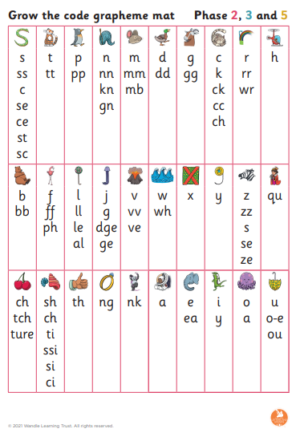
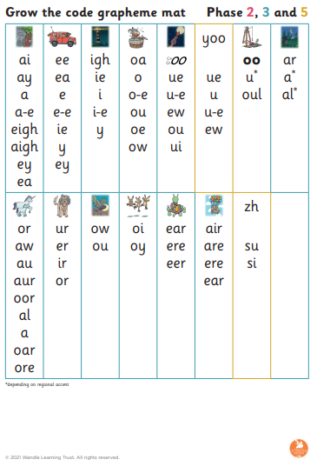
Phase 5
Year 1
Autumn 2, Spring 1 and 2 and Summer 1.

Slide 9
Keep up
Additional lesson everyday to ensure children keep up with the
Sounds
Blending
Segmenting
Children are observed and chosen for keep up sessions daily to ensure that they continue to access the new sounds and revisit sounds covered previously.
Sessions are carried out by our trained teaching assistants and they last no more that 10 minutes.

Slide 10
Reading Practise
Children read 3 times a week with the class teacher
Books follow the letters and sounds taught
1- To support fluency and decoding of the text
2- To develop prosody of reading- speech, expression
3- comprehension- a deeper understanding of the text

